Slide 1
Money
Lesson 2
16.11.21

Slide 2
Y2 LO: To be able to count money (pounds).
Y3 LO: To be able to count money (pounds) recap.
I can recognise notes and coins.
I can combine amounts to make a particular value.
I can use my understanding to solve problem solving questions.
I can confidently recognise notes and coins.
I can combine amounts to make a particular value.
I can use my understanding to solve problem solving questions.

Slide 3
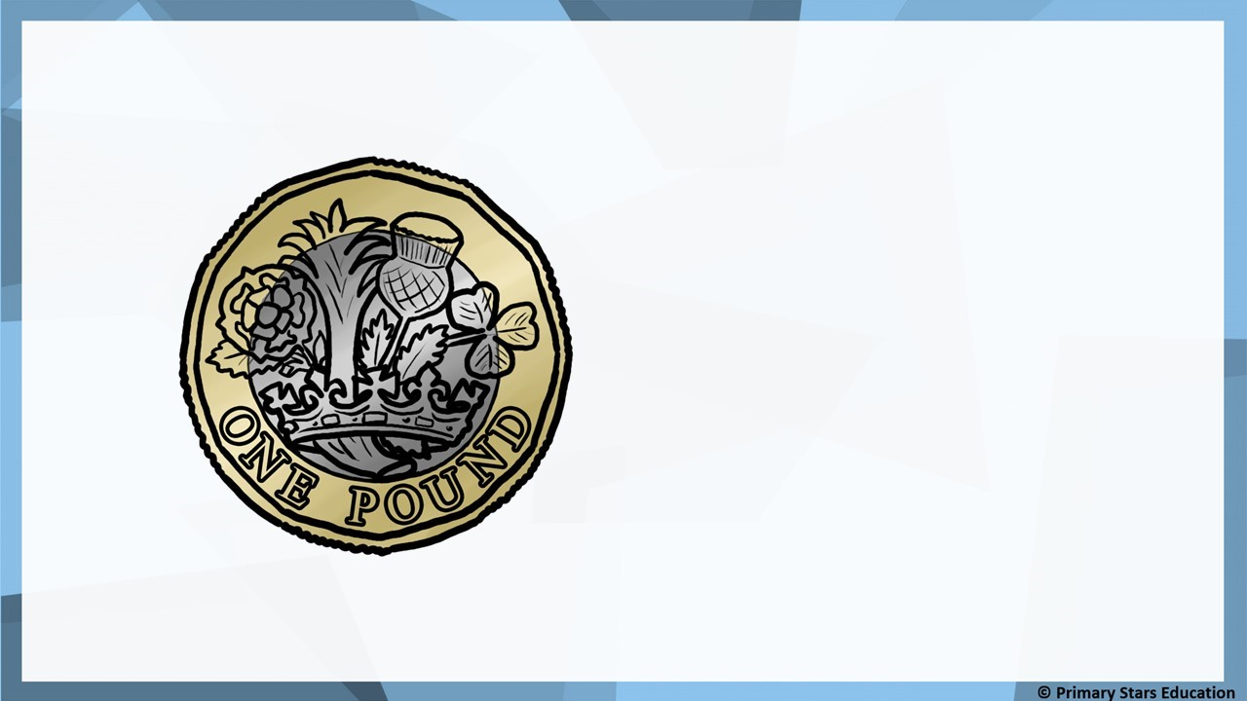
Fluency
£1

Slide 4

Fluency
£2

Slide 5
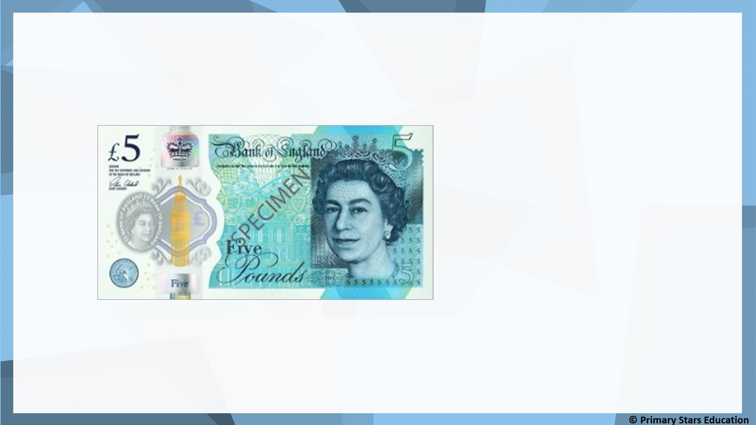
Fluency
£5

Slide 6
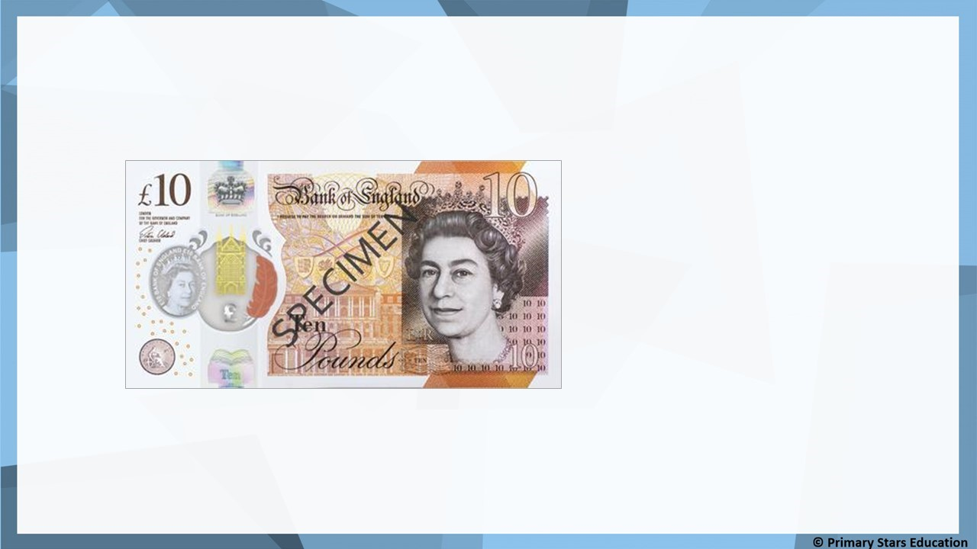
Fluency
£10

Slide 7
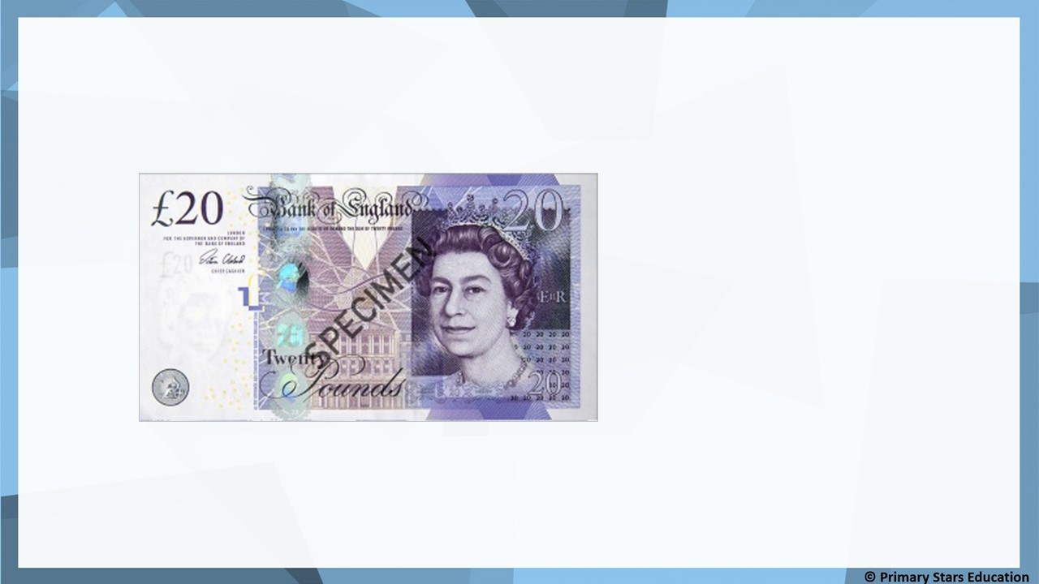
Fluency
£20

Slide 8
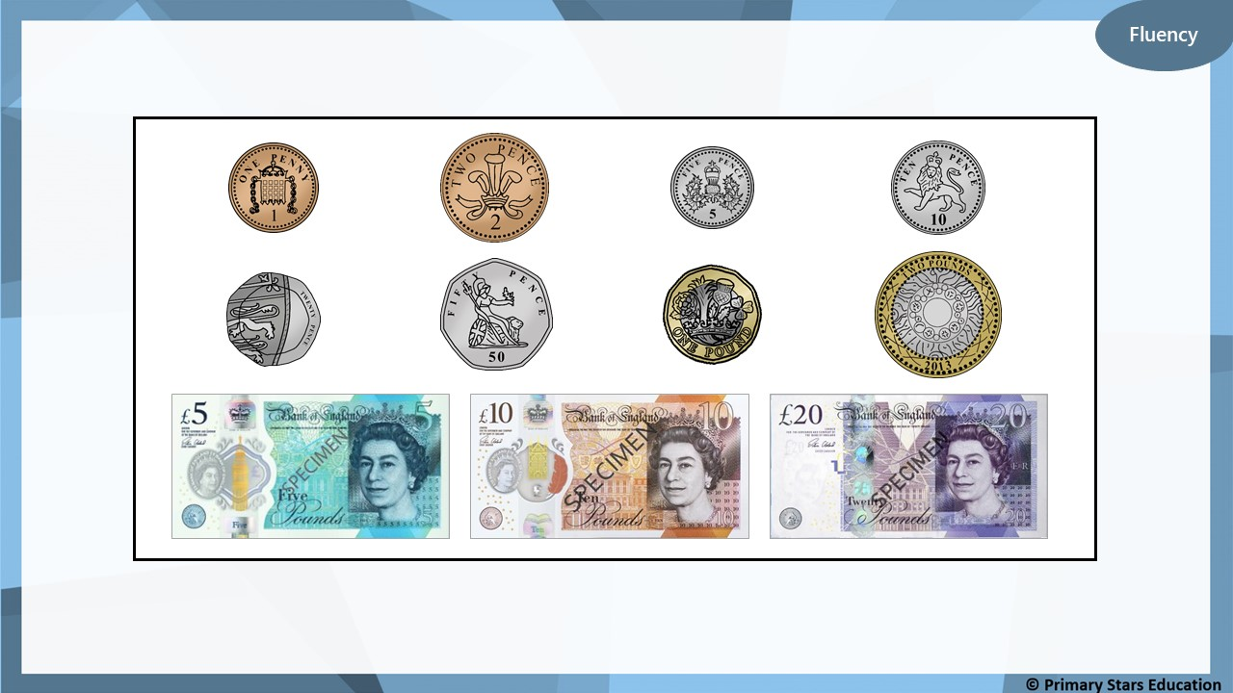
Look at the coins and notes below.
Can you describe them? What is the same? What is different?

Slide 9
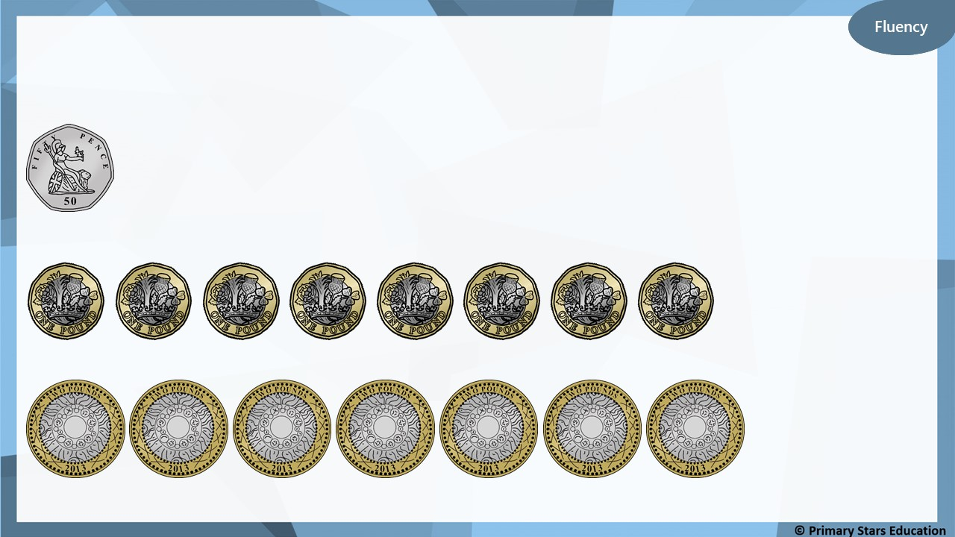
What amounts are shown?
50p
£8
£14

Slide 10
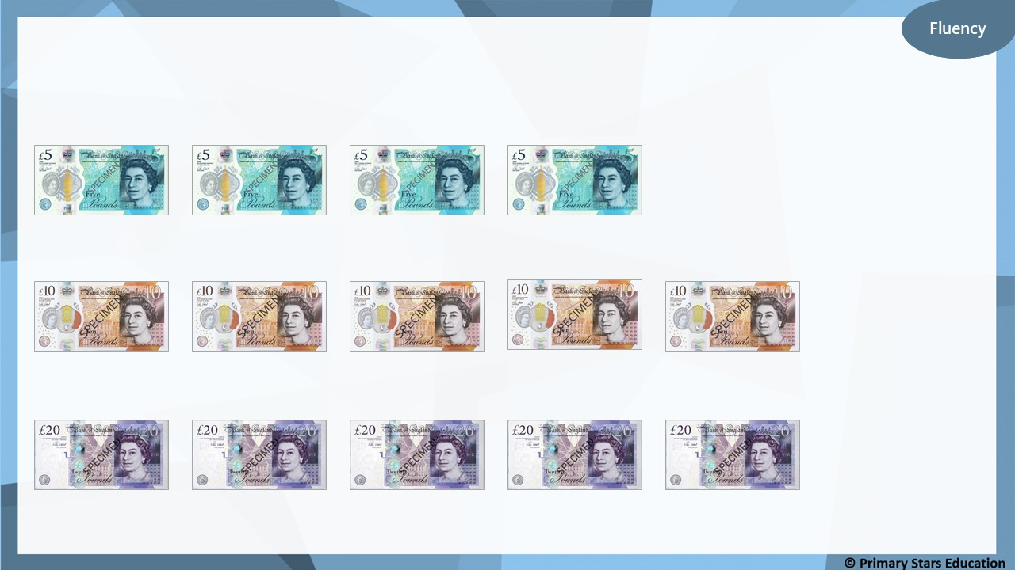
What amounts are shown?
£20
£50
£100

Slide 11
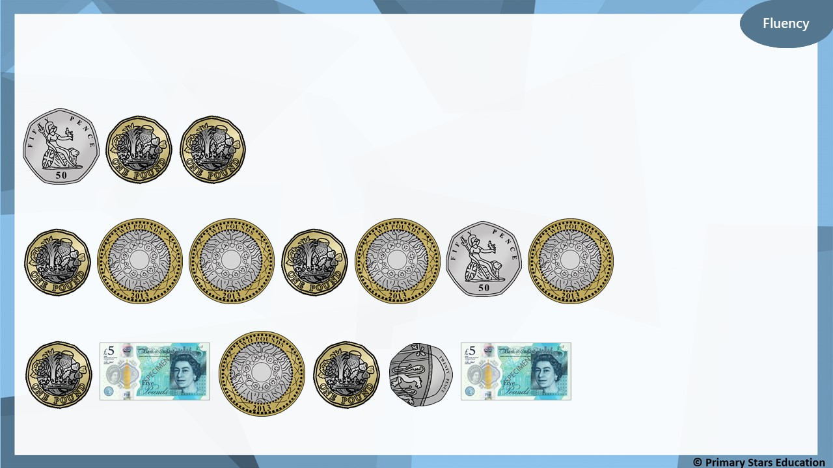
What amounts are shown?
£2 and 50p
£10 and 50p
£14 and 20p

Slide 12
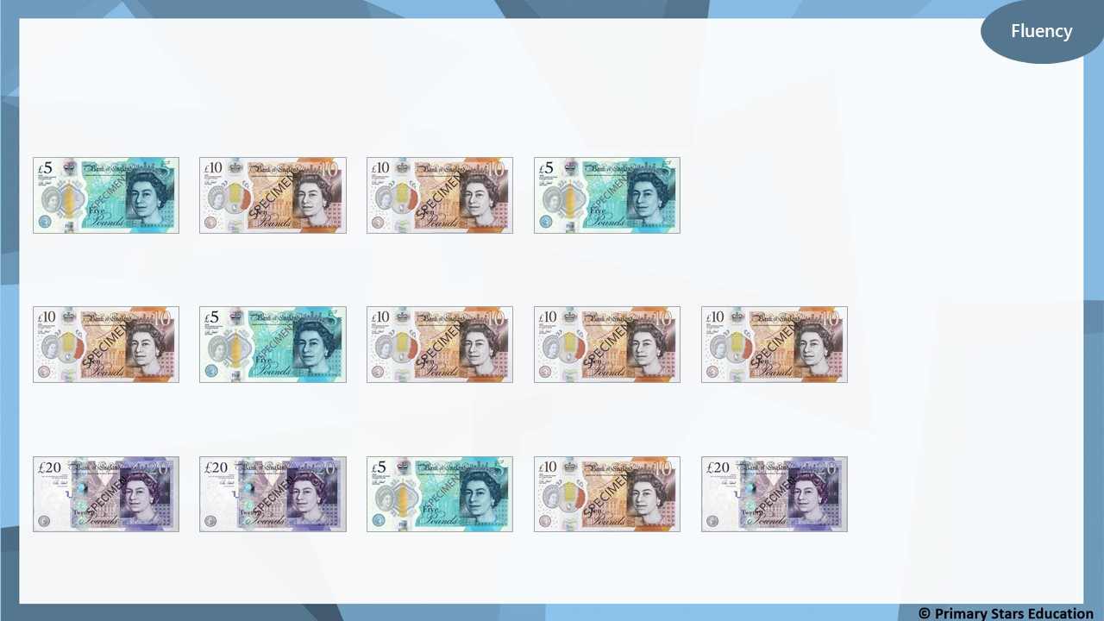
What amounts are shown?
£30
£45
£75

Slide 13
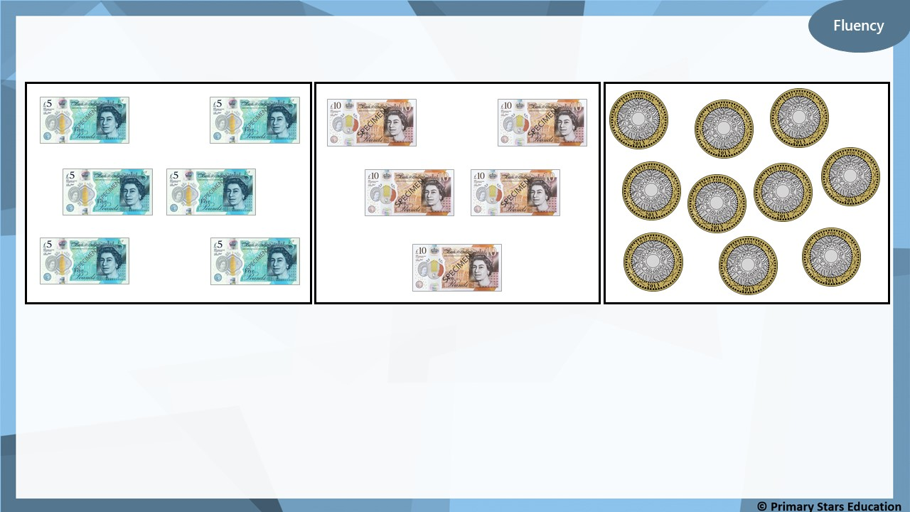
Match the money to the correct total.
£20
£30
£50

Slide 14
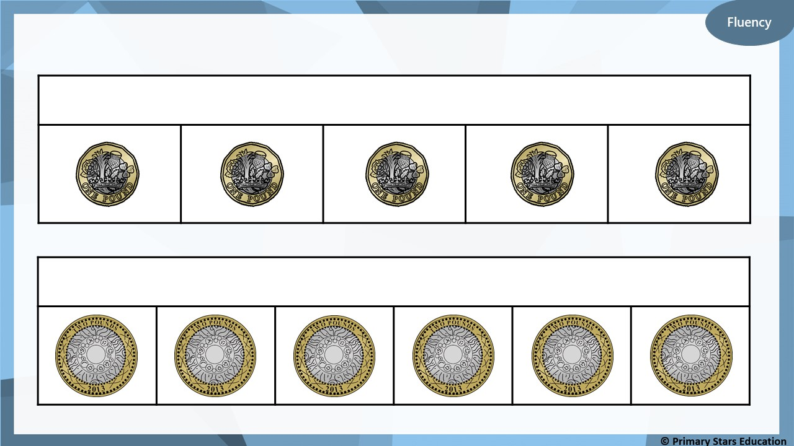
Complete the bar models.
£5
£12

Slide 15
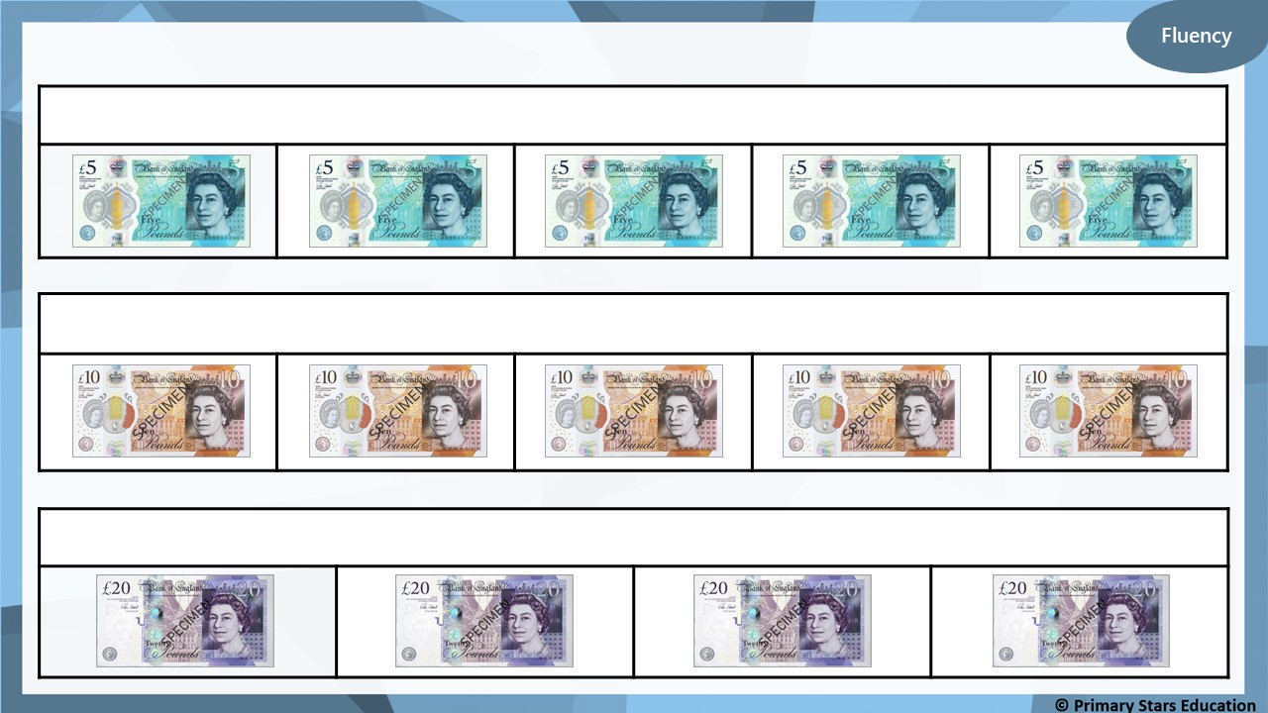
Complete the bar models.
£25
£50
£80

Slide 16
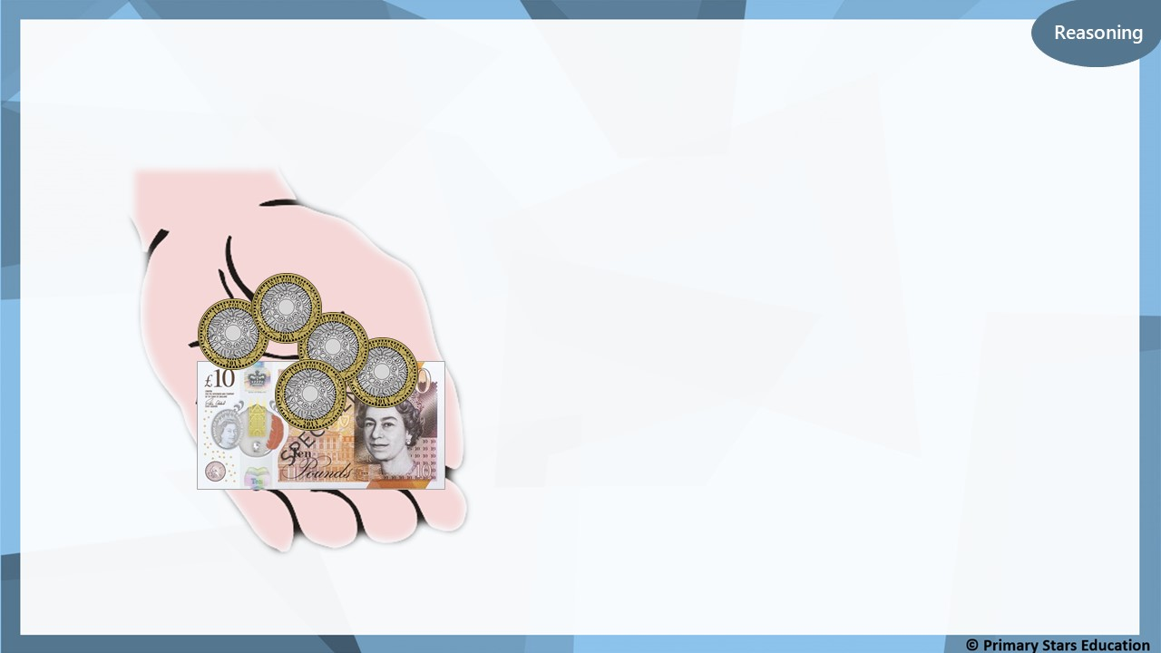
Che says he has £15.
Is Che correct?
Explain how you know.
No. Che has £20.
What mistake might Che have made?
Che may have mistaken the
£2 coins for £1 coins.

Slide 17

Problem solving
Identify the values below that can be made using only £5 notes.
£35
£80
£72
£4
£18
£65
£48
£100

Slide 18
Fluency
Complete the number sentences.
10
70
a) £5 + £2 + £2 + £1 + 50p + 20p = £__________ and __________p
8
80
b) £1 + £5 + £2 + 20p + 50p + 10p = £__________ and __________p
9
65
c) £5 + £2 + £2 + 50p + 10p + 5p = £__________ and __________p
10
85
d) £5 + £5 + 20p + 50p + 10p + 5p = £__________ and __________p
12
26
e) £10 + £2 + 10p + 10p + 5p + 1p = £__________ and __________p

Slide 19
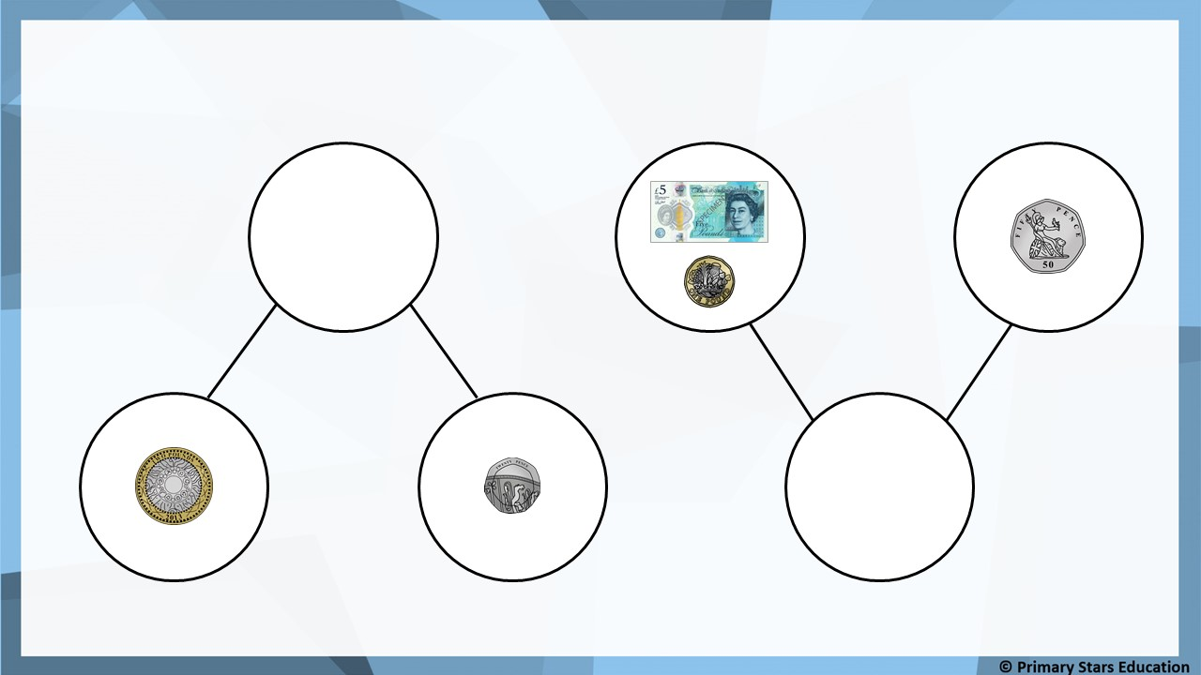
Fluency
Complete the part-whole models.
£2 and 20p
£6 and 50p

Slide 20
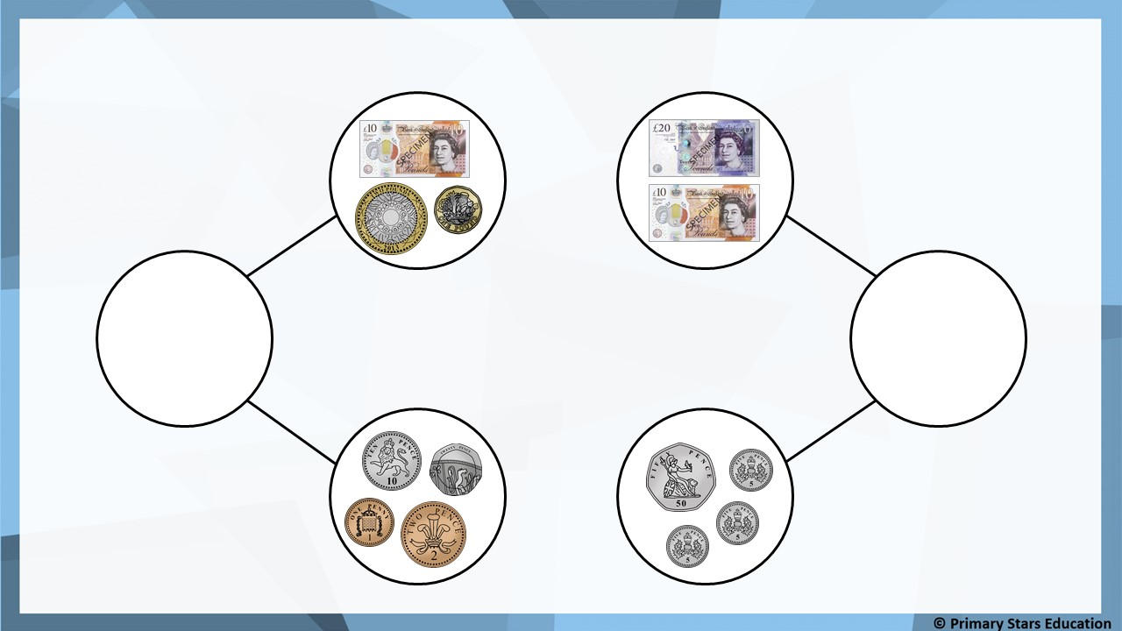
Fluency
Complete the part-whole models.
£13 and 33p
£30 and 65p

Slide 21
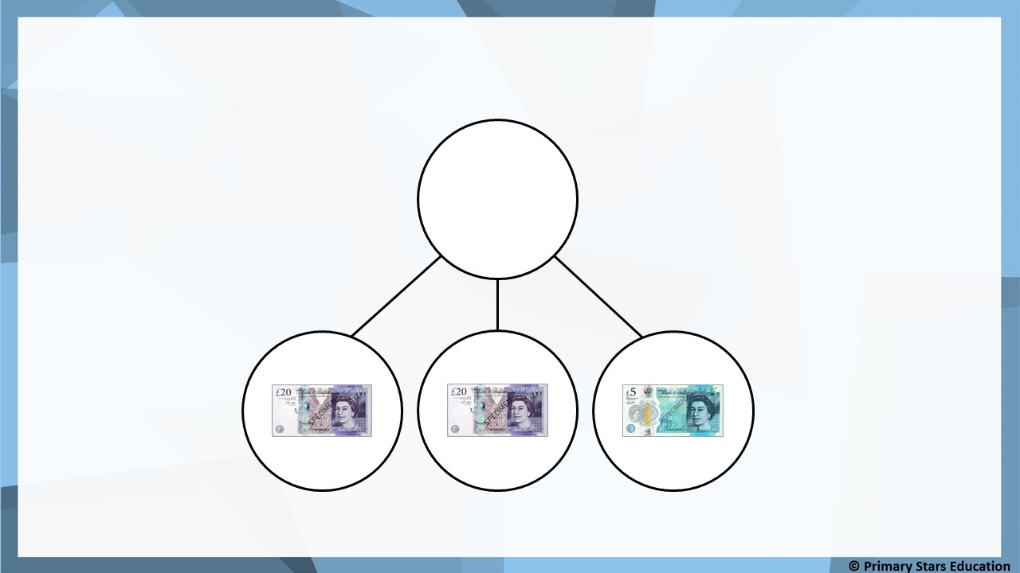
Fluency
Complete the part-whole model.
£45

Slide 22
Beth completed the number sentence:
Reasoning
2
£2 + £_______ + £2 + £1 + 50p + 10p + 1p = £10 and 61p
Is Beth correct? YES NO
Explain how you know.
Beth’s number sentence would total of £7 and 61p.
Beth should have written £5 to make the number sentence correct.

Slide 23
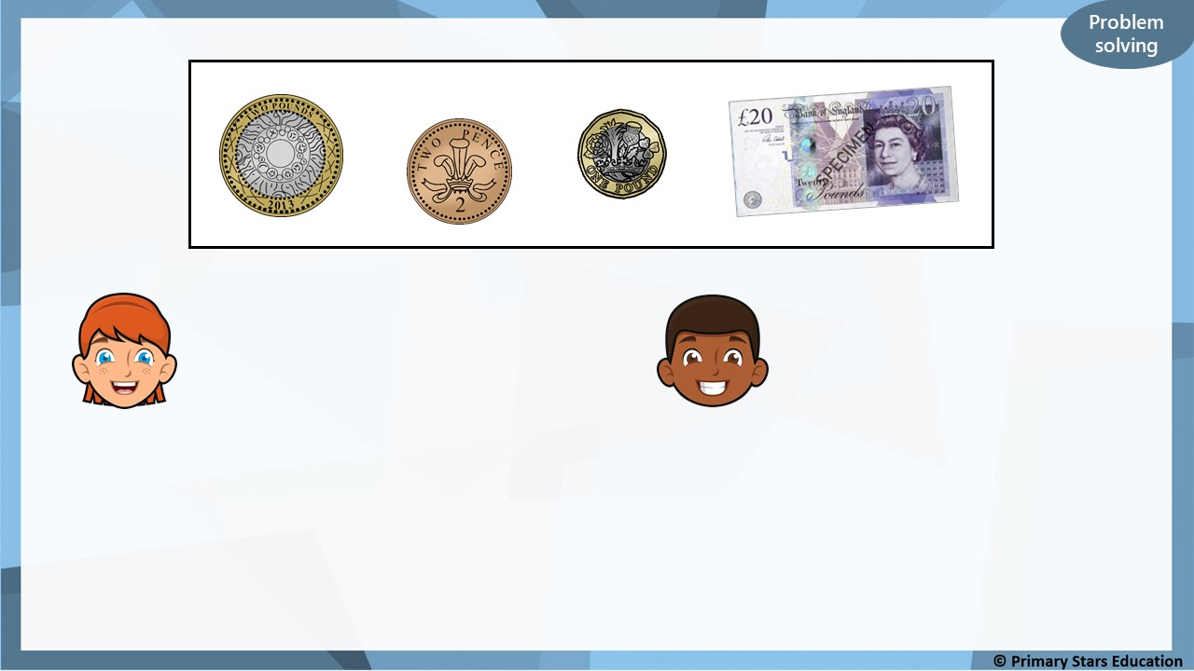
There is 25p.
There is £25.
Sue
Mo
Who is correct? Explain how you know.
Both are incorrect. The total is £23 and 2p.
Notes:
Y2 to activity

Slide 24
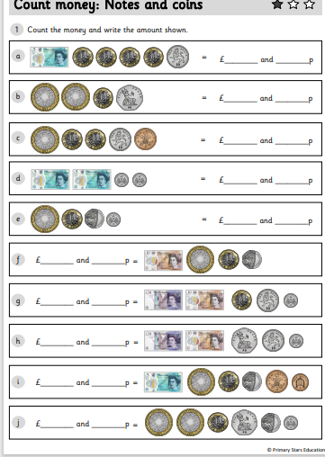
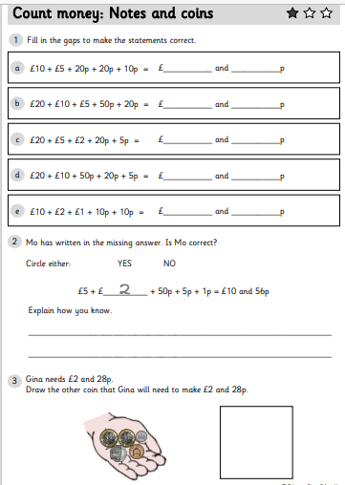
Y2 Activity one:
Complete the worksheet, you have two sheets to complete.

Slide 25
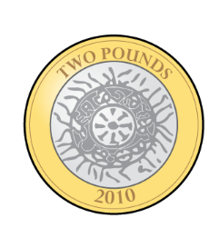
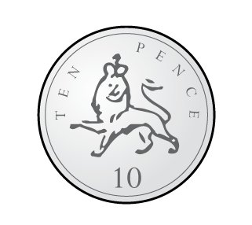
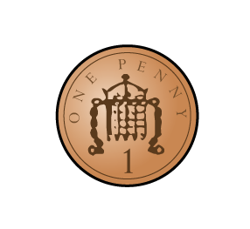
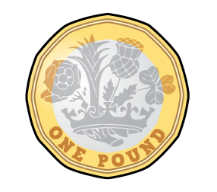

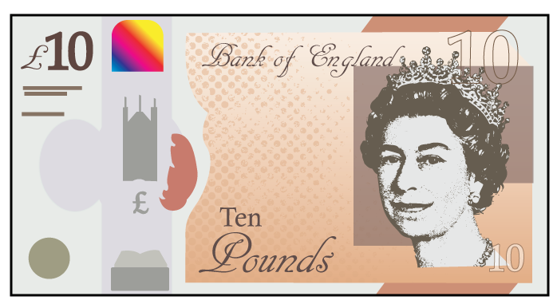
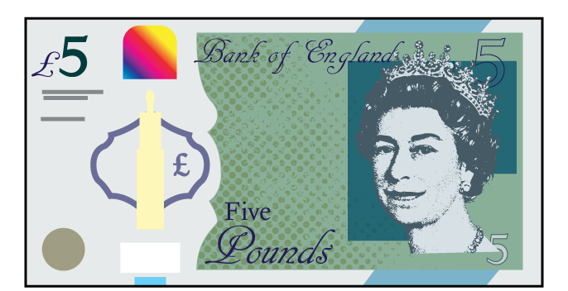
Which of these represent £14?
Have a think
Notes:
Y3

Slide 26
Which of these represent £14?

Slide 27

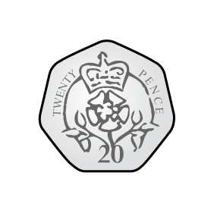
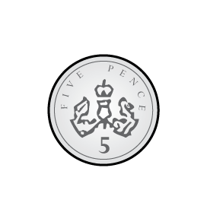


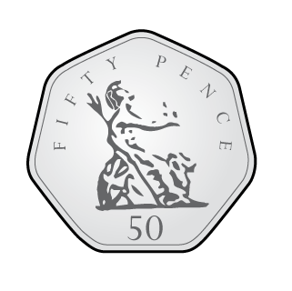

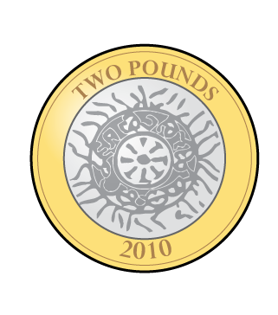
Who has the most money?
Who has the least?
50p
Jack
73p
Amir
£5
Mo
Have a think
Mo has the most money. Jack has the least.

Slide 28

Whitney is making 50p using only silver coins.
There are lots of different ways to do this.
Have a think

Slide 29
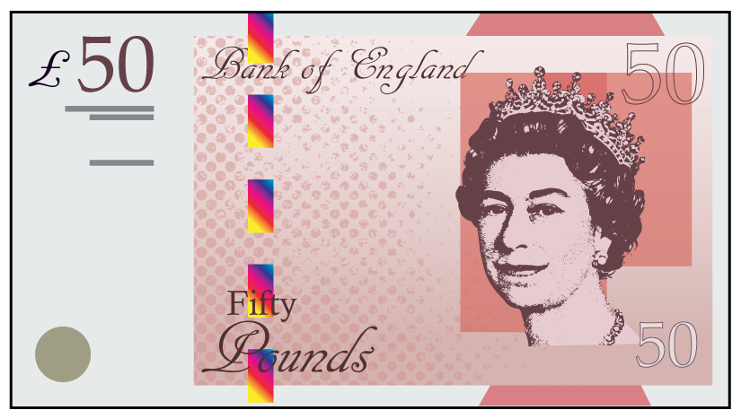
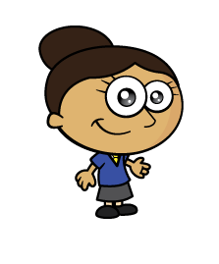
Which note has she represented?

Slide 30
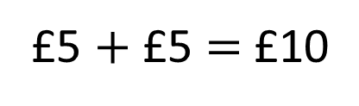
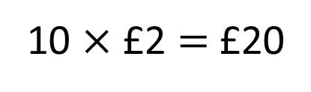
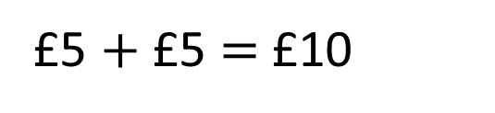
Which sets total £10?
a)
b)
c)
Have a think
10 $×$ £2 $=$ £20
£5 $+$ £5 $=$ £10
£5 $+$ £5 $=$ £10

Slide 31
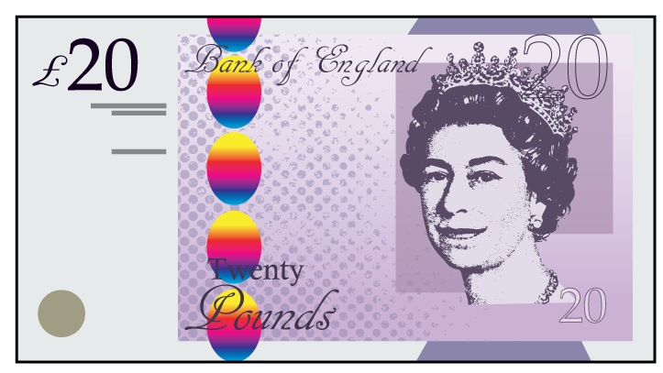

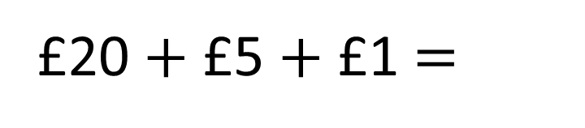
How much money is there?
£20 $+$ £5 $+$ £1 $=$
£26
It’s easier to add them if I place the greatest value notes first.

Slide 32

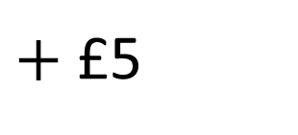
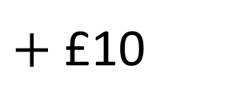
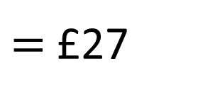
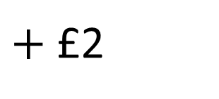
How much money is there?
$=$ £27
£10
$+$ £10
$+$ £5
$+$ £2
If you have pictures of notes and coins, you can cross them out as you count them.

Slide 33
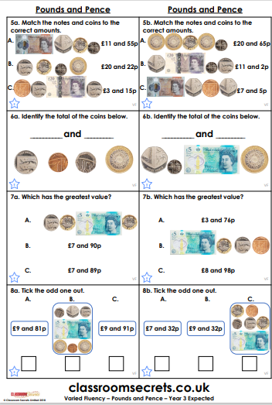
Y3 Activity:
Complete the worksheet. Choose the level you are most comfortable with.

