Slide 1
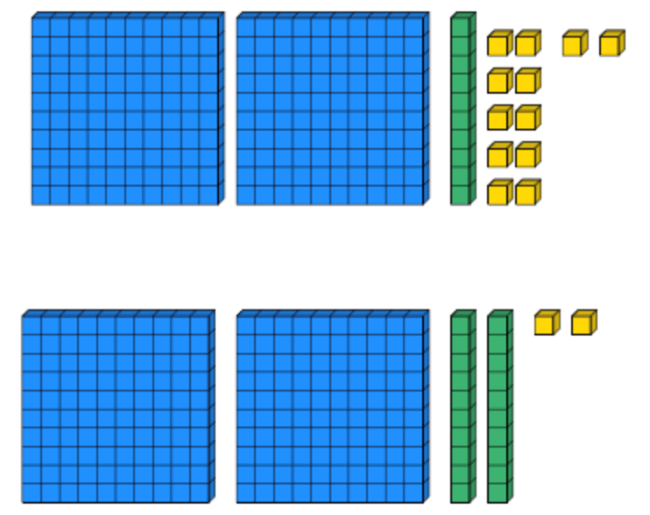
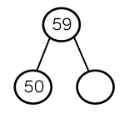
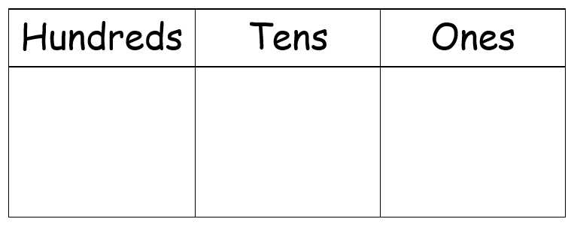
Place Value
Lesson 10

Slide 2
YR2 LO: To count from 0 in multiplies of 3.
To understand what a multiple is.
To count forwards accurately in multiples of 3.
To count backwards accurately in multiples of 3.

Slide 3
YR3 LO: To use a number line to identify and estimate numbers up to 1000.
I can use division to work out intervals on a number line.
I can count accurately in multiples.
I can use a number line to estimate a number up to 1000.

Slide 4
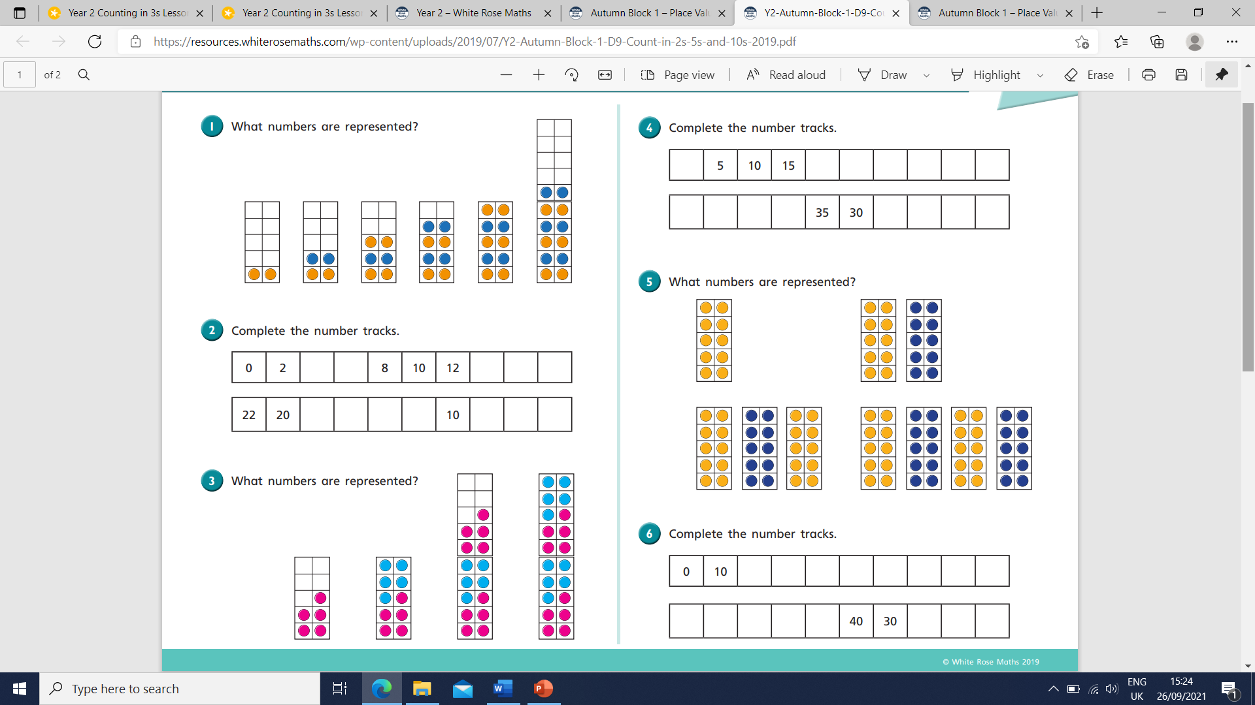
Starter:

Slide 5
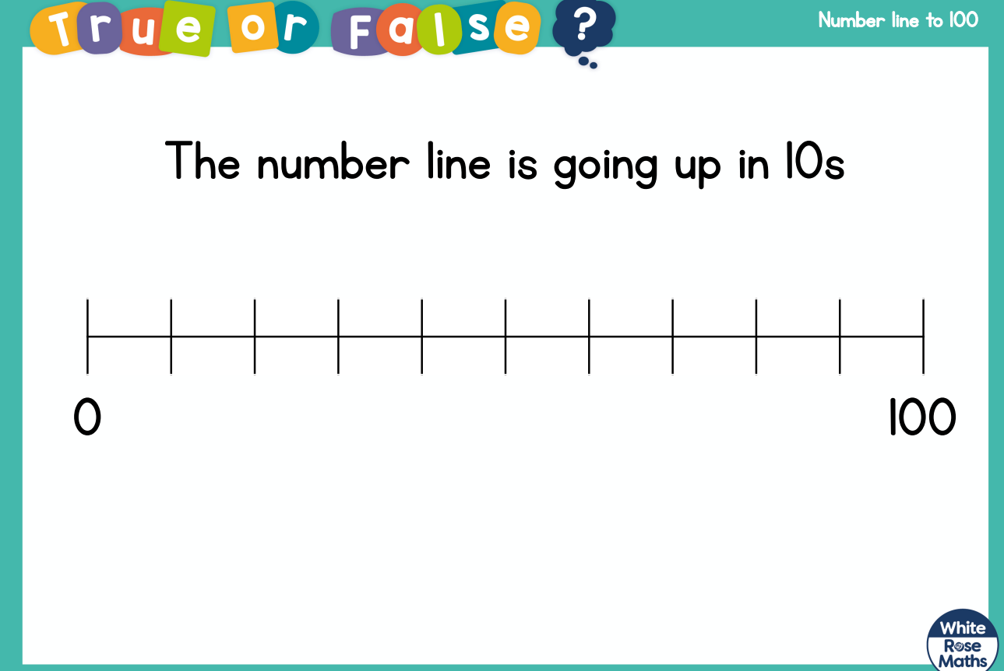
YR 3 Starter:

Slide 7
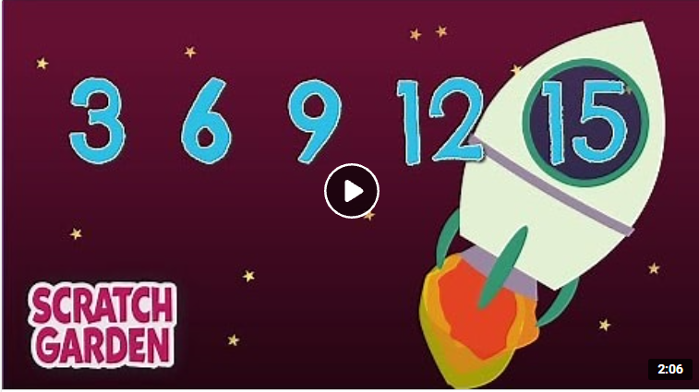
The Counting by Threes Song | Counting Songs | Scratch Garden - YouTube.
Notes:
Units work in a pattern of 3,6,9,2,5,8,1,4, 7,0 then repeat.

Slide 8
Can we complete the number lines?
3, ___, 9, ___, ___.
30, 27, ___, ___, ___.
36, ___, ___, 45, ___.

Slide 9
Can we complete the number lines?
3, 6, 9, 12, 15.
30, 27, 24, 21, 18.
36, 39, 42, 45, 48.

Slide 10
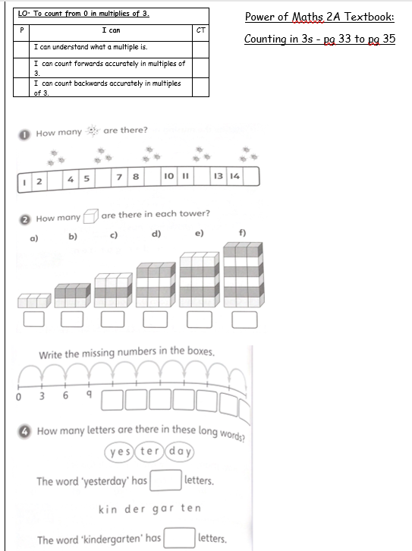
Year 2 task
Complete the Power of Maths worksheet counting in 2s.
EXT: Can you write your own word problem for your partner to solve.

Slide 12
Key language
ESTIMATING describes when we find something close to the correct answer. NUMBER LINES are horizontal (-), straight lines which have numbers placed at equal points. Most number lines begin at 0, however this is not always the case.
INTERVALS on a number line are the equal spaces marked between any two numbers.

Slide 13
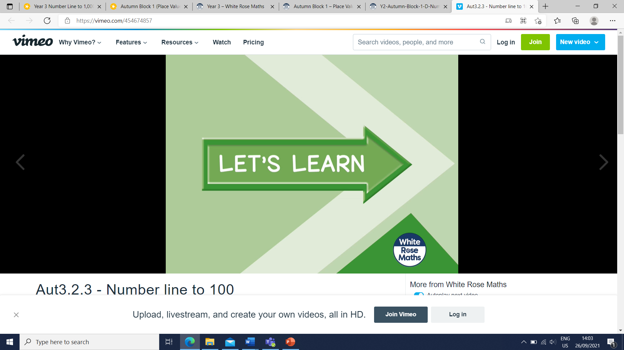
Year 3 - Aut3.2.4 - Number line to 1000 on Vimeo
Notes:
Start video at 1min. Stop at 5:35

Slide 14
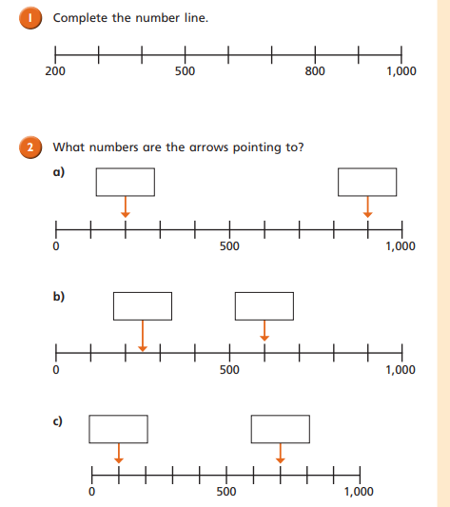
Year 3 task
Working with a partner, complete the WhiteRose number lines to 1000 sheet. Use a whiteboard to help you work out division if you need to.

