Slide 1
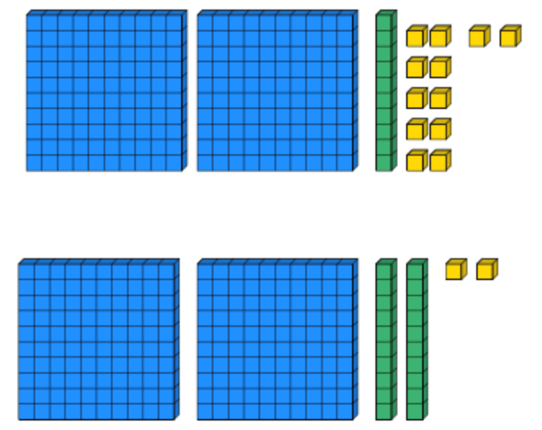
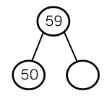
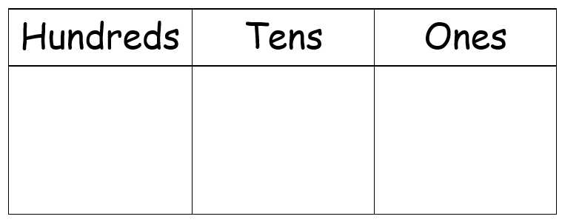
Place Value
Lesson 11

Slide 2
YR2 LO:To use my knowledge of counting in multiples of 3 to solve problems.
To count forwards accurately in multiples of 3.
To count backwards accurately in multiples of 3.
To solve problems using my understanding of multiples of 3.

Slide 3
YR3 LO: To consolidate my understanding of number lines.
I can use division to work out intervals on a number line.
I can solve word problems using my understanding of number lines.
I can verbally explain my reasoning to a partner.

Slide 5
Starter: Counting in 3s
Can you complete the patterns:
0, 3, 6, __, __, __, __.
18, __, 12, __, __, __.
24, __, 30, __, __, __.
How did you work out your answer?

Slide 6
Starter: Counting in 3s
Can you complete the patterns:
0, 3, 6, 9, 12, 15, 18.
18, 15, 12, 9, 6, 3.
24, 27, 30, 33, 36, 39.
How did you work out your answer?

Slide 7
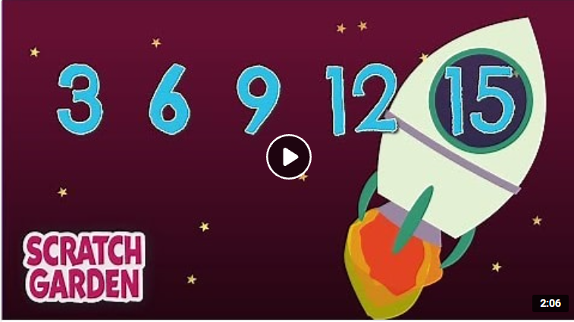
The Counting by Threes Song | Counting Songs | Scratch Garden - YouTube.
Notes:
Listen as a learning recap.

Slide 8
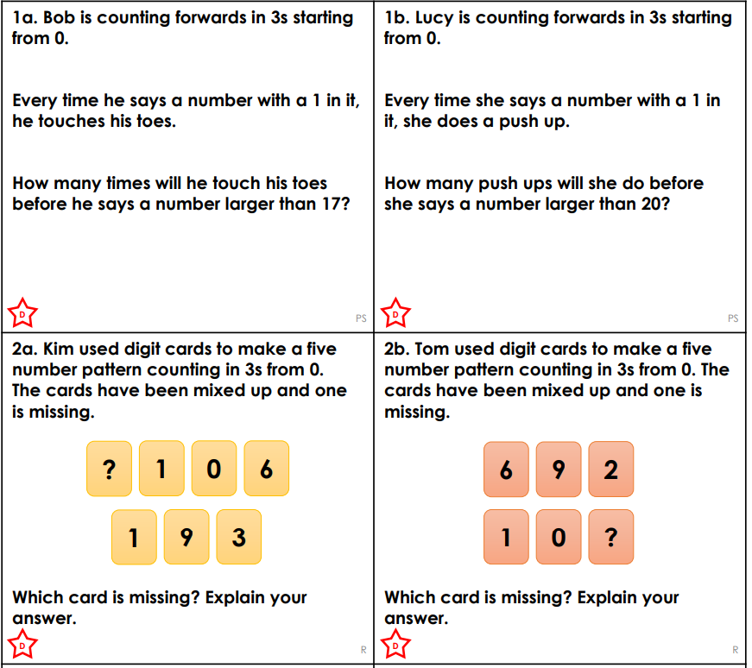
YR2 task
Complete the problem solving activity that matches your understanding. Remember to read the question carefully as problems sometimes need more than one answer. When it asks you to explain, write your answer clearly in your books.

Slide 9
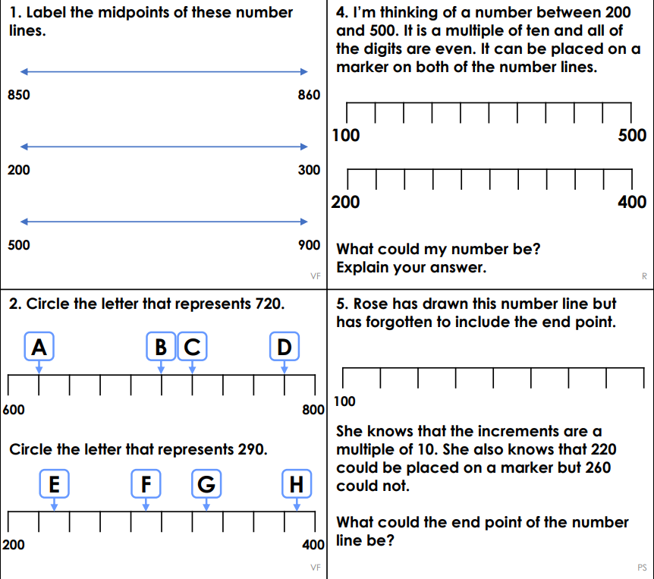
YR3 task
In mixed groups, complete the problem solving and varied fluency sheet. Remember that some questions may have more than one answer. If a question asks you to explain, write your answer clearly in your book.
Notes:
Verbally recap working out intervals on a number line by counting the different between start and end and dividing my number of lines.

