Slide 1
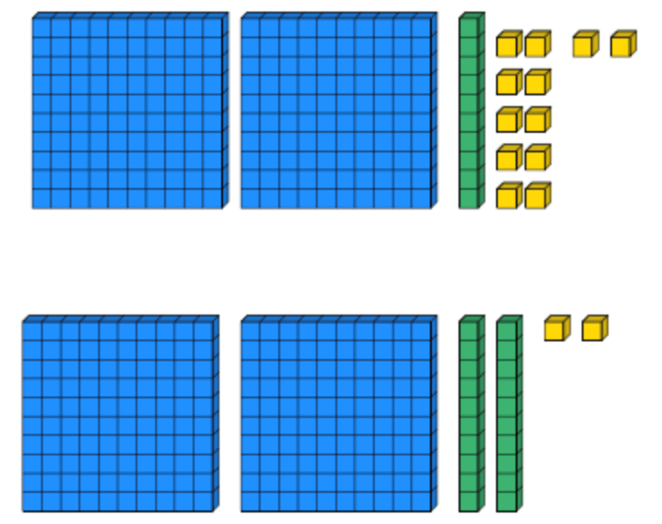
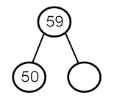
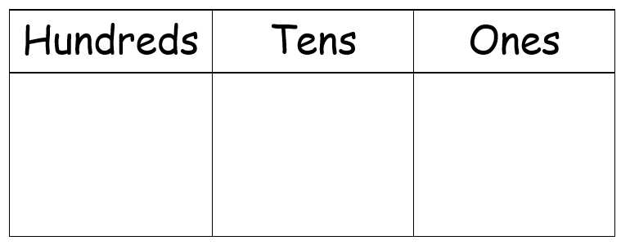
Place Value
Lesson 12

Slide 2
YR2 LO: To consolidate my understanding of counting in 2/5/10/3s.
I can count in multiples of 2/5/10/3 from 0.
I can find the difference between two numbers to find a pattern.
I can use my understanding to fill in sequences.

Slide 3
YR3 LO: To count from 0 in multiplies of 50.
I can use my knowledge of multiples of 5 to count in multiples of 50.
I can use my understanding to fill in sequences.
I can use my knowledge to solve problems.

Slide 5
Starter: Counting in 3s
Can you complete the patterns:
0, 3, 6, __, __, __, __.
18, __, 12, __, __, __.
24, __, 30, __, __, __, __.
How did you work out your answer?

Slide 6
Starter: Counting in 3s
Can you complete the patterns:
0, 3, 6, 9, 12, 15, 18.
18, 15, 12, 9, 6, 3.
24, 27, 30, 33, 36, 39.
How did you work out your answer?

Slide 8
How do we work out a pattern?
First, we need to look at the numbers that we have already been given. Are they getting bigger or smaller? If they are getting bigger then we are counting up. If they are getting smaller, we are counting down.
Then we have to work out which multiple we are counting in. We can do this by finding the difference between two of the numbers we are given that are next to each other.
0, 3, 6, __, __, __, __.
The difference between 3 and 6 is 3 so we are counting in 3s. To check this, we can look at the difference between 0 and 3 which is also 3. The numbers are getting bigger so we are counting up.

Slide 9
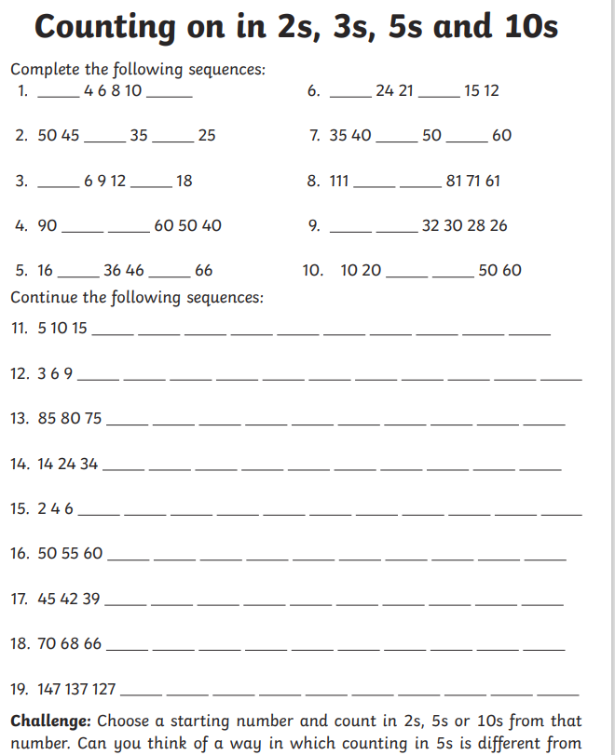
YR2 task
Complete the consolidation activity. Use the patterns to work out which multiple you need to count in. Use hundred squares or resources to help count on if struggling.
EXT: Choose a starting number that is not a multiple of 2,5,10 or 3 and create a counting pattern for a friend to complete.

Slide 10


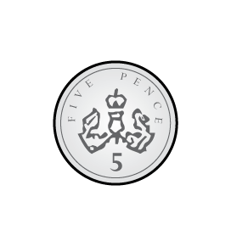
Counting in multiples of 50
1) How many fingers?
2) What is the total amount?
What comes next?
5, 10, 15, 20, 25 ___
What comes next?
50, 100, 150, 200, 250 ___

Slide 11
Counting in multiples of 50
1) How many fingers?
2) What is the total amount?
What comes next?
5, 10, 15, 20, 25, ___
What comes next?
50, 100, 150, 200, 250, ___
5
10
15
20
15 p
30
300

Slide 12
Counting in multiples of 50
We can use our knowledge of counting in 5’s to help with 50s. The numbers will be the same but they have moved along one place in place value and will therefore have a 0 at the end.
e.g. 5, 10, 15, 20 becomes 50, 100, 150, 200

Slide 13
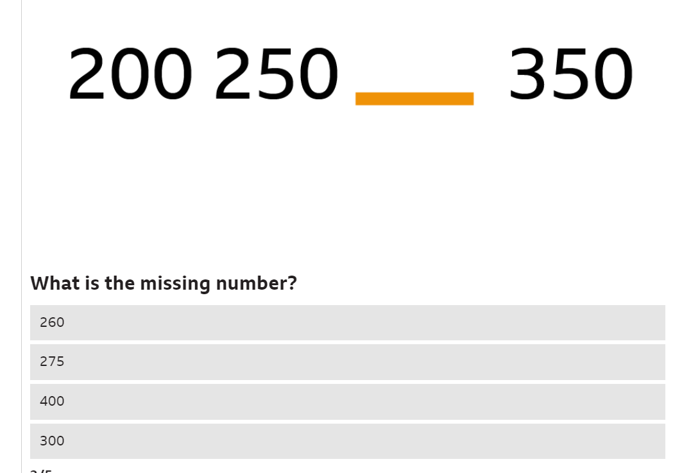
Counting in 50s - Year 4 - P5 - Maths - Home Learning with BBC Bitesize - BBC Bitesize

Slide 14
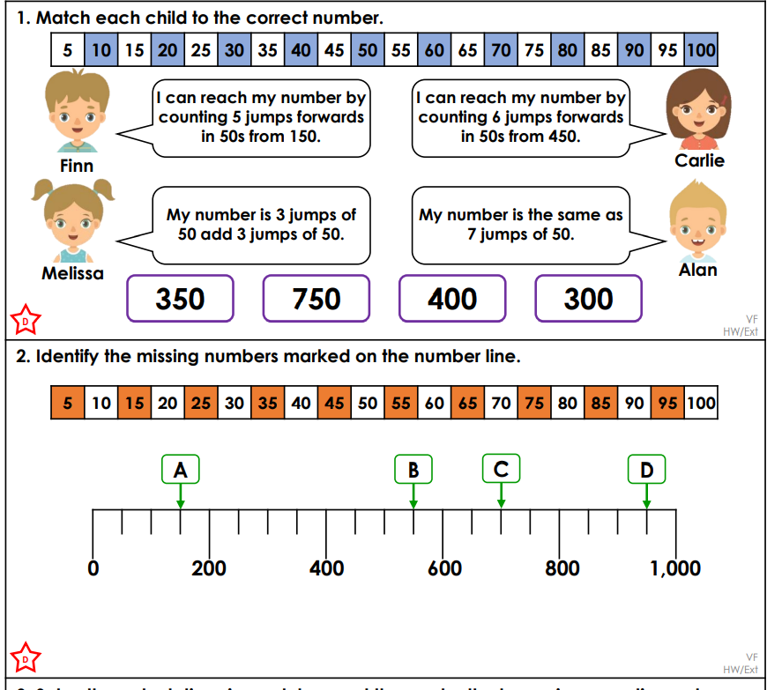
YR3 task
Choose the sheet that matches your understanding (either D or E). Using your understanding of counting in multiples of 50, solve the problems.
EXT: Complete the next sheet (E or GD)

Slide 15
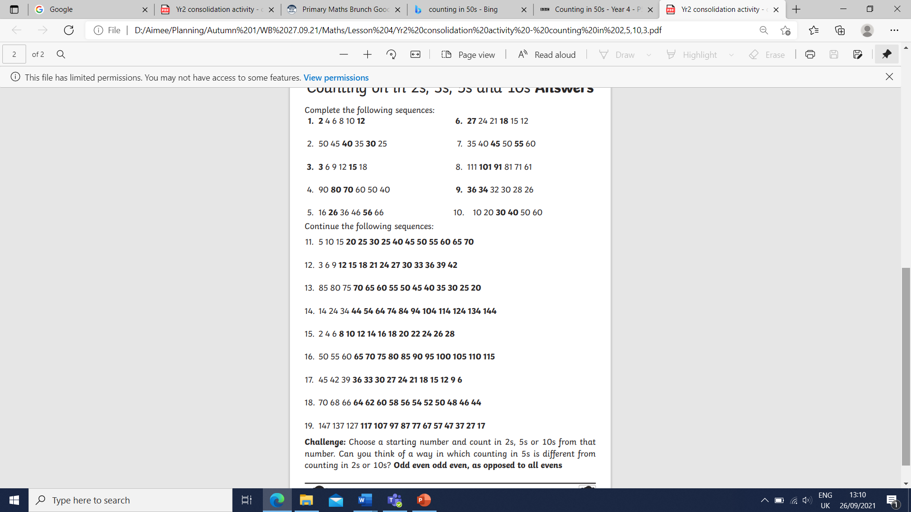
YR2 Answers

