Slide 1
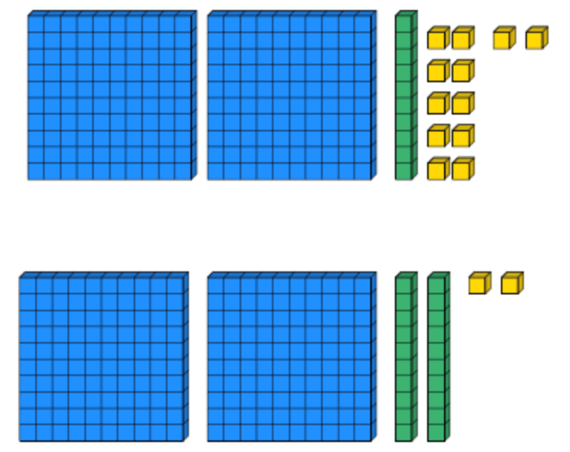
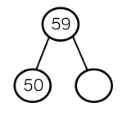
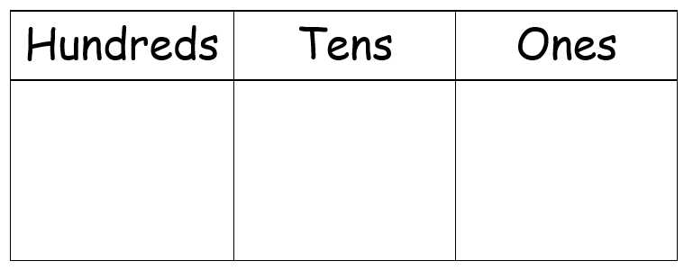
Place Value
Lesson 8

Slide 2
LO: To consolidate my understanding of comparing and ordering objects and numbers.
I can count amounts accurately.
I can partition numbers to help order them.
I can compare numbers using >, < and =.

Slide 4

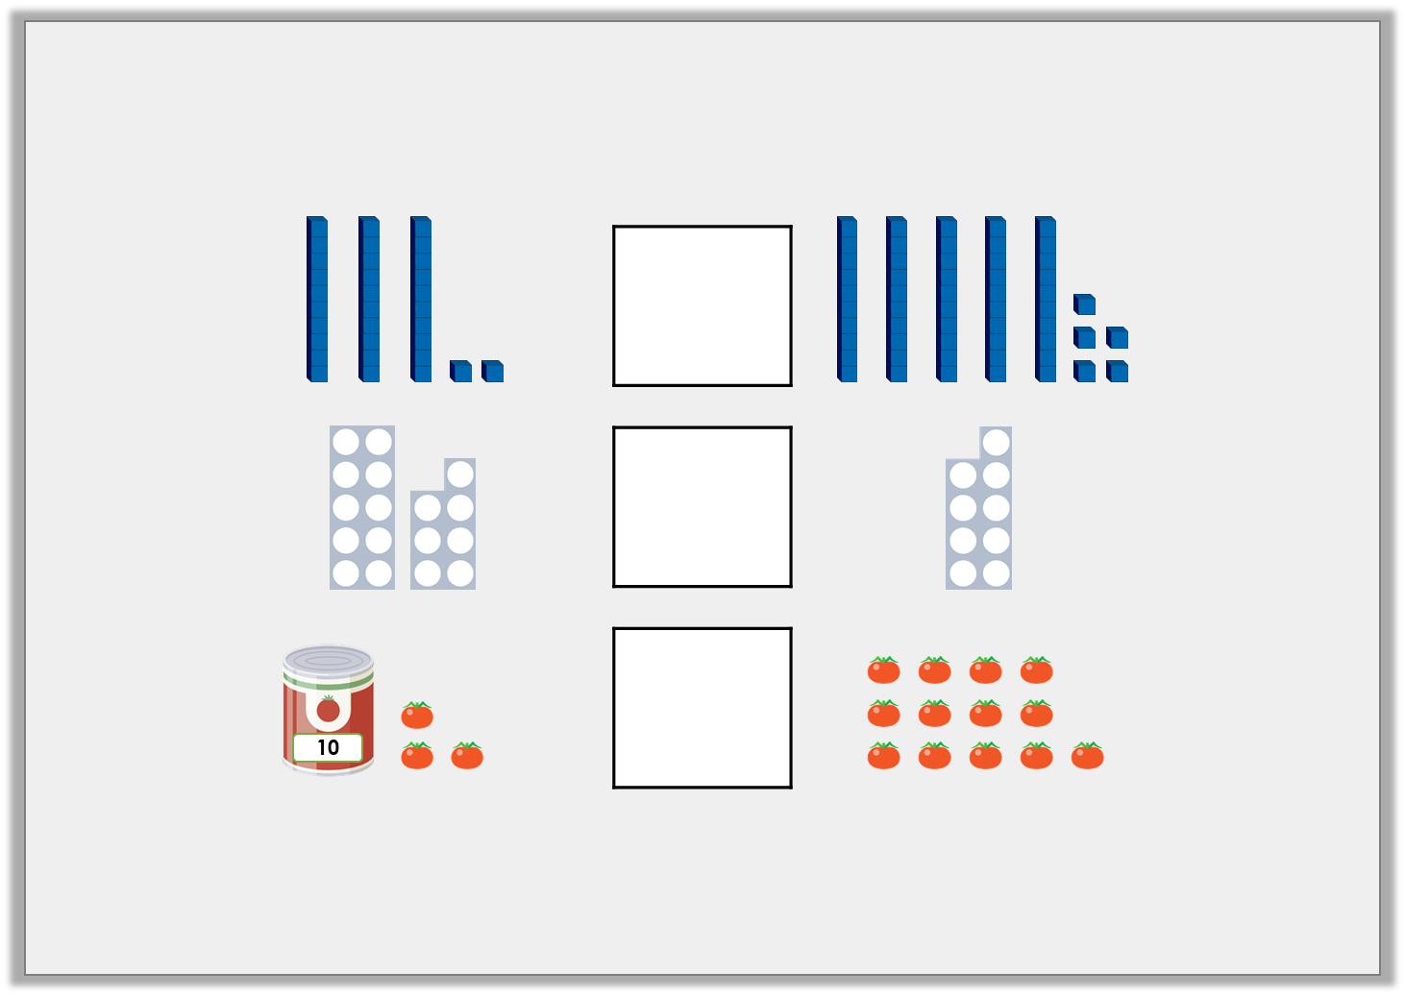

Introduction
Insert symbols to compare the objects correctly.
Y2
© Classroom Secrets Limited 2018

Slide 5
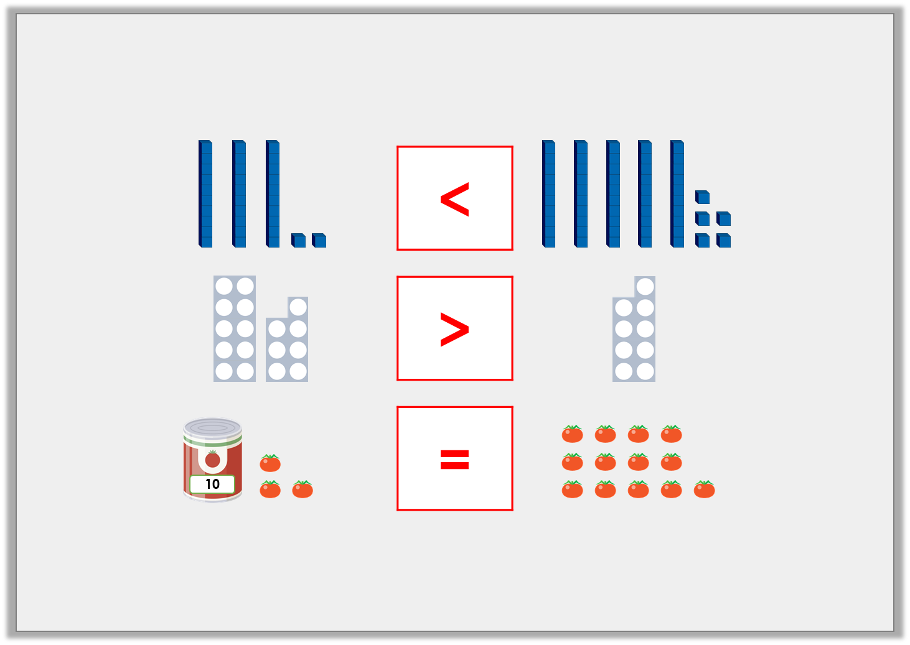
Introduction
Insert symbols to compare the objects correctly.
Y2
© Classroom Secrets Limited 2018
Notes:
31 is less than 56.
17 is more than 9
13 is equal to 13.

Slide 7
Introduction
Use the digit cards below to make as many numbers as you can that are greater in value than the number shown.
2
6
7
Y3
© Classroom Secrets Limited 2018

Slide 8
Introduction
Use the digit cards below to make as many numbers as you can that are greater in value than the number shown.
2
6
7
2
7
6
6
7
2
7
6
2
6
2
7
7
2
6
Y3
© Classroom Secrets Limited 2018
Notes:
Chn can make any 3 digit number that starts with a 6 or 7.
Chn can make a 3 digit number with 2 hundreds and 7 tens.

Slide 10
Varied Fluency 1
Match the numbers to each statement so that it is correct.
A. |  | < | 5 tens
B. | 19 | >
C. | 74 | >
62
2 tens and 3 ones
6
Y2
© Classroom Secrets Limited 2018

Slide 11
Varied Fluency 1
Match the numbers to each statement so that it is correct.
A. | 23 | < | 5 tens
B. | 19 | > | 6
C. | 74 | > | 62
62
2 tens and 3 ones
6
Y2
© Classroom Secrets Limited 2018

Slide 13
Varied Fluency 2
Circle the numbers that could be used to complete the following statement.
83 | <
40 and 5
85
90
31
Y2
© Classroom Secrets Limited 2018

Slide 14
Varied Fluency 2
Circle the numbers that could be used to complete the following statement.
83 | <
40 and 5
85
90
31
Y2
© Classroom Secrets Limited 2018

Slide 16
Varied Fluency 3
True or false?
sixty-eight | < | seventy
Y2
© Classroom Secrets Limited 2018

Slide 17
Varied Fluency 3
True or false?
True
sixty-eight | < | seventy
Y2
© Classroom Secrets Limited 2018

Slide 19
Varied Fluency 4
Complete the statement using <, > or =.
17 and 5 |  | 34
Y2
© Classroom Secrets Limited 2018

Slide 20
Varied Fluency 4
Complete the statement using <, > or =.
17 and 5 | < | 34
Y2
© Classroom Secrets Limited 2018

Slide 22
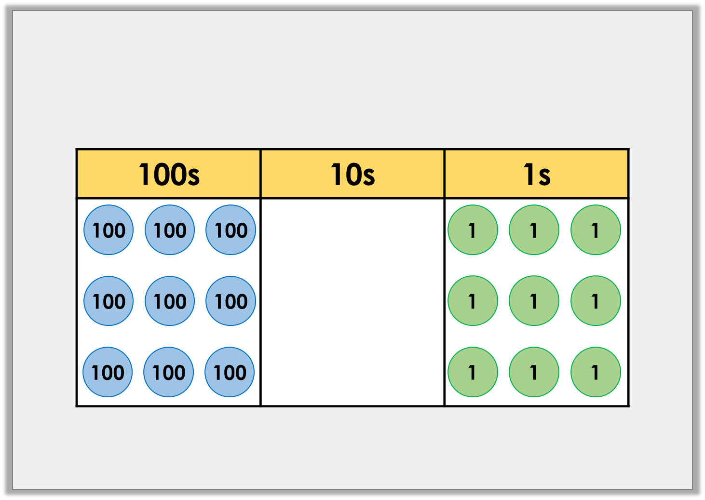
Varied Fluency 3
Add 10s to the place value chart to show
a number greater than 969 but less than 1,000.
Y3
© Classroom Secrets Limited 2018

Slide 23
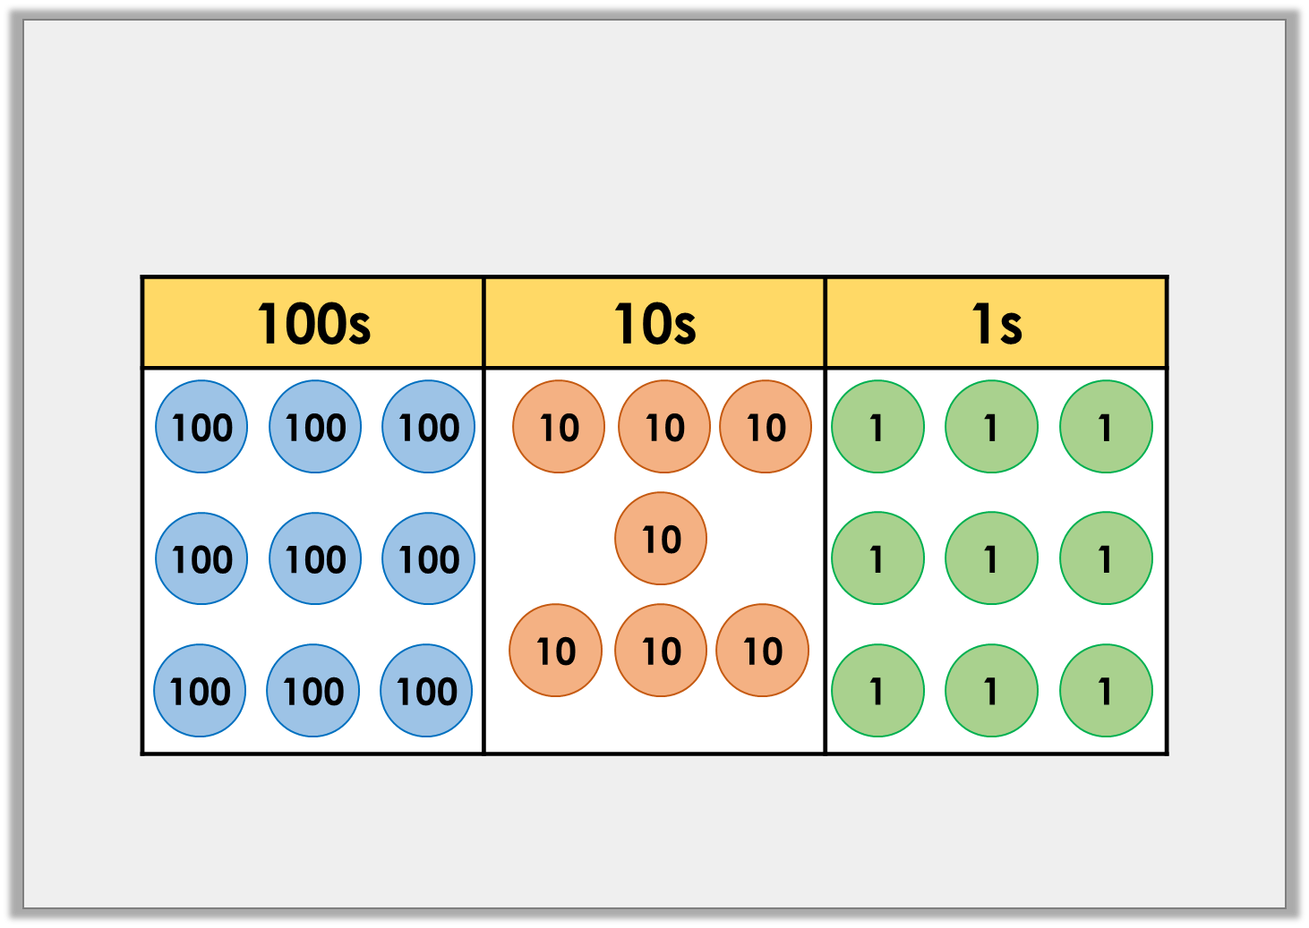
Varied Fluency 3
Add 10s to the place value chart to show
a number greater than 969 but less than 1,000.
Possible answers: any number of tens between 7 and 9.
Y3
© Classroom Secrets Limited 2018

Slide 25
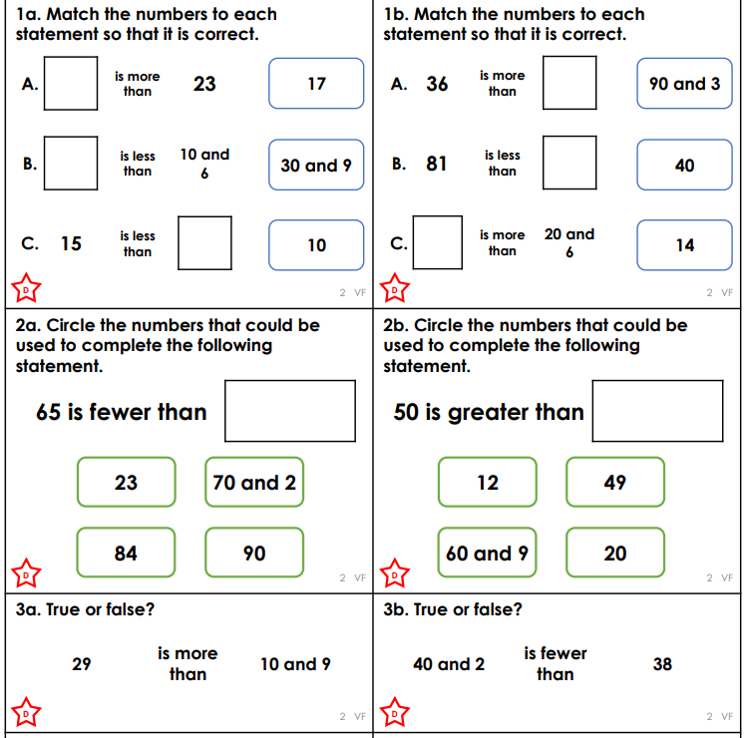
Your task
Complete the varied fluency question sheet in your books. Make sure to read the questions carefully. You will have two sheets to complete.
EXT – Can you complete the ‘developing’ problem solving question sheet for your year group.

Slide 26
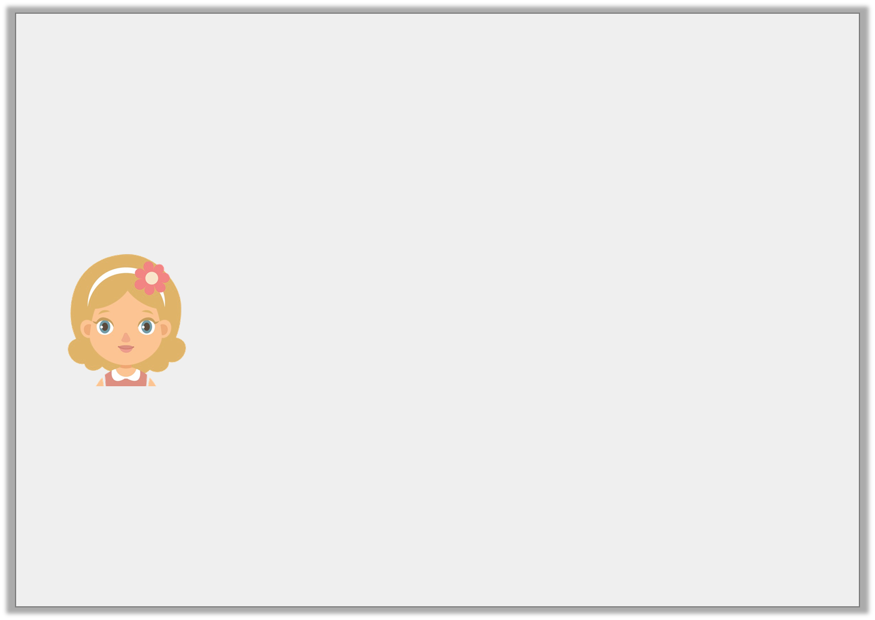
Problem Solving 2
Sarah is thinking of a number.
Which numbers could she be thinking of?
It is greater than forty-two.
It is less than nine tens.
The tens digit is one more than the ones digit.
Y2
© Classroom Secrets Limited 2018

Slide 27
Problem Solving 2
Sarah is thinking of a number.
Which numbers could she be thinking of?
43, 54, 65, 76, 87
It is greater than forty-two.
It is less than nine tens.
The tens digit is one more than the ones digit.
Y2
© Classroom Secrets Limited 2018

