Slide 1
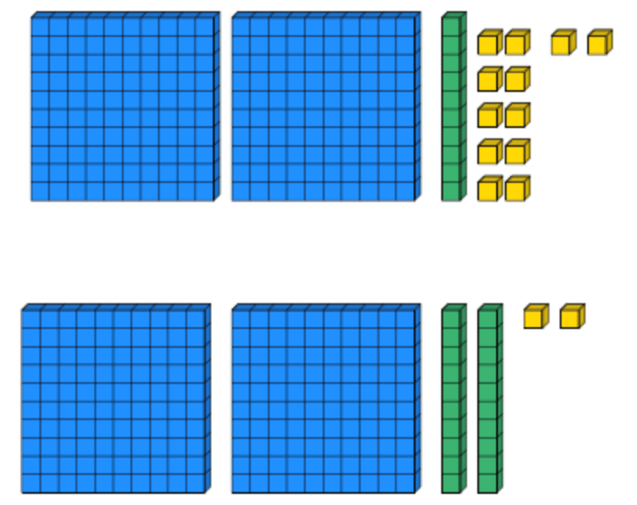
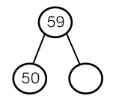
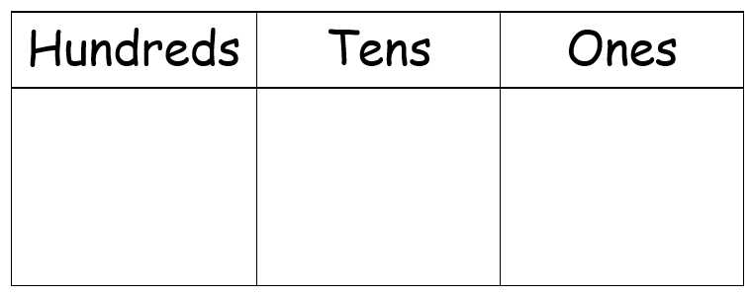
Place Value
Lesson 9

Slide 2
YR2 LO: To be able to count in 2s, 5s and 10s from any given number.
I understand what a multiple is.
I can count accurately in multiples of 2,5 and 10.
I can work out which multiple I need to count in.

Slide 3
YR3 LO: To use a number line to identify and estimate numbers up to 100.
I can use division to work out intervals on a number line.
I can count accurately in multiples.
- I can use a number line to estimate a number up to 100.

Slide 4
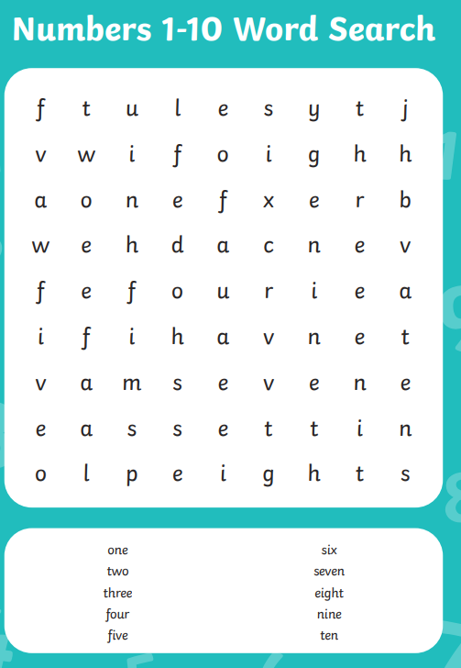
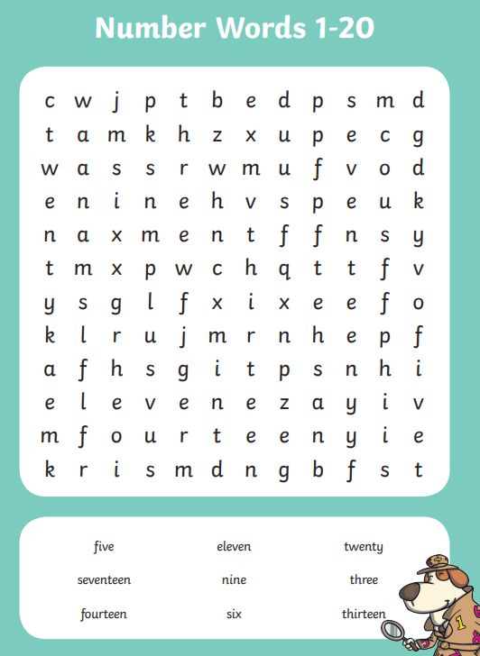
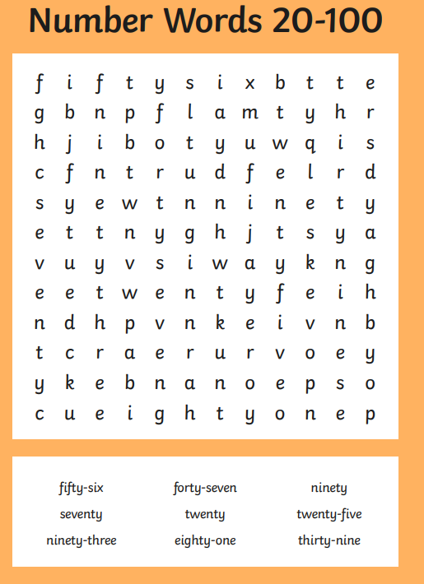
Starter:
Complete the word search for numbers written in letter form.
This will either be numbers to 10, to 20 or to 100.

Slide 6
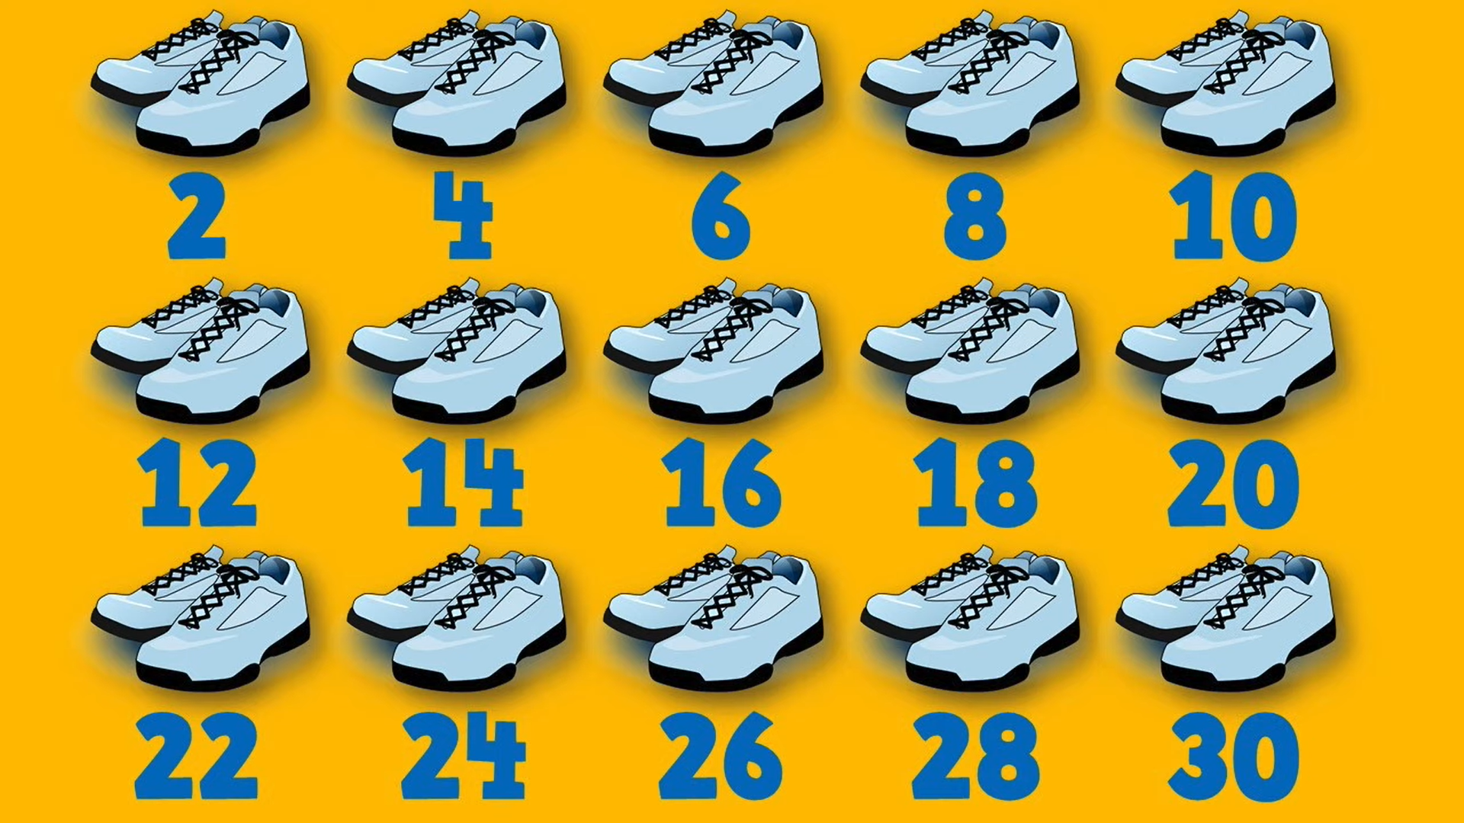
Recap: https://youtu.be/DS3W9WLIxlQ

Slide 7
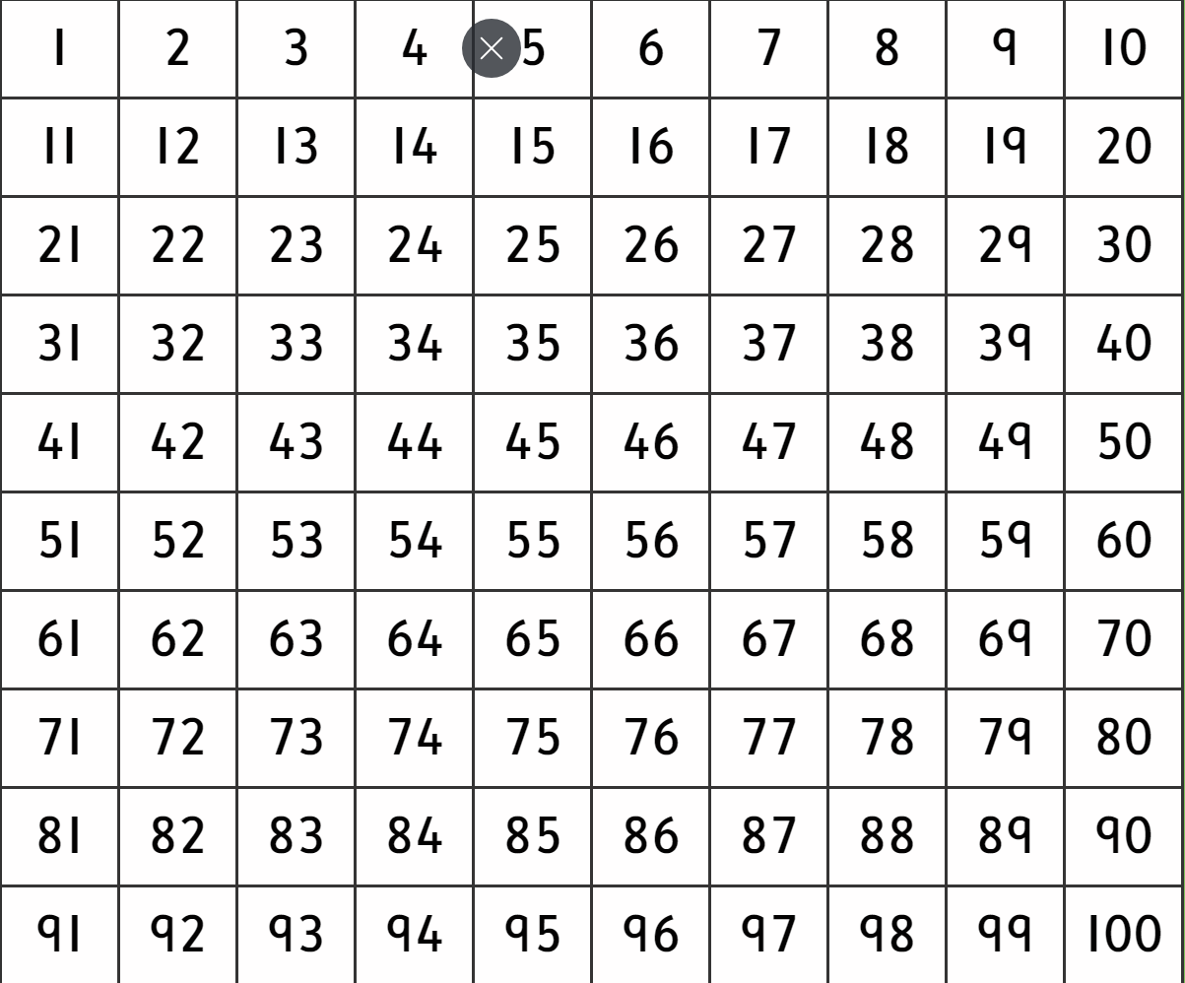
Paint the Squares - Interactive Number Charts (topmarks.co.uk)
Notes:
Use hundred square to practice counting in 2s 5s and 10 in multiples of numbers before starting at random numbers.

Slide 8
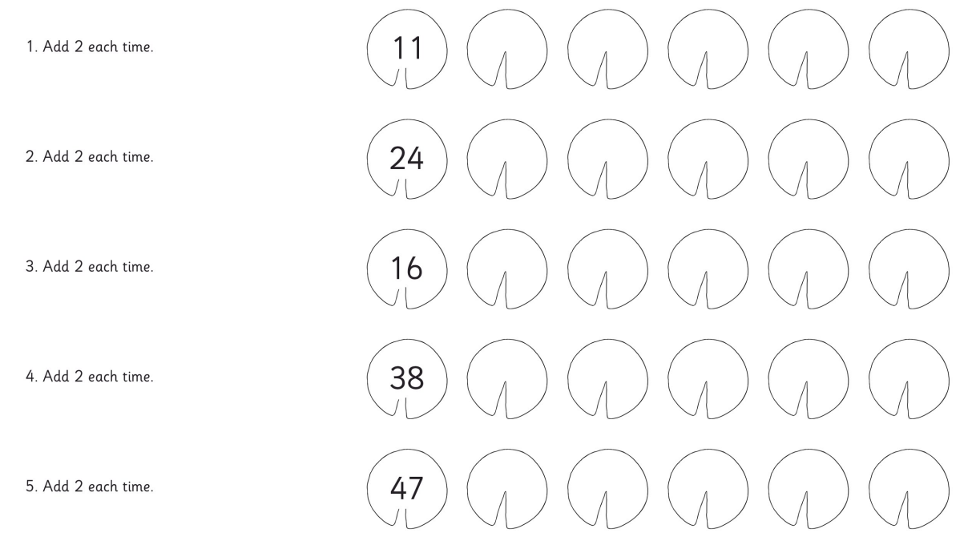
Year 2 task
Using the lily pad counting sheet, fill in the missing numbers by counting in multiples of 2,5 and 10.

Slide 9
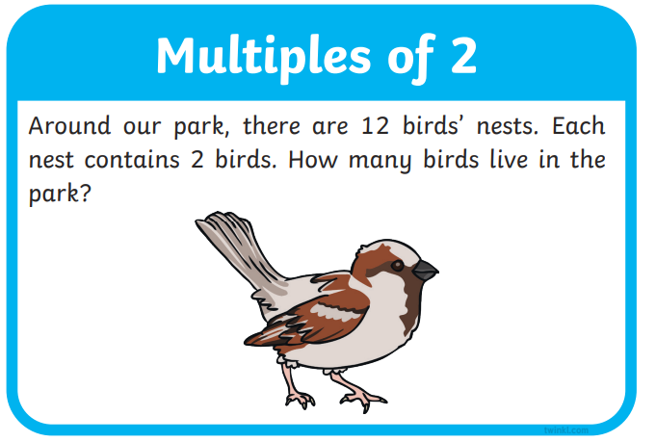
Year 2 HA task
Stick the word problem cards into your book, one at a time. Underneath each question, show how you worked out your answer. Complete a mixture of 2,5 and 10 questions.

Slide 10
Key language
ESTIMATING describes when we find something close to the correct answer.
NUMBER LINES are horizontal (-), straight lines which have numbers placed at equal points. Most number lines begin at 0, however this is not always the case.
INTERVALS on a number line are the equal spaces marked between any two numbers.

Slide 11

Year 3 - Aut3.2.3 - Number line to 100 on Vimeo
Notes:
Start video at 1min. Stop at 5:35

Slide 12
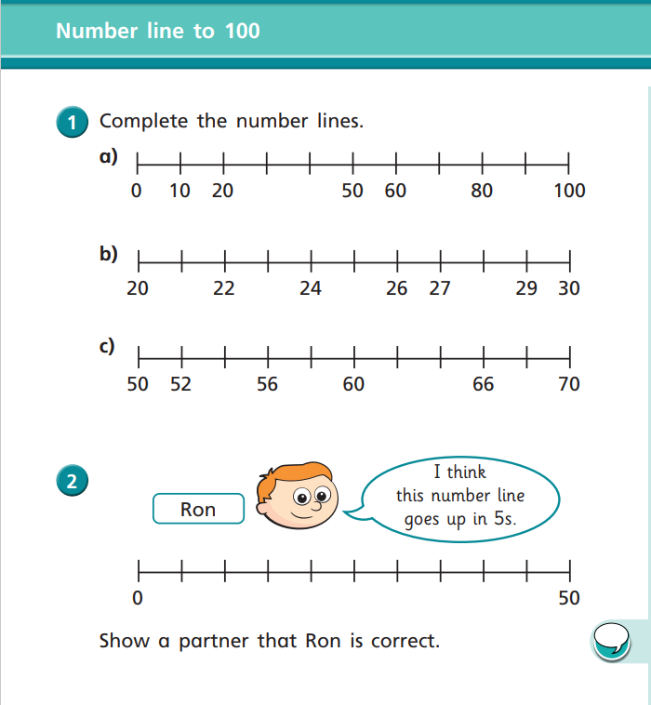
Year 3 task
Working with a partner, complete the WhiteRose number lines to 100 sheet. Use a whiteboard to help you work out division if you need to.

