Slide 1
Y2 LO: To draw an interpret pictograms on a scale of 1:2,5 and 10.
Y3 LO:To create and interpret bar charts.
To understand the importance of a key.
To draw pictograms based on information given.
To answer questions based on a pictogram.
I can draw bar charts to accurately show data.
I can interpret bar charts to answer questions.
I can solve one-step and two-step questions using information presented in a table.

Slide 2
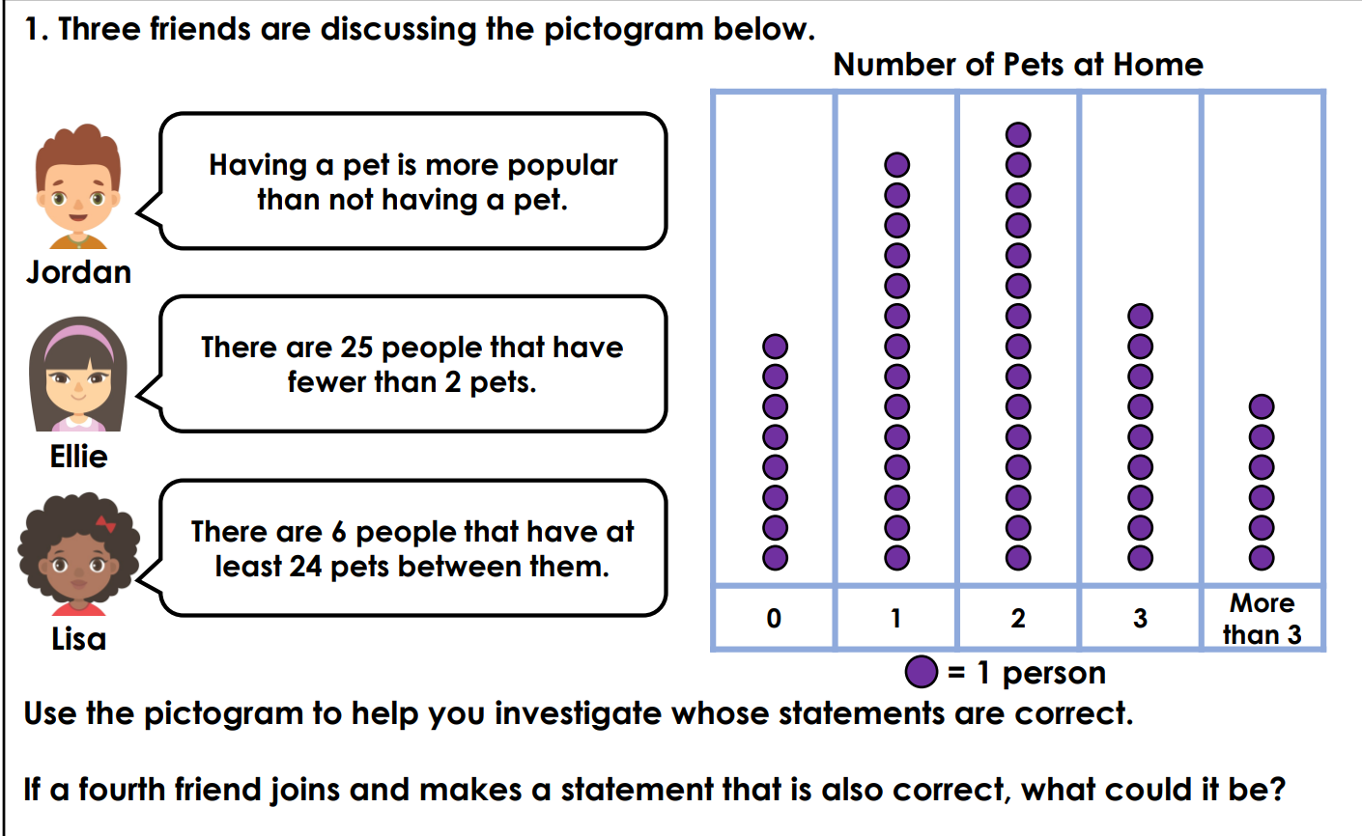
YR2 Starter: Can you think about these discussion problems with a partner

Slide 3
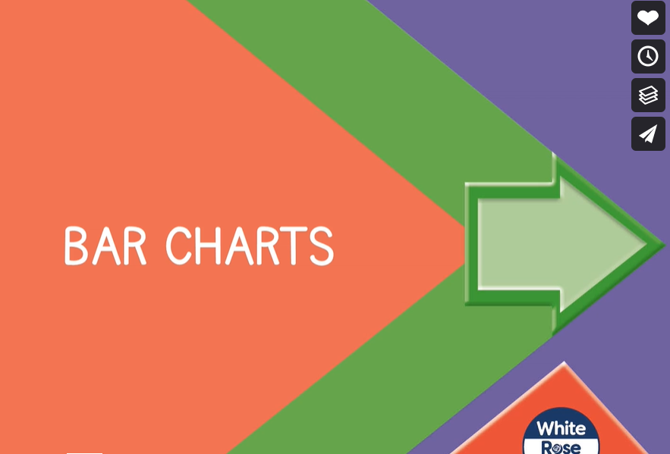
Spr3.6.3 - Bar charts on Vimeo
Notes:
YR3 input

Slide 4
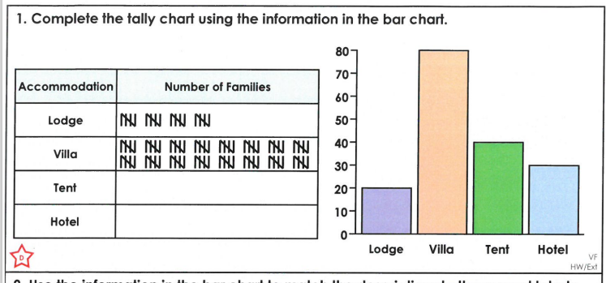
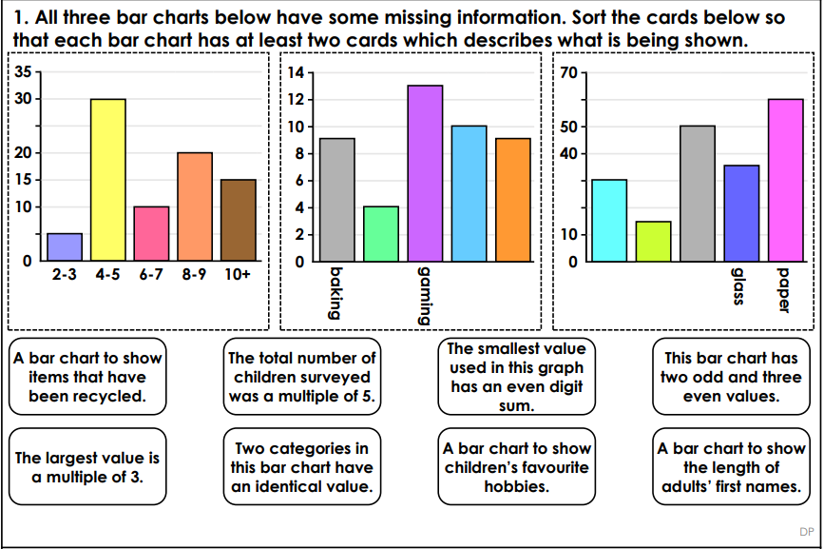
YR3 Task:
First, complete the differentiated VF sheet for bar charts.
Then, try to complete the tricky discussion problem sheet with a partner.

Slide 6
Recap: What did we look at last lesson?

Slide 7
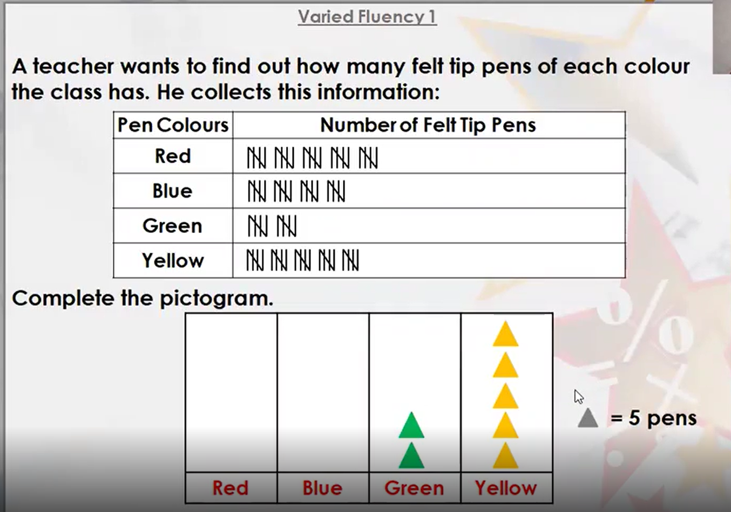
Notes:
We need to play close attention to the key. This is telling us that every triangle is worth 5. Remind chn that we know how to count in 5s so we don’t have to count each line.

Slide 8
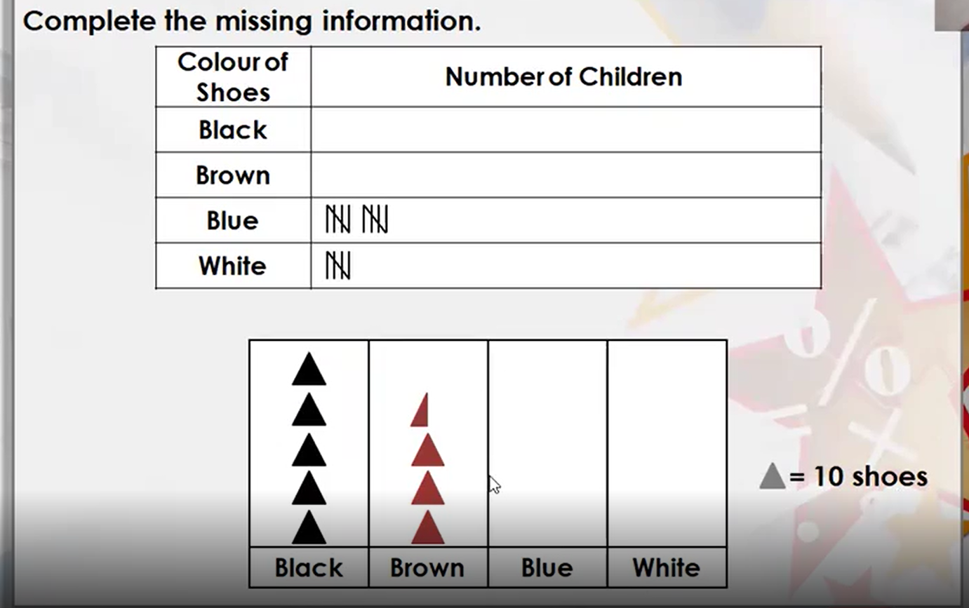
Notes:
Direct chn towards the half triangle shape. This means we have to half the key. Half of 10 is 5 so we know that the half triangle is worth 5. That means that for every whole triangle, we need to draw 10 tallies.

Slide 9
YR2 Task:
Work through the WhiteRose questions to consolidate your understanding. MA and HA to complete the word question sheet also. Before you start answering a question, use a highlighter to find the key. This is really important, so you are counting in the right amount.
Remember: If they picture is halved, you need to half the number in the key.

