Slide 1
Y2 LO: To draw and interpret block diagrams.
Y3 LO: To complete and interpret tables.
I can draw block diagrams based on information given.
I can answer questions based on a block diagram.
I can choose appropriate intervals to draw my own block diagram.
I can interpret data presented using tables.
I can complete a table using clues.
I can solve one-step and two-step questions using information presented in a table.

Slide 2
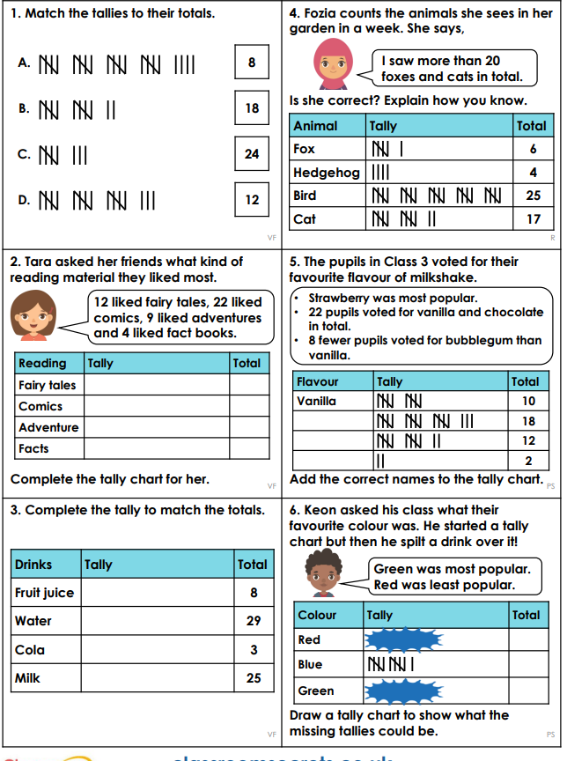
YR3 Starter:
Complete the priory learning activity to prepare you for our new learning.

Slide 3
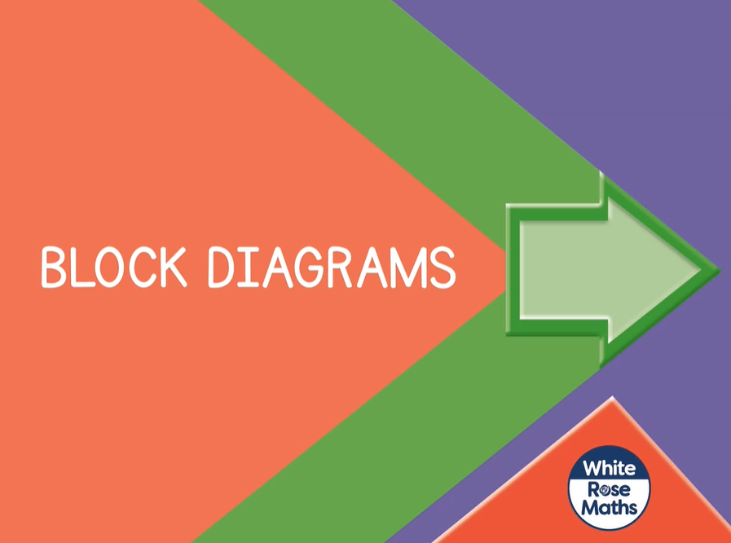
Spr2.6.4 - Block Diagrams on Vimeo
Notes:
YR2 input.

Slide 4
YR2 Task:
First complete the WhiteRose Sheet on block diagrams.
Then, with a partner, choose a chart and draw a bar chart in your book to share the information. Think carefully about which intervals you are going to count in. Try not just to count in 1s.

Slide 5

Table to show the number of visitors to the library
Day of the week | Mon | Tues | Wed | Thur | Fri | Sat | Sun
Number of visitors | 52 | 45 | 60 |  | 38 |  | 70
Use the clues below to complete the table
Twice as many people visited the library on Thursday than on Tuesday.
There were 120 visitors in total at the weekend.
Have a think

Slide 6
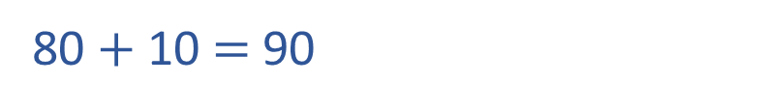
Table to show the number of visitors to the library
Day of the week | Mon | Tues | Wed | Thur | Fri | Sat | Sun
Number of visitors | 52 | 45 | 60 |  | 38 |  | 70
90
Twice as many people visited the
library on Thursday than on Tuesday.
45
40
5
double
double
80 $+$ 10 $=$ 90
80
10
90 people visited on Thursday.

Slide 7
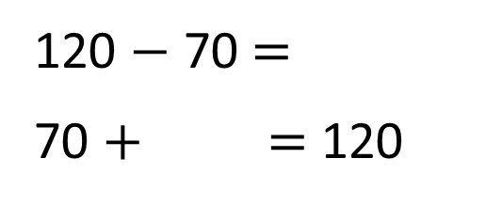
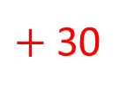
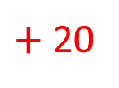
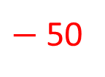
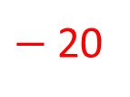
Table to show the number of visitors to the library
Day of the week | Mon | Tues | Wed | Thur | Fri | Sat | Sun
Number of visitors | 52 | 45 | 60 |  | 38 |  | 70
90
50
There were 120 visitors in total at the weekend.
50
Weekend 120
Sat ? | Sun 70
120 $−$ 70 $=$
70 $+$ $=$ 120
50
$−$ 50
$−$ 20
$+$ 30
$+$ 20
50
100
120
70
100
120

Slide 8
Table to show the number of visitors to the theatre
Day | Adults | Children
Thurs | 110 | 40
Fri | 95 | 60
Sat | 115 | 85
Sun | 75 | 50
1. How many people attended the theatre on Friday?
2. The theatre holds 200 people.
Which day was sold out?
3. How many children attended overall?
Have a think

Slide 9
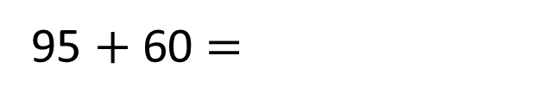
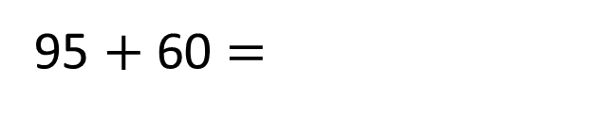
Table to show the number of visitors to the theatre
Day | Adults | Children
Thurs | 110 | 40
Fri | 95 | 60
Sat | 115 | 85
Sun | 75 | 50
1. How many people attended the theatre on Friday?
95 $+$ 60 $=$
155
155
95 $+$ 60 $=$
5
55
55
40

Slide 10
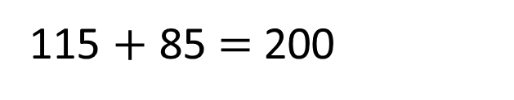
Table to show the number of visitors to the theatre
Day | Adults | Children
Thurs | 110 | 40
Fri | 95 | 60
Sat | 115 | 85
Sun | 75 | 50
2. The theatre holds 200 people.
Which day was sold out?
115 $+$ 85 $=$200
Saturday was sold out.

Slide 11
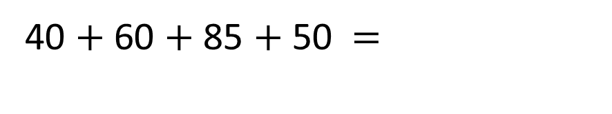
Table to show the number of visitors to the theatre
Day | Adults | Children
Thurs | 110 | 40
Fri | 95 | 60
Sat | 115 | 85
Sun | 75 | 50
3. How many children attended overall?
40 $+$ 60 $+$ 85 $+$ 50 $=$
235
35
50

Slide 12
Table to show number of visitors to a swimming pool
Day | 10am-12pm | 12pm-2pm | 6pm-8pm
Mon | 20 | 45 | 15
Tues | 30 | 40 | 20
Wed | 35 | 50 | 30
Thurs | 15 | 35 | 20
Fri | 30 | 40 | 35
1. Which was the pools busiest day?
2. How many people visited the pool in the evening?
Have a think

Slide 13
Table to show number of visitors to a swimming pool
Day | 10am-12pm | 12pm-2pm | 6pm-8pm | Total
Mon | 20 | 45 | 15
Tues | 30 | 40 | 20
Wed | 35 | 50 | 30
Thurs | 15 | 35 | 20
Fri | 30 | 40 | 35
80
90
115
70
105
Which was the pools busiest day?
Wednesday was the busiest day.

Slide 14
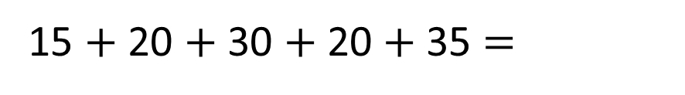
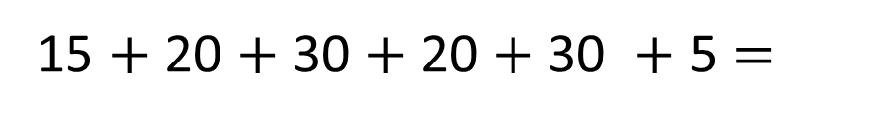
Table to show number of visitors to a swimming pool
Day | 10am-12pm | 12pm-2pm | 6pm-8pm
Mon | 20 | 45 | 15
Tues | 30 | 40 | 20
Wed | 35 | 50 | 30
Thurs | 15 | 35 | 20
Fri | 30 | 40 | 35
2. How many people visited the pool in the evening?
15 $+$ 20 $+$ 30 $+$ 20 $+$35 $=$
120
15 $+$ 20 $+$ 30 $+$ 20 $+$30 $+$ 5 $=$

Slide 15
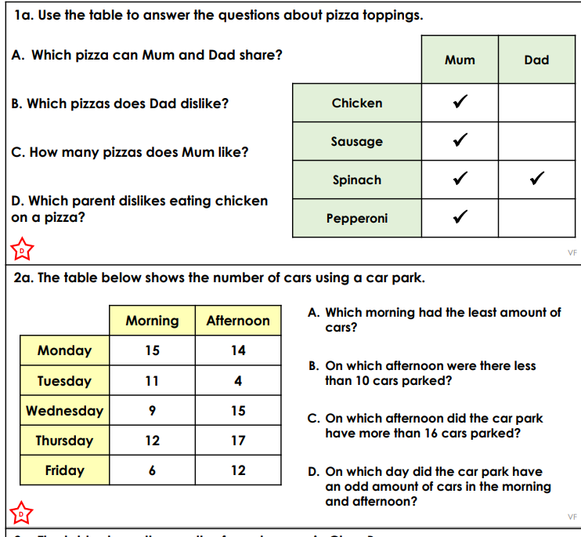
YR3 Task:
Choose the sheet that matches your understanding and use the tables to answer the questions.

Slide 16
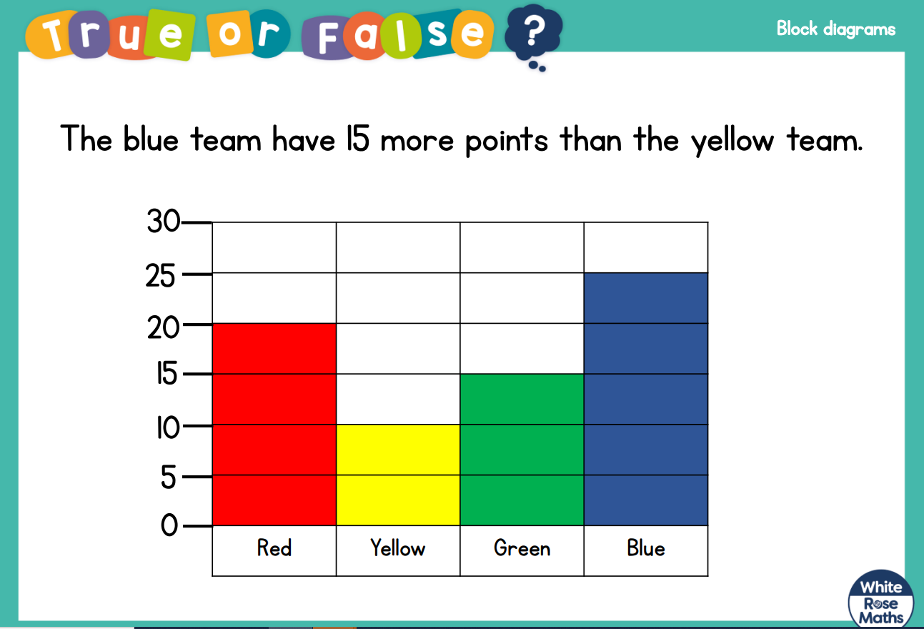
YR2 Plenary:
Notes:
True The blue team have 25 points. The yellow team have 10 points. The difference between 25 and 10 is 15

Slide 17
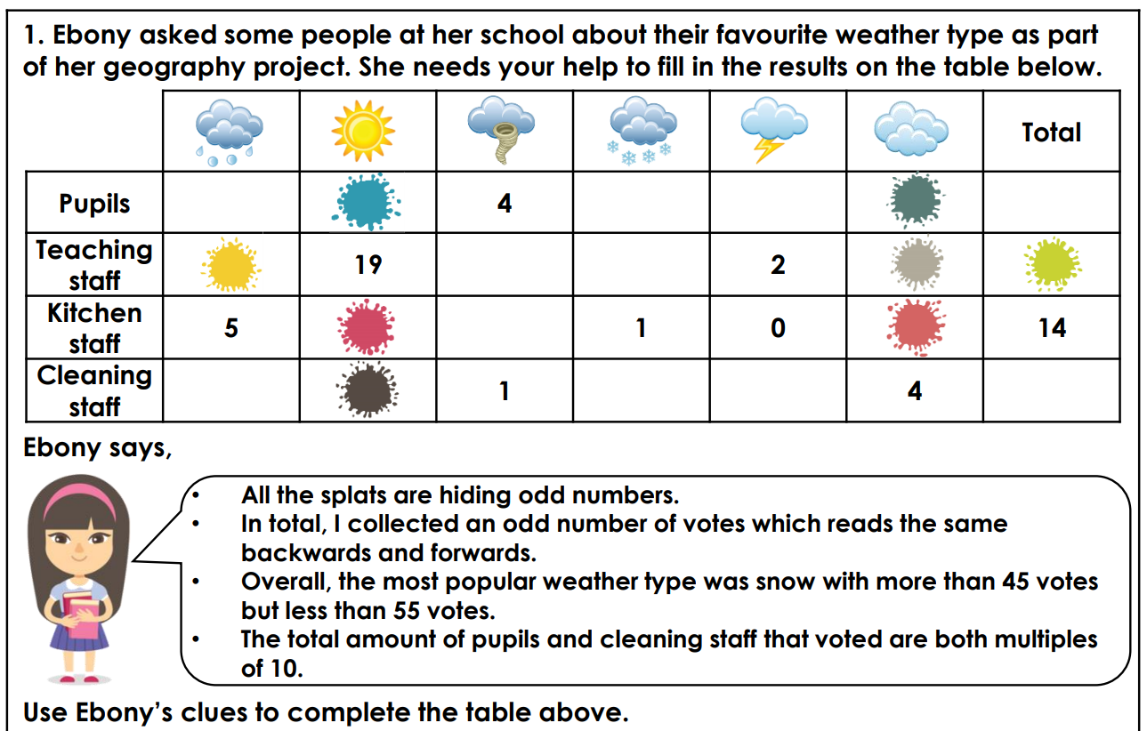
YR3 Plenary:
Notes:
Chn to work as a group.

