Slide 1

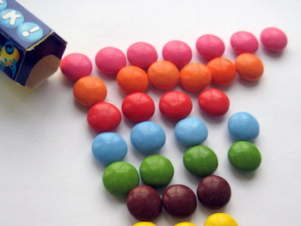
Tom has 10 counters. He makes a pattern of two rows of 10. What other patterns can he make that give him a square or rectangle shape?
Cut the counters out to help you if you want.
Example: 1 row of 20
row of
row of
row of
row of
row of
2) How many ways can 28 sweets be shared equally?
Cut the sweets out to help if you want.
Example: 28 people have one sweet each.
people have sweets each.
people have sweets each.
people have sweets each.
people have sweets each.
Well done on completing these tricky question! Was this easy? Turn over for TRICKIER questions!

Slide 2

Tricky questions…if you dare!
Which of these numbers can’t be shared
equally when there is more than one
person?
Circle the numbers which can’t be shared
equally.
11
4
14
15
13
7
Bonus questions:
Something to think about…
1)What do you notice about the numbers that can’t be shared equally?
2) Why can all even numbers be shared equally?

