Slide 2
Aim
To explore how scientists are diverse.
Success Criteria
I can explain what the words ‘diversity’ and ‘stereotype’ mean.
I understand that scientists come from a diverse range of backgrounds.
I can name and describe some of the many different jobs scientists do.

Slide 3
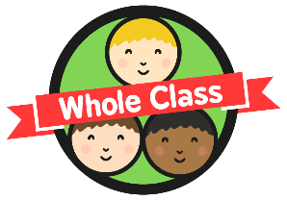

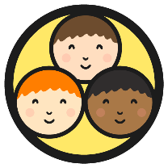

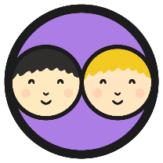


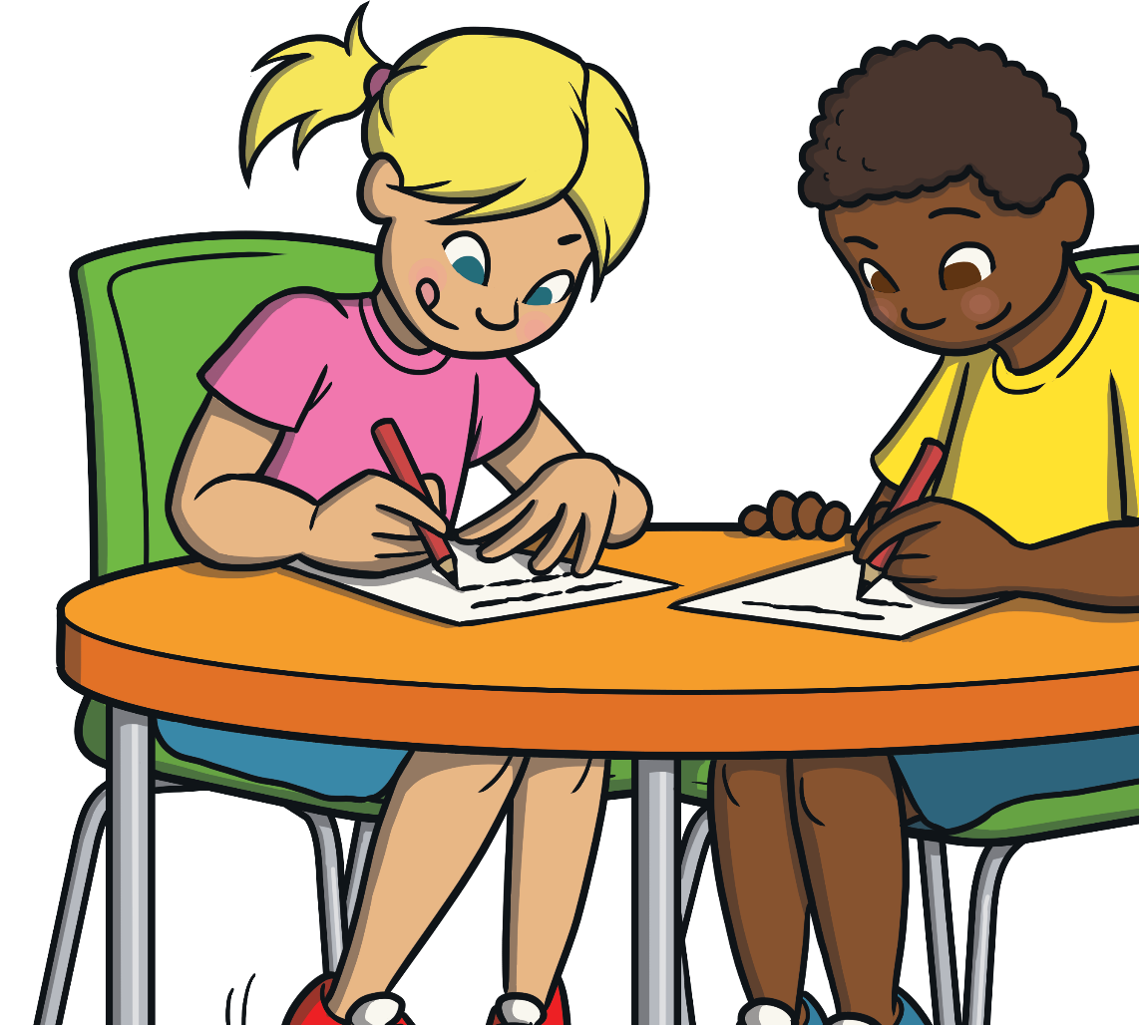
What Is a Scientist?
Can you draw a picture of a scientist?
12
Time’s Up!
11
1
10
2
9
3
8
4
7
5
6

Slide 4
What Is a Scientist?
Let’s share our pictures of what we have drawn.
Are they similar or different?

Slide 5
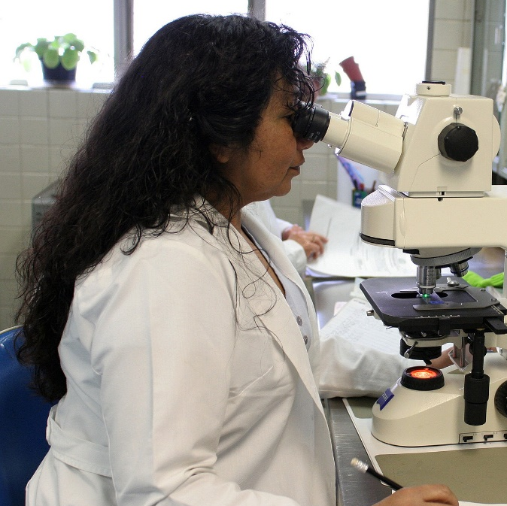
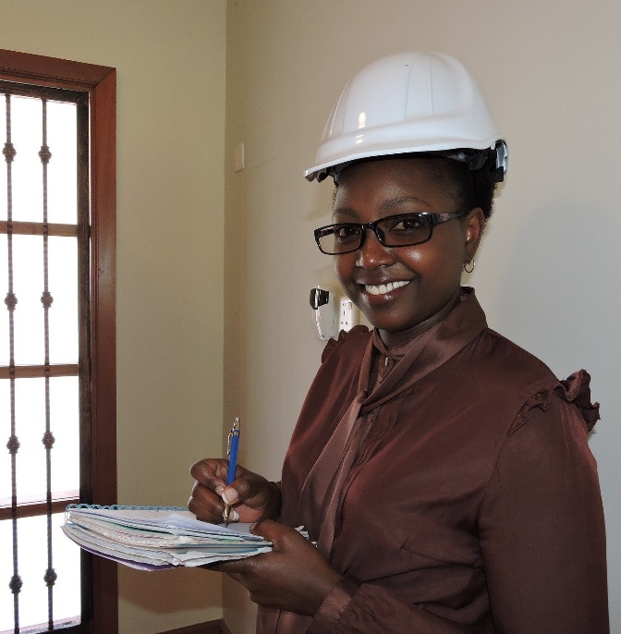
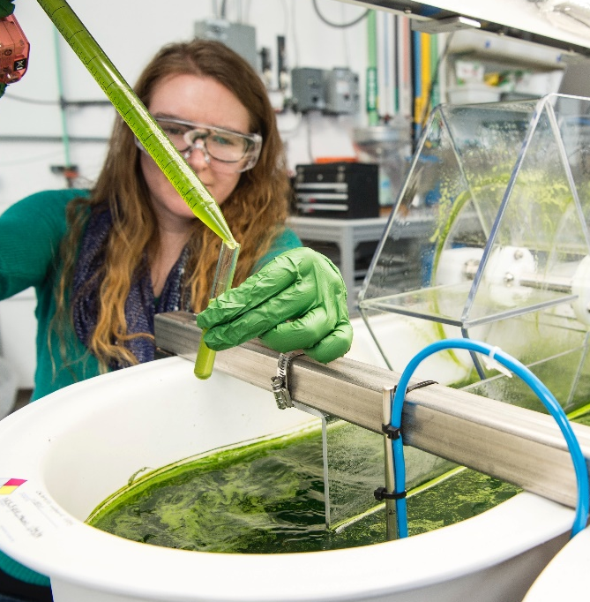
What Is a Scientist?
A scientist studies science.
They are curious about how the world works. Their work includes:
Making observations (looking at things closely)
Carrying out experiments to find out new things.
Asking questions

Slide 6
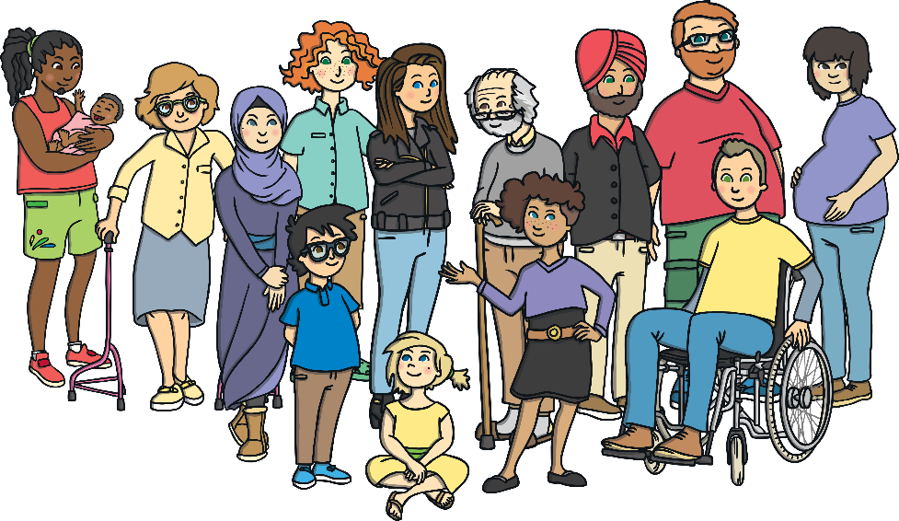
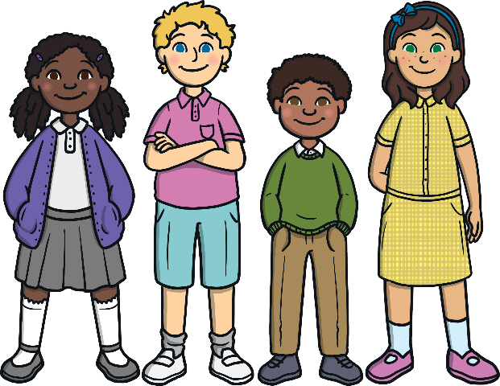
Smashing Stereotypes in Science
Keywords
diverse
stereotype
means a mix of different people or things, for example:
an idea about what a certain group of people are like that may not be true, for example:
‘Girls wear pink and boys wear blue’ is a stereotype, because this is not always true!
This group of people is diverse.

Slide 7
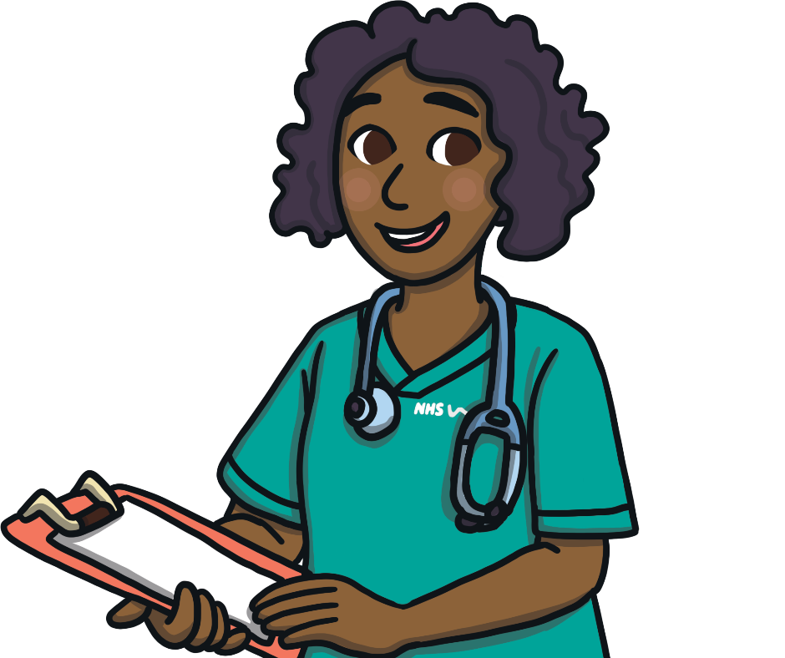
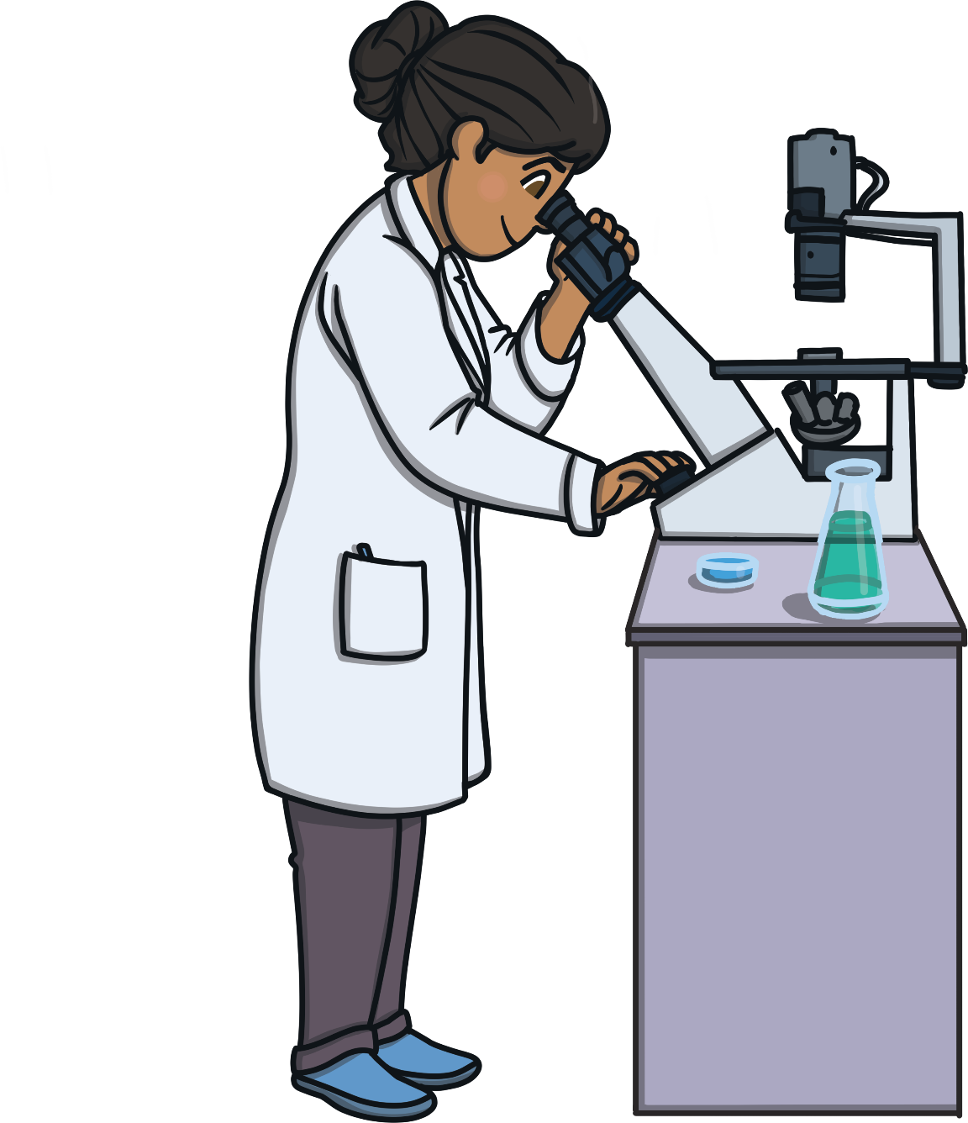
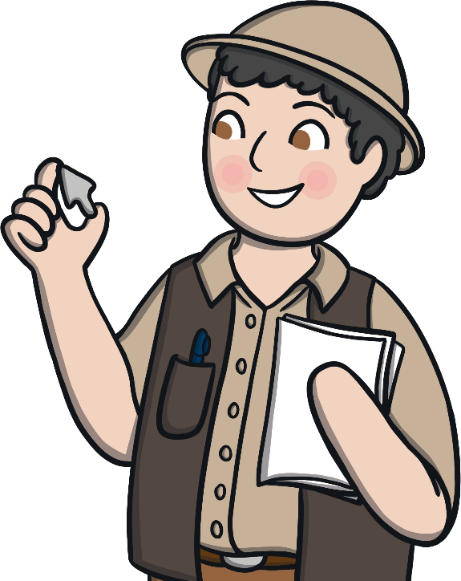

Smashing Stereotypes in Science
Sometimes people have one idea of what a scientist looks like - a stereotype.
One theme of British Science Week this year is 'Smashing Stereotypes' and celebrating how diverse scientists are!
Scientists aren’t just one type of person.
They do lots of different jobs.
Many different kinds of people work as scientists.
They also work in lots of different places and ways.
Scientists are everyday people often working together to do great things
in their everyday jobs. Today, we are going to look at the diversity
of scientists and smash the stereotype!
X
Can you tell your partner what you think is meant by 'smash the stereotype'?

Slide 8
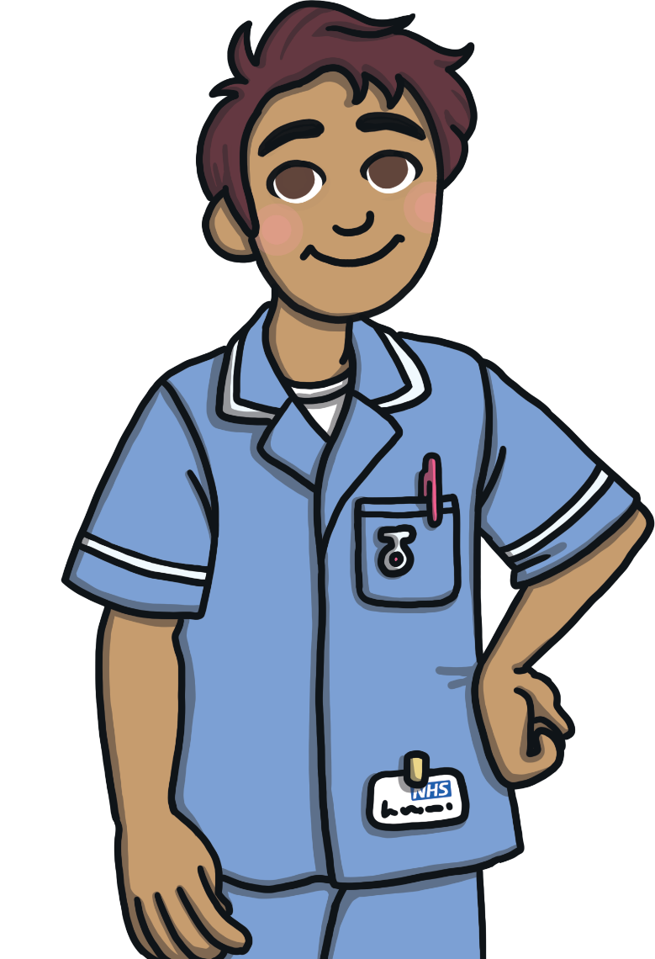

Types of Scientists
There are lots of different types of scientist. Here are some examples.
Medicine
People who work in medicine, such as doctors and nurses, know lots about science.
They need to understand the science of how the human body works and how people can get ill.
They find out why people are ill and how to treat them. They may even research new ways to make people better.
They work in many places including hospitals and GP surgeries.

Slide 9
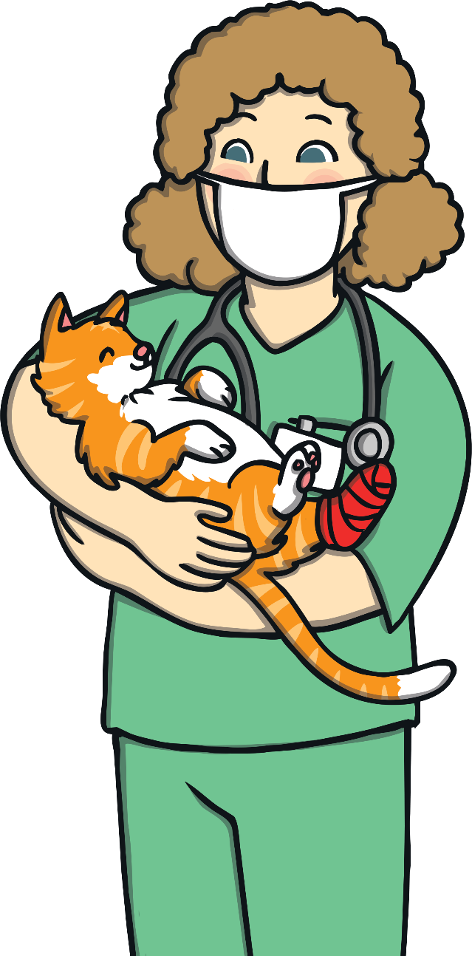
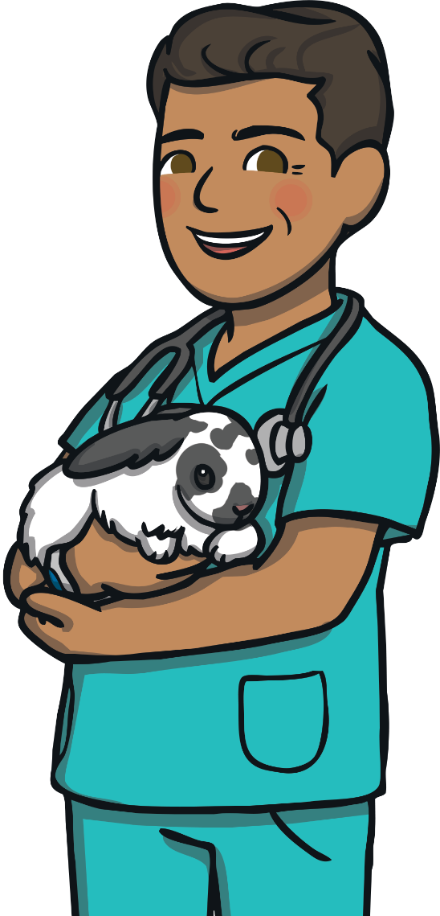
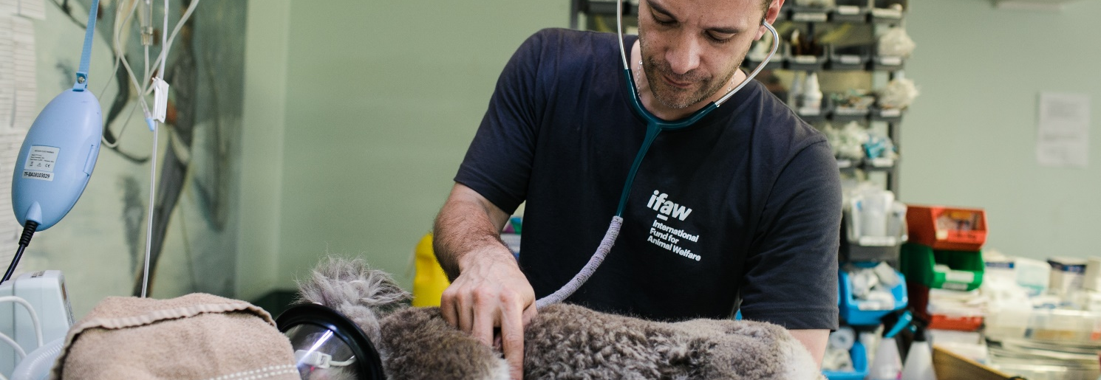
Types of Scientists
Vets and Veterinary Nurses
When animals are poorly, they need to be looked after as well.
Vets and veterinary nurses have to know all about the science of animals and how to make them better.
They work in places such as veterinary surgeries, safari parks, conservation areas and many places you may not expect.

Slide 10
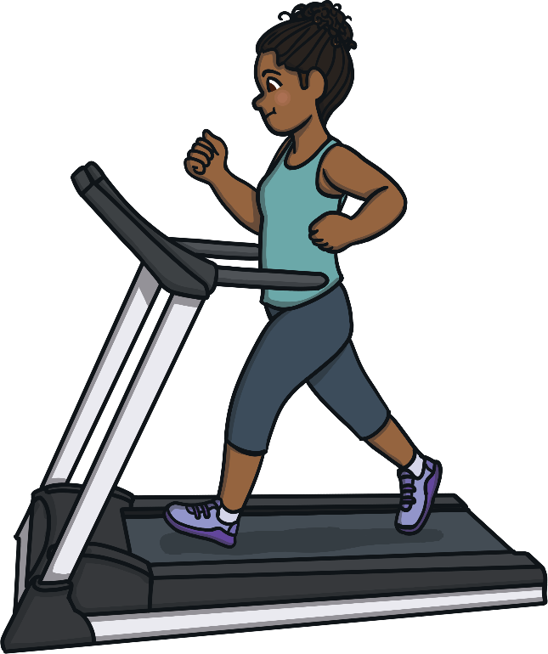
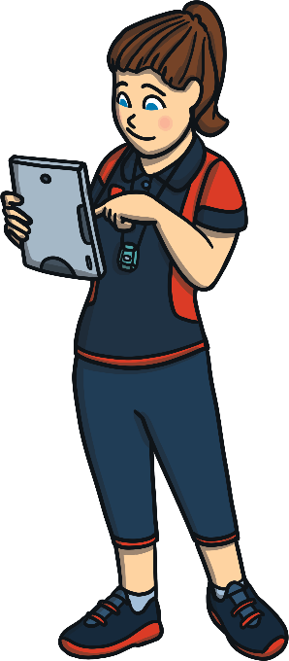
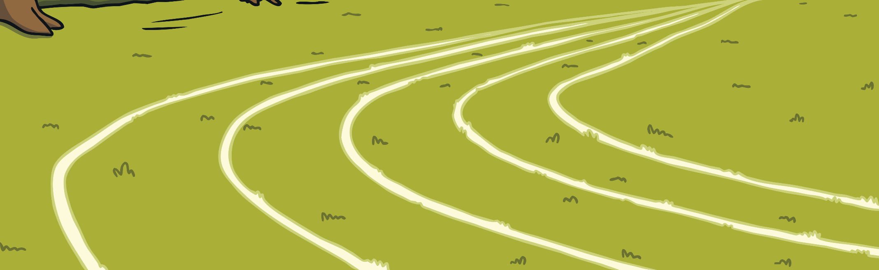
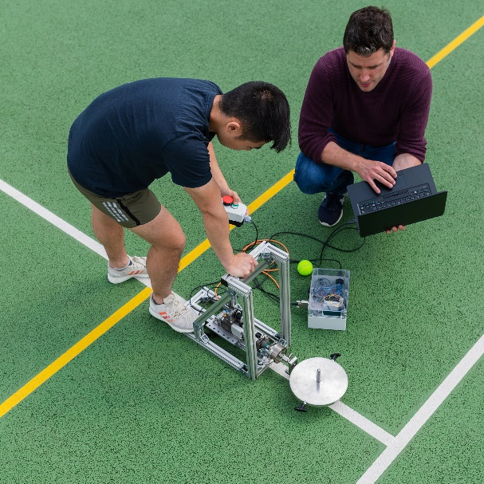
Types of Scientists
Sports Scientists
These scientists know all about how the human body works. They use this to help people to try and become healthier and get better at their sport or activity.
They can also help to design sports equipment.
They work in places such as fitness centres, hospitals or outdoor sports fields.

Slide 11
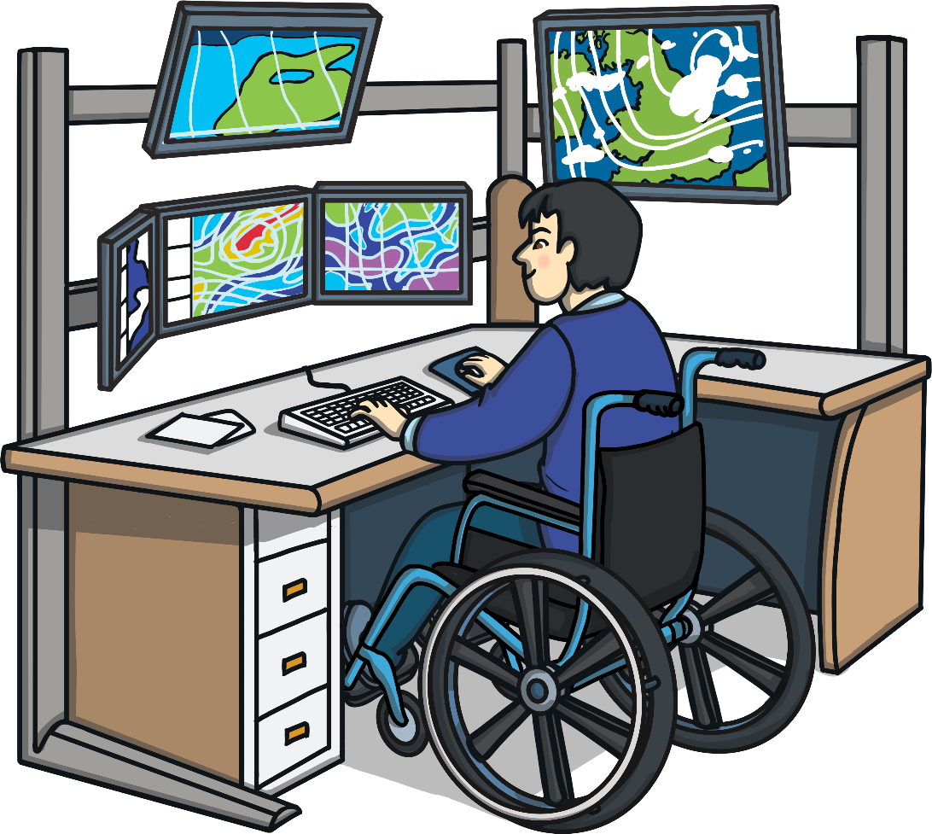
Types of Scientists
Meteorologists
These scientists study the weather and put together our weather forecasts. They are also learning more about climate change.
Using computer programs is an important part of their job.
They work in many different places all around the world.

Slide 12
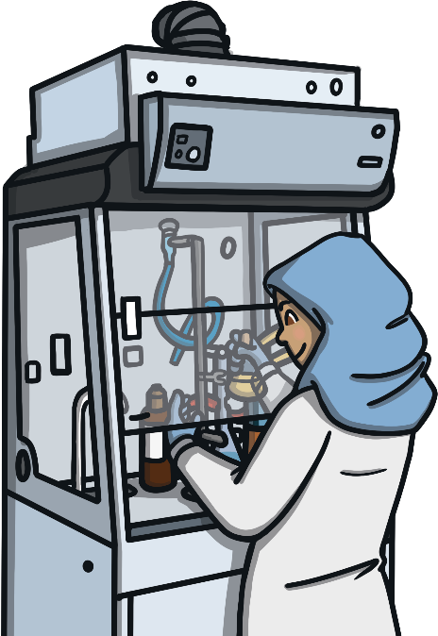
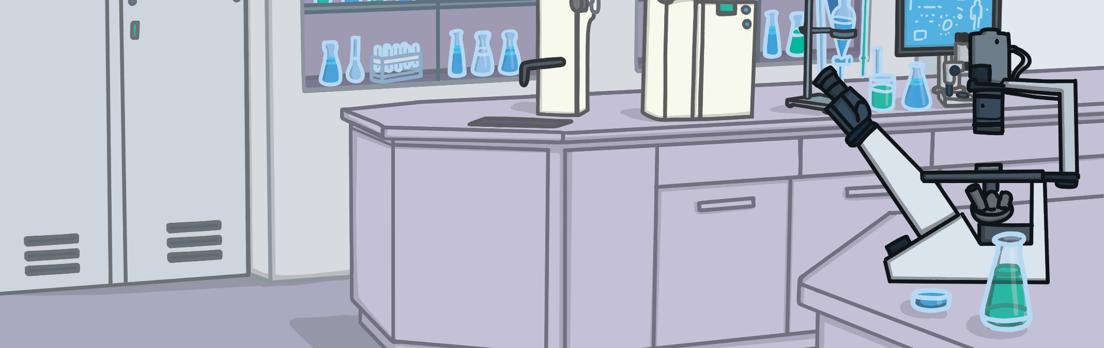
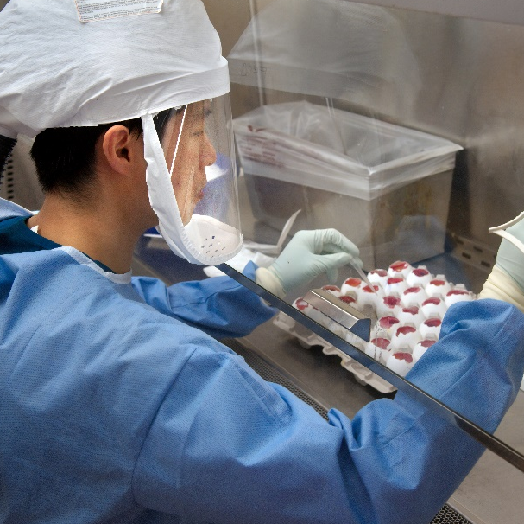
Types of Scientists
Materials Scientists
These scientists look at how to make materials better for us to use.
They might find new ways to use materials and even create new materials.
They might work in a factory, a lab or an office.

Slide 13
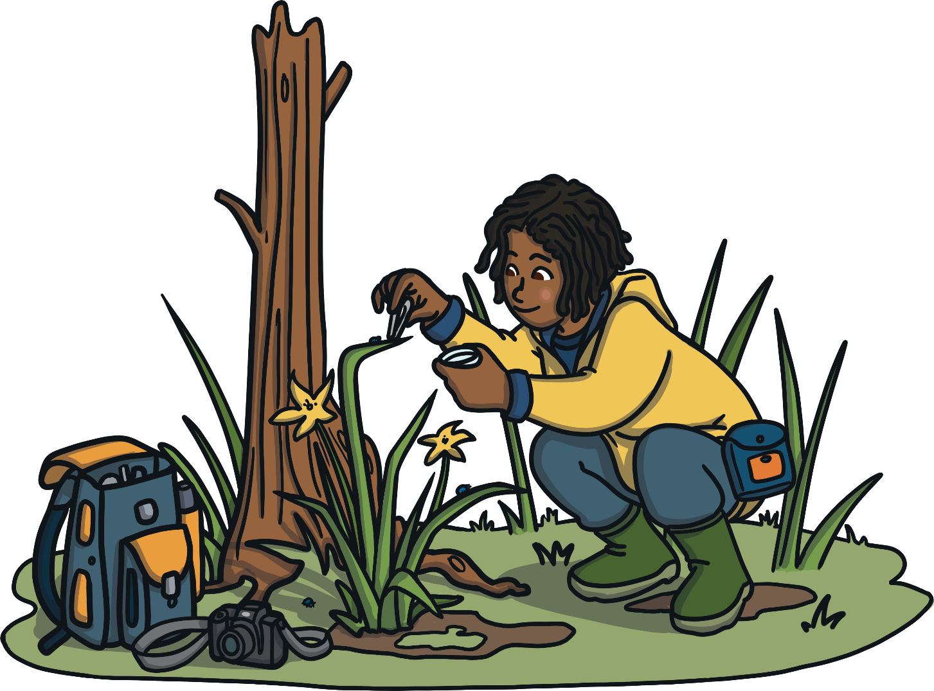
Types of Scientists
Ecologists
Ecologists find out about how living things (including animals and plants) and the environment affect
each other.
They can do lots of work
outdoors but also work in
labs and offices.

Slide 14
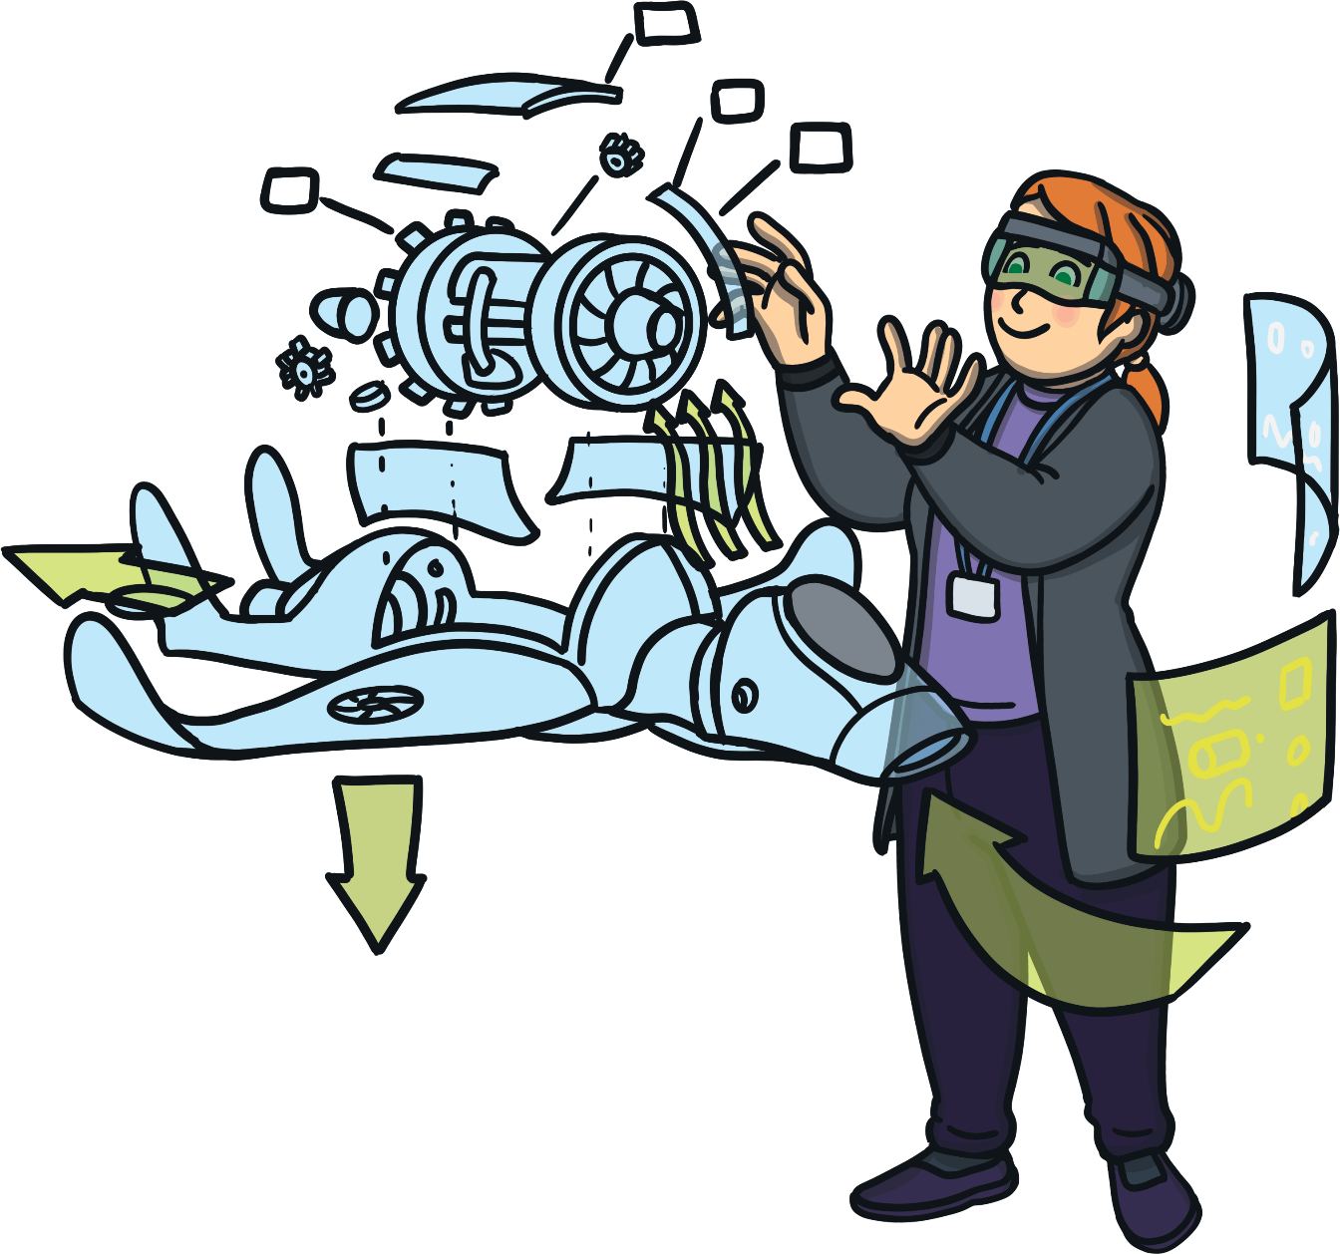
Types of Scientists
Engineers
Engineers use their scientific knowledge to design and build things.
They work in lots of different places including on ships and in factories, construction sites, offices and hospitals.

Slide 15
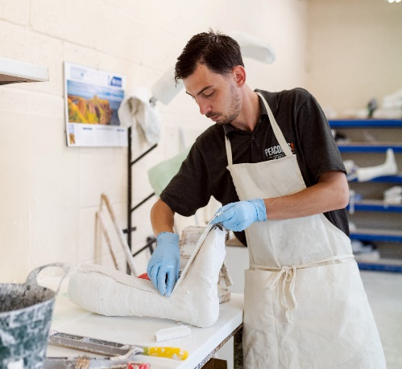
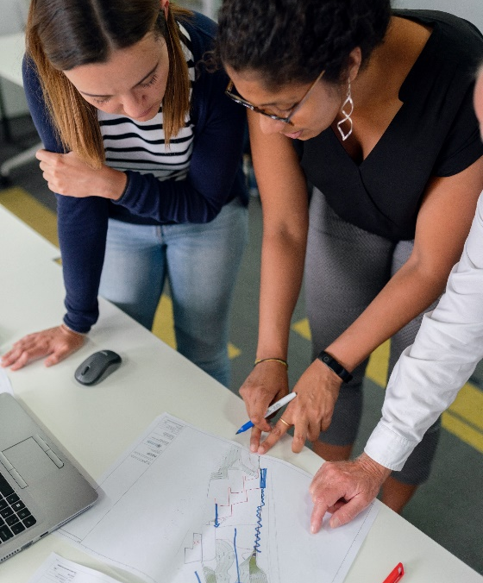
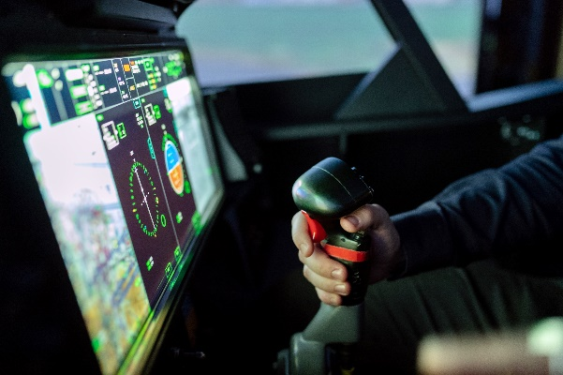
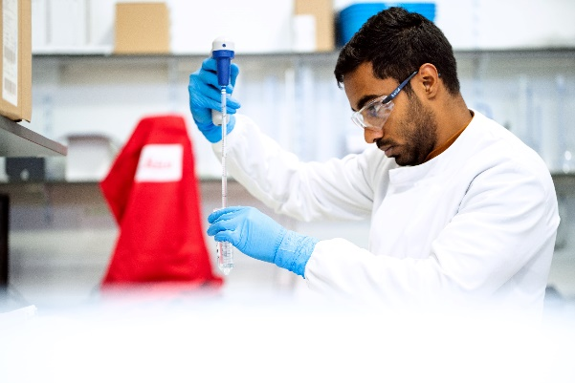
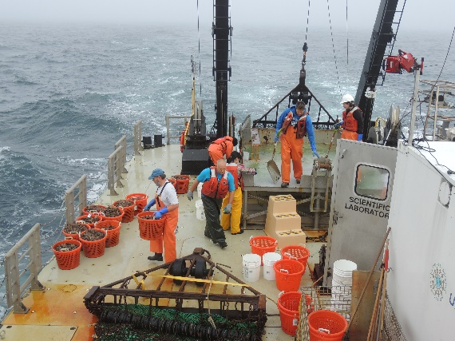
Types of Scientists
Engineers
Clinical engineers design and build equipment for helping people who are ill.
Aerospace engineers design and build planes, spacecraft and satellites.
Civil engineers work on building projects such as bridges, roads, railways, schools and offices.
Chemical engineers turn basic materials into things we can use. They work with fuels, medicines and food and drink.
Marine engineers design and build things linked to the sea, such as boats and ships.

Slide 16
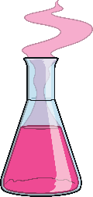
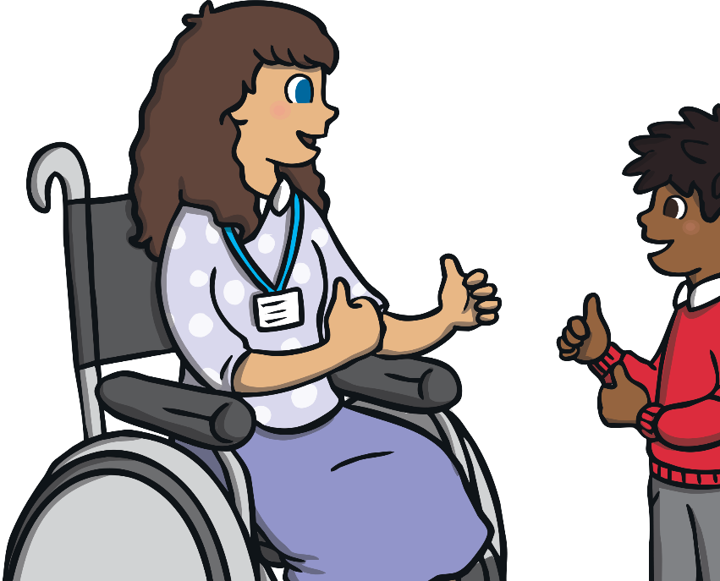
Types of Scientists
Science Communicators
These scientists share their scientific knowledge and discoveries with people.
They might run science workshops for children, write about science or make television programmes.
They can work in all sorts of places such as schools, universities, museums and TV studios.
Many of the different scientists we have learnt about also do this as part of their job. For example, scientists sometimes visit schools to teach children about their jobs.
Your teacher is a science communicator too!

Slide 17
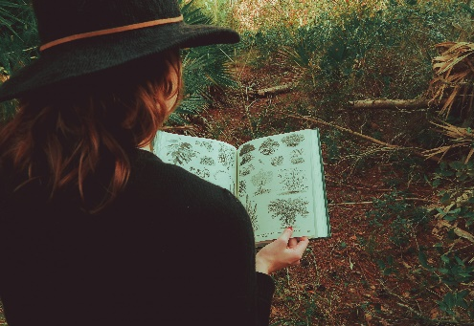
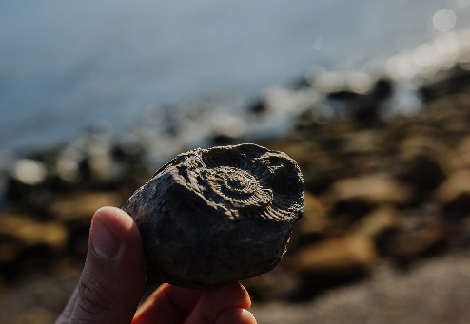
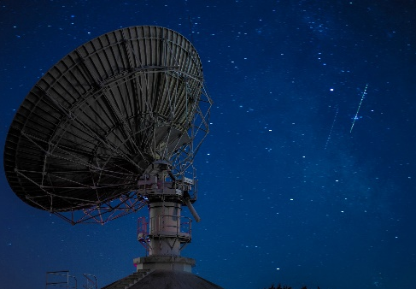
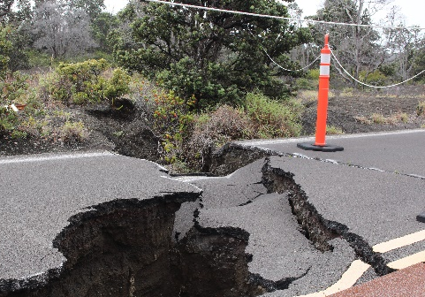
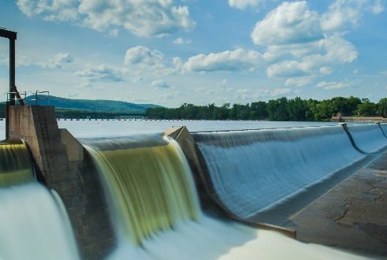
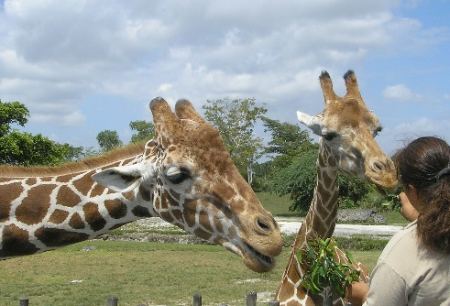
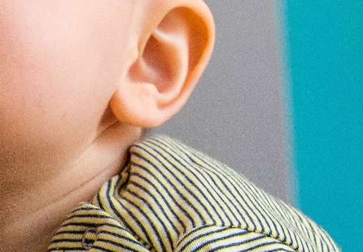
Types of Scientists
There are many more types of scientists!
Can you guess what these scientists do? Click on a picture to find out!
Botanists
Palaeontologists
Astronomers
Seismologists
study plants
study fossils
study space
study earthquakes
Hydrologists
Zoologists
Audiologists
X
study water
study animals
study hearing
Do you know any scientists in real life? What job do they do?

Slide 18
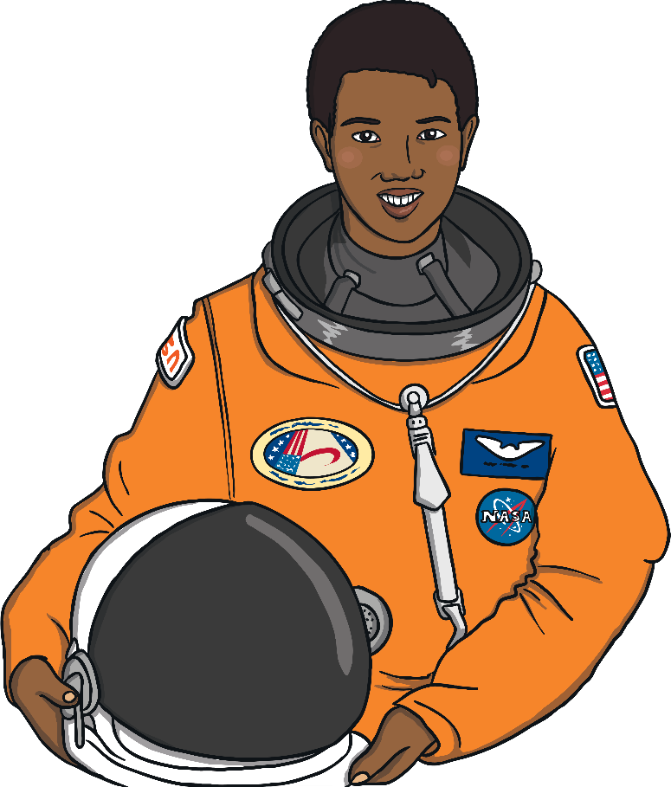
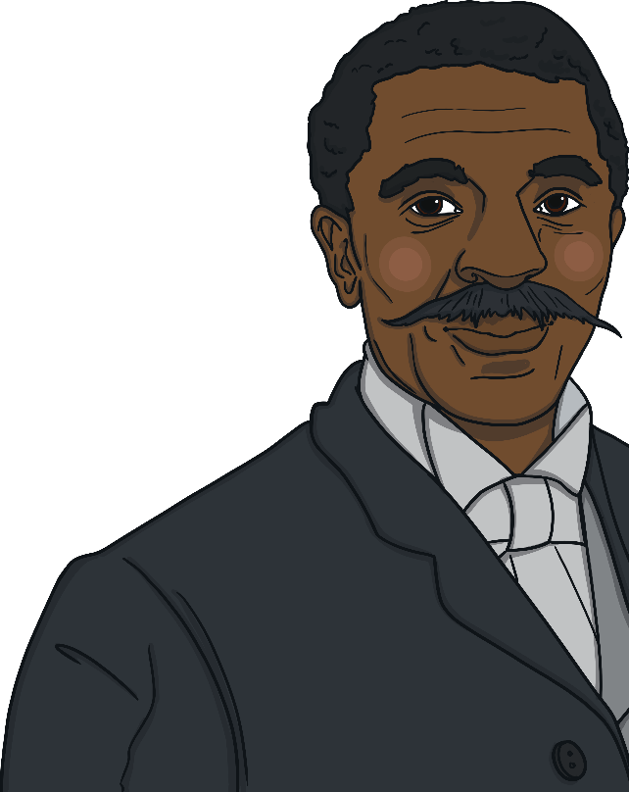
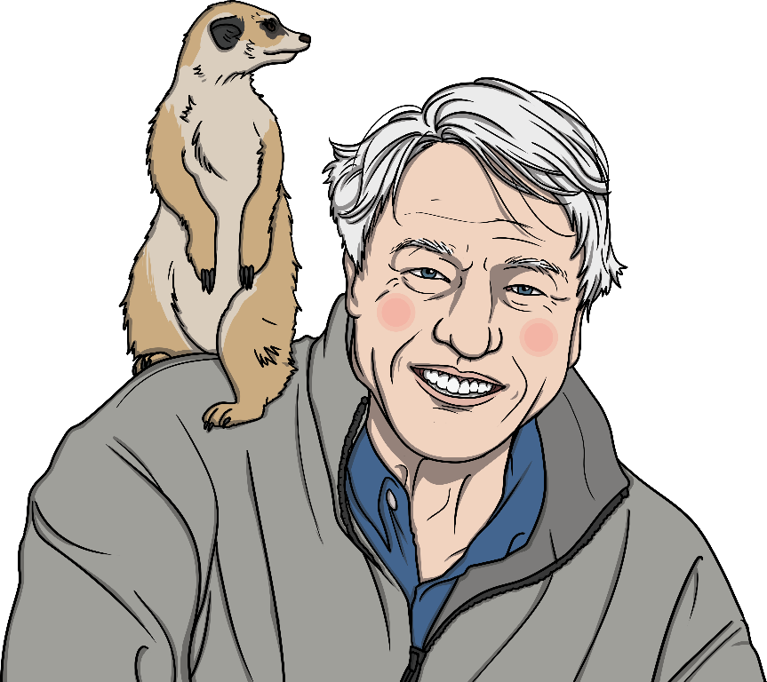
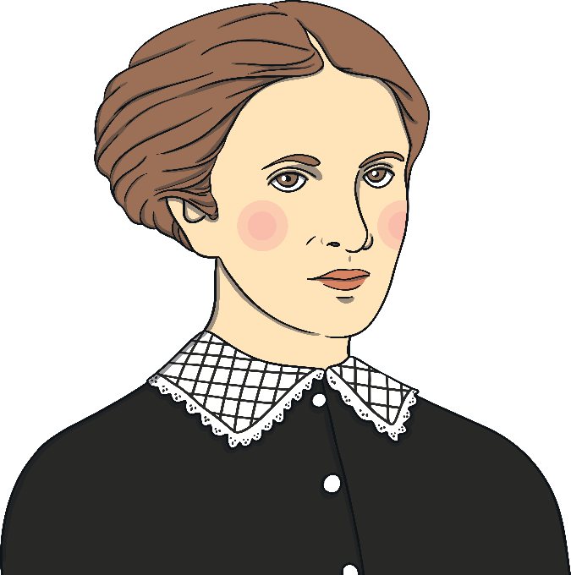
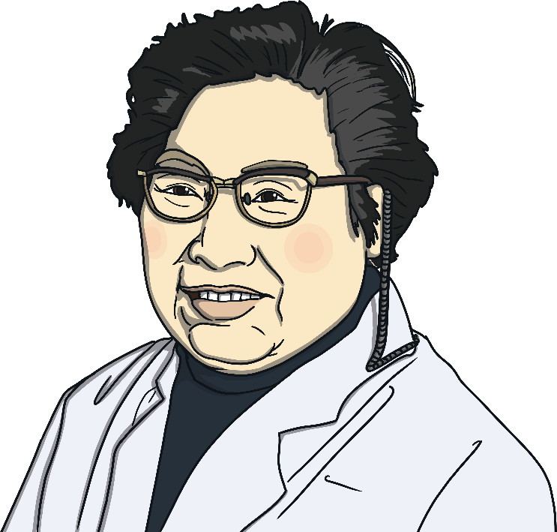
Inspirational Scientists
As well as studying many different things, scientists come from different backgrounds (e.g. places, homes and families).
Here are some examples of well-known scientists. They show the diversity of people working in science.

Slide 19



Inspirational Scientists
Mae Jemison is a doctor, teacher, inventor and astronaut.
She was the first Black woman to go into space.
She first went to medical school and learnt how to be a doctor, then she applied to be an astronaut.
She went to space in 1992 on board the Endeavour space shuttle.
In space, she carried out experiments into weightlessness.
Scientists have hobbies too - Mae likes reading and dancing!
Mae Jemison

Slide 20



Inspirational Scientists
Sir David Attenborough is a wildlife film-maker and naturalist.
A naturalist is a scientist who studies the natural world, including animals and plants.
He has taught people about science on television for over 60 years.
Have you seen any of his programmes?
Sir David Attenborough

Slide 21

Inspirational Scientists
She was the first Englishwoman to qualify as a doctor in Britain, in 1865.
She wasn’t allowed to study medicine at university. Instead, she studied science in the evenings.
Even when she was qualified, she was still not allowed to work as a doctor in any hospital.
So, she decided to open her own doctor’s surgery which became very popular.
She went on to open a hospital in London, which still treats patients today.
Elizabeth Garrett Anderson

Slide 22

Inspirational Scientists
Then, some colleges turned him down because they did not want Black students to attend.
These events were because of racism. This is now against the law but wasn’t when George was alive. Unfortunately, racism is still something that affects the lives of people today.
George went on to become a teacher and carry out research into agriculture.
He helped farmers to keep their soil healthy for plants by using something called ‘crop rotation’. This is still important in farming today.
George was born in the USA in the early 1860s.
He worked in agriculture (the science
of farming).
He loved learning but wasn’t allowed to attend any of the schools near his home because they were for White children only.
So George travelled to lots of different cities to find schools that would allow him to learn.
George Washington Carver
Racism: Treating people differently because of the colour of their skin or because they or their family members come from a different country or area.

Slide 23


Inspirational Scientists
Tu Youyou is a Chinese scientist.
After having a disease called tuberculosis as a teenager, she learnt about medicine so that she could help other people who were ill to get better.
She is known for discovering a substance from a plant that has been used as a medicine to treat a disease called malaria.
This has helped millions of people to get better.
Tu Youyou
Substance: A material that something is made from.

