Slide 2
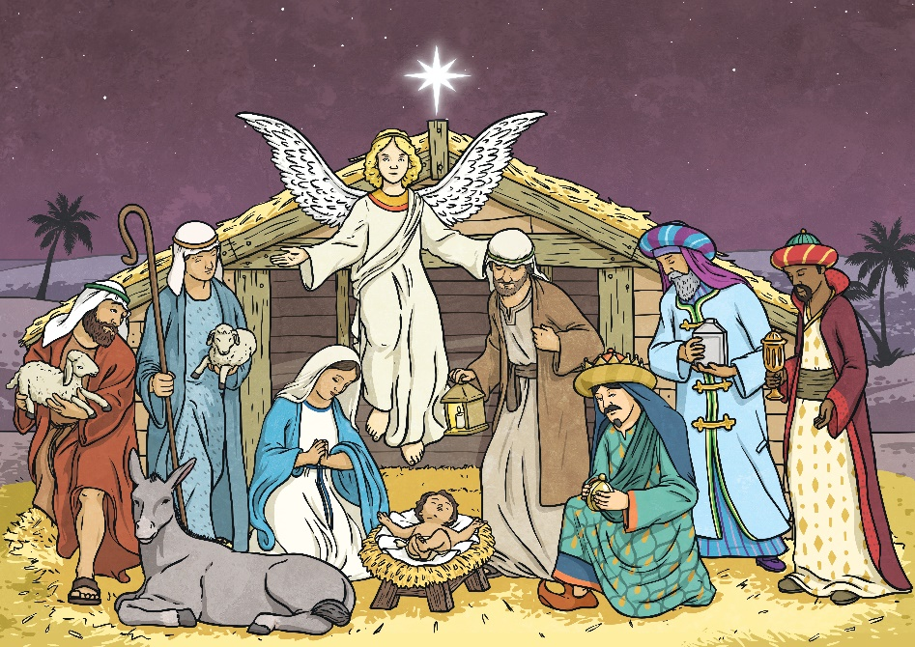
What Is Epiphany?
Epiphany is a Christian festival that is celebrated on 6th January. It is also known as the Feast of the Epiphany, Theophany or Three Kings’ Day.
The word Epiphany comes from the Greek word ‘epiphaneia’ which means appearance. Jesus, the founder of Christianity, belonged to the Jewish faith. Epiphany marks the appearance of Jesus to non-Jewish people, symbolised in the Christmas story by the visit of the Wise Men. In Eastern Orthodox Churches, Epiphany also marks the baptism of Jesus.
Talk About It
What do you know about the Christmas story?

Slide 3

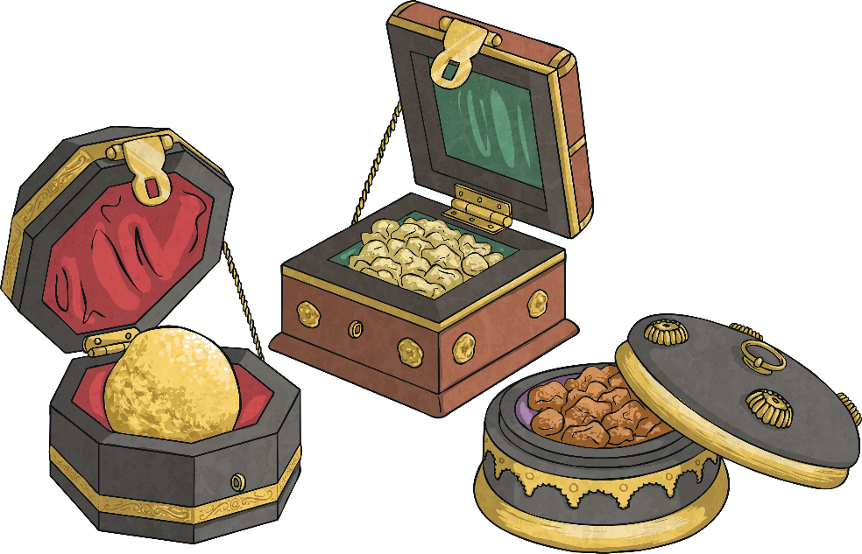
How Many?
You may have heard of the Three Wise Men but the Bible story doesn’t actually say how many Wise Men there were.
“Title of Image Used” by [Author] is licensed under CC BY 2.0
Why do so many of the stories and songs mention three? It is probably because of the three gifts that were given to Jesus.
Can you remember what they were?
gold, frankincense and myrrh
In the Bible story, there were at least two Wise Men but there could have been many more!

Slide 4

Why the Gifts?
When someone we know has a baby, it is common to buy a present. What different presents might you buy a family with a new baby? The gifts the Wise Men (also known as Magi - pronounced ‘may-jigh’) bought Jesus were not what we might expect so why were they given?
Gold was given because they believed Jesus was a king.
Frankincense was used in religious ceremonies. This symbolised that Jesus was a religious leader.
Myrrh symbolises suffering and was used in funeral ceremonies. Christians believe this gift symbolised that one day Jesus would die on a cross.

Slide 5
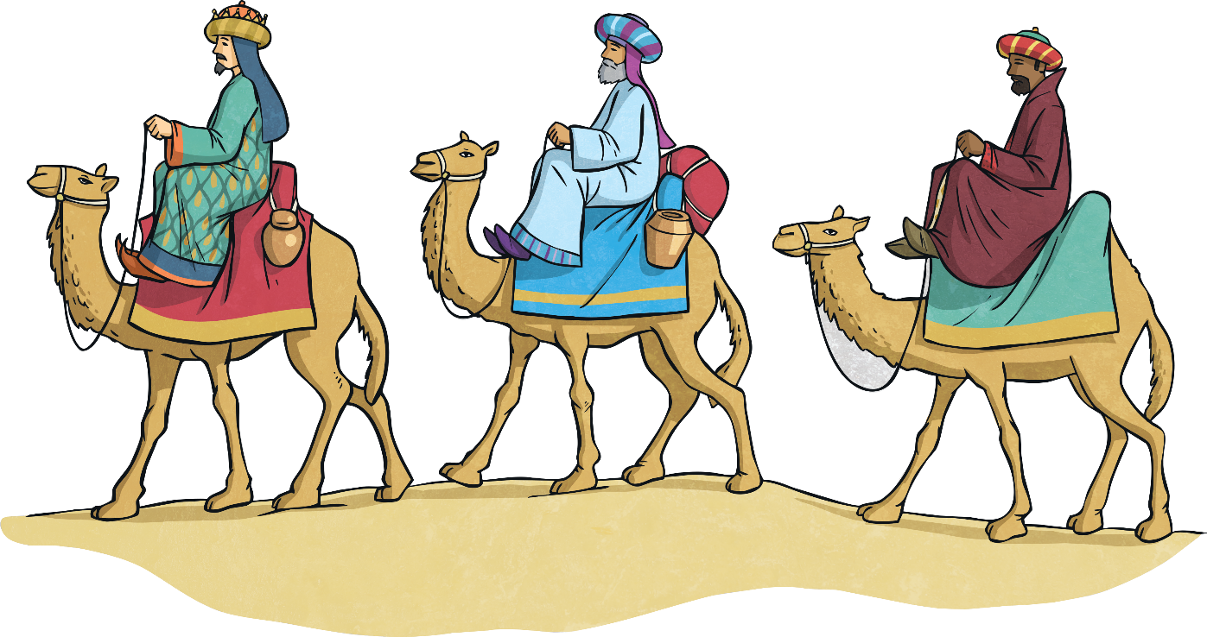
The Baby Jesus
Traditional Christmas cards often show scenes of the baby Jesus in a stable surrounded by the Wise Men. However, the Bible story does not actually say this happened. It tells that ‘after Jesus was born, Wise Men from the east’ arrived, having followed a star that they believed led them to a newborn king. First, they went to the royal palace in Jerusalem before continuing to follow the star to Bethlehem where Jesus was living. The visit of the Magi could have taken place weeks, months or even years after the birth of Jesus.
Did You Know…?
It is believed that the Wise Men were called Caspar, Melchior and Balthazar.

Slide 6
How is Epiphany Celebrated?
Many Christians celebrate Epiphany on 6th January, which is the end of the twelve days of Christmas.
At Epiphany, special church services are held and prayers are said to say thank you for the arrival of Jesus. In some churches, special prayers are said over water. This holy water is then used to baptise people. Priests also sprinkle the holy water in the homes of churchgoers to bless them. This remembers Jesus’ baptism.
Did You Know…?
The first recorded celebrations of Epiphany was in the 4th century.
Did You Know…?
Some Orthodox Churches celebrate Christmas on 7th January and Epiphany on 19th January.

Slide 7
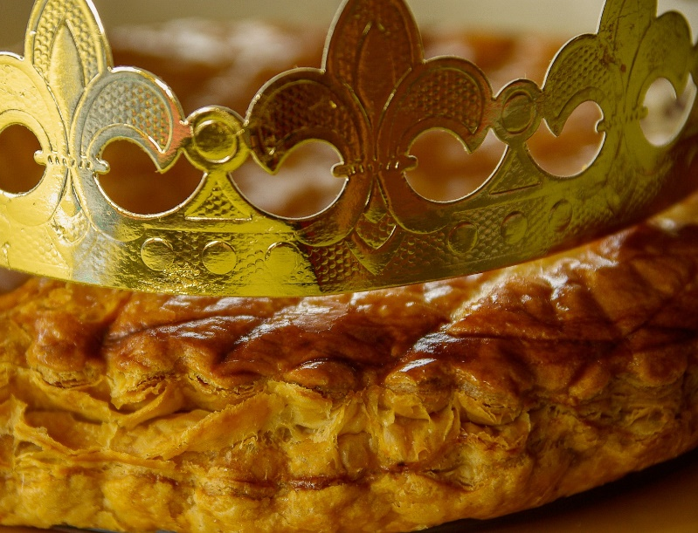
Epiphany Around the World
In France, Epiphany is known as ‘la Fête des Rois’ and commemorates the journey of the Three Wise Men. Some people leave their Christmas decorations up to celebrate the festival. Special flat almond cakes called ‘galette des rois’ (king’s cake) are eaten. A toy crown or figurine representing Jesus is hidden inside the cake and the cake is decorated with a crown.
In Portugal, special songs called Janeiras (January songs) about the Wise Men are sung. Singing is also an important part of Epiphany in Belgium and Poland, where children dress up as the Wise Men and go from door to door singing Epiphany songs. Belgian children are given sweets or money from the people they visit.

Slide 8
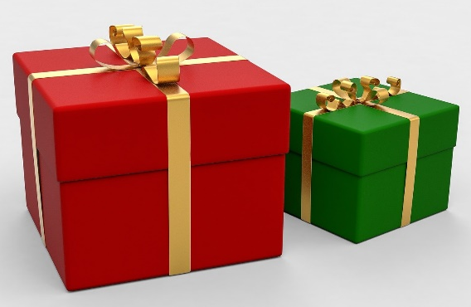
Epiphany Around the World
In Spain, Epiphany is known as ‘Fiesta de Los tres Reyes Magos’, the festival of the Three Magic Kings. Spanish children receive their Christmas presents at Epiphany. On the morning of Epiphany, Spanish people buy ‘roscón’, a ring-shaped roll filled with cream or chocolate. A bean is hidden inside the cake and whoever finds it is meant to pay for the roscón. A similar cake is eaten in Mexico, where Epiphany is known as ‘El Dia de los Reyes’.
As in Spain, children in parts of Italy receive their Christmas presents at Epiphany. Children hang their stockings by the fire and believe that an old lady called Befana brings them their presents.
The legend tells that the Wise Men asked Befana directions when they were looking for Jesus. She later joined the search for Jesus and gives children presents while she is on her journey.

Slide 9
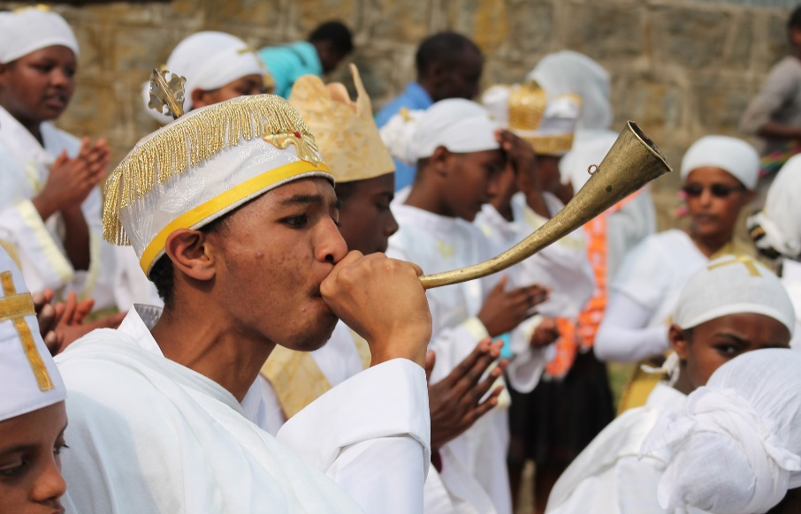
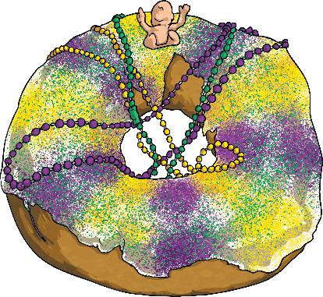
Epiphany Around the World
In Austria, some people remember the visit of the Wise Men by drawing signs in chalk across their front door. This is meant to protect the house for the coming year. The signs are made up of the year divided into two with the initials of the traditional names of the Wise Men in-between. Epiphany 2022 would have the sign: 20+C+M+B+22.
In New Orleans, USA, some people remove the Christmas decorations from their Christmas trees and replace them with purple, gold and green ones. Some people also eat a ‘king’s cake’, which is a pastry filled with jam that has a small figure of baby Jesus inside it.
In Ethiopia, a three-day festival called Timkat starts on 19th January
and celebrates the baptism of Jesus.

Slide 10
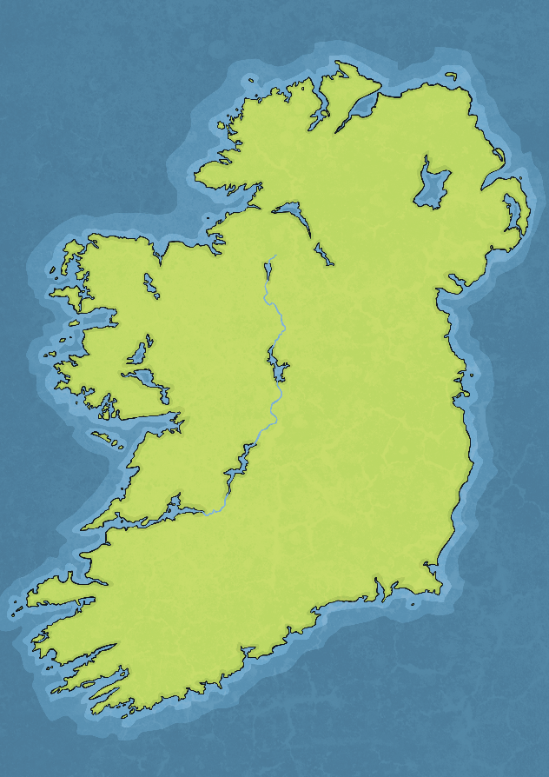
Women’s Christmas
During Epiphany in Ireland, Nollaig na mBan (pronounced null ug na mon) is celebrated. Meaning women’s Christmas, it celebrates how hard many women work during Christmas. This custom gave women a chance to relax after all the cooking and cleaning during the celebrations. On Nollaig na mBan, women meet at a friend’s house and eat fruit cake or enjoy a meal together in a restaurant.
Sometimes, Nollaig na mBan is called little Christmas. In Ireland, (as in many other countries) Christmas decorations are taken down at Epiphany.

Slide 11
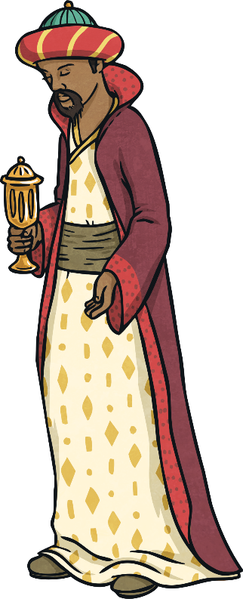
Talk About It
What have you learnt about Epiphany?
Have you ever celebrated Epiphany or do you know someone who has?
Which of the celebrations from around the world would you like to experience and why?
Did You Know…?
The word ‘epiphany’ is used to describe a moment when someone has a realisation or a great idea.

