Slide 1
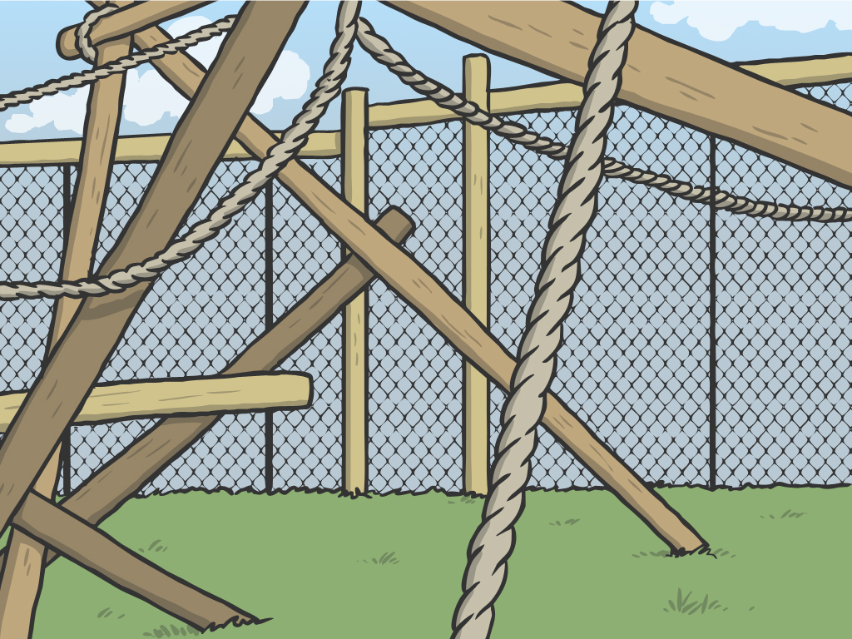
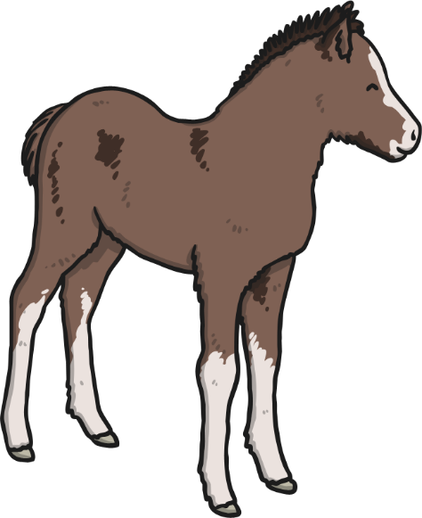
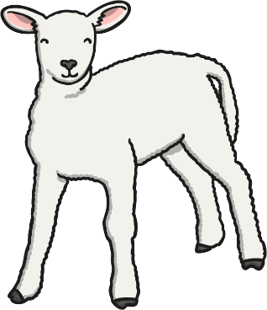
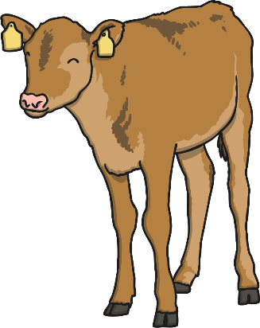
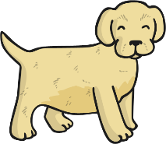
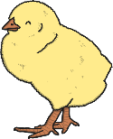
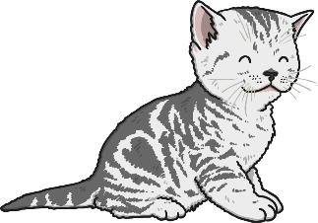
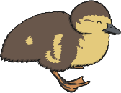

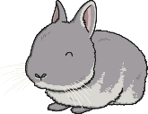
Animal Babies

Slide 2
Yr2 LO: To identify and classify by matching animals with their babies.
P | I can | CT
 | Must: name a range of animal babies.
 | Should: understand which animals produce which babies.
 | Could: compare different animal babies based on their mother classification.

Slide 3
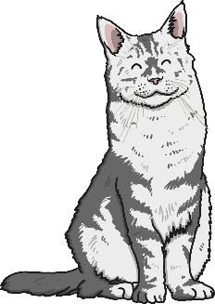
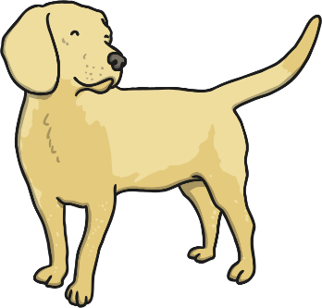




Animal Babies
All living things can reproduce. This is when a living thing, makes a new living thing (of the same kind).
Plants reproduce by bearing seeds that grow into new plants. Humans and other animals reproduce by having babies.
Some animal babies look just like their grownups but smaller. Some animal babies look very different!
We are going to learn about some different kinds of animal babies, and how they change as they grow.

Slide 4

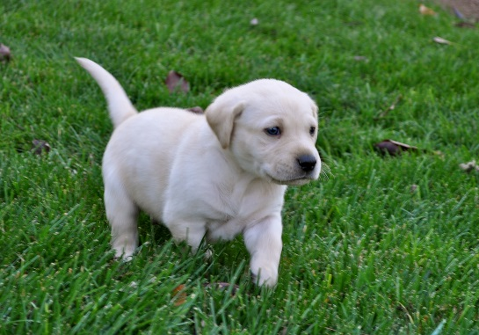
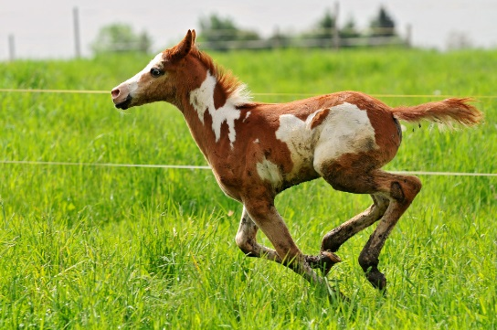
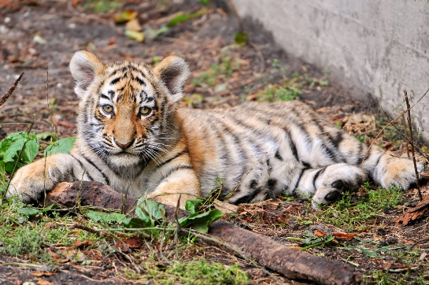
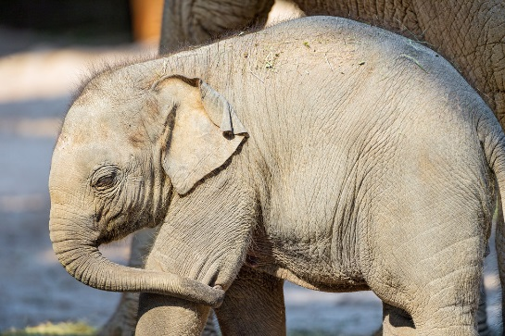
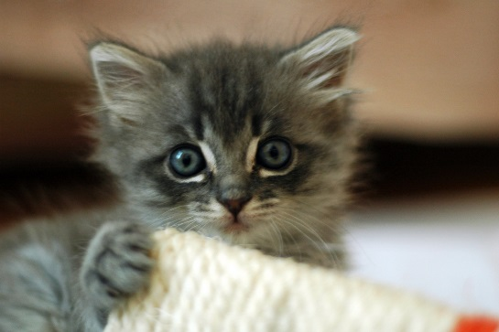
Animal Babies
These animal babies are mammals.
Do you know what these baby mammals are called?
Photo courtesy of Lisa L Wiedmeier, nicsuzor, Tambako the Jaguar @flickr.com) - granted under creative commons licence – attribution

Slide 5

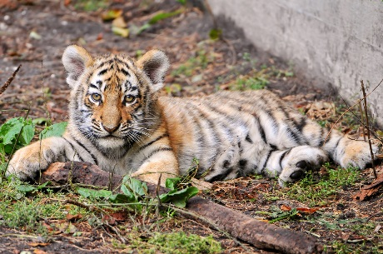
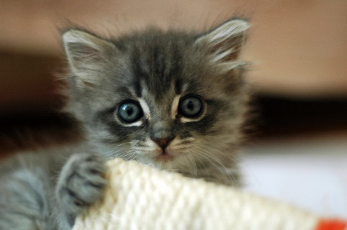

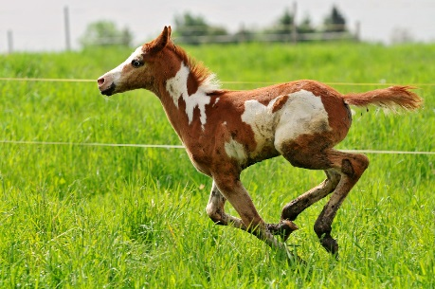
Animal Babies
Baby mammals have lots of different names.
A puppy is
a baby dog.
A baby tiger is called a cub.
A kitten is
a baby cat.
A baby elephant is called a calf.
A foal is a baby horse.
Photo courtesy of Lisa L Wiedmeier, nicsuzor, Tambako the Jaguar @flickr.com) - granted under creative commons licence – attribution

Slide 6
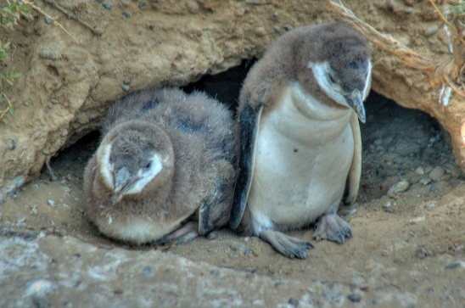
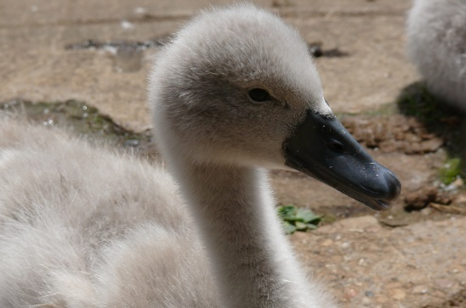
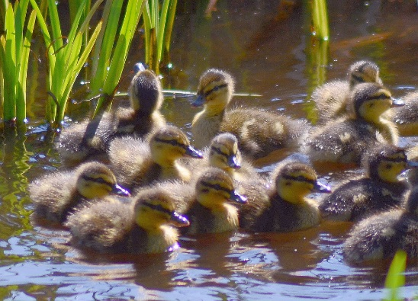
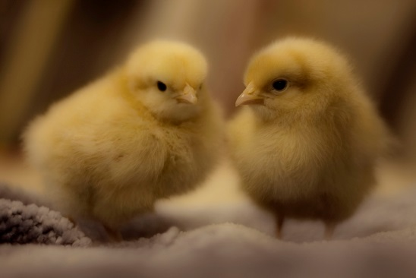
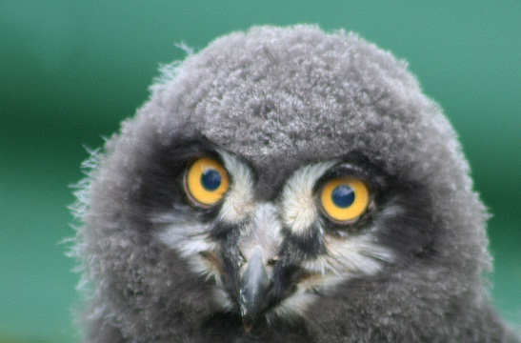
Animal Babies
These animal are baby birds. Do you know what these baby birds are called?
Which kinds of birds will these babies grow up to be?
Photo courtesy of *Jer*, generalising, Kevin Cortopassi, MICOLO J, Stevie-B, Tim Green ala atoach (@flickr.com) - granted under creative commons licence – attribution

Slide 7




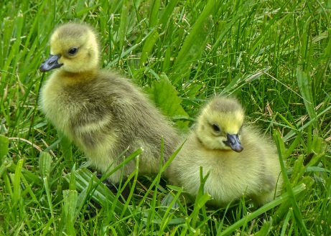
Animal Babies
Many birds are called chicks.
Baby ducks are called ducklings.
These chicks
will grow up
to be chickens.
A baby owl
is an owlet.
These are penguin chicks.
A baby goose is a gosling.
Photo courtesy of *Jer*, generalising, Kevin Cortopassi, MICOLO J, Tim Green aka atoach, Stevie-B (@flickr.com) - granted under creative commons licence – attribution

Slide 8
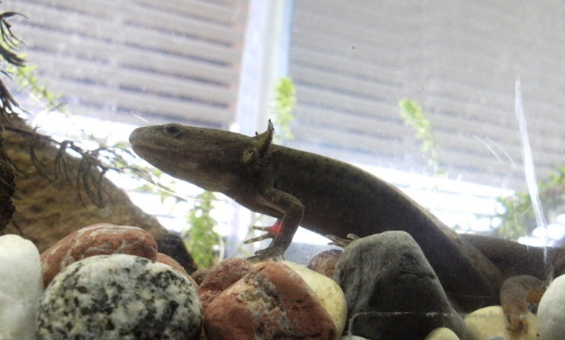
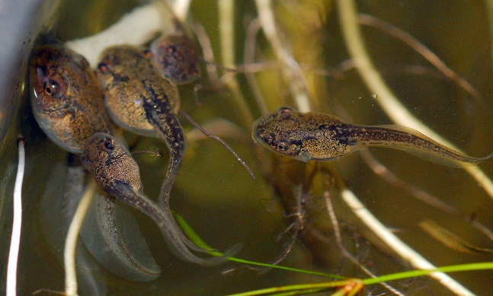
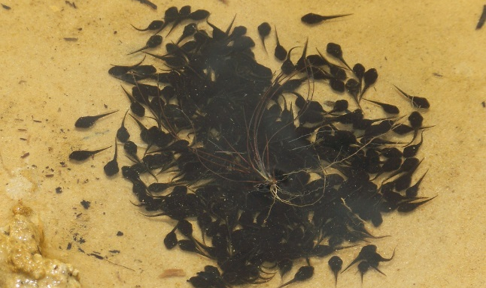
Animal Babies
These are baby amphibians. Do you know what they are called?
What do you think they will grow up to be?
Photo courtesy of trishhartmann, anyeye4wonder, born1945 (@flickr.com) - granted under creative commons licence – attribution

Slide 9
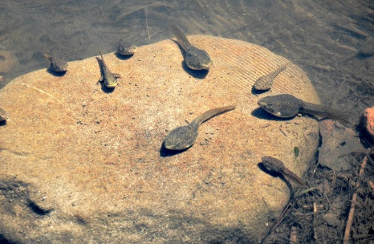
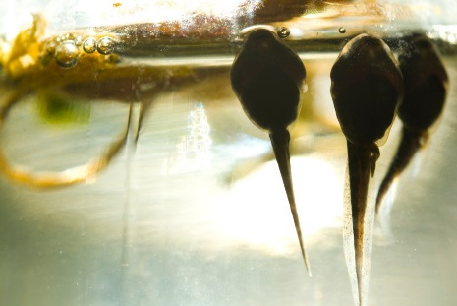
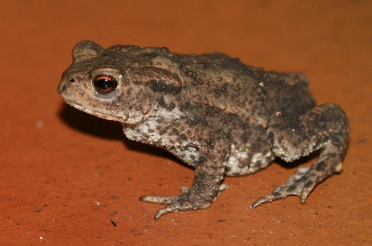
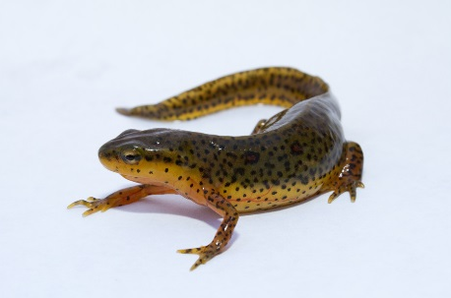
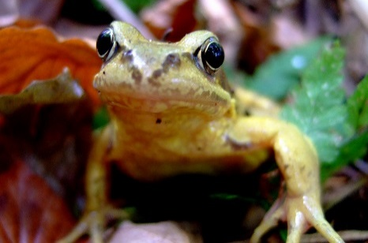
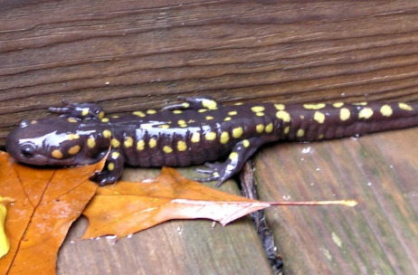
Animal Babies
Baby amphibians are called tadpoles. Most frogs, toads, newts and salamanders start their lives as tadpoles.
Tadpoles
Tadpoles
Toad
Newt
Frog
Salamander
Photo courtesy of normanack, brian.gratwicke, S. Rae, marfis75, oliver.dodd, marc falardeau (@flickr.com) - granted under creative commons licence – attribution

Slide 10
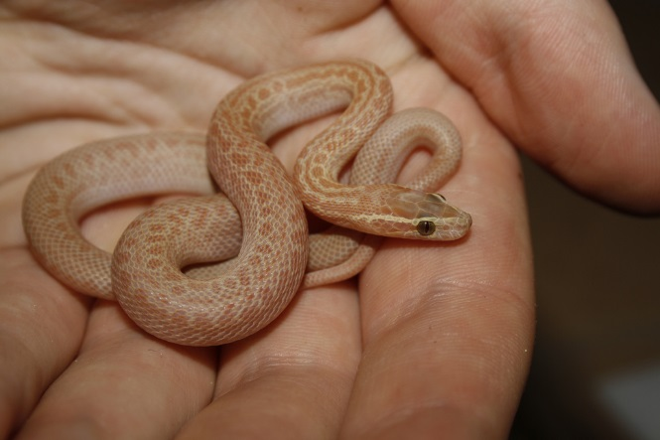
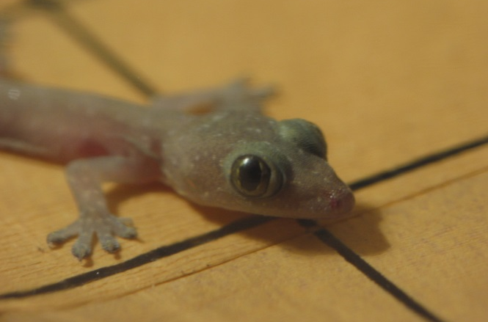
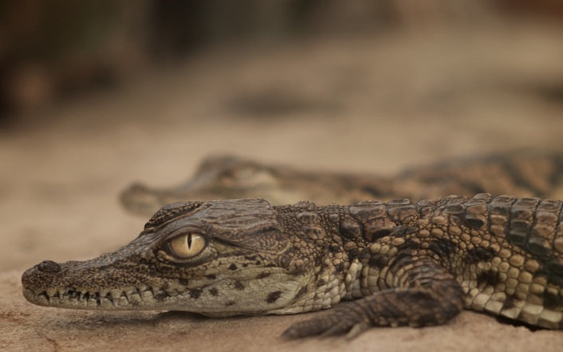
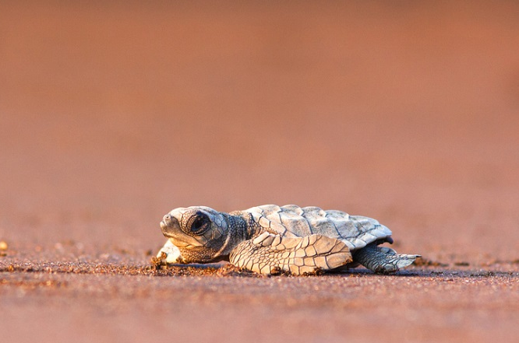
Animal Babies
These are baby reptiles. Do you know what they are called?
Photo courtesy of chadmiller, erikpaterson, _thinrhino, devstopfix (@flickr.com) - granted under creative commons licence – attribution

Slide 11


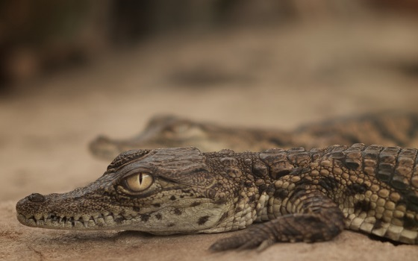

Animal Babies
Baby reptiles are called hatchlings.
This is a baby snake.
This is a
baby lizard.
This is a baby crocodile.
This is a
baby turtle.
Photo courtesy of chadmiller, erikpaterson, _thinrhino, devstopfix (@flickr.com) - granted under creative commons licence – attribution

Slide 12

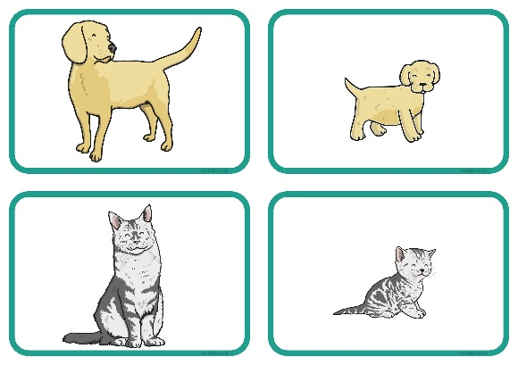
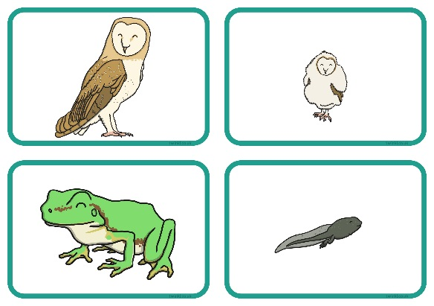
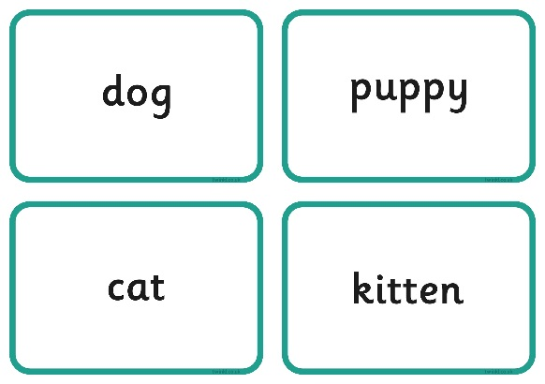
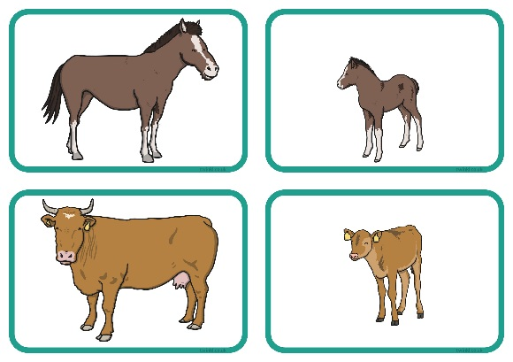
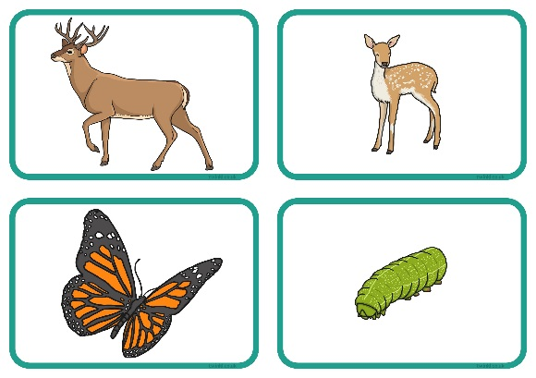
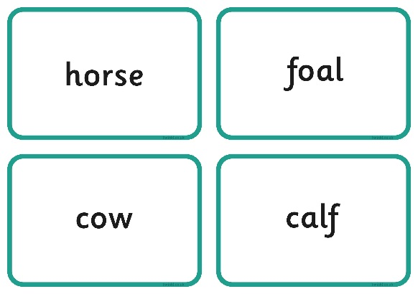
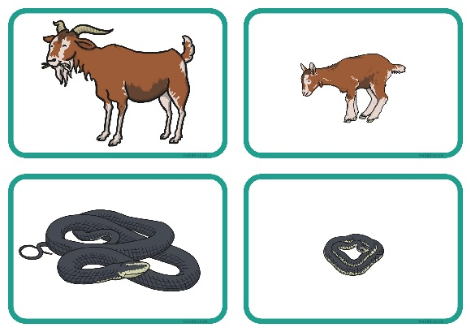
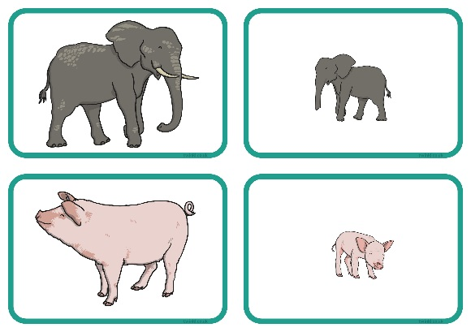
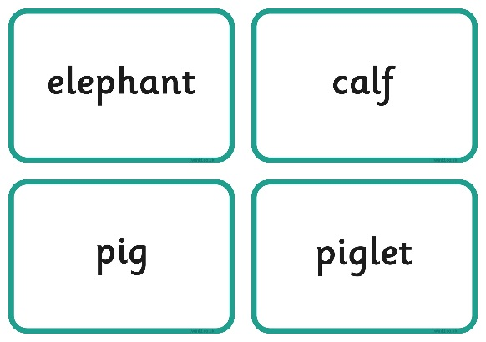
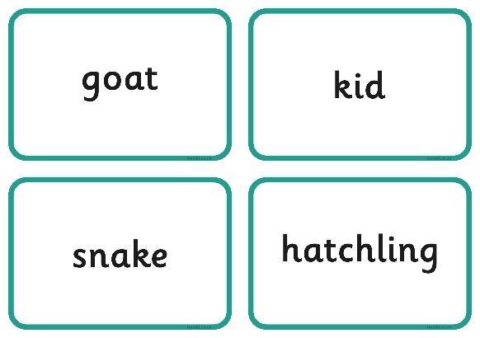
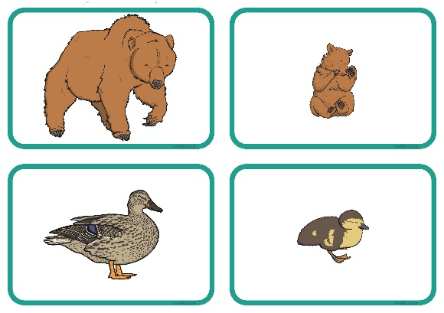









Animals and Their Young
Matching Activity
Work in a group to match the animal babies to their parents, then match the animals and their babies with their names.

