Slide 2
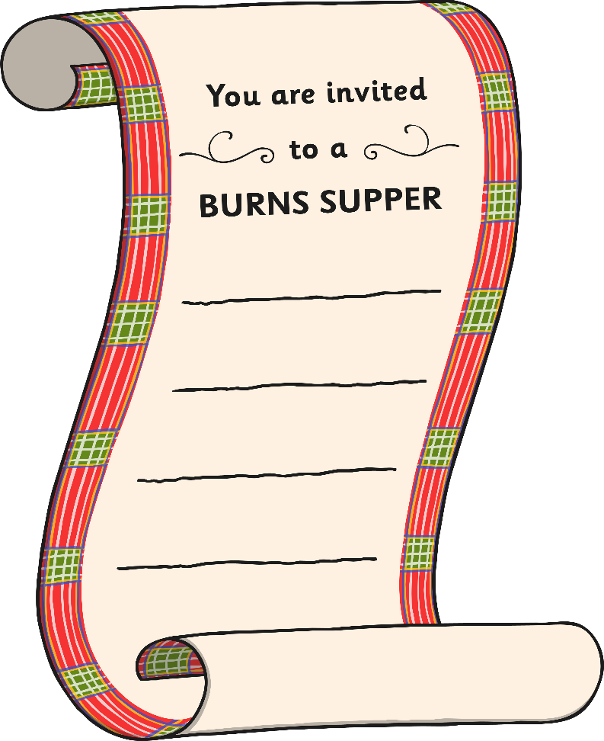
What Is Burns Night?
Burns Night is a celebration held in
Scotland on or around the 25th of January.
It celebrates the life and work
of a famous poet named Robert Burns.

Slide 3
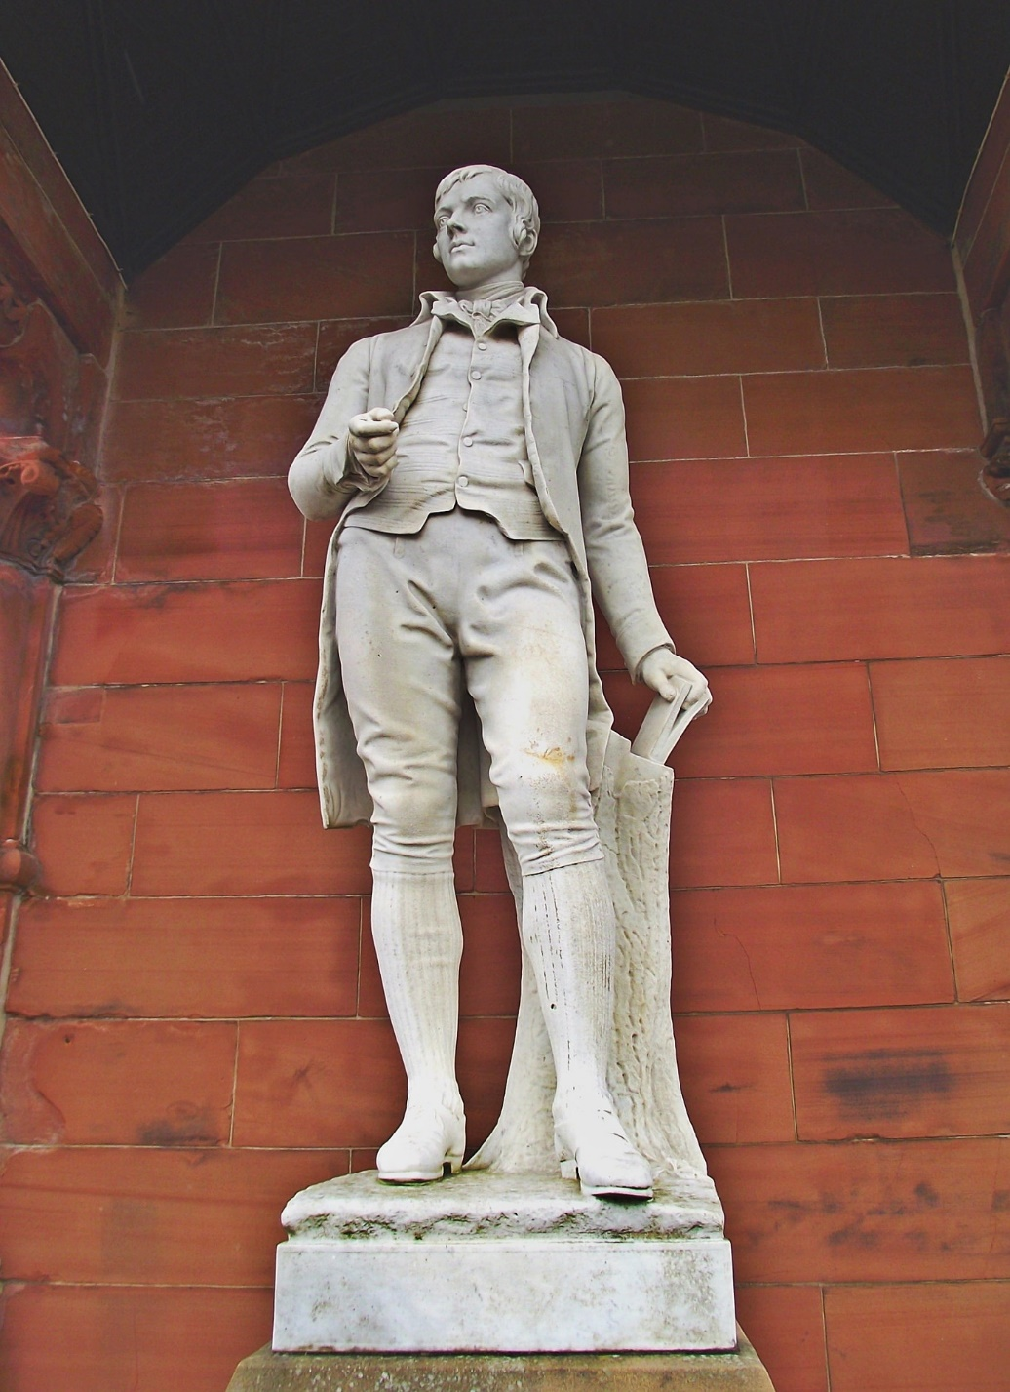
Robert Burns

Slide 4
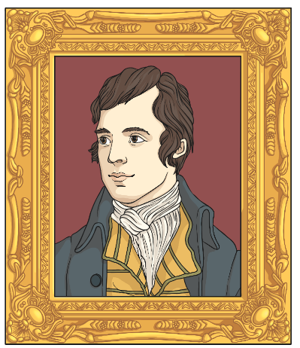
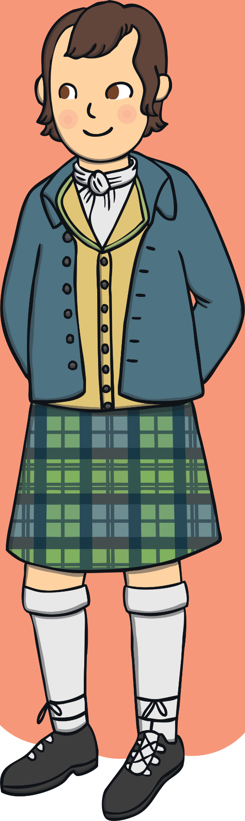
All About Robert Burns
Robert Burns was born
on the 25th of January 1759.
He was a poet and songwriter
and is famous around the world.
One of his most famous songs is
Auld Lang Syne, which is often sung
at New Year and Burns Night.

Slide 5
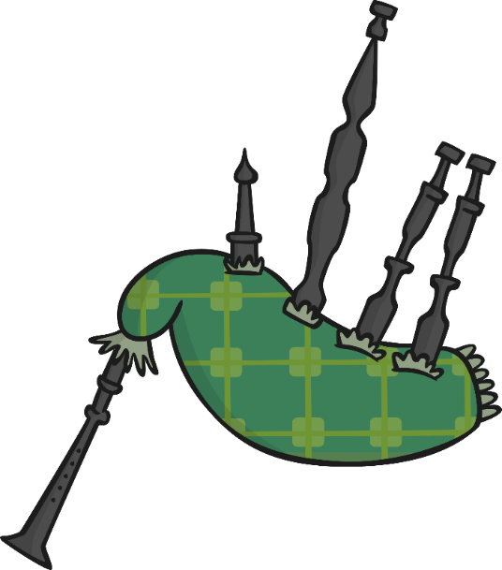
Burns Night
Bagpipes are often played during Burns Night celebrations. Bagpipes
are instruments that are played by blowing into reeds and squeezing
a bag of air.
Have you heard bagpipes before?
At a Burns Supper many people
wear clothes made of tartan,
including kilts.

Slide 6
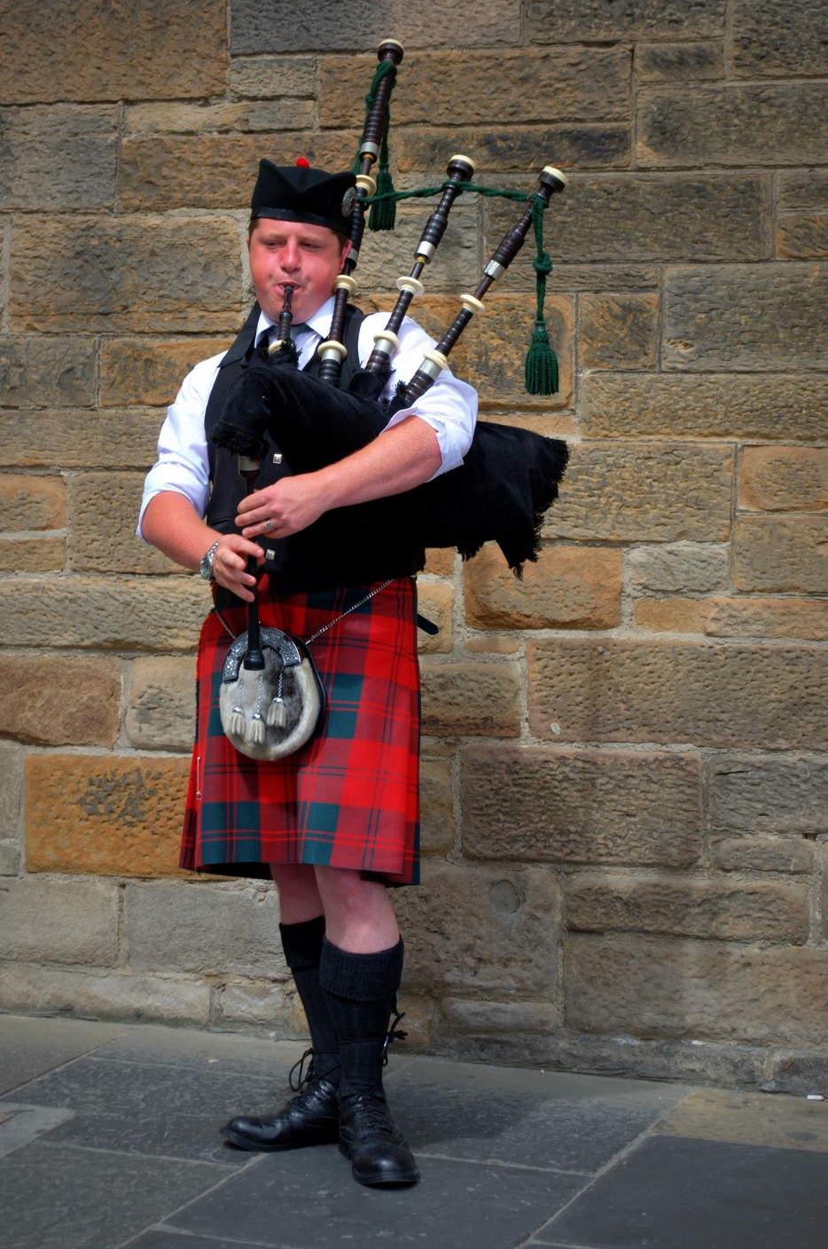
Piping in the haggis

Slide 7
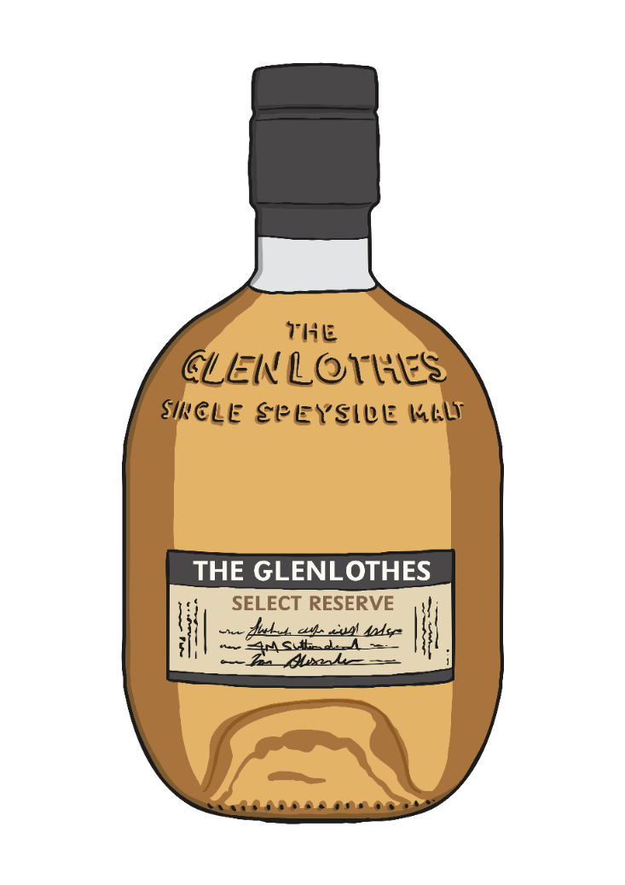
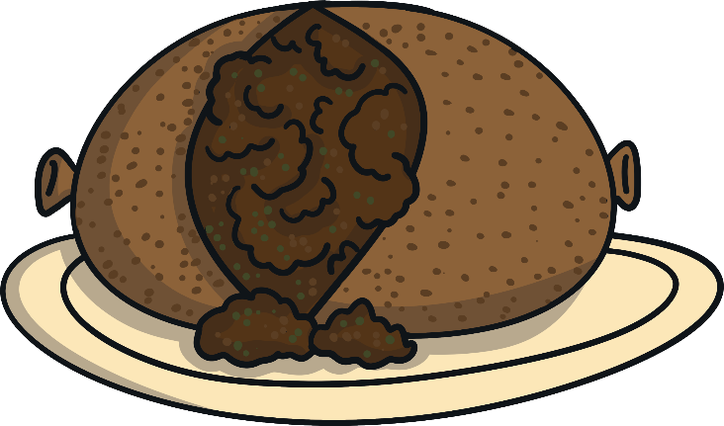
Burns Night
On Burns Night, many people have a
traditional dinner called a Burns Supper.
This usually includes eating haggis, which is a traditional Scottish food. It is often served with
neeps (turnip) and tatties (potatoes).
Poems written by Burns are often read aloud too.

Slide 8
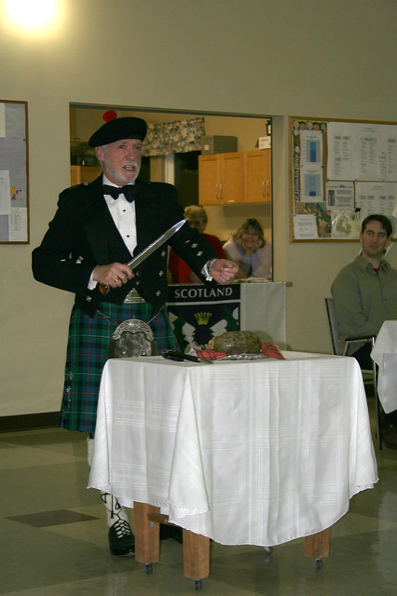
When the speaker says “His knife see rustic Labour dicht” the haggis is sliced open.
Address to the haggis
Photo courtesy of erikcharlton (@flickr.com) - granted under creative commons licence – attribution
Photo by Ian Mackenzie (CC BY 2.0)

Slide 9
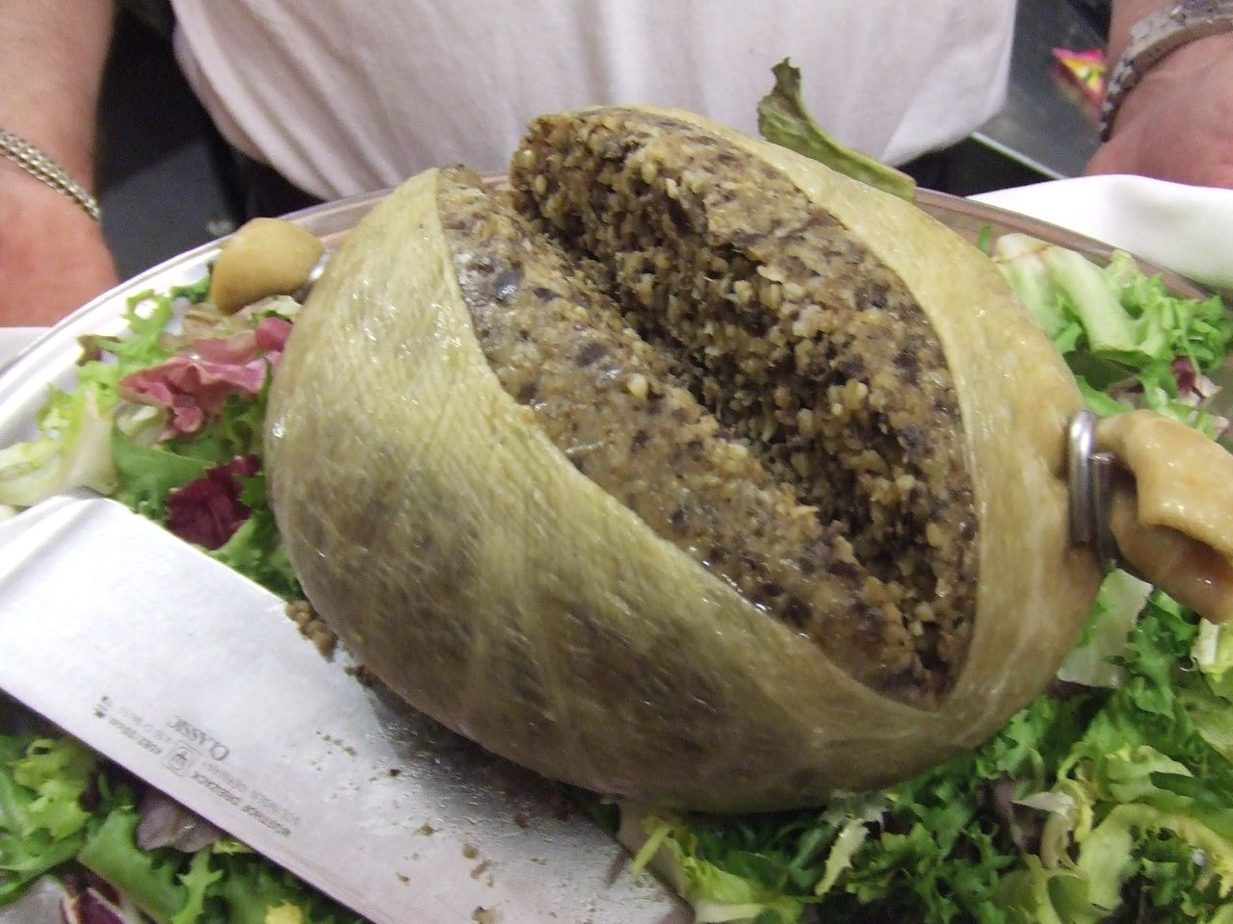
The cutting of the haggis
Photo by Tess Watson (CC BY 2.0)

Slide 10
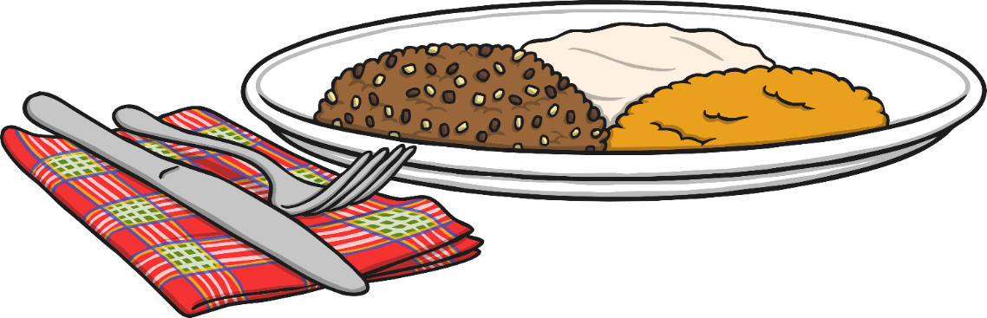
Burns Night
Before people start eating their Burns Supper, the Selkirk Grace
is often said:
Some hae meat and canna eat,
And some wad eat that want it;
But we hae meat, and we can eat,
And sae let the Lord be thankit.

Slide 11
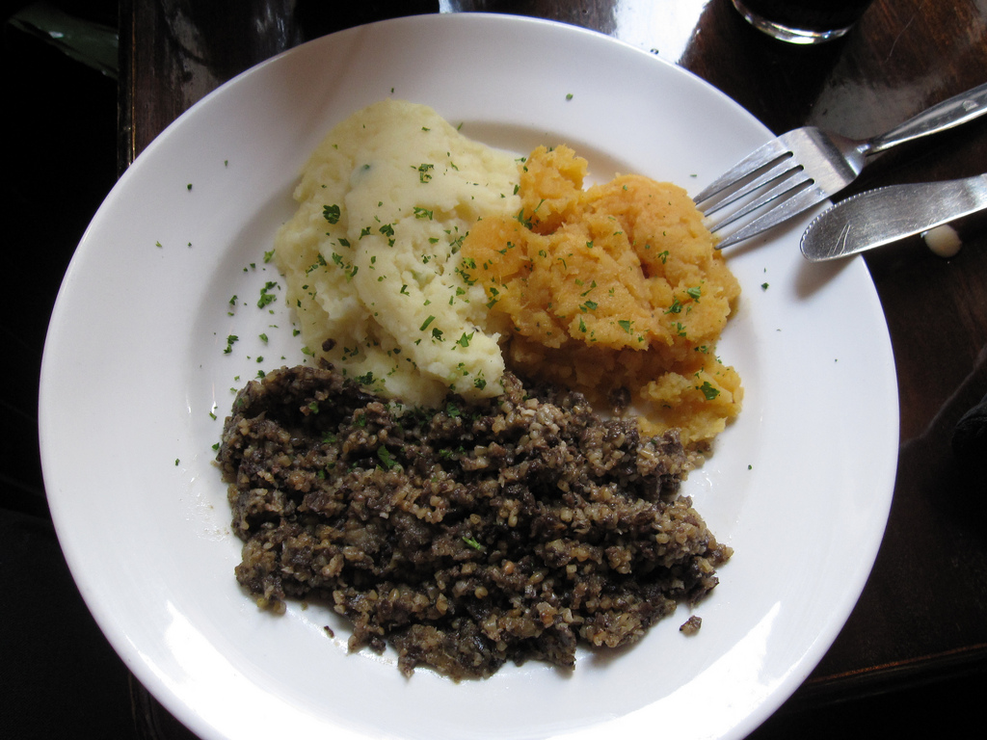
Haggis, Neeps and Tatties
Photo by Bernt Rostad (CC BY 2.0)

Slide 12
A National Figure
Robert Burns is still very famous today. He has been voted ‘The Greatest Scot’ by the Scottish Public in a survey held by a national Scottish television channel, STV.
There is also a Robert Burns Museum in Alloway which is in the place where he was born.

Slide 13
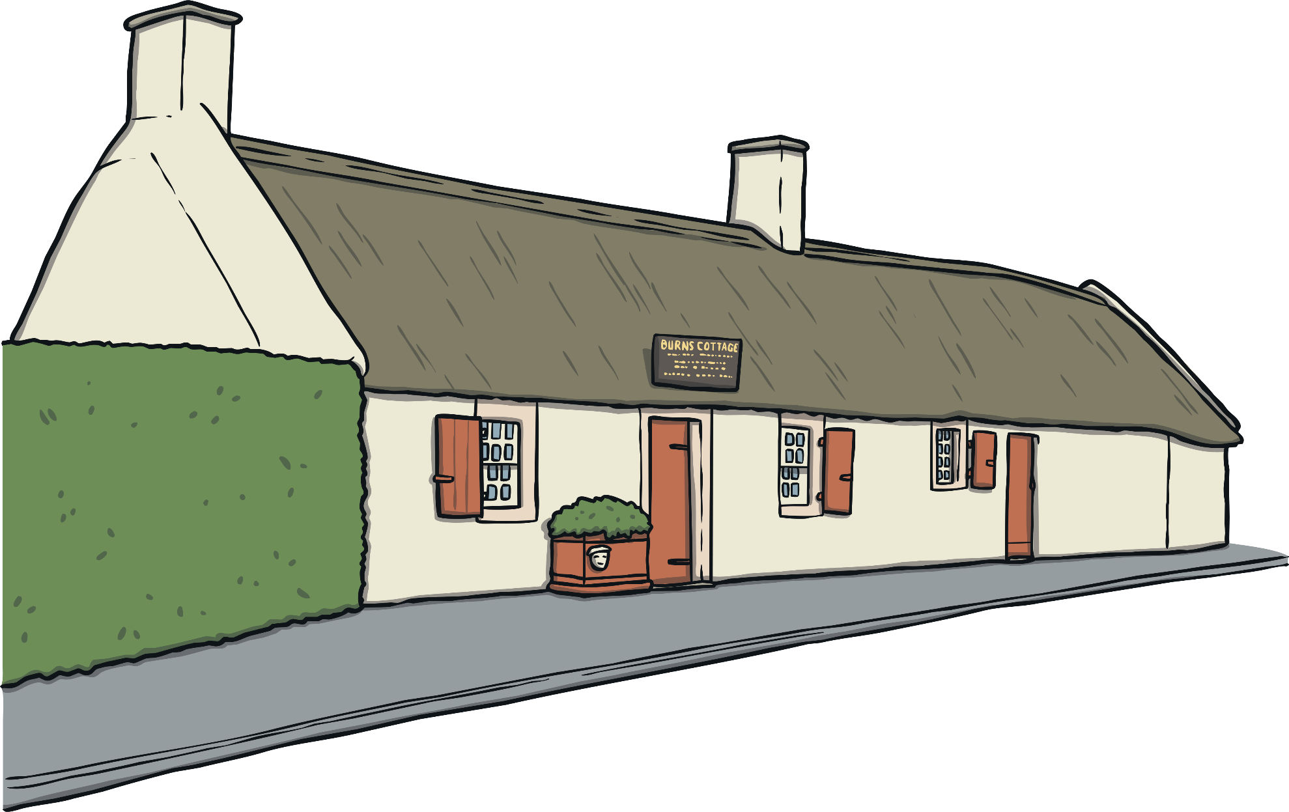
Burns Cottage in Alloway

