Slide 1
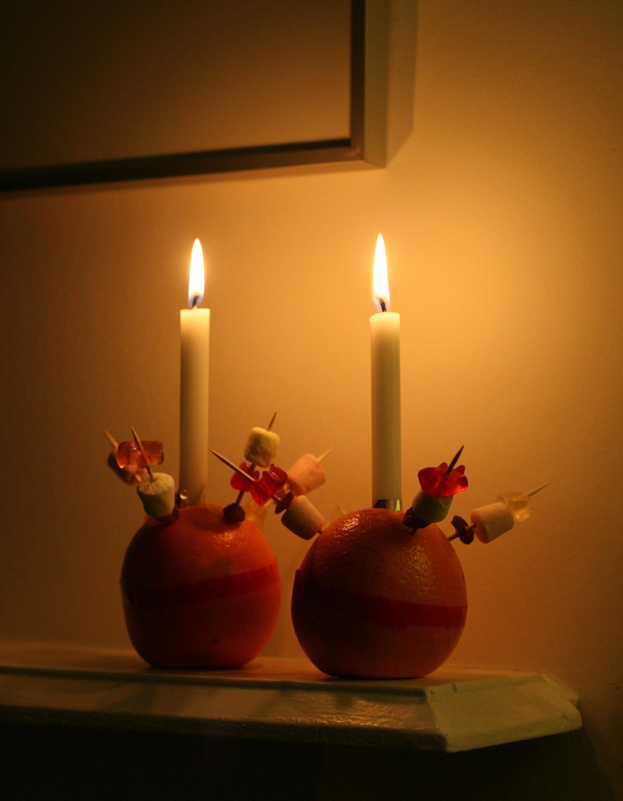
Christingles

Slide 3
What Is a Christingle?
A Christingle is made from an orange, red ribbon, four small sticks, dried fruits or sweets and a lit candle.
Christingle means ‘Christ’s Light’.
Christingles are used by Christians to celebrate Jesus as the Light of the World.
Christingles are usually used during church services and school assemblies during Advent.
Photo courtesy of (rachelandrew@flickr.com) - granted under creative commons licence - attribution

Slide 4
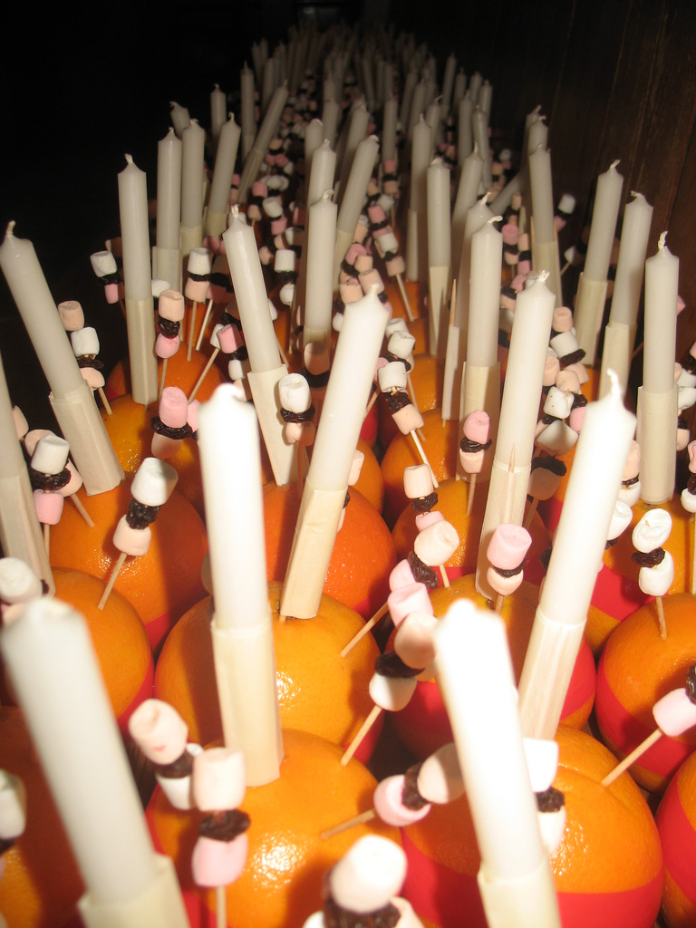
History of Christingles
Christingles date back to 1747, when a minister in a church in Germany gave children a lighted candle with a red ribbon around it.
It wasn’t until 1968 that Christingles were introduced into Anglican churches in England.
The first Christingle service, in 1968, raised money for the Children’s Society charity.
Photo courtesy of (Adrian Wallett@flickr.com) - granted under creative commons licence - attribution

Slide 5
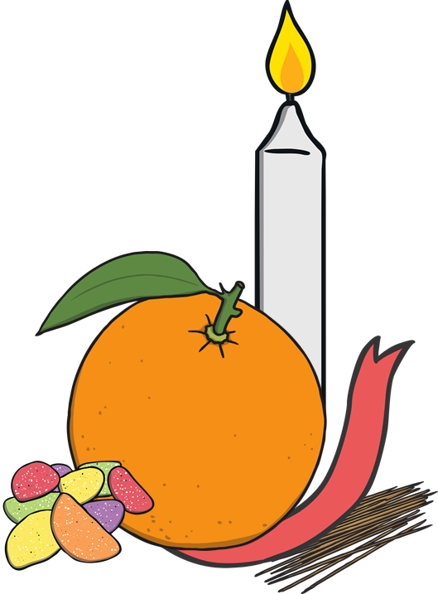
A Christingle
In 1968, the Children’s Society charity used the idea of the Christingle and made their own version.
You need:
4 cocktail sticks
an orange
a red ribbon
some sweets or dried fruit
a candle
You may need some help from an adult to make your Christingle.

Slide 6
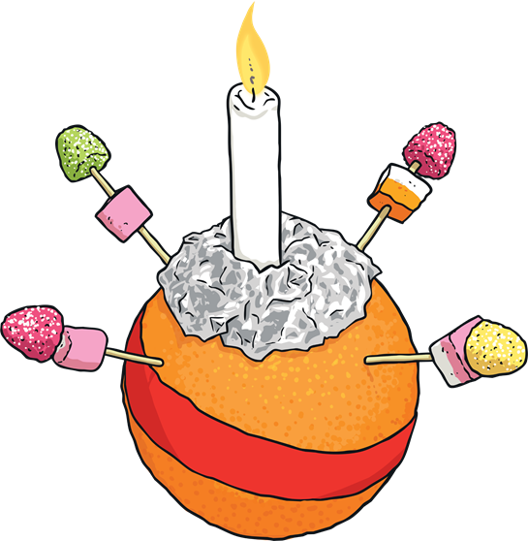
Making a Christingle
The red ribbon goes around the middle of the orange.
The sticks are pushed in around the edge of the orange.
The sweets are put onto the top of each of the cocktail sticks.
The candle is pushed into the top of the orange.

Slide 7
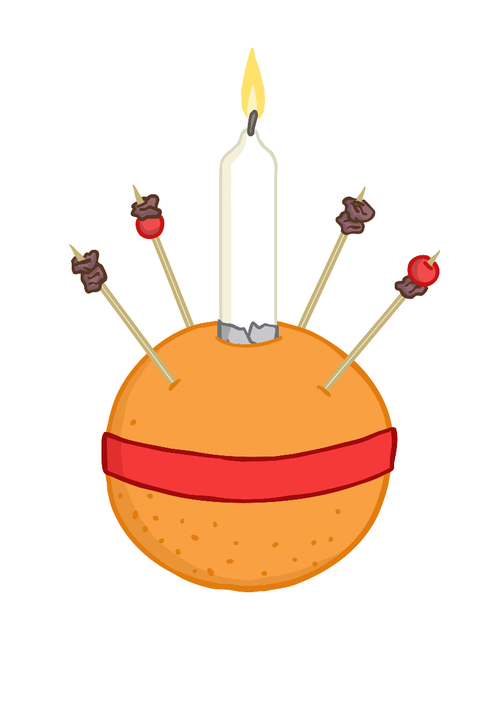
What Do the Parts of the Christingle Represent?
Each part of the Christingle has an important meaning.
The lit candle represents Jesus as the Light of the World.
The fruits or sweets skewered on sticks represent the fruits of the Earth.
The four sticks represent the four compass directions and the four seasons.
The red ribbon (or red paper frill) represents the blood of Jesus.
The orange represents the world.

Slide 8
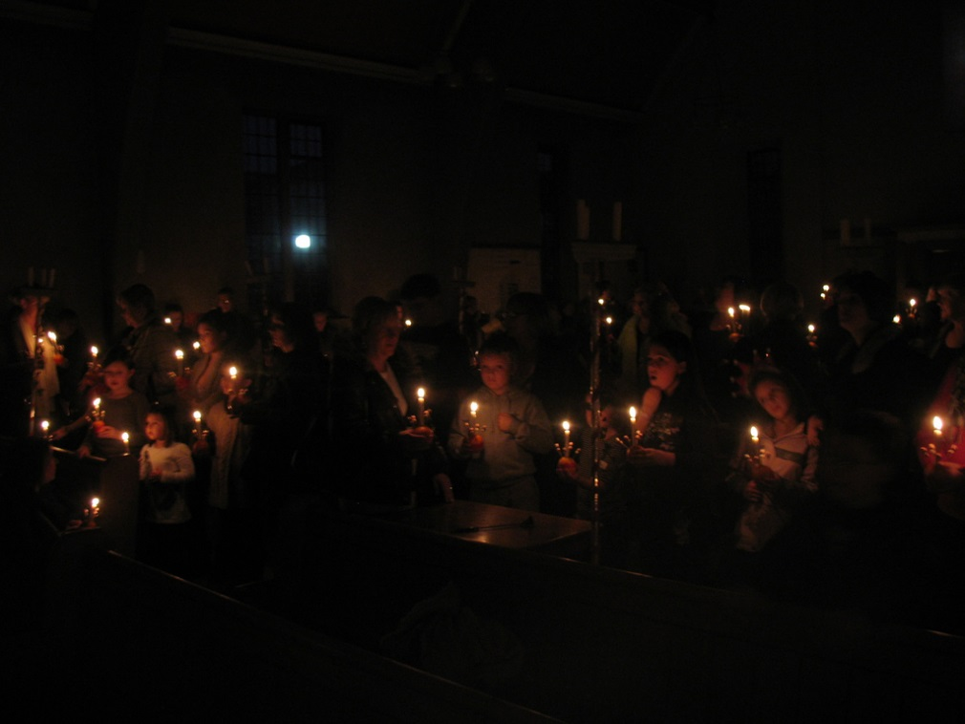
Christingle Services
Christingle services usually involve children and are held in many churches and schools during Advent.
Often the lights are turned off and the Christingles light up the room, reminding
Christians that Jesus is the Light of the World.
Christingle services also remind Christians that Christmas is a time to remember Jesus and celebrate his birth.
Traditionally, Christingle services are held in churches on the Sunday before Christmas or on Christmas Eve.
Photo courtesy of (Adrian Wallett@flickr.com) - granted under creative commons licence - attribution

Slide 9

Think about how you can bring light to other people who might be feeling sad or lonely.

Slide 10


