Slide 1
Techniques

Slide 2
LO: To apply colour using different techniques.
Must: name different techniques.
Should: Successfully use a variety of techniques to create colour.
Could: experiment creating own techniques to create colour.

Slide 3
Who can remember what skill we learnt last week?
What was our key word in our LO?
Notes:
Who can remember what skill we learnt last week? Creating tones
What was our key word in our LO? Experiment--- emphasis the fact this is there opportunity to practice and have a go, no such thing as it going wrong.

Slide 4
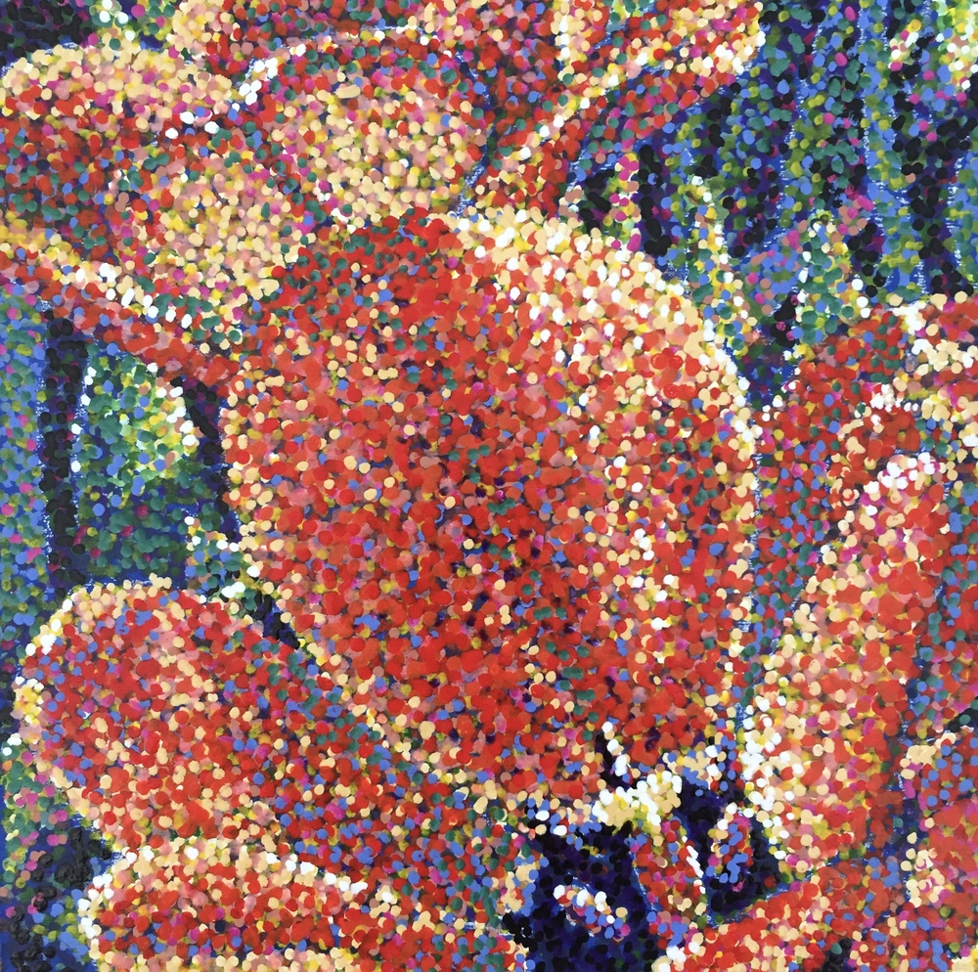
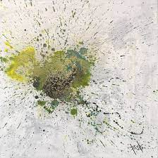
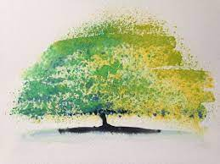
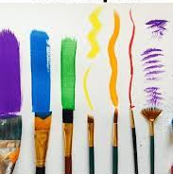



Slide 5
In todays lesson we are going to be experimenting different techniques.
Dotting with the end of a paintbrush.
Dotting with your finger.
Dotting with a pipette.
Dotting with a cotton bud.
Splashing by flicking the paintbrushes.
Splashing by shaking the paintbrushes.
Different brush strokes with different paint brushes.
Dabbing and pressing a sponge.
Notes:
Model a few to chd but allow them to go free with experimenting.
Encourage discussion about why you may choose different techniques for different effects. When would each technique be appropriate?

Slide 6
Task:
In your sketch book you are going to experiment using a variety of different techniques, to create different effects.
Using the techniques we have discussed today, experiment with different colours in you book.
Notes:
Model on piece of paper.
Explain to chd that your using ready colours, rather then mixing and creating colours as the focus is on the techniques. Chd to show in books a variety of different techniques.

