Slide 2
LO: To be able to know why dental hygiene is important and how it contributes to a healthy lifestyle.
P |  | CT
 | I know why it is important to look after my teeth.
 | I know some ways of looking after my teeth.
 | I know what could happen if I didn’t look after my teeth.

Slide 3

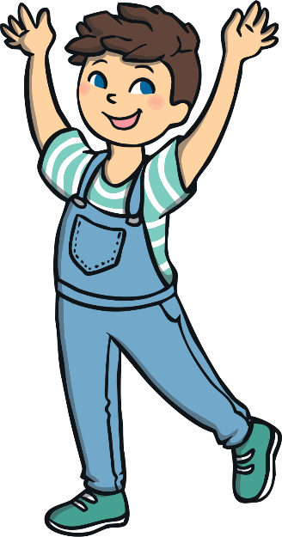
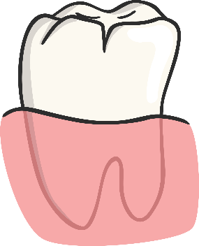
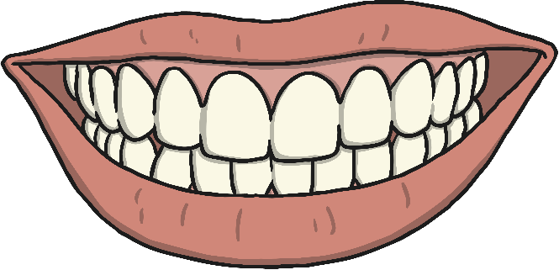
How Can We Keep Teeth Healthy?
We need to look after our teeth just like we look after the rest of our body.
Do you know how to keep your teeth healthy?
Let’s find
out more!

Slide 4
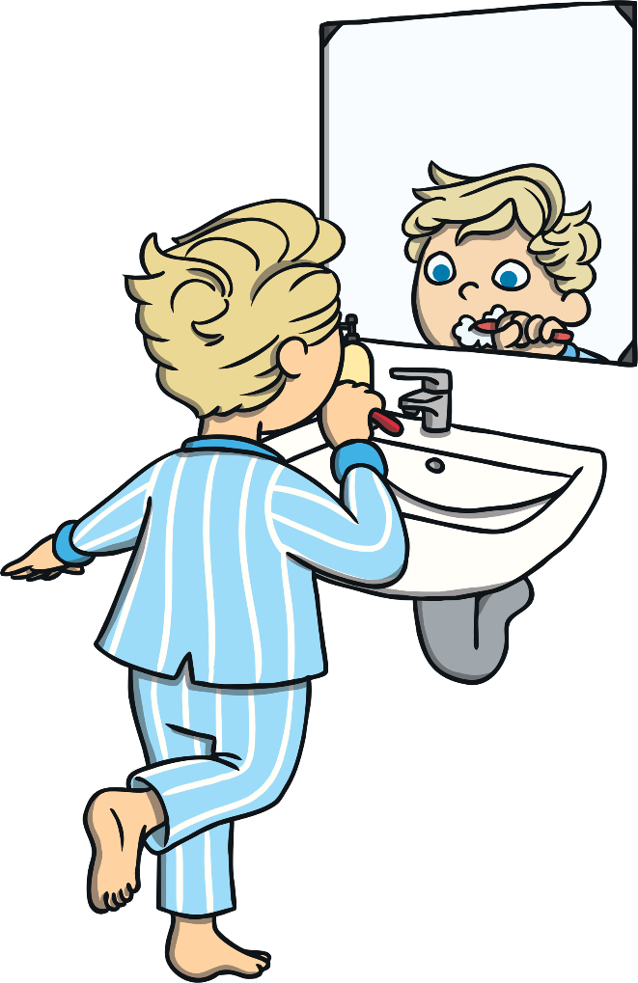

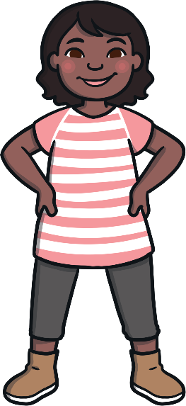


Brush Your Teeth
It is really important to brush your teeth at least twice a day.
Brushing your teeth gets rid of any food that is around your teeth.
It washes away any sugar and other things that can hurt your teeth.
Let’s find
out how.
Do you know how to brush your teeth properly?

Slide 5
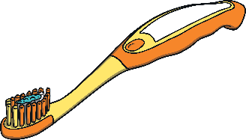
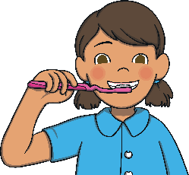
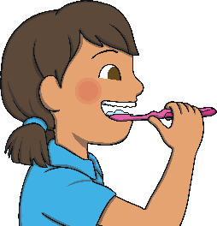
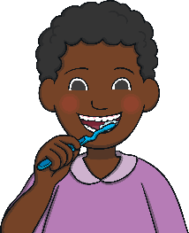
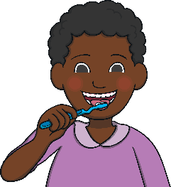
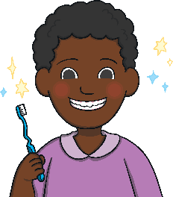
How to Brush Your Teeth
First, put a pea-sized amount of toothpaste on the toothbrush.
Next, brush the front of your teeth.
Then, gently brush the outside of your teeth and the back teeth.
Brush the insides and tops of all your teeth.
Then, gently brush your tongue.
Finally, spit out any toothpaste that is left and you are finished.

Slide 6

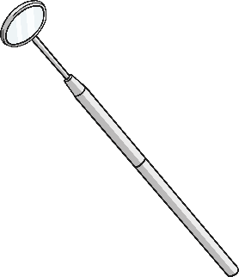
Visiting the Dentist
Even if you have been looking after your teeth, you should go to
the dentist regularly for a check-up.
Can you tell
a friend about a trip to the dentist?
This is what a dentist’s room might look like.
The dentist will look in your mouth and at your teeth to see if
there are any problems.
They might use special tools to help them, like this little mirror.
Then, if there are any problems, the dentist can help to fix them.

Slide 7



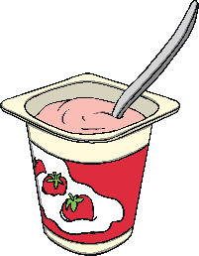
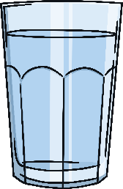
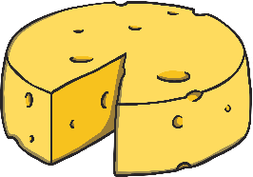
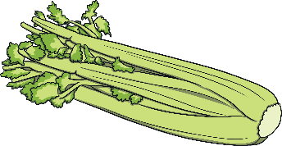
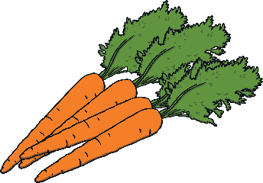
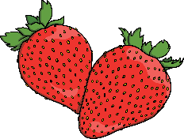

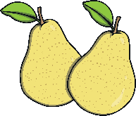

Food for Healthy Teeth
Having lots of sugar isn’t good for teeth as it can hurt them.
Some foods have lots of sugar in so we shouldn’t eat too much of them.
It doesn’t mean we can’t eat them at all, just not all the time.
Some foods are good for our teeth as they help to make them stronger.
Can you think of some foods that are good for your teeth?

Slide 8


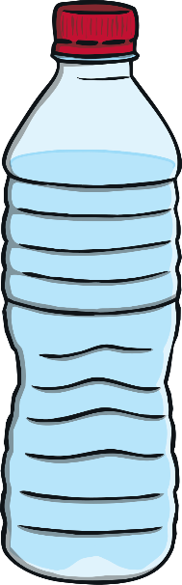
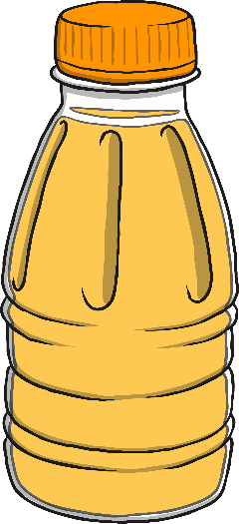
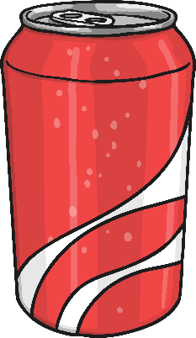

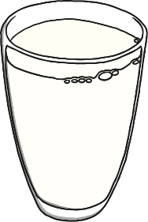
Drinks for Healthy Teeth
Some drinks have lots sugar in them too, even fruit juice.
It doesn’t mean we can’t drink them, just that we shouldn’t have
lots of it all the time.
The best drink for teeth is water.
Milk is also good as it helps to make teeth strong.
Which of these
drinks can I have
all the time?

Slide 9
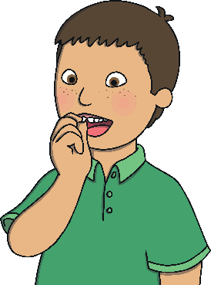
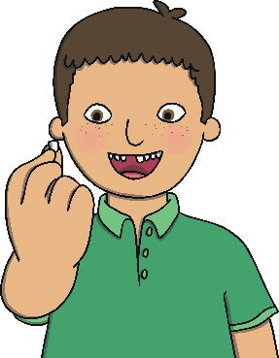
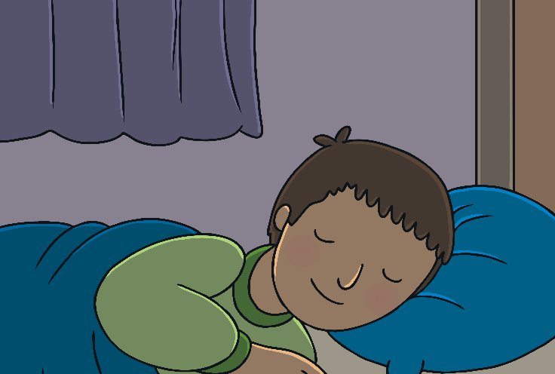
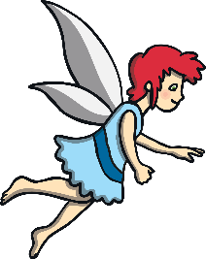
Wobbly Teeth
The teeth you have at the moment are called milk or baby teeth. As you start to get older, you need bigger teeth and your milk teeth start to fall out. Don’t worry, it doesn’t hurt – it is meant to happen and it doesn’t mean there is anything wrong with your teeth.
You might notice a tooth start to get
a bit wobbly. Then, after a few days,
it will fall out. They usually only
fall out one at a time.
In some families, children may leave their tooth under their pillow or on their bedside table for a tooth fairy.

Slide 10


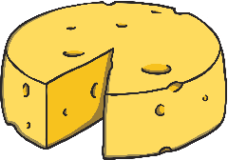


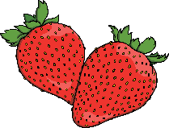






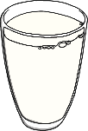
What Have You Learnt?
Can you remember all the different ways you can help
to keep your teeth healthy?
Eat foods that help to make your teeth strong.
Brush your teeth twice a day.
Drink water or milk.
Visit the dentist.

