Slide 1


Science
States of Matter
Year One
Science | Year 4 | States of Matter | Evaporation Investigation | Lesson 5

Slide 3
Aim
I can investigate how water evaporates.
Success Criteria
I can explain the effect of temperature on the process of evaporation.
I can plan and carry out a comparative test using equipment accurately and display my results.

Slide 4

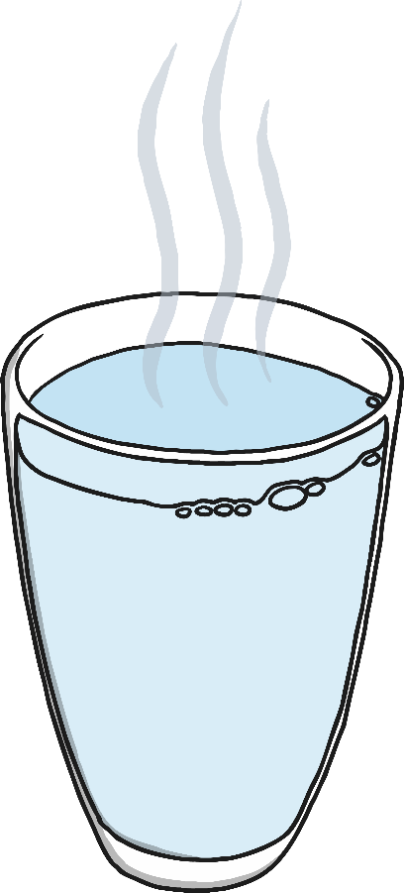
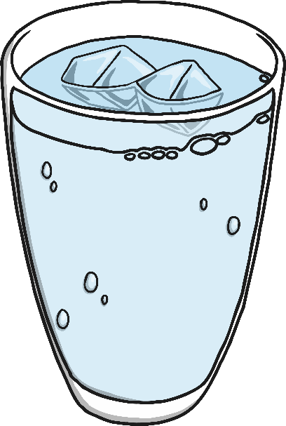
How Do Wet Clothes Dry?
Evaporation is the process of a liquid changing into a gas.
When clothes dry on the washing line, it is evaporation that causes the liquid on the wet clothes to turn into gas, leaving the clothes dry.
But how is the water evaporated from the wet clothes? Around the room are some children's ideas about what makes this happen. Have a look at each statement, think about whether you agree or disagree with it, and write your ideas around it.

Slide 5
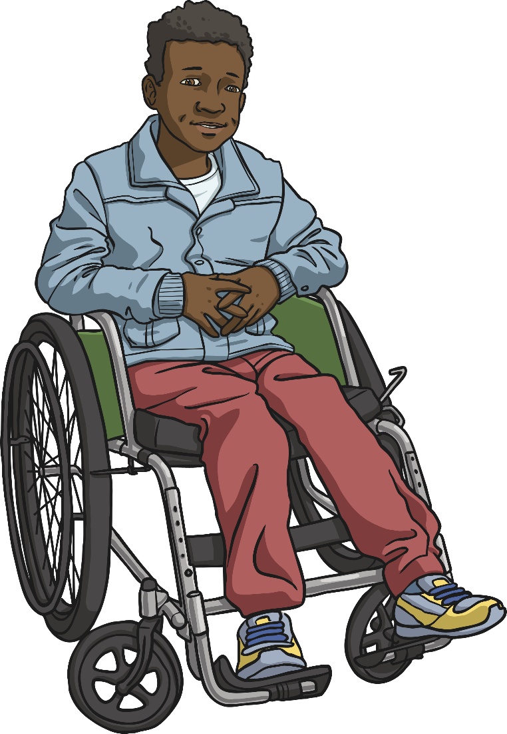
How Do Wet Clothes Dry?
This boy has the answer!
The particles in a liquid have energy and are moving around each other quite fast. Some of the particles move so quickly that they turn into a gas and move away from the liquid.
This happens quickly if the liquid is boiling, but when clothes are drying it is not that hot so I think it just happens slower. Eventually all the particles will have changed into a gas and the clothes will be dry!

Slide 6
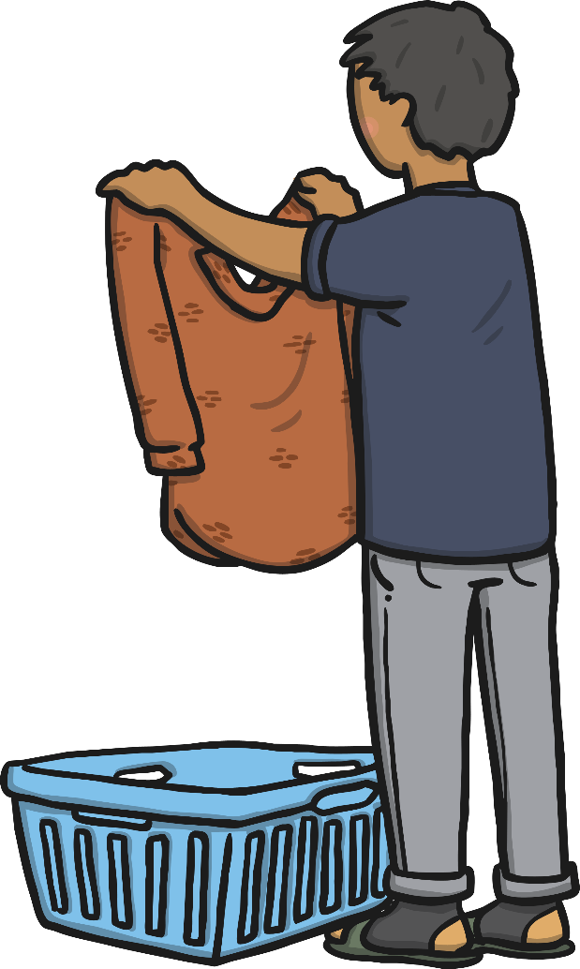
How Do Wet Clothes Dry?
When clothes are hung on a washing line to dry, they are
exposedto heat. They are not boiling, but there is some heat.
The particles in the liquid water are moving around
and over each other, and some particles move
faster than others.
These particles move so fast that they change state,
turning into water vapour. The particles of water
vapour move away from the clothes, spreading
out into the air. The particles don't turn into air!
Eventually, if the clothes are left on the washing line for long
enough, all the particles of liquid water will change
state into gaseous water vapour. The water will
have evaporated and the clothes will be dry.

Slide 7

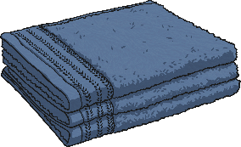
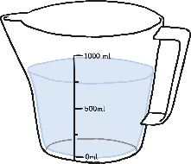
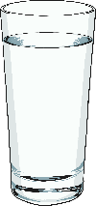
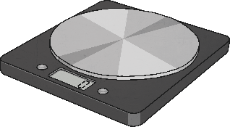
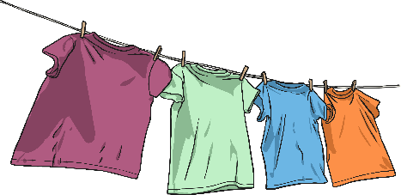

Does the Temperature
Affect How Fast Towels Dry?
You are going to work in a group to plan and set up
an investigation to find the answer to this question.
You will have access to the following equipment:
water
three tea towels
measuring jug
a clock
thermometer
scales
washing lines

Slide 8
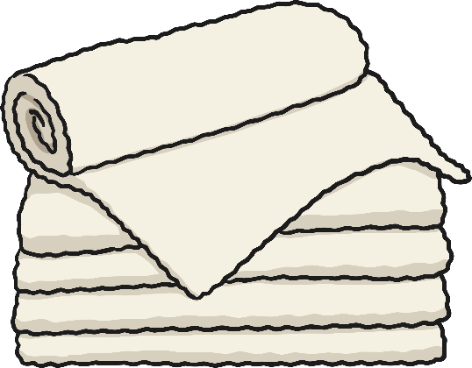
Does the Temperature
Affect How Fast Towels Dry?
You will need to decide how to use the equipment
to answer this question.
You will also make a prediction about what you think the answer will be.
You must think about how you will make sure each towel is equally wet at the start of the investigation. If one towel is completely wet through but another is just damp then you won't get reliable results!
You should also think carefully about how you will be able to tell how dry the tea towels are after they have been hung up on the washing lines for some time. Will you feel them, observe them, measure their temperature, find their weight, or something else?

Slide 9
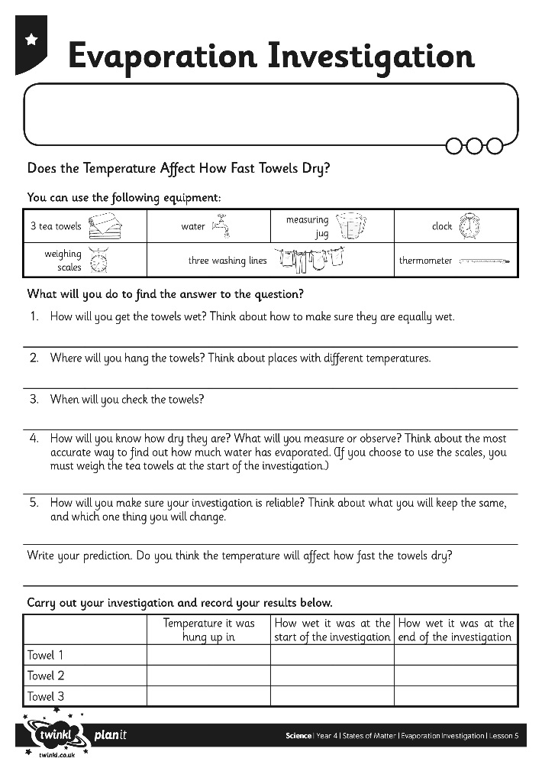
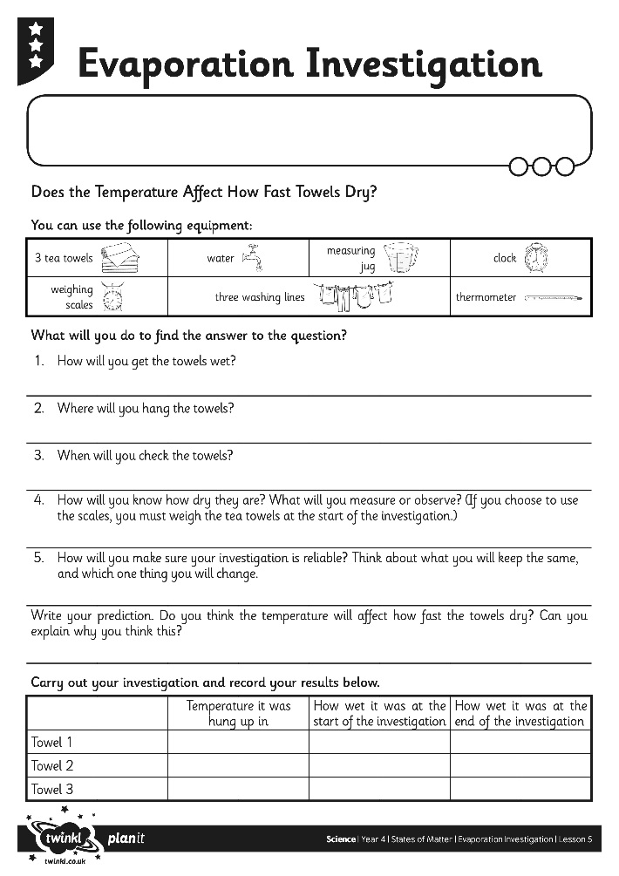
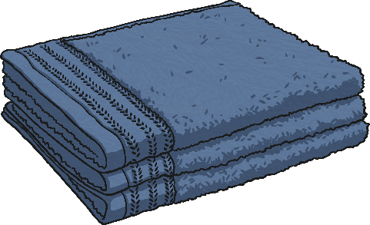
Does the Temperature
Affect How Fast Towels Dry?
Plan your investigation on your Evaporation Investigation Activity Sheet.

Slide 10

Finding the Answer
When you are ready, carry out the investigation!
Record your results on the table on your Evaporation Investigation Activity Sheet.

Slide 11
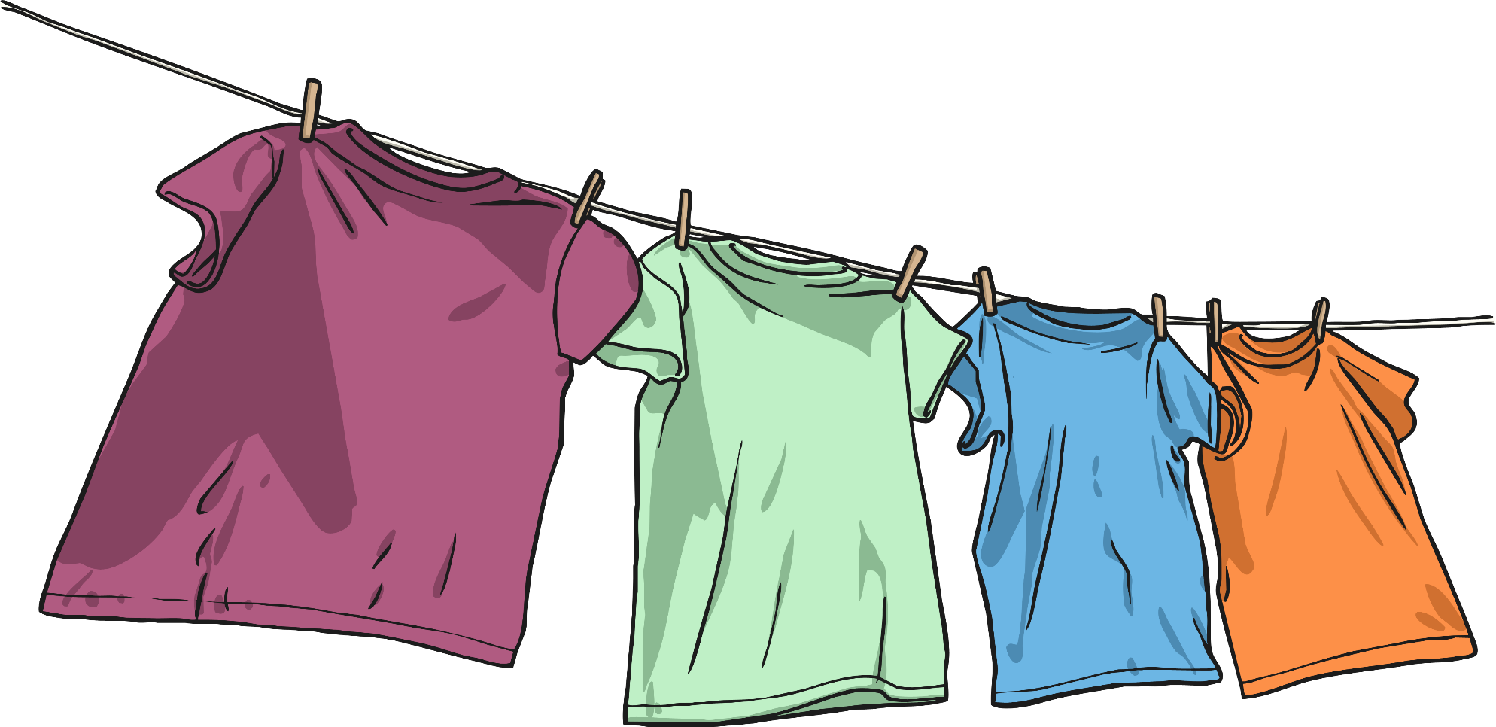
Sharing Ideas and Evaluating
Display your results and conclusions so that others can see them.
Have a look at other children’s results and conclusions.
Have your classmates found out whether temperature affects how fast towels dry? Do they agree with you?

Slide 12
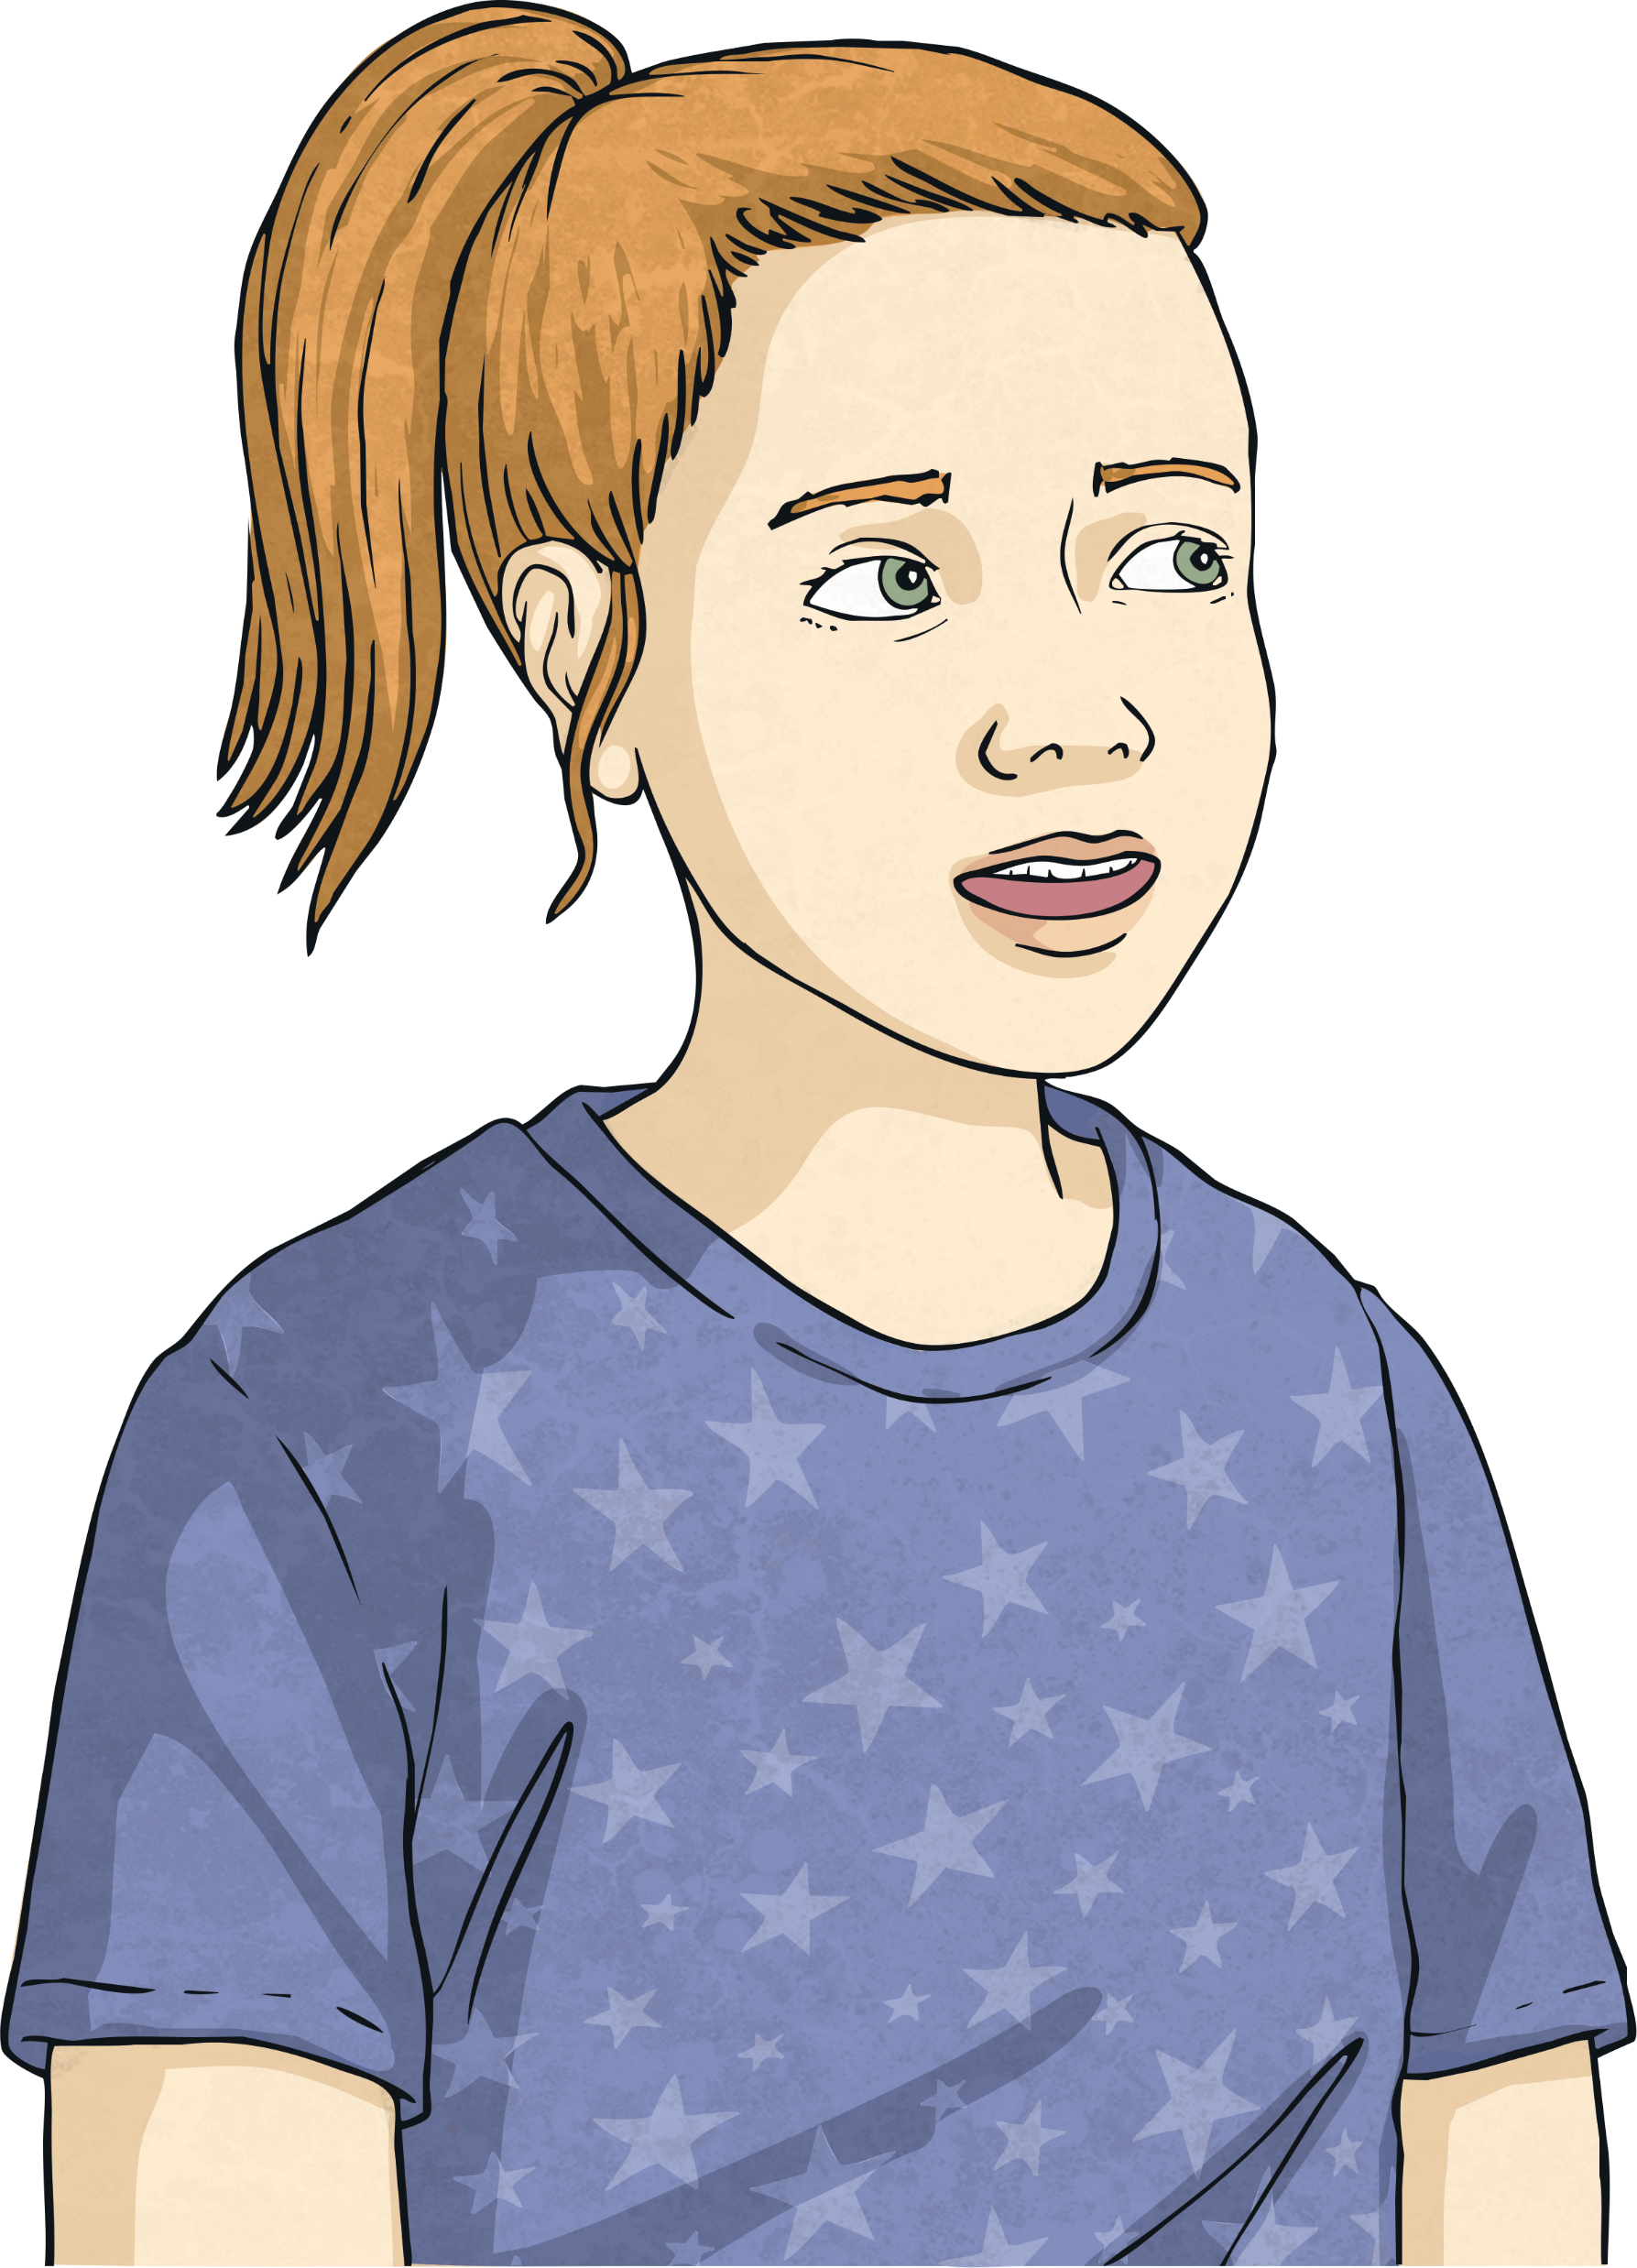
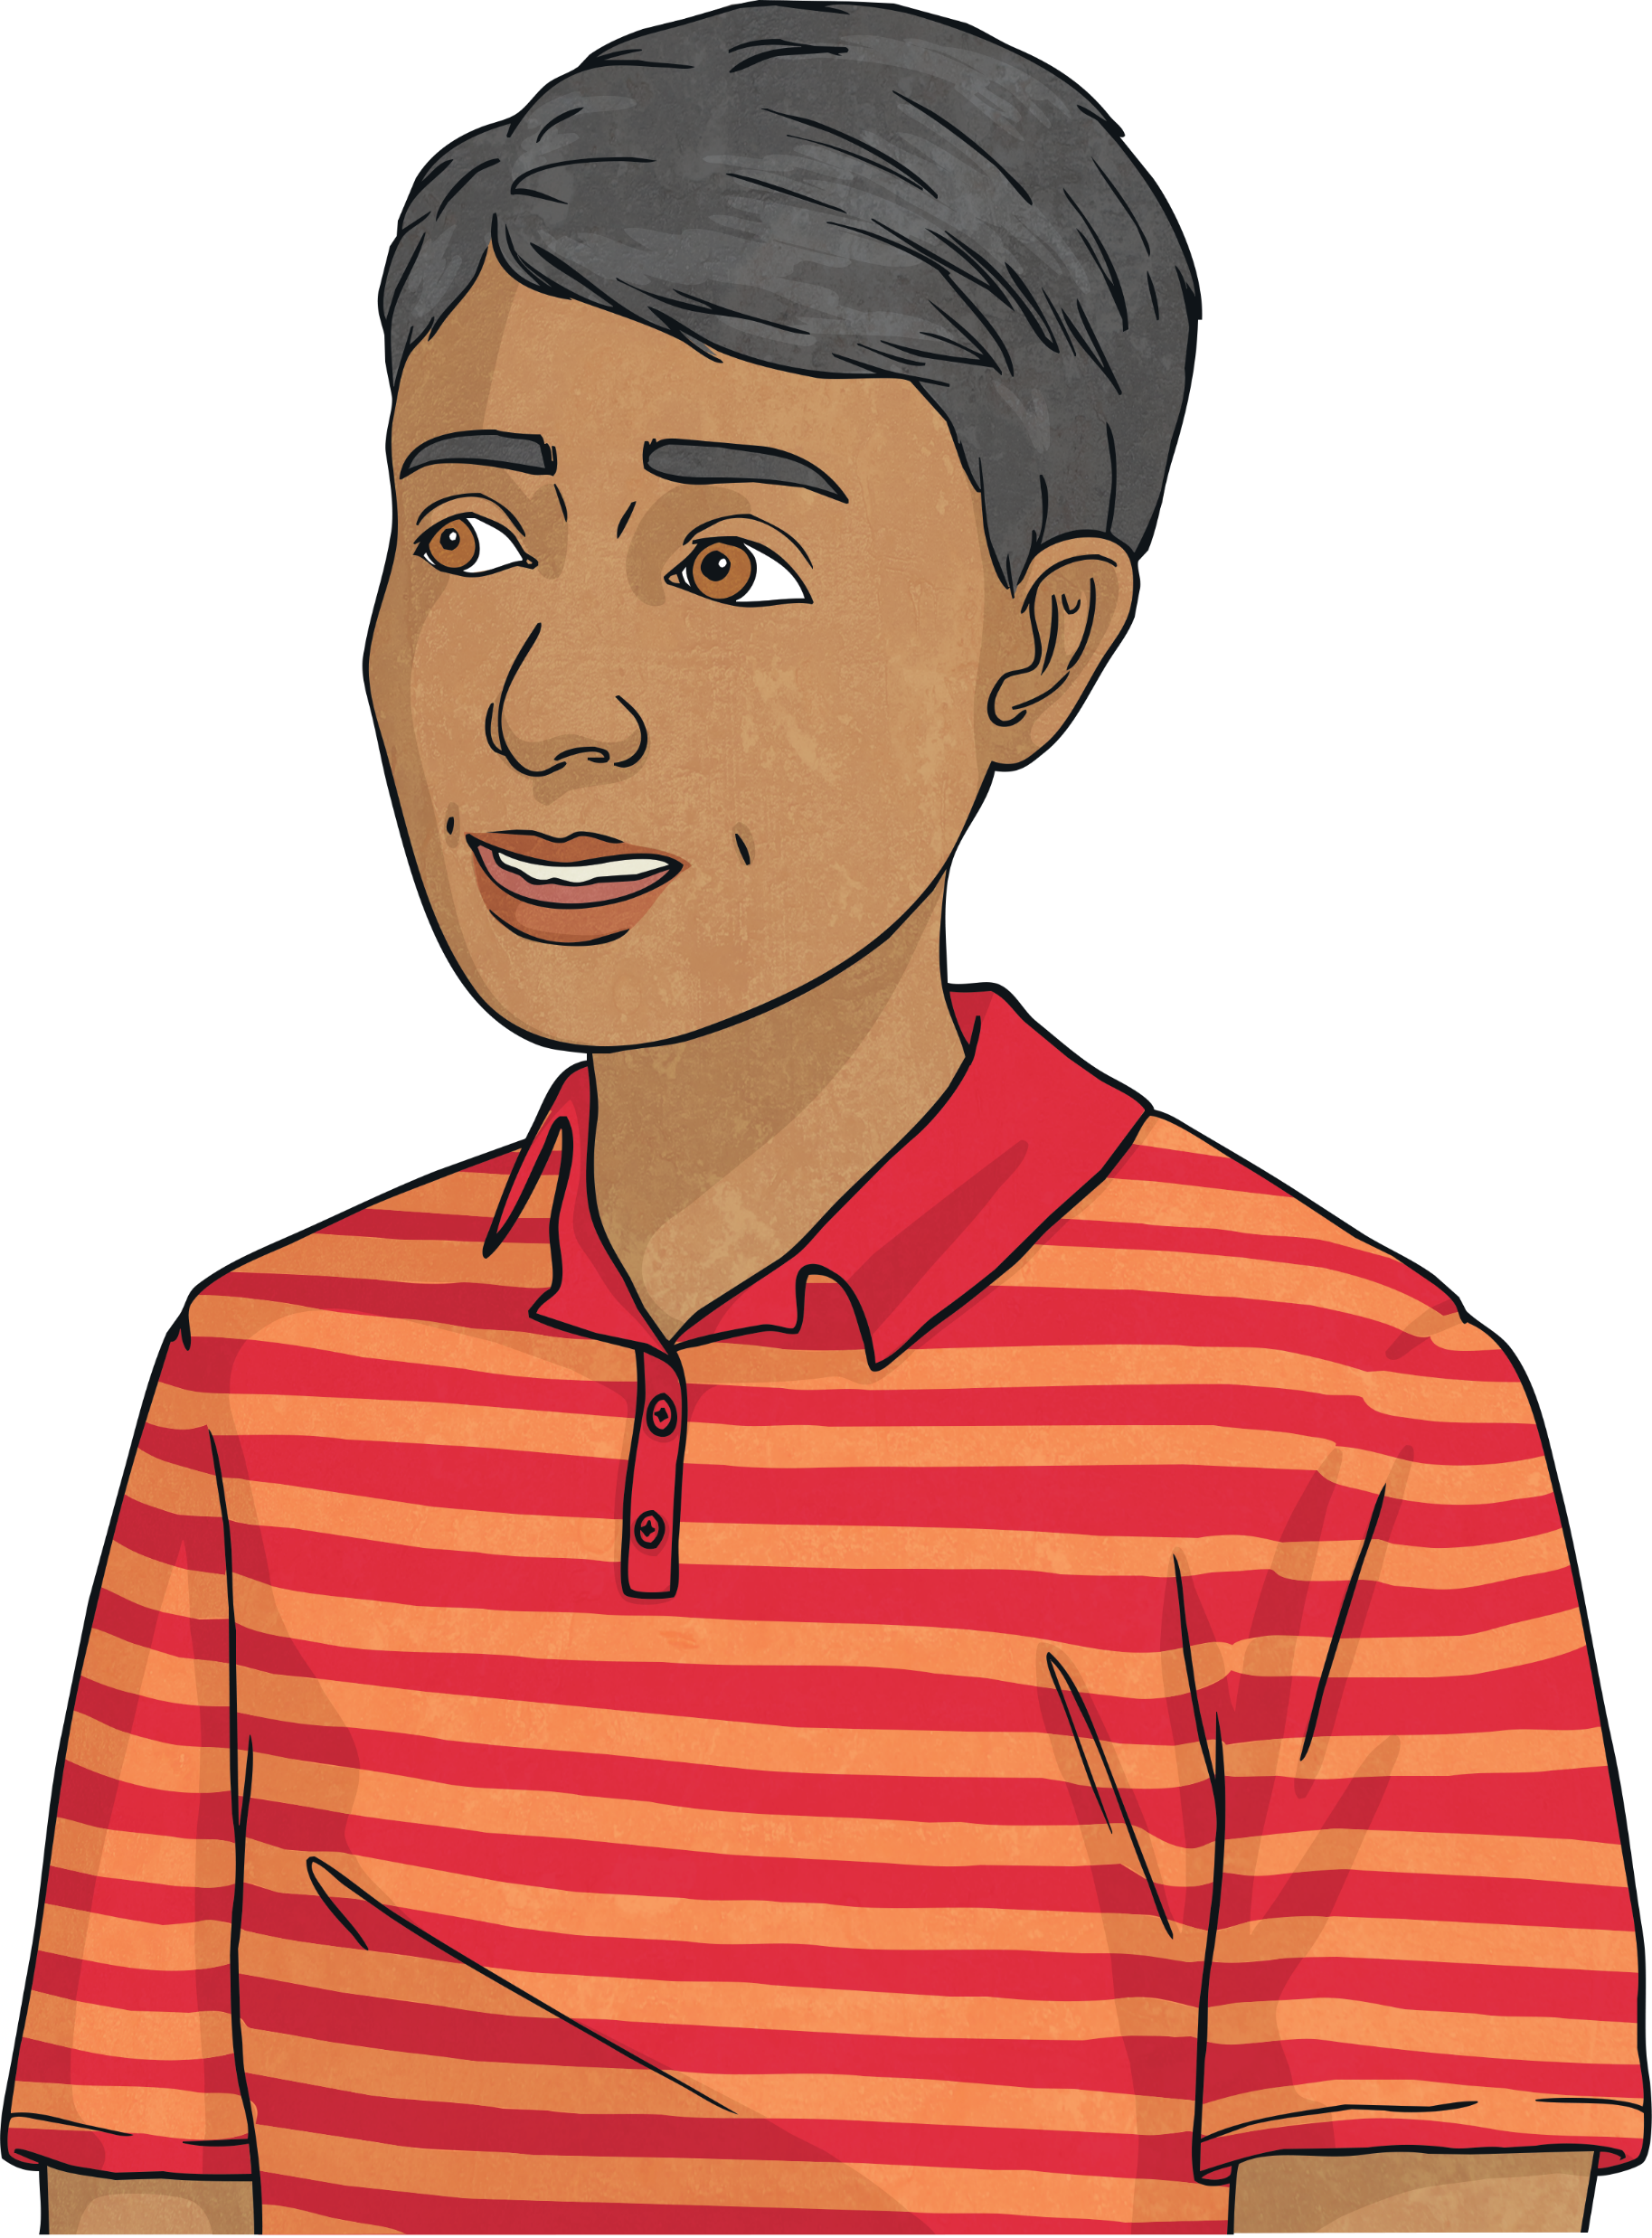
Sharing Ideas and Evaluating
How could we improve this investigation?
Are there any further questions you would like to investigate following on from this investigation?

Slide 13

Aim
I can investigate how water evaporates.
Success Criteria
I can explain the effect of temperature on the process of evaporation.
I can plan and carry out a comparative test using equipment accurately and display my results.

