Slide 1


Science
Sound
Year One
Science | Year 4 | Sound | Good Vibrations | Lesson 1

Slide 2
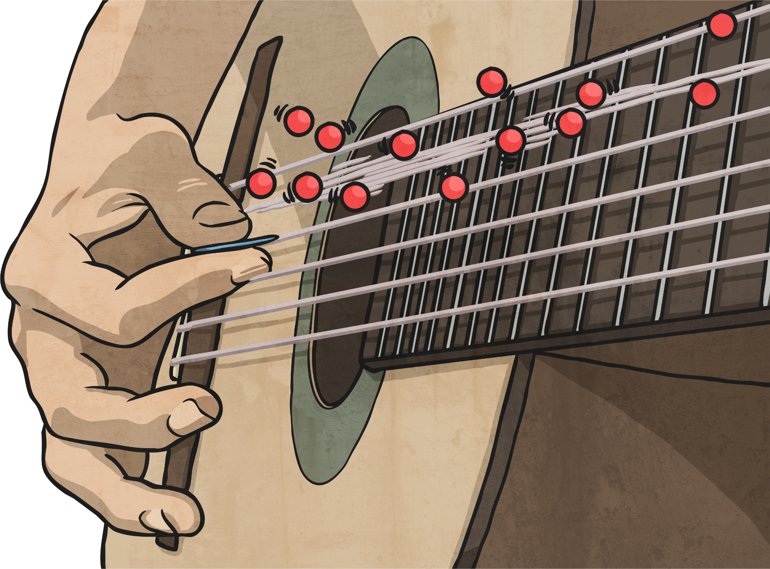

Good Vibrations

Slide 3
Aim
I can describe and explain sound sources.
Success Criteria
I can identify and describe sound sources around school.
I can explain how sources of sound vibrate, creating sound.

Slide 4

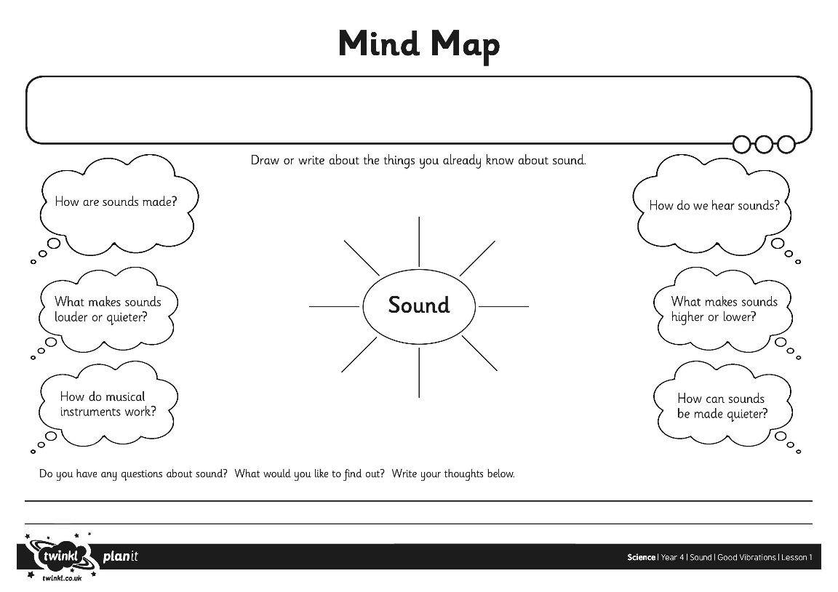
What is Sound?
What do you already know about sound and do you know anything about how sounds are made?
Complete your Sound Mind Map to show what you already know, and to ask questions about what you want to find out.

Slide 5

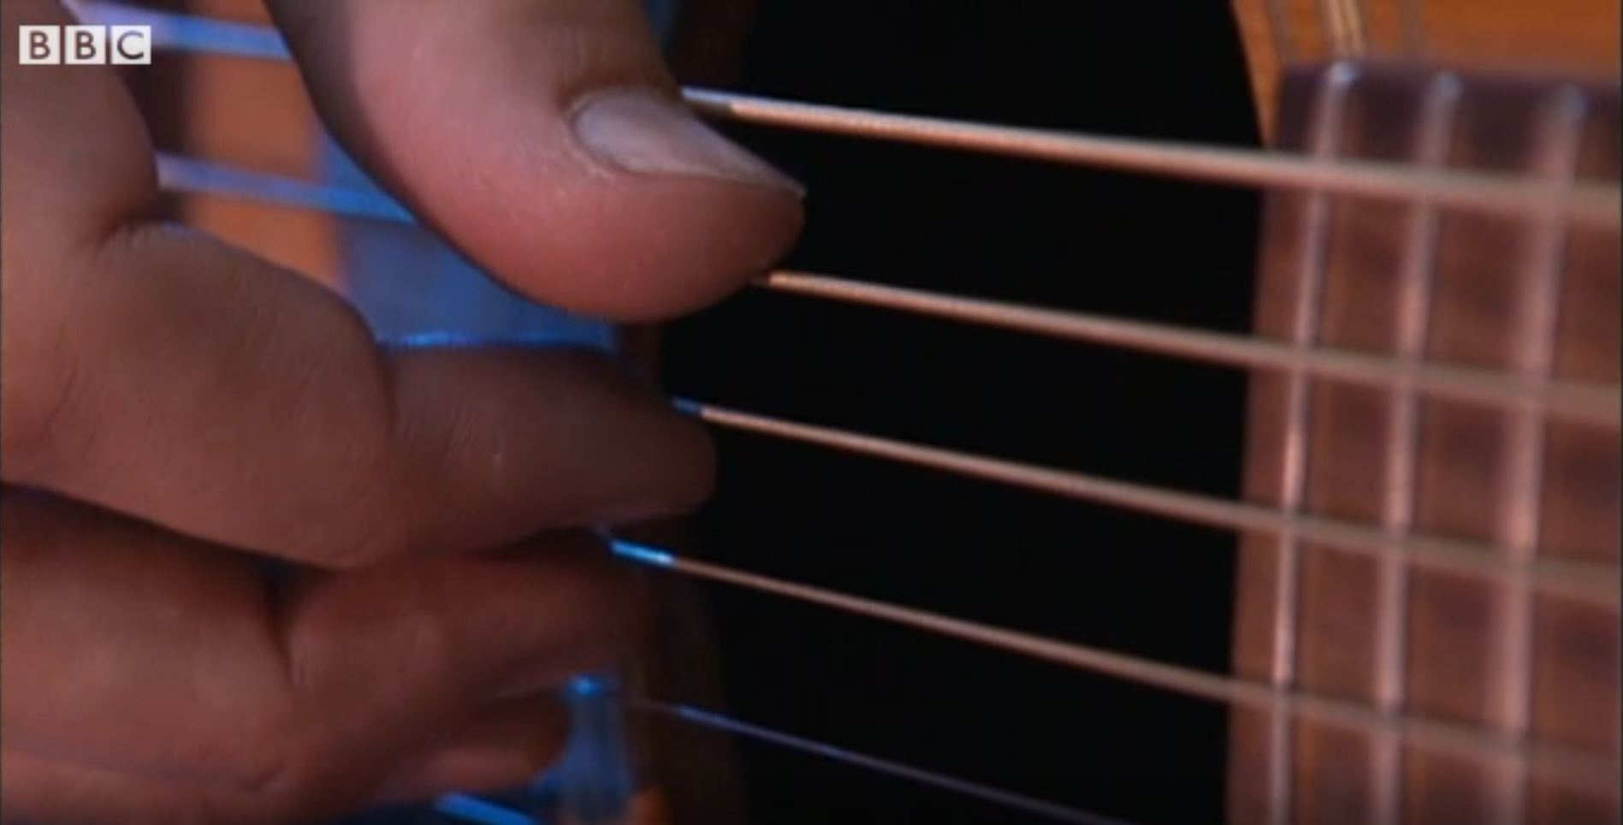
What is Sound?
Watch this clip to see to see how the different families of musical instrument create different sounds.
Click on this image to play the video in a new window.
Notes:
Teacher Note - Please check your volume is set to the appropriate level for this video. Please do not let the next video automatically play at the end of the clip. Please check the content in this link, including any comments, is suitable for your educational environment before showing. Twinkl accepts no responsibility for the content of third party websites.

Slide 6
What is Sound?
Did you come up with some words to explain how the musical instruments make sounds?
Look at the words below. Did you choose any of these words?
Vibrate
Vibration
Twang
Blow
Bang
Scrape
Shake
Pluck

Slide 7
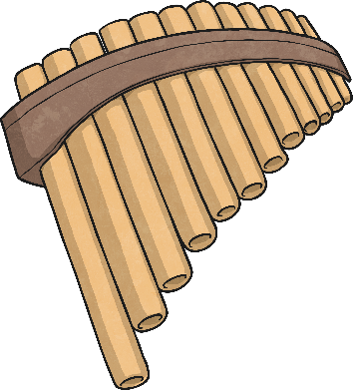
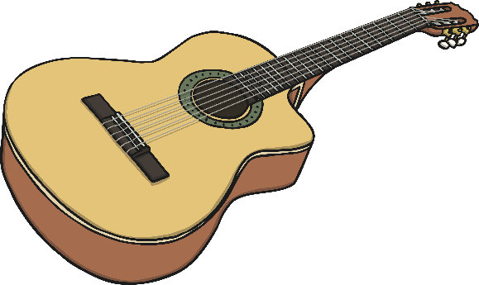
Vibrations
All the instruments are played in different ways, but they all have something in common. They all create sounds by vibrating.
The strings of the guitar and the gopichand vibrate when they are plucked.
The pan pipes and horn are filled with air, which vibrates when they are blown.
The balafon and the bongos make sounds when they are hit or banged, causing the blocks or the skin to vibrate.
But what is a vibration?

Slide 8
Vibrations
We can see and feel vibrations whenever sounds are made.
Gently place your hand on your throat.
Say ‘Ah!’
Can you feel the vibrations from your vocal cords?
Ahh

Slide 9

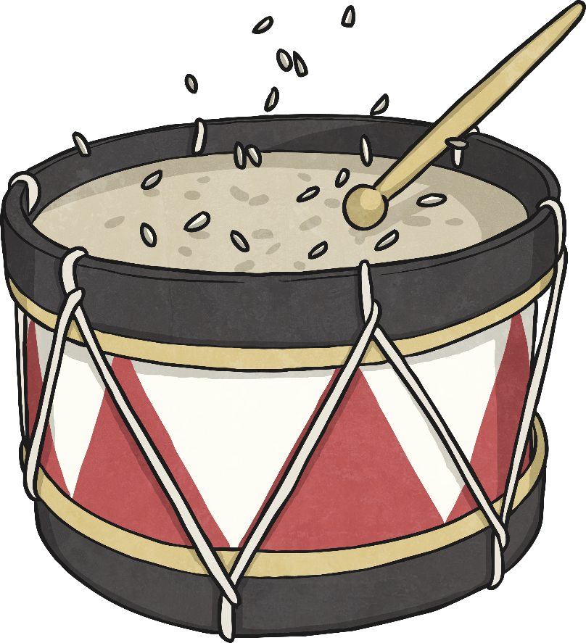
Vibrations
Place a few grains of rice on a drum skin and gently bang the drum.
What do you observe?
The grains of rice bounce on the drum skin when it is hit.
This is because the drum skin vibrates, and the vibrations pass to the grains of rice, which also vibrate.

Slide 10
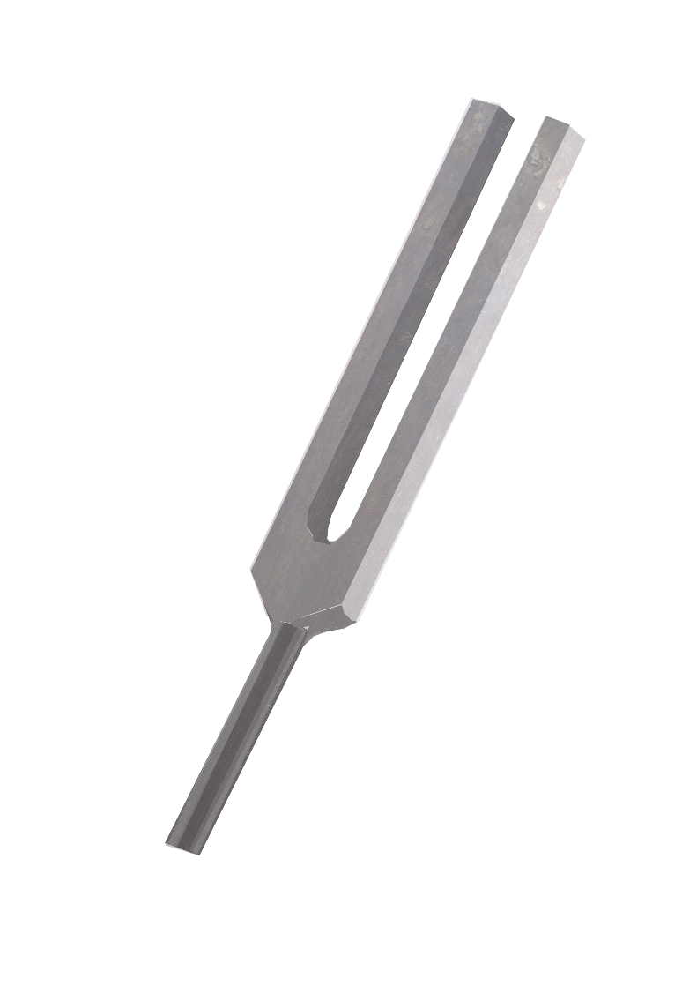
Vibrations
Gently hit a tuning fork and listen to the sound it makes. Lower the tuning fork into a bowl of water.
What do you observe?
You can see the ripples in the water when you place the tuning fork into it.
The tuning fork vibrates when it is hit, making the sound. These vibrations travel through the water, making the ripples as the water vibrates.

Slide 11
School Sound Survey
Around school there are lots of different sounds. Some places will be noisy, whereas some places will be quiet. The loudness of the different places will even change throughout the day!
You are going to carry out a sound survey of your school to find which places are noisy and which are quiet at different times of day. You may decide to rate each place out of 5, with 5 being very noisy and 0 being totally silent.
You may choose to use a data logger, which will record the loudness of each place for you to compare.

Slide 12
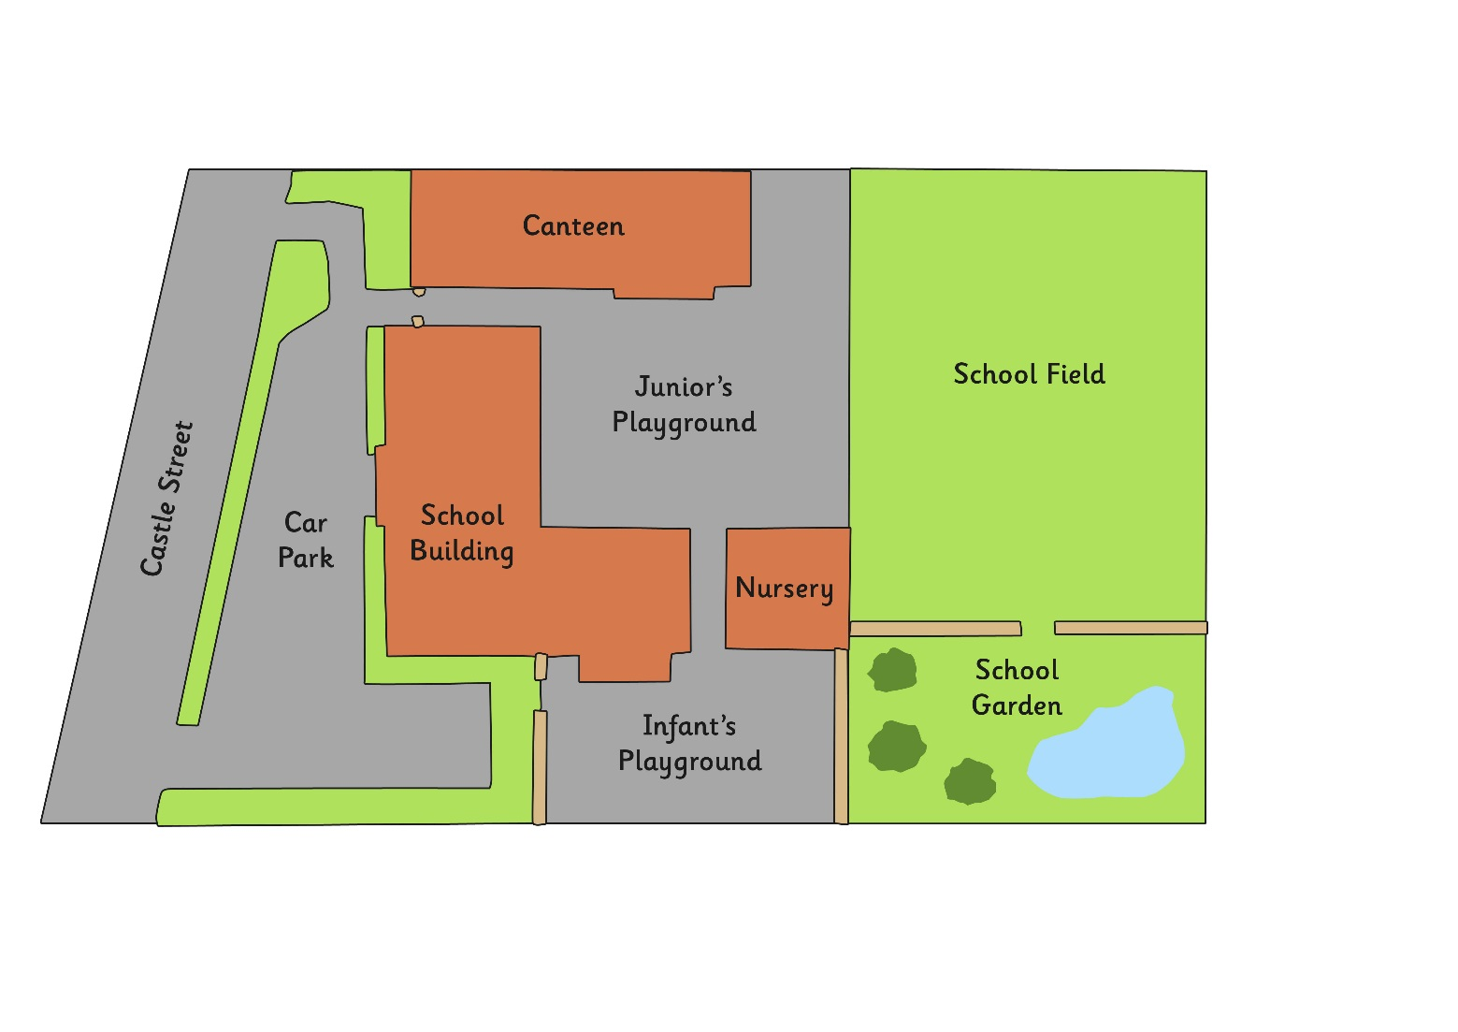
School Sound Survey
Use a map of the school to decide which places you are going to visit.
Then visit each place with your group and either rate the noise level or use the data logger to measure the noise level.
Make a note of this on your school map.
Canteen
Juniors’ Playground
School Field
Castle Street
Car Park
School Building
Nursery
School Garden
Infants’ Playground

Slide 13

School Sound Survey
When you have completed your sound survey, you should all swap groups.
Try to work with different people as much as possible.
Take turns in your new groups to describe the noisiest place you visited, and what sounds you could hear in that place.

Slide 14
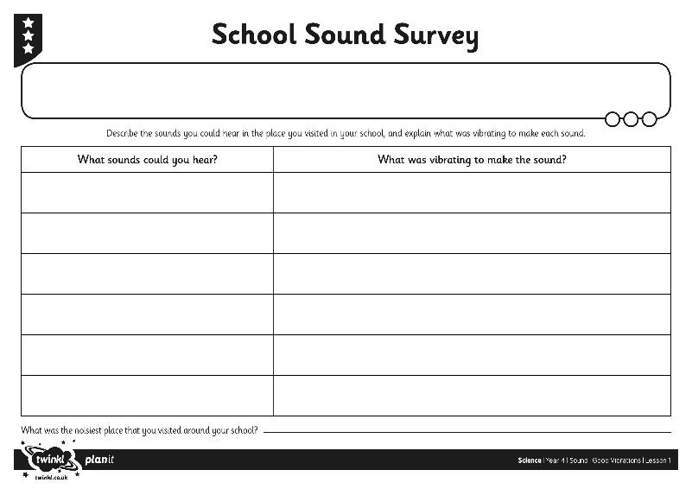
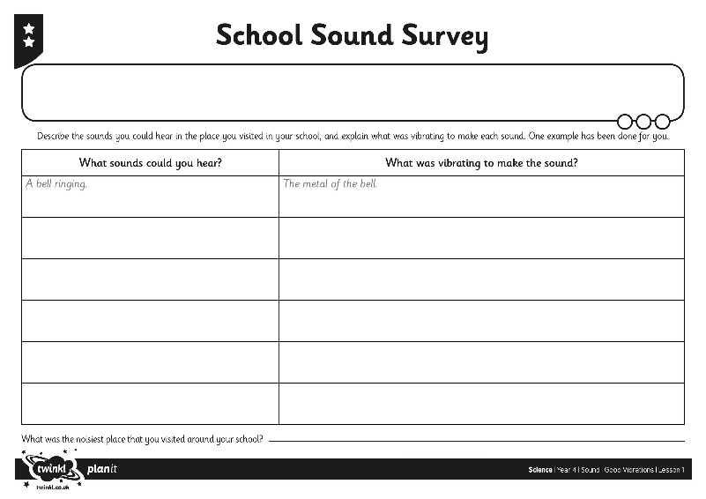
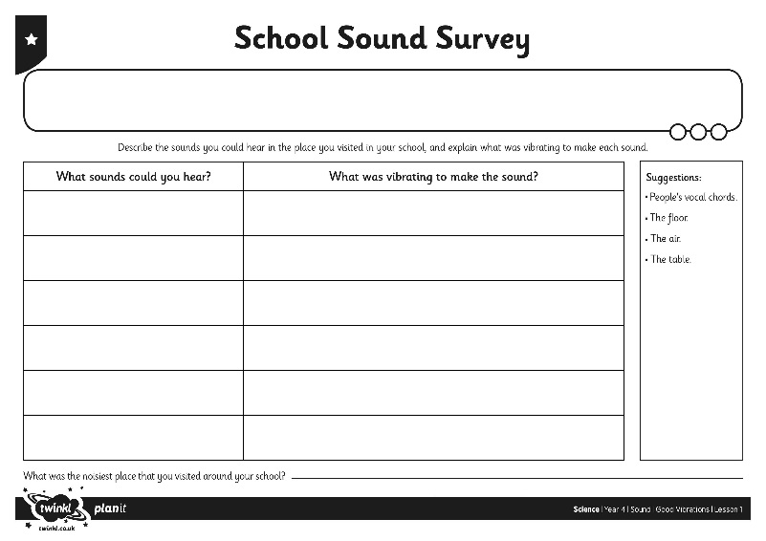
Explaining Sounds
On your School Sound Survey Activity Sheet, make a list of the sounds you could hear in the noisiest place you visited around school. For each one, think about what was vibrating to make that sound.
Complete the table on your activity sheet.

Slide 15

Aim
I can describe and explain sound sources.
Success Criteria
I can identify and describe sound sources around school.
I can explain how sources of sound vibrate, creating sound.

