Slide 1
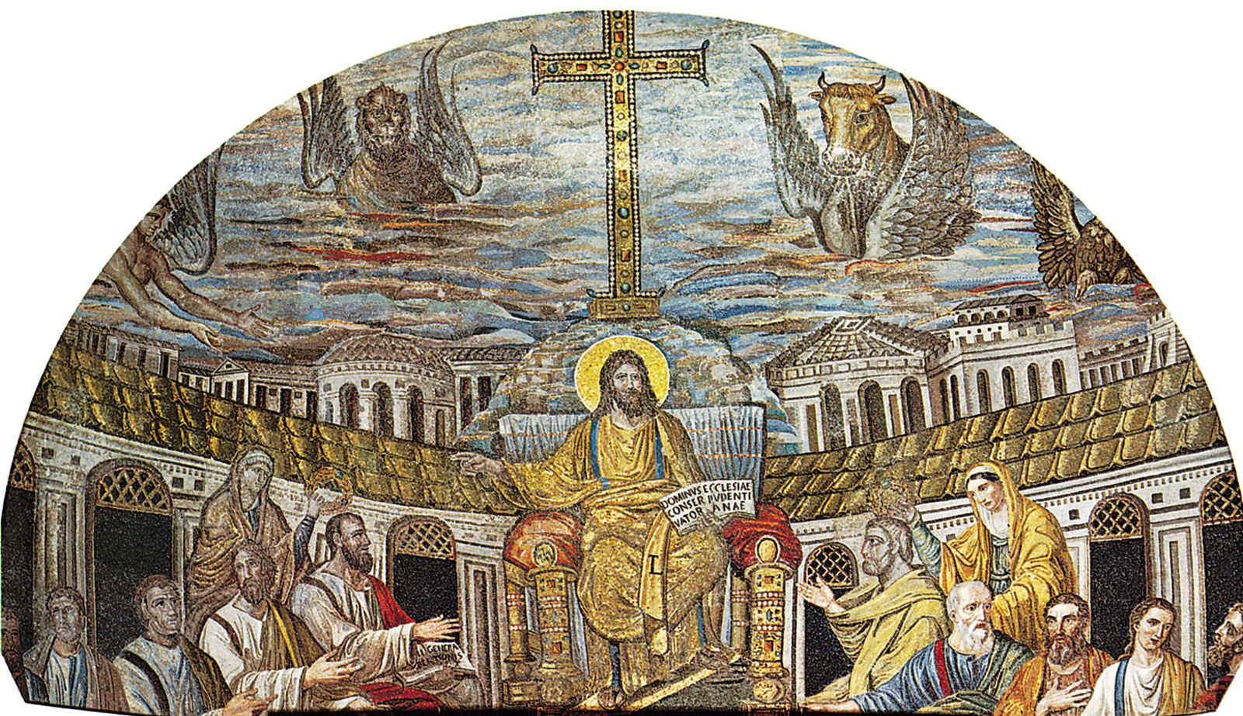
Christianity
Lesson 1

Slide 2
LO: To understand basic information about who Jesus was.
I know where Jesus grew up and who his parents were.
I can describe what Jesus might have looked like.
I can create a fact file to demonstrate what I know about Jesus so far.

Slide 3
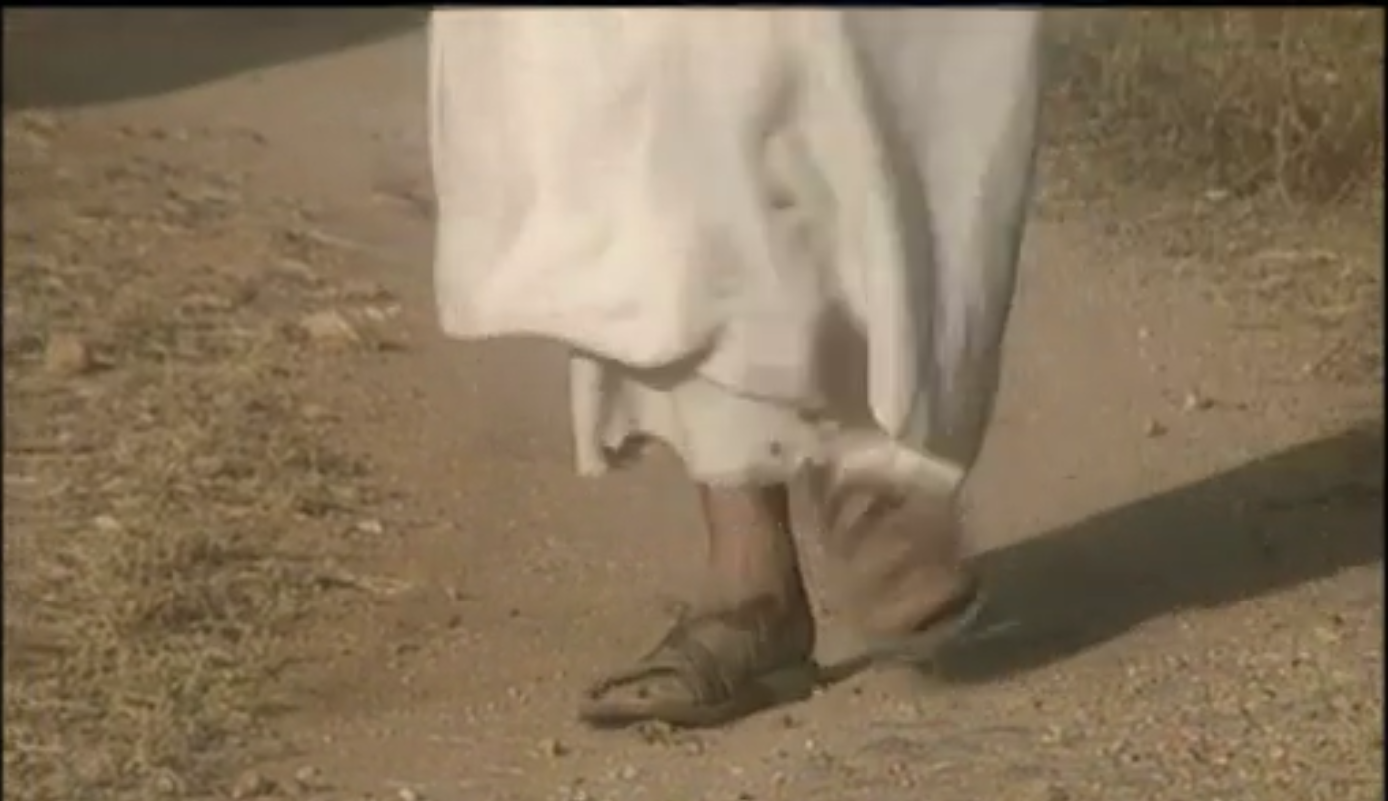
What was Jesus like and where did he grow up? - KS1 Religious Education - BBC Bitesize

Slide 4
Jesus’ Birth
Jesus grew up in a town called Nazareth which is in North Israel, Asia.
His parents were Mary, a Jewish woman, and Joseph, who was a carpenter.
He was the son of God and was born during the Roman era in the year 0 in our calendar.
In those days, a typical Jewish person only had one name, sometimes followed by the phrase "son of [father's name]", or where the person was born. Sometimes he is called Jesus Christ and, in the Bible, he is sometimes called "Jesus of Nazareth".
Notes:
Explain that a carpenter is someone who makes and repairs wooden objects and structures.

Slide 5
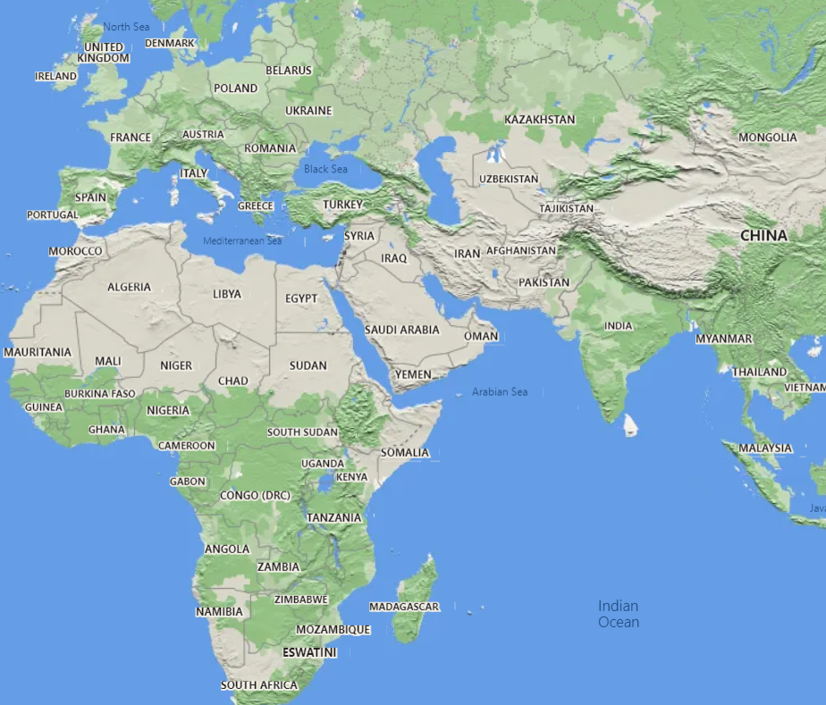
Where is Nazareth?
Let’s look at where Nazareth is using Google Maps.

Slide 6
What did Jesus look like?
Because Jesus was born the Middle East, it is likely that he might have had olive skin, although nobody knows for sure.
He had a beard and probably had dark hair and eyes.
He probably wore a knee-length tunic.
On top of his tunic, he would have worn a mantle, We know that Jesus wore one of these because this is what the Bible says a woman touched when she wanted to be healed by him. A mantle was a large piece of woolen material, though it was not very thick and for warmth you would want to wear two.
On his feet, Jesus would have worn sandals. hey were very simple, with the soles made of thick pieces of leather sewn together, and the upper parts made of straps of leather going through the toes.

Slide 7
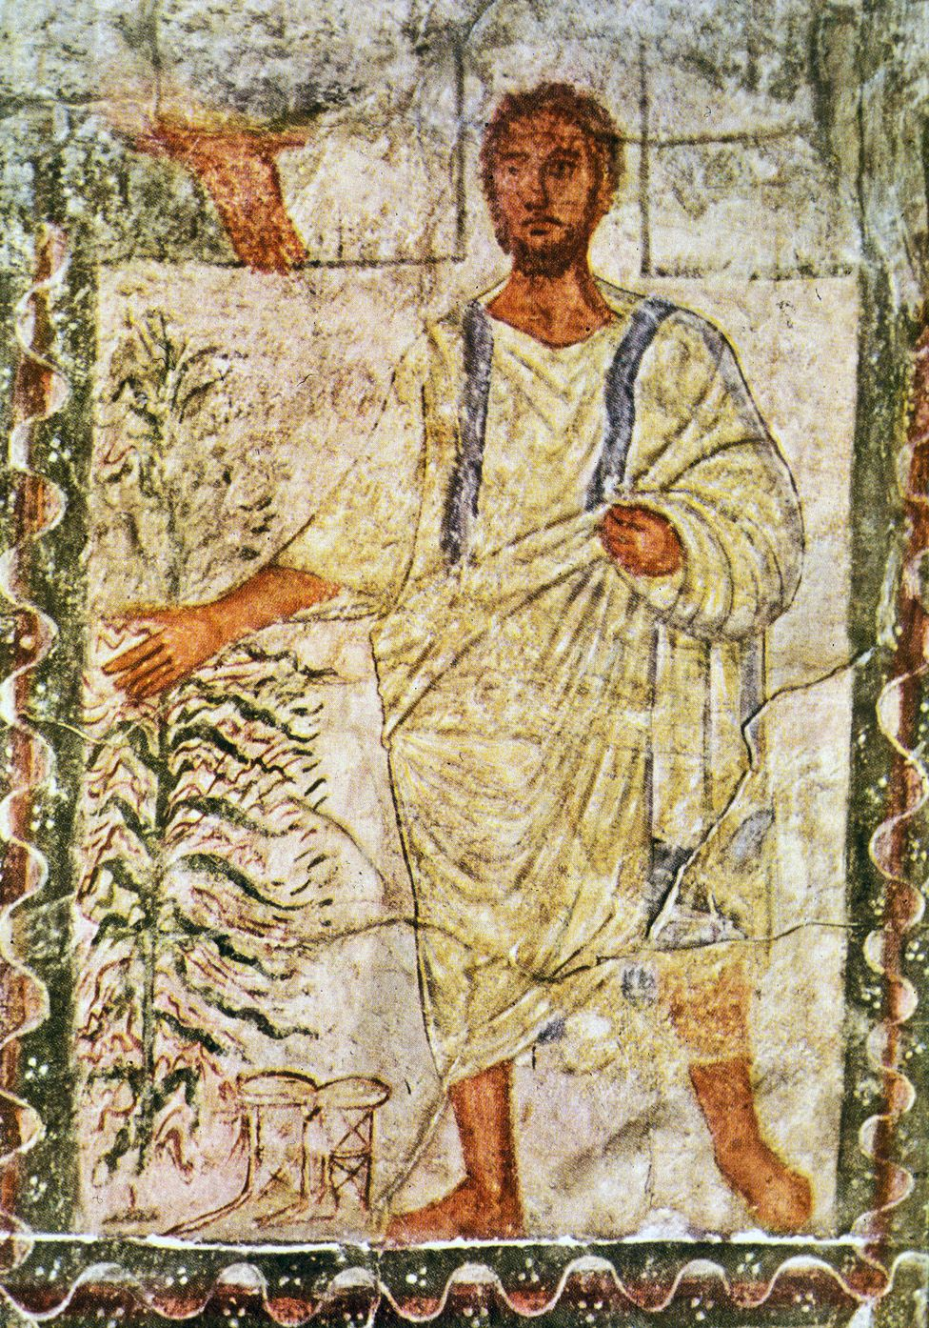
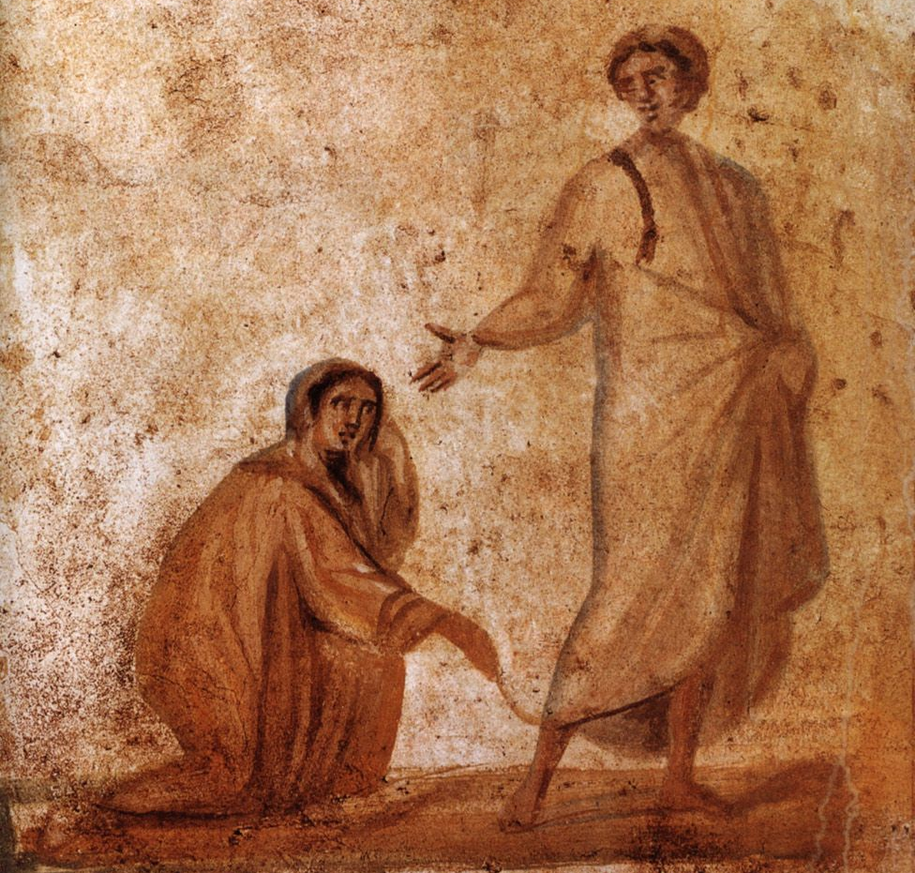
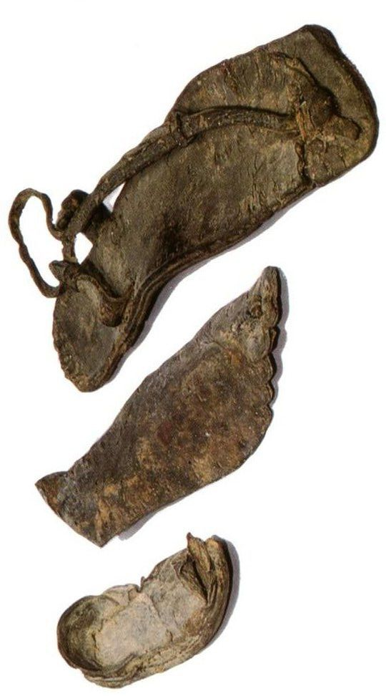
What did Jesus look like?

Slide 8
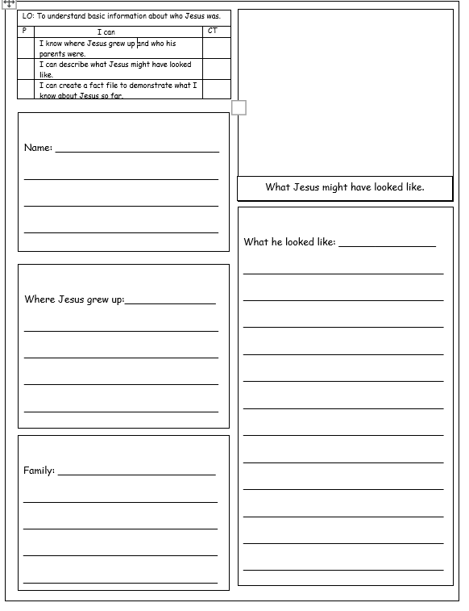
Your task
We are going to be creating a fact file about the key information about Jesus Christ. We need to include information such as where he was born, who his parents were, what he looked like and a paragraph (or sentences) about what he was famous for.
Let’s brainstorm some ideas as a class first, then you will work independently.
Notes:
LA to work with TA to fill in the gaps from learning in lesson. Can use word map on board to help.
MA to work independently to answer.
HA – work with CT to agree on subheadings e.g. name, hometown, parents, what he looked like.

Slide 9
Jesus Christ

Slide 10
Word Bank:
Jesus
Mary
Joseph
Christ
Nazareth
north Israel
sandals
Jewish
mantle
tunic
olive skin
carpenter
Asia
Words with capital letters are names and need a capital letter wherever they are in your writing.

