Slide 1
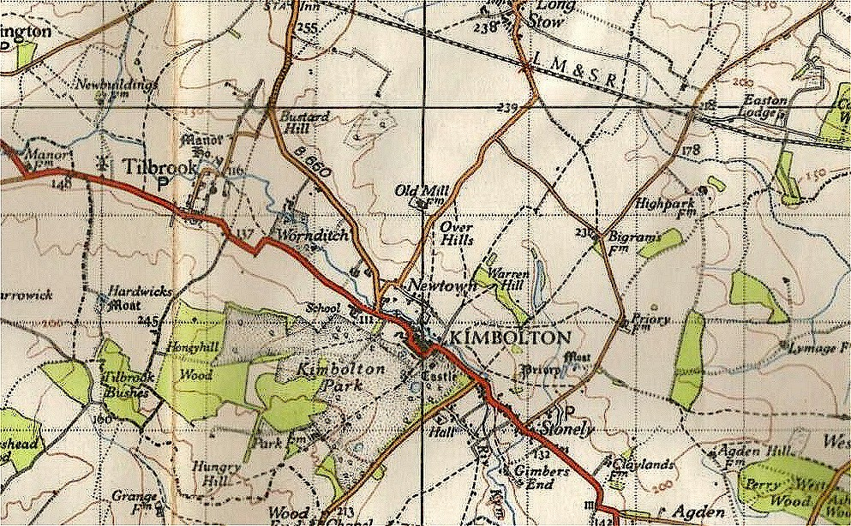
Local History

Slide 2
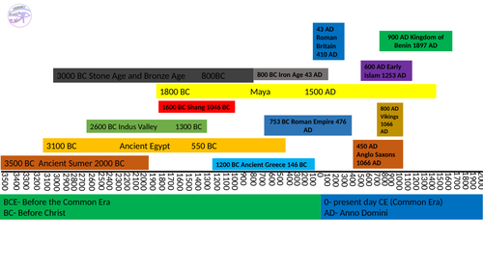
LO: To create a timeline of the history of my locality.
P | Success Criteria | T
 | I can decide the start and end points of the timeline.
 | I can research key events and add these to the timeline.
 | I can find out what was happening elsewhere at the same time.
We will be creating a timeline to help organise our knowledge of local history.
What does this timeline remind you of?

Slide 3
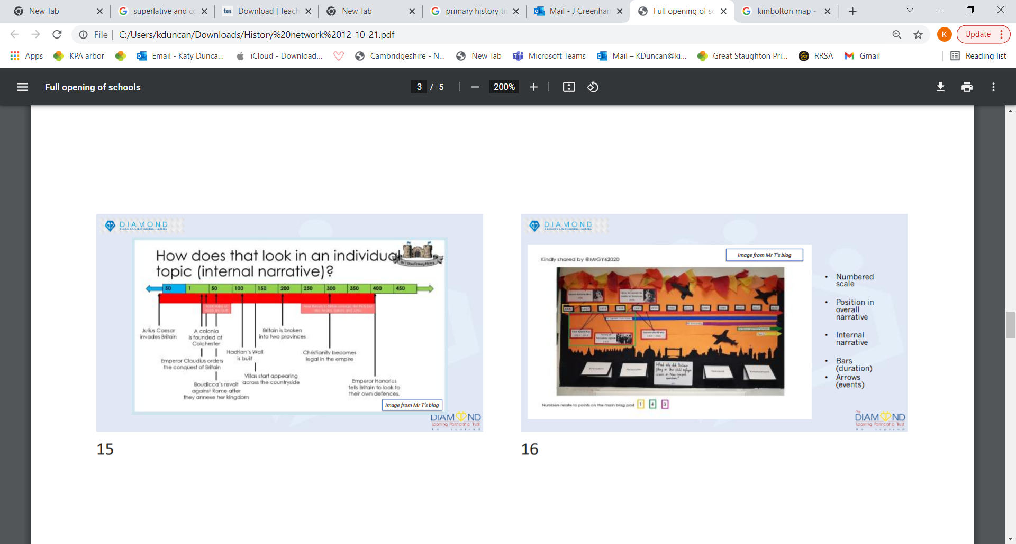
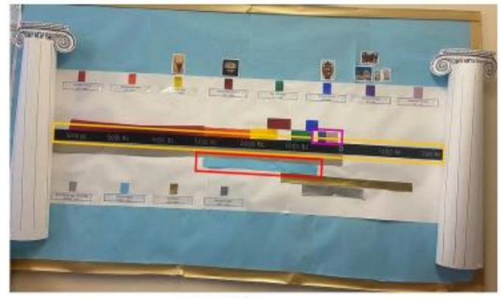
Timelines help us to show the past in a visual way.
How has information been displayed on these examples?
What key information should we include in a timeline about Kimbolton/ Great Staughton?
How will we represent the information?

Slide 4
With your group, make a list of suggestions for important periods or events in the history of your village.
Key features needed:
Bars to show duration of periods.
Arrows to show key events.
Numbered scale of years.
As a class, we will vote on which ones should be displayed on our working wall.

Slide 5
Extension Task- find out what else was happening during these events.
E.g. Kimbolton castle was bought by the Wingfield family in the 1520’s.
During this time, Spanish Conquistadors battled the Aztecs to take over much of central and south America.
Protestantism continued to spread through Europe due to Martin Luther.
The bubonic plague began to spread through Europe and reached England in 1528.

