Slide 1
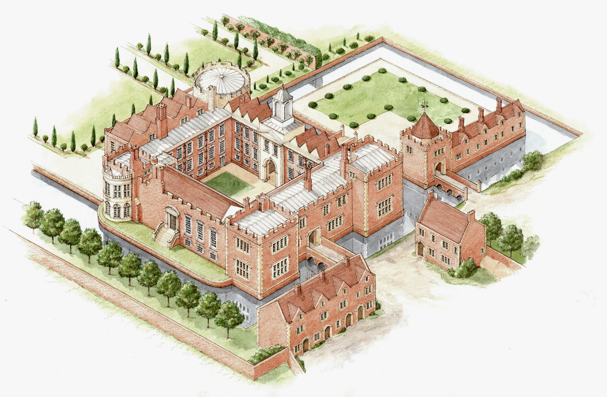
L.O: To research the lives of famous figures in local history.
P | Success Criteria | T
 | Create a fact file of information about my figure.
 | Explain how they are linked to the local area.
 | Share what I have discovered with the class.

Slide 2
Your task today is to find out about the lives of three famous historical figures with links to the local area.
You will need to create a fact file about the life of your chosen person.
What information will you choose to display in your fact file?
Where could we find out more information?
What is the link between each person and Kimbolton?

Slide 3
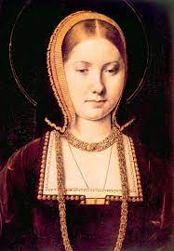
Catherine of Aragon 1485 – 1536 (Tudor Period)
First wife of Henry VIII
Died at Kimbolton Castle.
https://www.bbc.co.uk/bitesize/clips/zp8w2hv
https://kids.britannica.com/kids/article/Catherine-of-Aragon/476235
https://kids.kiddle.co/Catherine_of_Aragon
https://primaryfacts.com/325/catherine-of-aragon-facts-about-the-first-wife-of-henry-viii/

Slide 4
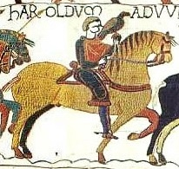
King Harold Godwinson 1022 – 1066
(Early Medieval/ Saxon period)
Last Anglo-Saxon King of England.
Died at the Battle of Hastings.
https://www.bbc.co.uk/bitesize/topics/zxsbcdm/articles/z3s9j6f
https://www.bbc.co.uk/teach/school-radio/history-ks2-anglo-saxons-1066-hastings/zkvxxyc
https://kids.kiddle.co/Harold_Godwinson
https://schoolhistory.co.uk/medieval/norman-conquest/harold-godwinson/
https://www.imagininghistory.co.uk/post/who-was-harold-godwinson

Slide 5
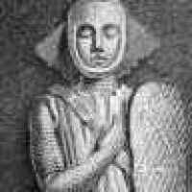
Geoffrey Fitzpiers 1162 – 1213 (Medieval)
Also known as Geoffrey Fitz Peter
First Earl of Essex.
Less is known about him, so this is a tougher challenge suitable for Year 6.
https://www.berkhamstedcastle.org.uk/biographies/geoffrey-fitz-piers/
https://en.wikipedia.org/wiki/Geoffrey_Fitz_Peter,_1st_Earl_of_Essex
https://www.findagrave.com/memorial/63276113/geoffrey-fitzpiers
https://www.kimbolton.cambs.sch.uk/castle-early-years

Slide 6
Plenary
We will be working in groups to present what we have found out about the famous figures linked to the local area.
Extension Task- What famous people can you discover with links to the wider local area, such as St. Neots or Cambridge?

