Slide 1
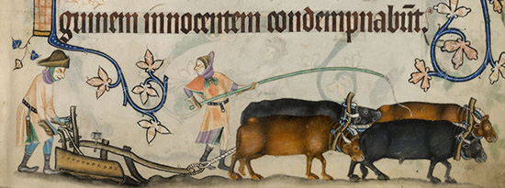
L.O: To research what life was like for local people in the past.
P | Success Criteria | T
 | I can investigate different aspects of everyday life.
 | I can think about what life might have been like for rich and poor.
 | I can imagine what life might have been like for women.

Slide 2
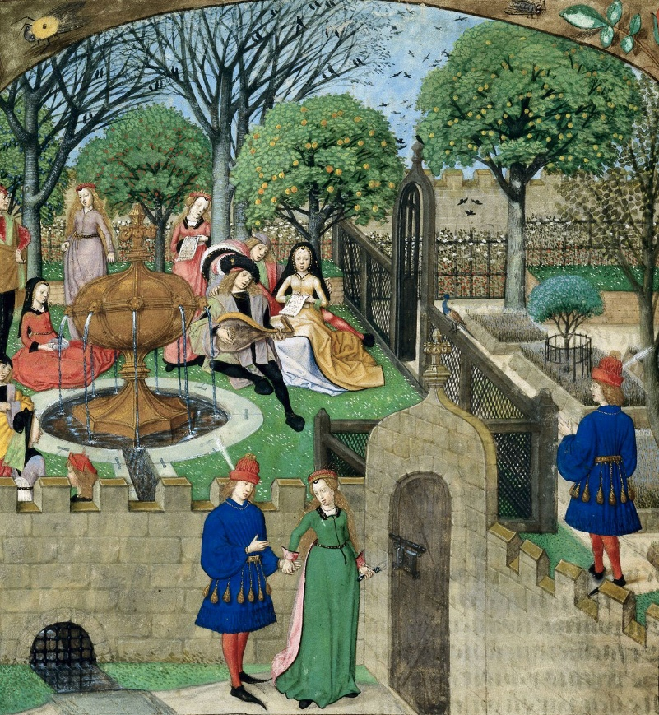
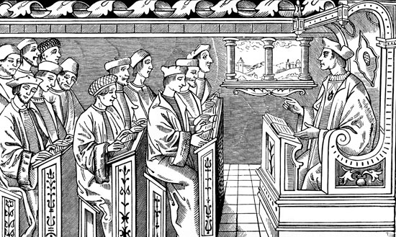
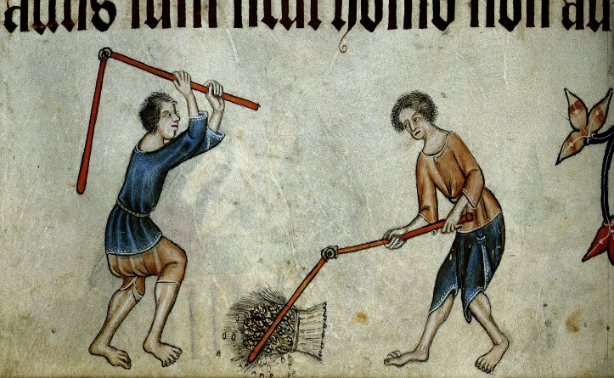
Imagine you had a time machine, and could step back through history into the past. What might life be like in Kimbolton or Great Staughton hundreds of years ago?
Do you think life would be better or worse that it is today?
Why do you think so?
How might it be different for men, women and children?
How might life be different for the rich and the poor?

Slide 3
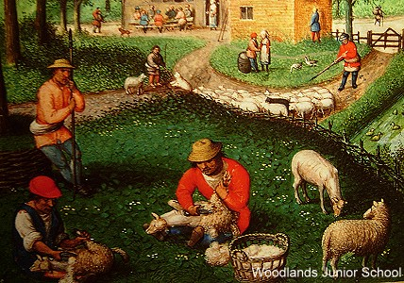
Last session we learned about the lives of three famous figures with links to Kimbolton.
They lived in three different historical periods- the Early Medieval period, Medieval Period and Tudor Period.
Talk to your partner- what do you think life would be like in each period?
What ideas or knowledge do you already have about these time periods?
Make a list of ideas you could find out more about, e.g.
Food, Work, Entertainment, Law, Families or the role of women in society.

Slide 4
Your task is to find out what life might have been like for ordinary people living in Kimbolton or Great Staughton at the same time as the people we researched previously.
The Tudor Period
(Catherine of Aragon)
http://www.primaryhomeworkhelp.co.uk/tudors/dailylife.htm
https://kids.kiddle.co/Tudor_period
https://www.bbc.co.uk/teach/how-could-you-survive-in-tudor-england/znvmkmn
https://www.funkidslive.com/learn/top-10-facts/top-10-facts-about-the-tudors/
https://www.bbc.co.uk/bitesize/guides/zwbj6sg/revision/5
The Early Medieval Period
(Harold Godwinson)
https://www.historyforkids.net/medieval-daily-life.html
http://www.primaryhomeworkhelp.co.uk/saxons/houses.htm
https://www.dkfindout.com/uk/history/anglo-saxons/
https://www.ducksters.com/history/middle_ages/daily_life_in_the_middle_ages.php
The Medieval Period
(Geoffrey Fitzpiers)
https://www.bbc.co.uk/bitesize/topics/zbn7jsg/articles/zwyh6g8
https://www.medievalchronicles.com/medieval-people/medieval-children/
https://www.historyforkids.net/medieval-daily-life.html
https://www.ducksters.com/history/middle_ages/daily_life_in_the_middle_ages.php

