Slide 1
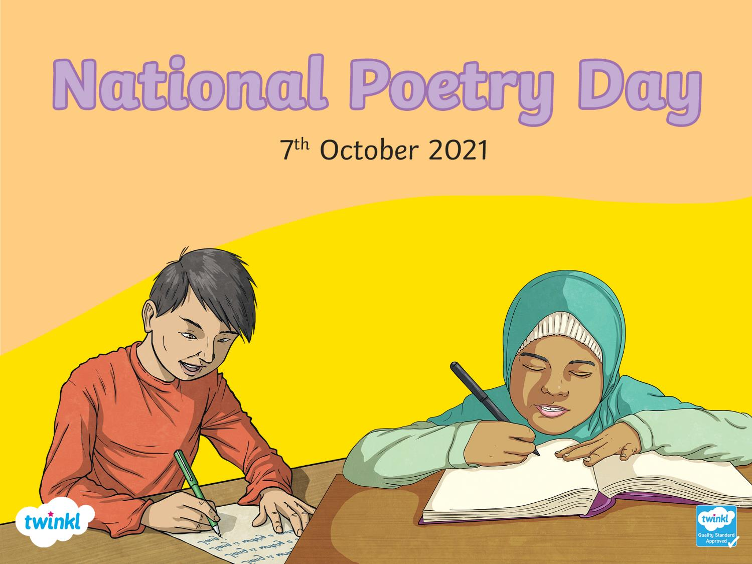

Slide 2
What is Poetry?
Poetry is a type of artistic writing that inspires a reader's imagination or emotions.
The poet does this by carefully choosing and arranging language for its meaning, sound, and rhythm.
Can you think of any types of poems?
Haiku
Limerick
Ballad
Sonnet
Free Verse
Acrostic
Have you heard of these types of poems?
Can you name any of the characteristics?

Slide 3
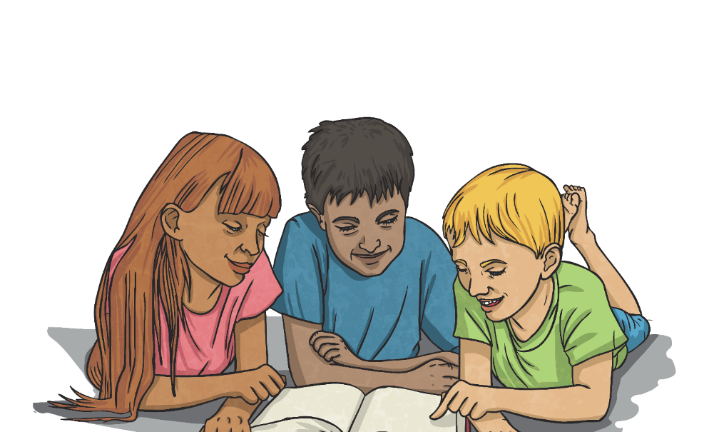
What Is National Poetry Day?
National Poetry Day is a UK-wide celebration of poetry. It is a chance to enjoy, discover and share poetry with others. National Poetry Day is an annual event which happens on the first Thursday of October.
In 1994, the charity, Forward Arts Foundation, founded National Poetry Day with the mission to celebrate excellence in poetry and increase its audience.
Businesses, such as BBC, Arts Council England and leading literary and cultural organisations all love to get involved. Booksellers, publishers, libraries and schools also enjoy participating
in National Poetry Day – can you remember
how your school celebrated this day
in other years?
This year, it takes place on 7th October.

Slide 4


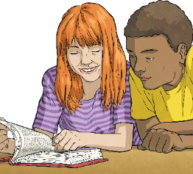

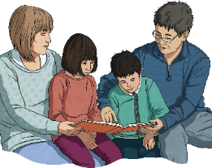


Ways To Celebrate National Poetry Day
Can you think of some ways you could celebrate National Poetry Day?
Read a poem
Write a poem
Share a poem
Find an event near you
Put on a poetry reading or event
Visit your local library or bookshop
Create a display

Slide 5
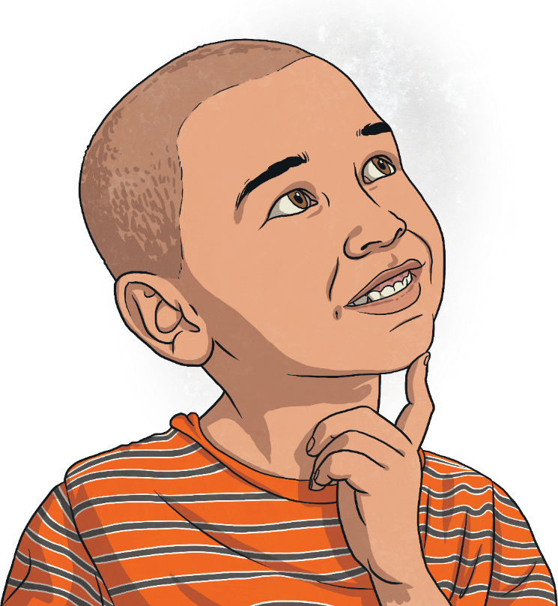
National Poetry Day Theme
This year, the theme of National Poetry Day is Choice.
What do you think ‘choice’ means?
Choice means to chose between two or more possibilities.

Slide 6
Choice Poetry
Let’s take a look at a poem about choice:
Two roads diverged in a yellow wood,
And sorry I could not travel both
And be one traveler, long I stood
And looked down one as far as I could
To where it bent in the undergrowth;
Then took the other, as just as fair,
And having perhaps the better claim,
Because it was grassy and wanted wear;
Though as for that the passing there
Had worn them really about the same,
And both that morning equally lay
In leaves no step had trodden black.
Oh, I kept the first for another day!
Yet knowing how way leads on to way,
I doubted if I should ever come back.
I shall be telling this with a sigh
Somewhere ages and ages hence:
Two roads diverged in a wood, and I—
I took the one less traveled by,
And that has made all the difference.
By Robert Frost

Slide 7
Choice Poetry
What was the poem about?
What choice did he have to make?
What choice do you think you would have made?
What did you like about the poem?

Slide 8
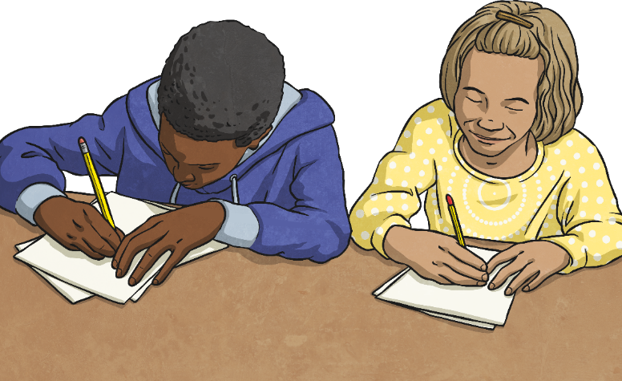
Have A Go!
Have a go at writing your own poem about choices you make in everyday life.
What characteristics will your poem have?
What will it be called?
When you have finished, read your poem aloud.
You could do this loud or quiet, quickly or slowly or a mix of them all.

