Slide 1
UNICEF/Aliaga Ticona
Notes:
In the centre is a 17 year old student from Bolivia who founded Fridays for Future in her home country in 2020.
“From a very young age I have had my parents who have been interested in the environmental issue. We have the idea of not wasting anything, of recycling and reusing the things that we can. But they have also led me to places where I have been able to create a relationship with the environment, of respect and care. When I realized it was in danger, I decided to take care of it.
“Last year I found out from my dad, who had read an article about the Fridays for Future movement, and he told me what Greta Thunberg was doing. There I learned that there was a worldwide protest to demand that the authorities take stronger actions against climate change.”
UNICEF/Aliaga Ticona

Slide 2


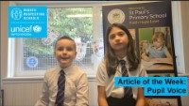
INTRODUCING PUPIL VOICE
Pupils from a Gold Rights Respecting School in Glasgow introduce Articles 12 & 13
This week we’re talking about pupil voice and democracy, linked to Articles 12 and 13. Pupils from a Gold Rights Respecting school in Glasgow tell us about how children’s participation has made a difference in their school.
Article 12 – Respect for the views of the child​
Every child has the right to express their views, feelings and wishes in all matters affecting them, and to have their views considered and taken seriously. This right applies at all times, for example during immigration proceedings, housing decisions or the child’s day-to-day home life.
Article 13 – Freedom of expression
Every child must be free to express their thoughts and opinions and to access all kinds of information, as long as it is within the law.
Click here to watch on YouTube

Slide 3
EXPLORING PUPIL VOICE
Why do you think it’s important that you are able to participate at school?
Why should you be able to share your views and opinions?
UNICEF/Aliaga Ticona
Notes:
UNICEF/Aliaga Ticona

Slide 4
How many of these did you get?
Being involved in decisions makes you feel like a part of it, you have ownership.
Relationships between children and adults improve when there’s communication.
School is there to help children to learn, so it is important to put children at the centre.
Pupils have some great ideas that adults might never think of.
It helps to prepare you for adulthood.
Children and young people feel valued.
Involving young people means there are more people to make a difference.
We all have different views and experiences, so including everyone means we get lots of perspectives.
It can help you to learn about politics and democracy.
It is your right to be involved in decisions which affect you!
What else did you think of?

Slide 5

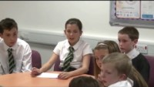
What do the words ‘opinion’ and ‘viewpoint’ mean?
Discuss as a class how your teachers listen to your opinions in different ways every day.
Listen to this story Everyone Gets A Say, then discuss with your class why it’s important to listen to a lot of people’s ideas.
Watch this video clip of a pupil council meeting where they’re talking about homework.
Is it the same or different from meetings in your school? What advice would you give to your class representatives?
What can teachers do to make it easier for you to share your views?
Draw a picture of a teacher and around them write all your ideas about how they can respect your right to be heard.

Slide 6
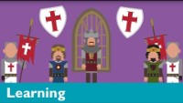
You’ve probably heard the word Parliament, but do you know what it is? Well, it works a bit like a school council, but for the whole of the UK!
This video explains what it does and why it’s important.
Make a poster to highlight the important facts you learnt.
Imagine the Prime Minister (or First Minister) arrived at your school, what would you tell or show them to persuade them that your school respects your right to be heard?
This old Newsround article talks about what makes a good pupil council.
Use their checklist of the important things and see whether your pupil council passes the test!
You might want to then speak to your headteacher about how you can make your pupil council even better.
Work together to create a news report of the things your pupil council has done recently.
Perhaps you could create a podcast or video and share it with the school community?

Slide 7
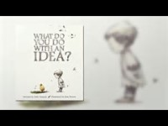
REFLECTION
Watch this short story (it may seem to be aimed at younger children but there is a message for everyone!)
Then think about these questions.
What ideas do you have to make things better? In your life? At home? At school?
Do you think it’s important to listen to get ideas from lots of different people?
How can your school encourage people to share their ideas and show that they’re listening?

Slide 8
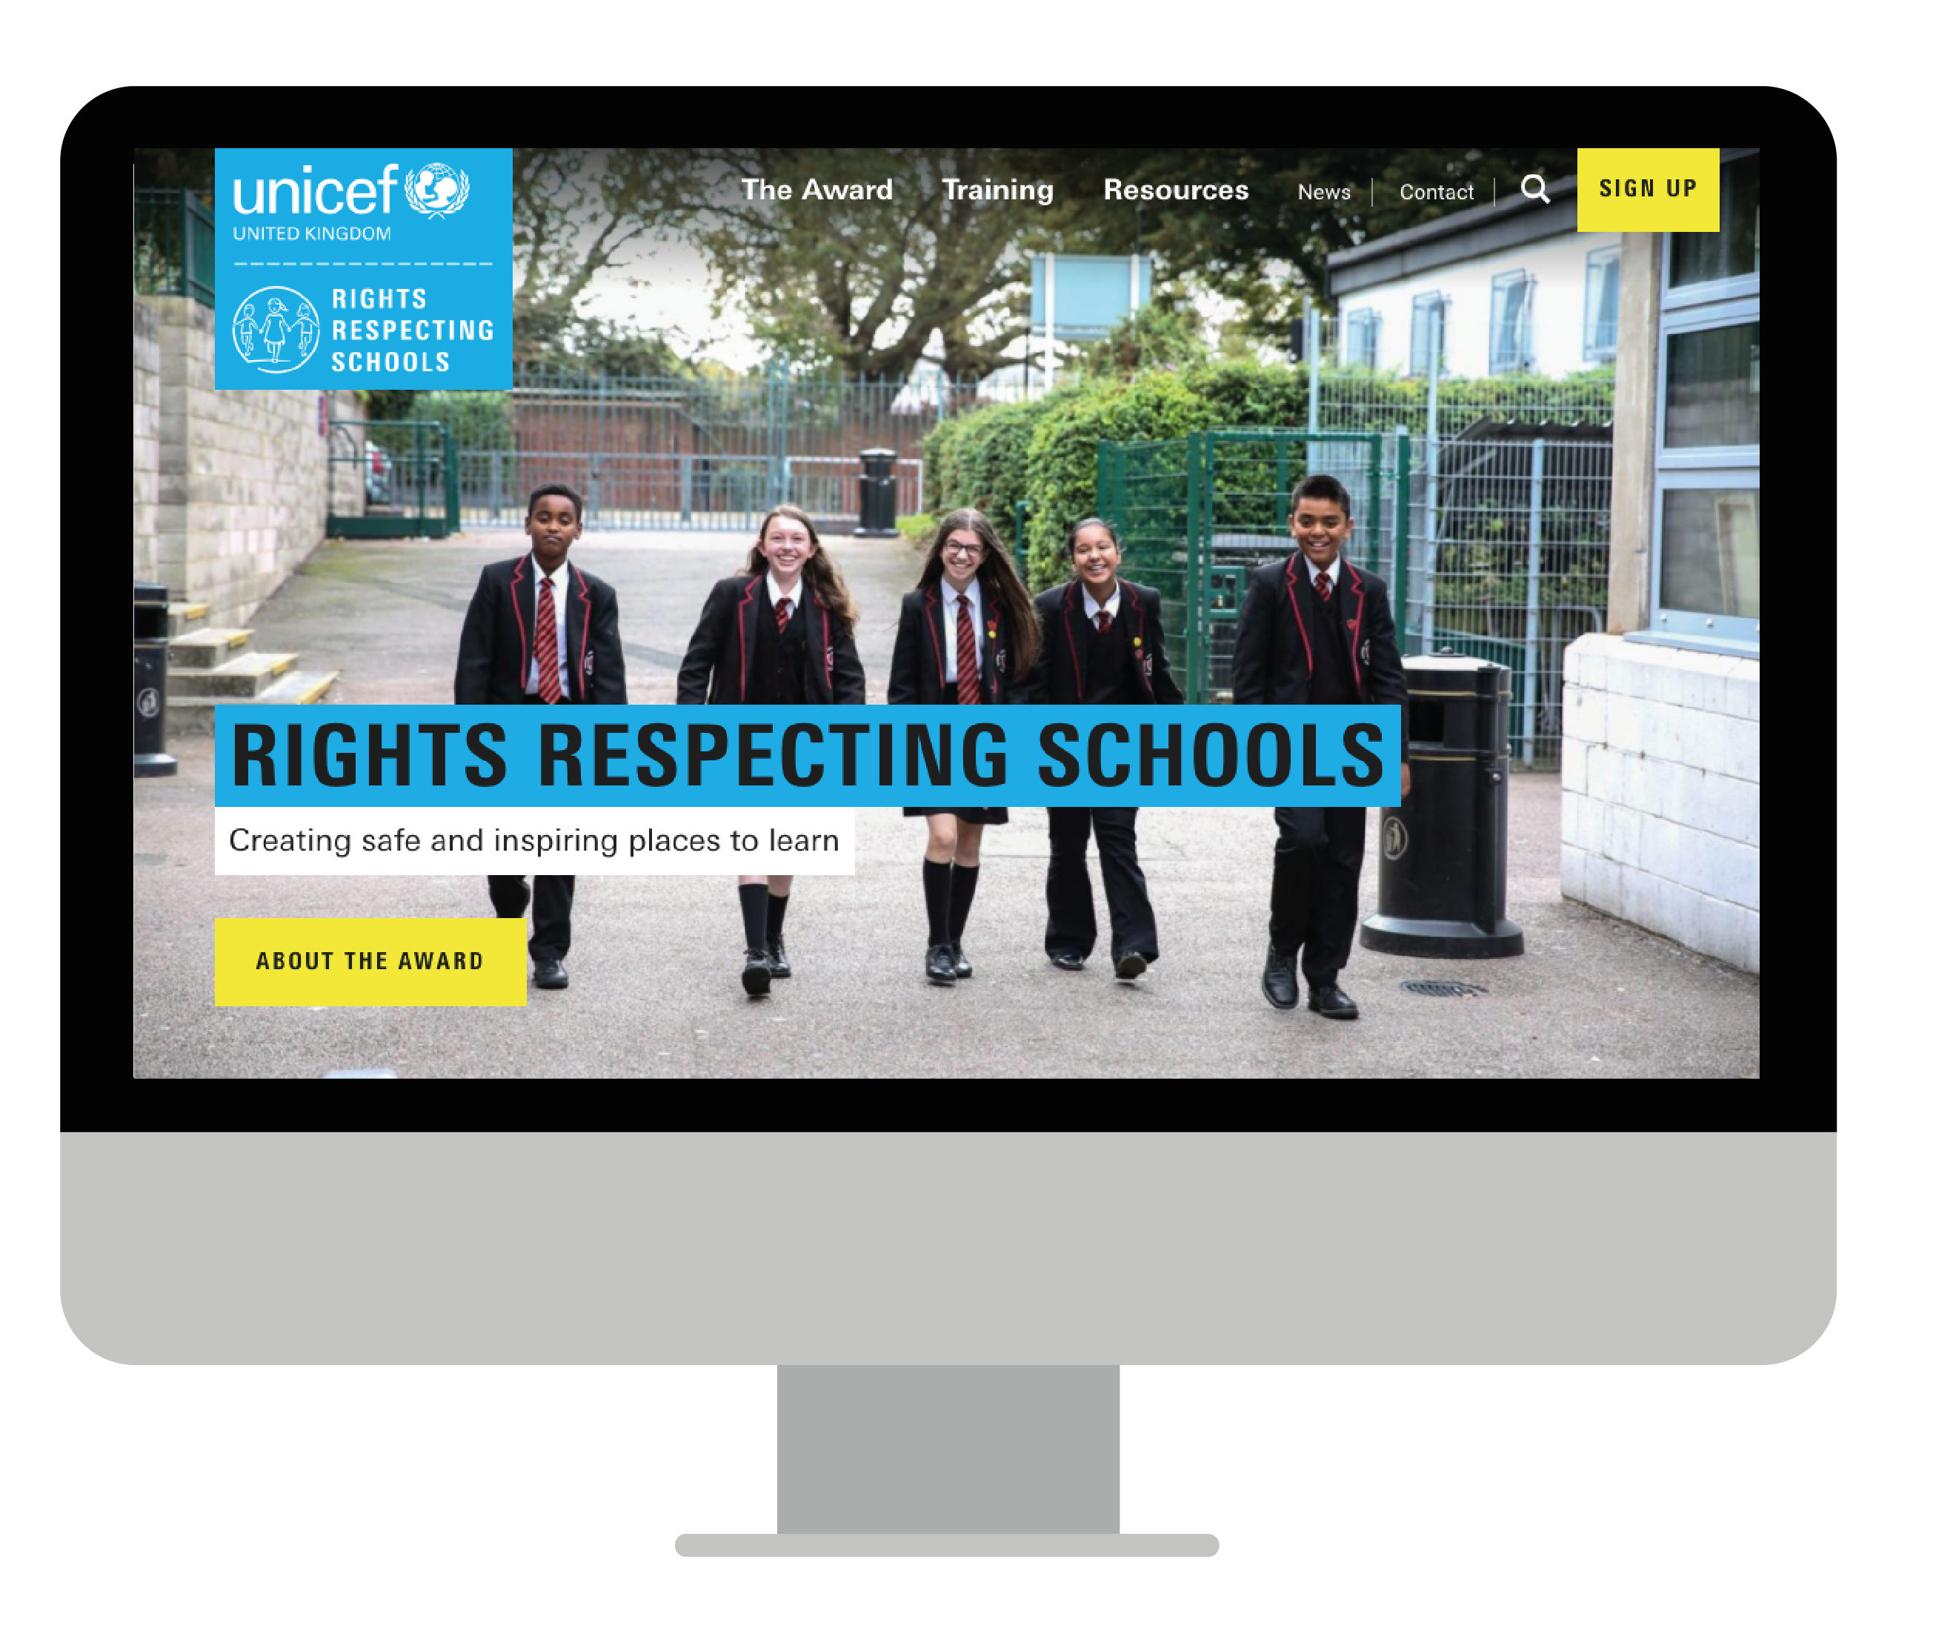
MORE INFO…
RRSA WEBSITE
For more information or to download previous Article of the Week packs please visit the RRSA website by clicking the link below
CLICK HERE

