Slide 1
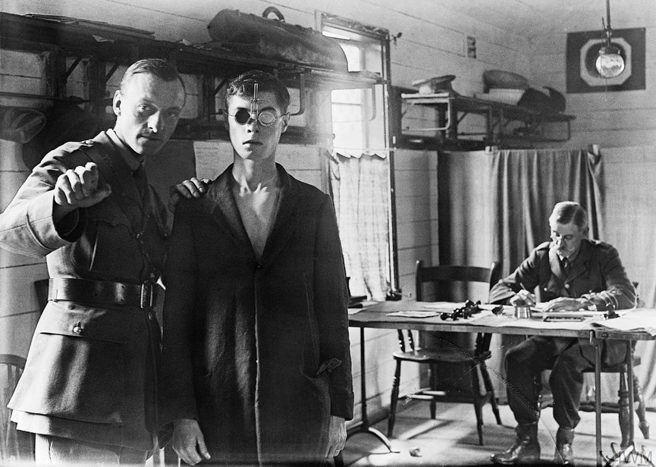
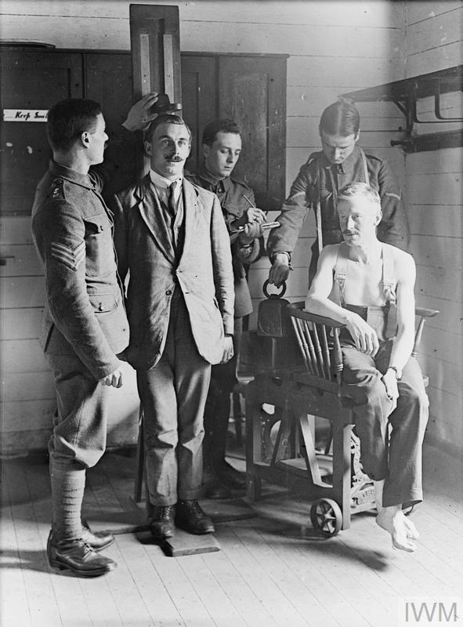

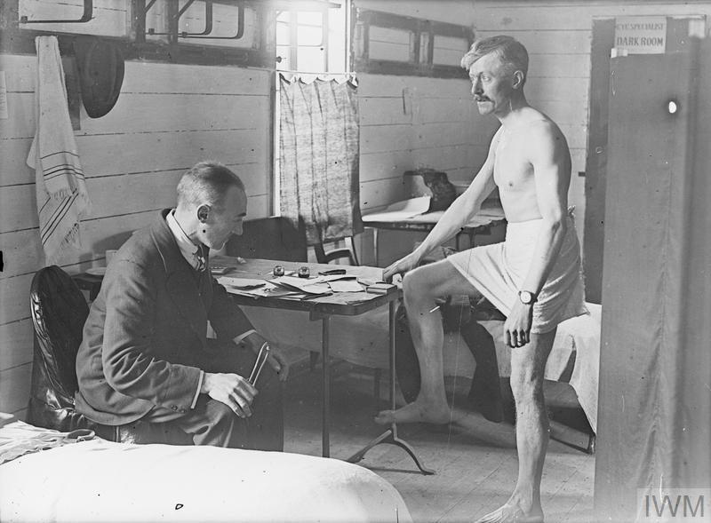
L.Q: How can a healthy body win the war? 24.01.22
P | Success Criteria | T
 | I can explain why soldiers needed to be strong and healthy.
 | I can explain how the heart and lungs work.
 | I can devise an enquiry to test the health of new recruits.
At the beginning of WW1 and WW2, there was a rush of young men eager to join the army and fight for their country.
But not all were accepted.
Why do you think some men were turned away?

Slide 2
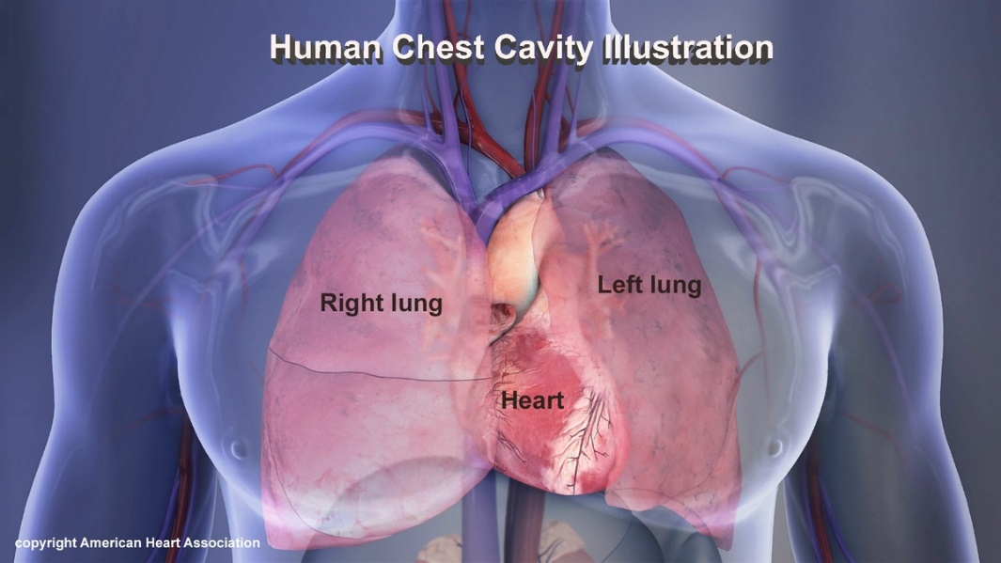
Principal points in the medical examination of recruits (1914)
That the recruit is sufficiently intelligent;
That his vision, with either eye, is up to the required standard;
That his hearing is good;
That his speech is without impediment;
That he has no glandular swellings;
That his chest is capacious and well formed, and that his heart and lungs are sound;
That he is not ruptured in any degree or form;
That the limbs are well formed and fully developed;
That there is free and perfect motion of all the joints;
That the feet and toes are well formed;
That he does not bear traces of previous acute or chronic disease pointing to an impaired constitution;
That he possesses a sufficient number of sound teeth for efficient mastication (chewing).
Why do you think is was considered so important for soldiers to have a healthy heart and lungs?
https://www.bbc.co.uk/bitesize/topics/zwdr6yc/articles/zs8f8mn

Slide 3
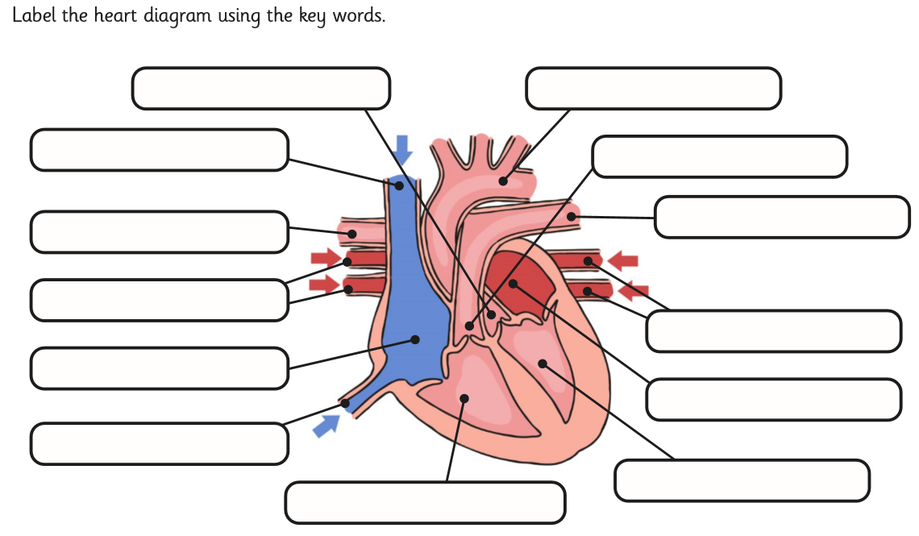
Your circulatory system brings oxygen and nutrients to every part of your body!
The other parts of your body (such as your muscles) can only do their jobs as long as they get enough oxygen.
Your heart is the pump that powers the whole thing! It is a muscle that can never stop working- if your heart stops, your brain will die in minutes.
Task 1- label the diagram of the heart for your year group.
If you have time, you can research some of the jobs of each part.
https://www.dkfindout.com/uk/human-body/heart-and-blood/heart/

Slide 4
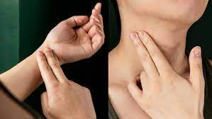
You can measure your heart rate by using a stethoscope to listen to your heart beat.
(Remember your heartbeat has two sounds for each beat!)
You can also count your pulse, which you can feel in your neck or on your wrist.
Being a soldier involves a lot of hard physical work and exercise.
You need to be highly fit and healthy.
Your heart and lungs need to be able to work efficiently to carry oxygen to the muscles.
In general, people with higher fitness will have a lower heart rate than those with low fitness.
Their heart does not need to beat as fast to do the same amount of work.
Try to find your pulse now!
If you count your pulse for one minute, you can find out your heart rate.
Measure your pulse for one minute after resting for one minute.
Then measure it again after exercising for one minute!
What do you predict will happen?

Slide 5
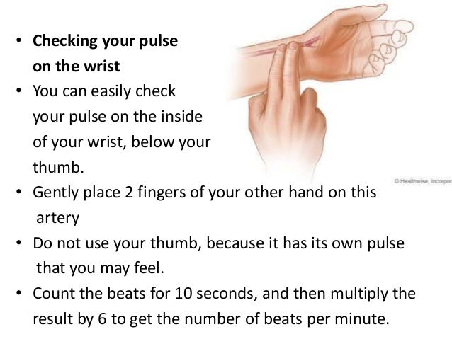
Task- cardiovascular health enquiry.
Working in a group, your task is to come up with a test for new recruits to test their cardiovascular fitness.
When will you record your recruits’ heart rate?
(resting heart rate, working heart rate or both?)
How will you collect data? (take pulse, stethoscope)
How will you record and present your data?
Recruit Name | Resting heart rate (bpm) | Working heart rate (bpm)

Slide 6
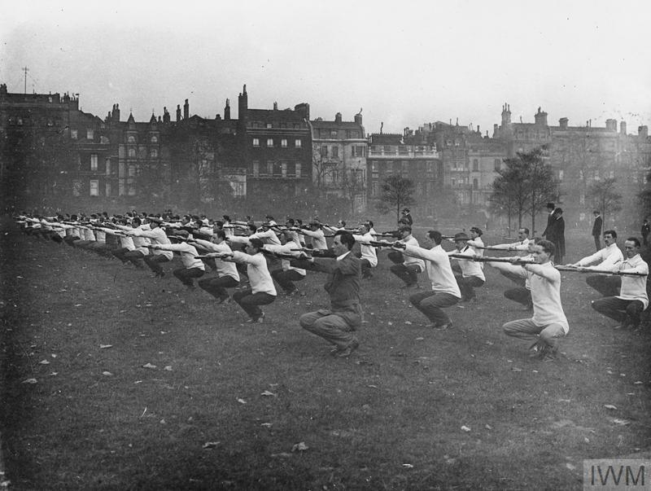
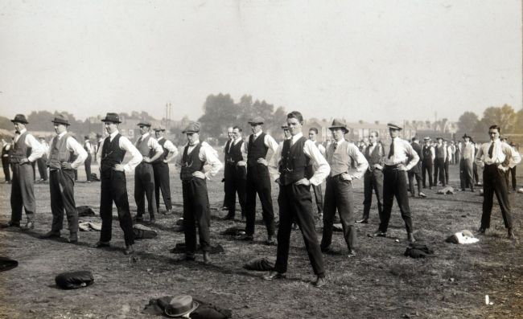
How can you improve the cardiovascular fitness of your recruits?
Come up with a plan to improve the heart rate scores you recorded.
Most recruits spent around three months in basic army training. Predict what might happen to their fitness in that time.
https://www.iwm.org.uk/history/voices-of-the-first-world-war-training-for-war

