Slide 1
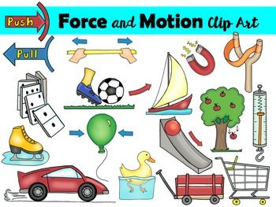
L.O: To recognise levers, pulleys and gears affect how much force is needed. 13.01.22
P | Success Criteria | T
 | I know in science a machine is something that allows us to use greater force.
 | I can recognise everyday objects that use levers.
 | I can investigate how levers allow us to exert greater force.
Talk to your partner- What are forces?
Do you know the names of any forces?

Slide 2
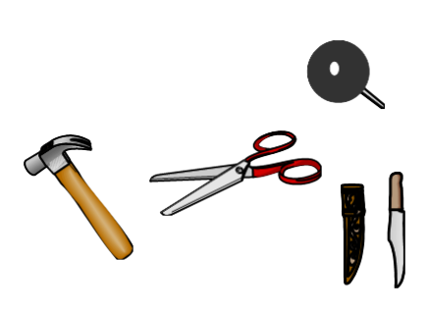
What is a machine?
Scientifically, a machine is anything that increases the amount of force you can use.
So a hammer is a machine.
A drawing pin is a machine.
A knife and fork are a pair of machines.
And even an egg whisk is a machine.
All these machines have one thing in common: when you apply a force to them, they increase its size and apply a greater force somewhere else.

Slide 3
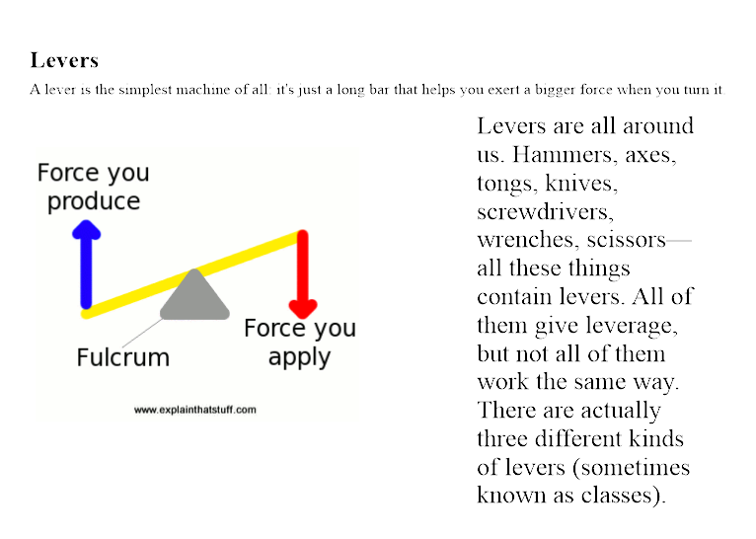

Slide 4
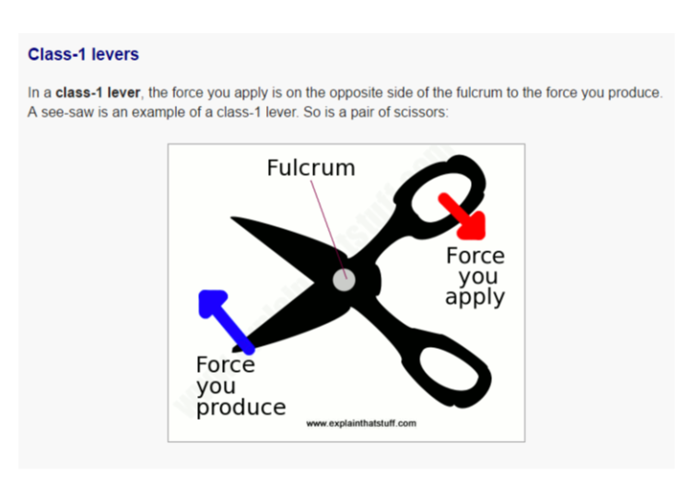
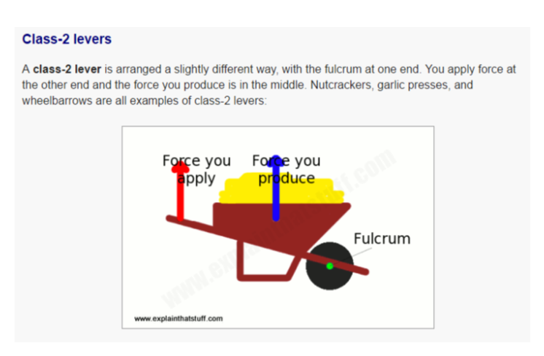
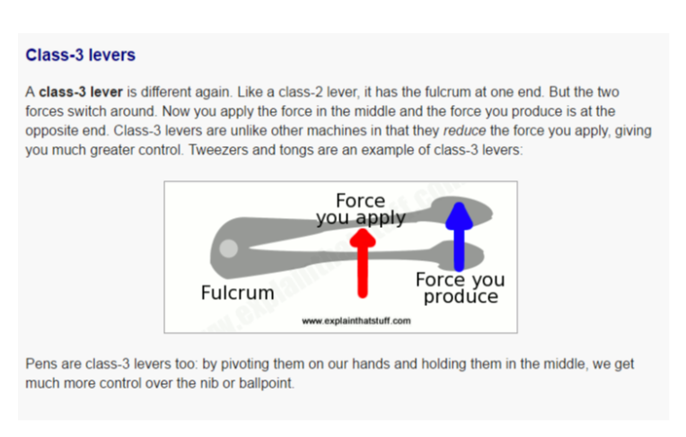

Slide 5
In your groups, think of some everyday items that use each type of lever.
Can you spot any in the classroom?

Slide 6
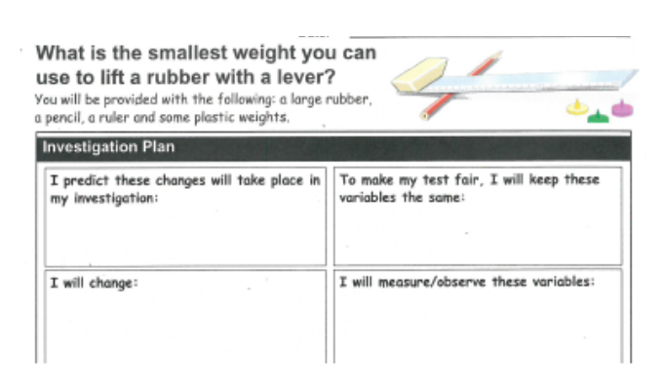

Slide 7
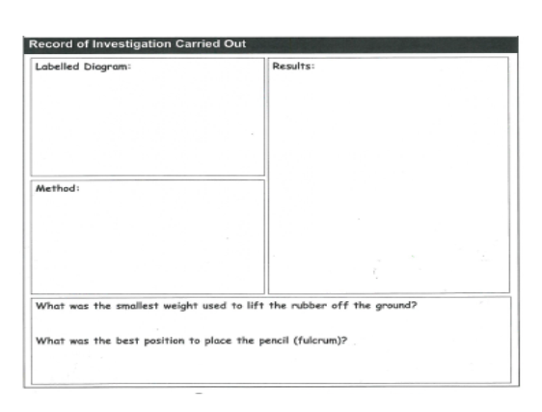

Slide 8

Plenary: Ancient Greek thinker Archimedes is reported to have once said,
Is there any scientific truth to this? Why do you think so?

