Slide 2
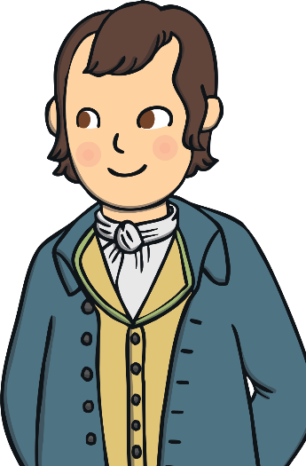
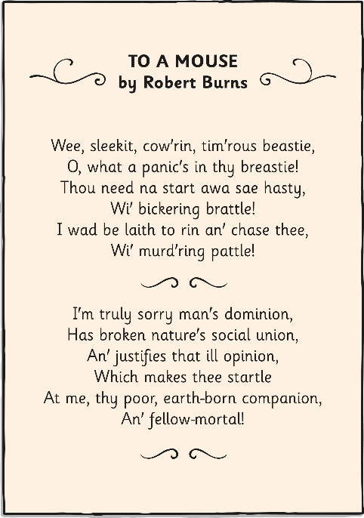
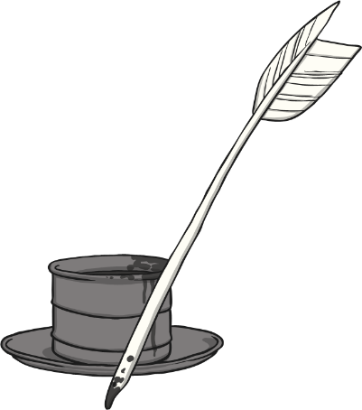
Who is Robert Burns?
Robert Burns was a Scottish poet (25th January 1759 to 21st July 1796) and lyricist and is known as the national poet of Scotland. His work is very well known and celebrated worldwide.
He wrote his works in both the Scots language and Standard English and he sometimes liked to voice his political views through them.
He also wrote folk songs which are still enjoyed by many people today.

Slide 3
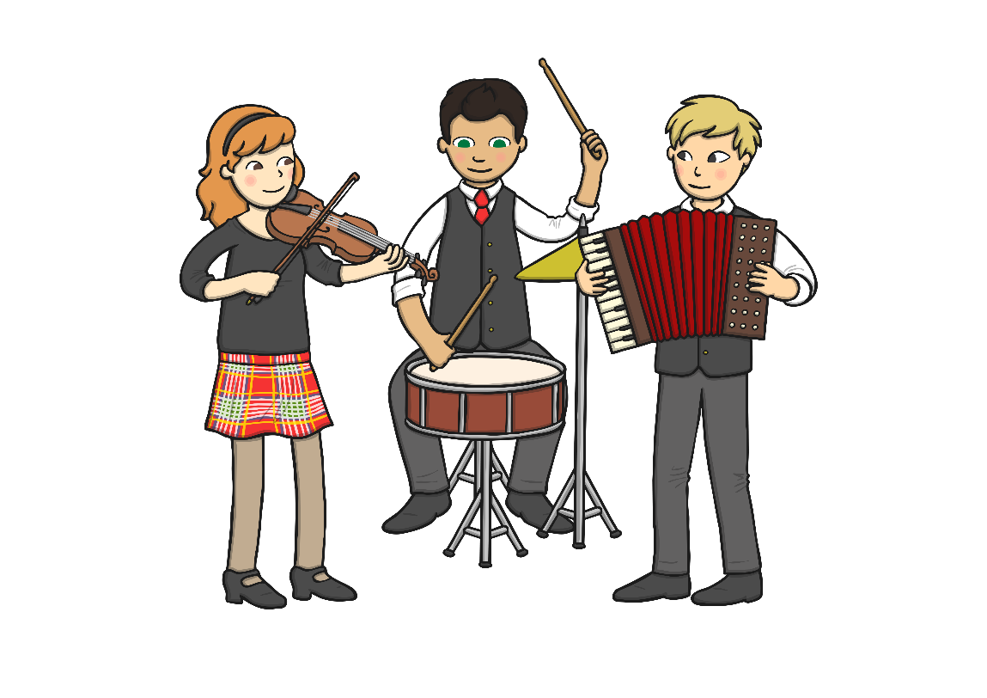
Burns’ Night
The Scottish people, and many others, celebrate Robert’s life every year on his birthday, 25th January by having a Burns’ Supper on Burns’ Night. There are clubs and societies formed, outside of Scotland as well, in honour of him, including New Zealand!
The first suppers were arranged by Robert’s friends in the 18th century and they originally held them on the 29th January, thinking it was the date of his birth. They soon discovered from church records that it was, in fact, the 25th January and have celebrated it on that night since then.

Slide 4
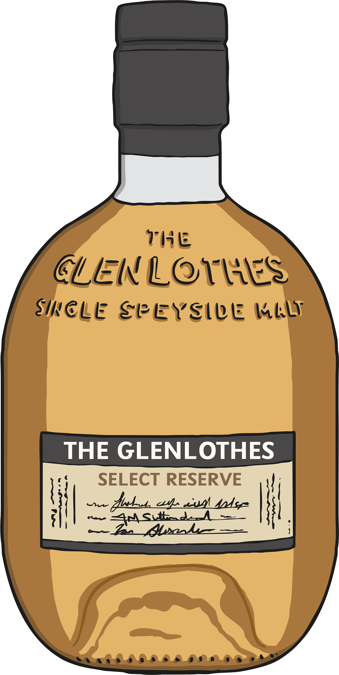
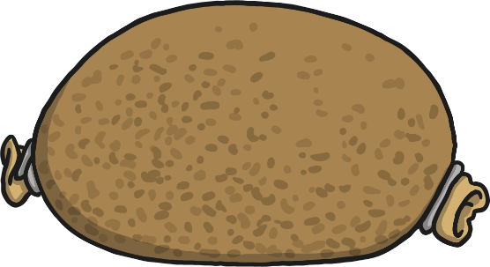
Burns’ Night
A traditional Burns’ supper will include a serving of haggis, a Scottish favourite that is a savoury pudding made with sheep’s stomach stuffed with minced sheep’s liver, heart, lungs, oatmeal, onion and suet.
Scotch Whisky will also be served.

Slide 5
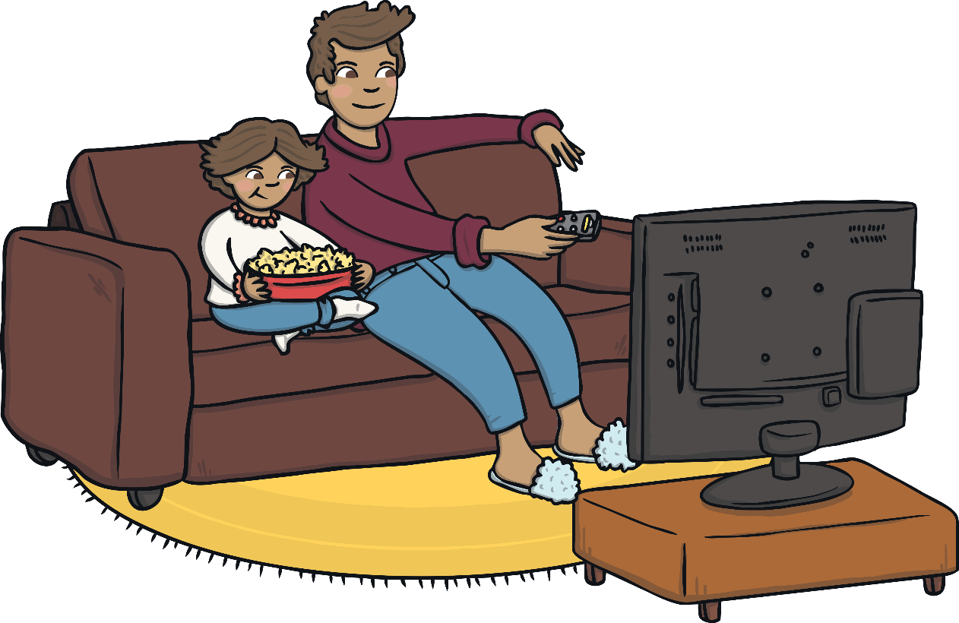
A National Figure
Robert Burns is such an iconic figure in modern Scottish culture that he was voted to be The Greatest Scot by the Scottish Public in a survey held by National Scottish television channel, STV.

Slide 6
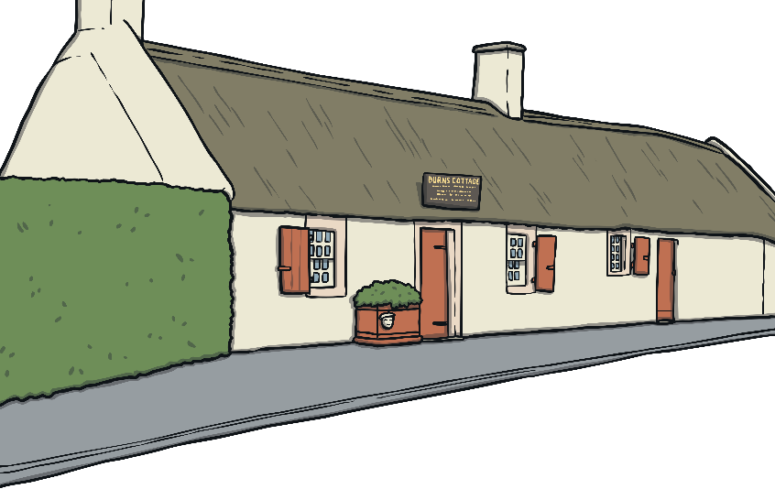
A National Figure
The Scottish are immensely proud of Robert Burns’ achievements and regard him as a national treasure.
The Robert Burns’ Birthplace Museum is situated in the location of Robert’s first ever home built by his father, William Burness. It is located on Murdoch Lane in Alloway, South Ayrshire, Scotland.

Slide 7

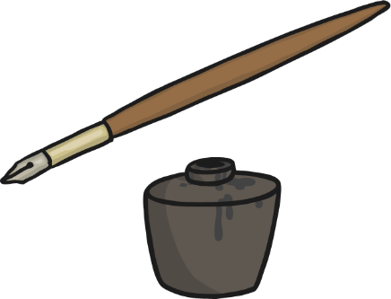

A National Figure
In the museum, there are numerous artefacts that were personal belongings to Robert, such as his quills and manuscripts of his work. There are even the pistols that he carried when he worked as an exciseman (a collector of taxes) and needed them for protection!

Slide 8
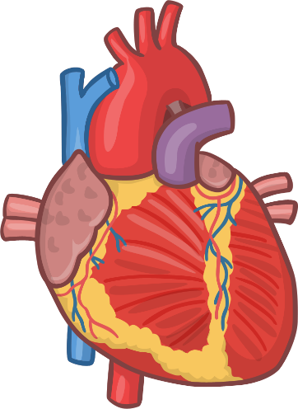
Burn’s Night
Though immensely successful and popular nowadays, in life Robert was not. He led a life of hardship and poverty with most of his education provided by his father. His controversial political views had alienated many friends and employers, who questioned his loyalty to the Scottish crown. He had 12 children altogether, resulting in 600 living descendants today.
He died at the age of 37 due to his failing health and an ongoing heart condition.

