Slide 2
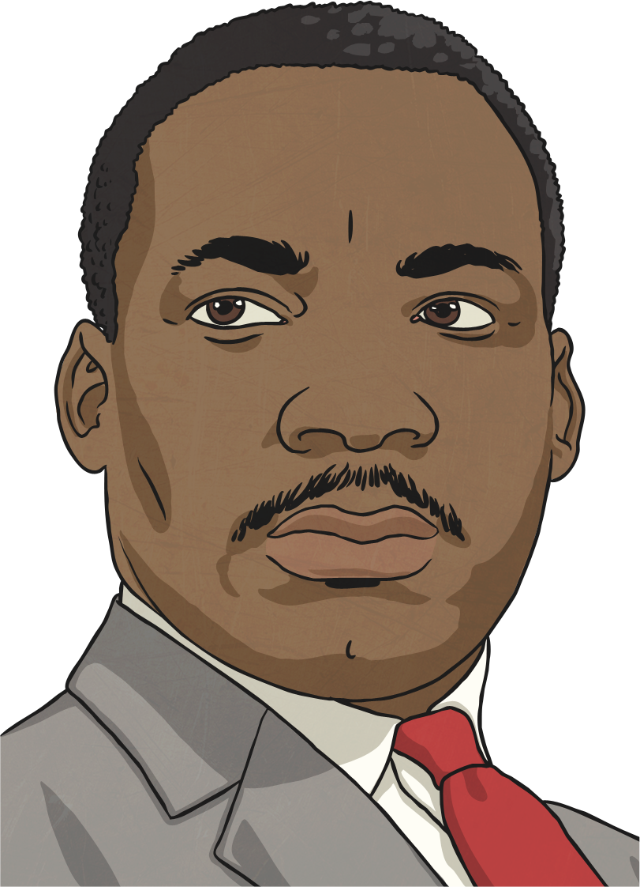
Before you finish eating breakfast this morning, you’ve depended on more than half the world.
-Martin Luther King Jr.

Slide 3
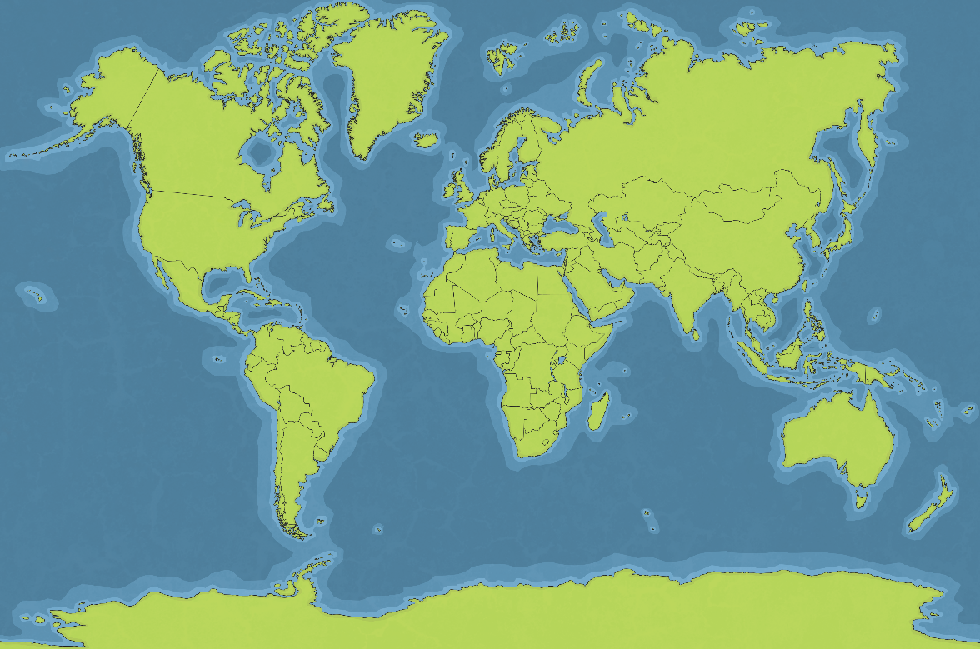



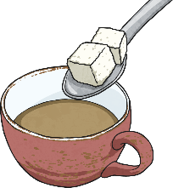

My International Breakfast Table
Costa Rica
India
bananas
cotton
Guatemala
coffee
Belize
South Africa
sugar
sultanas

Slide 4
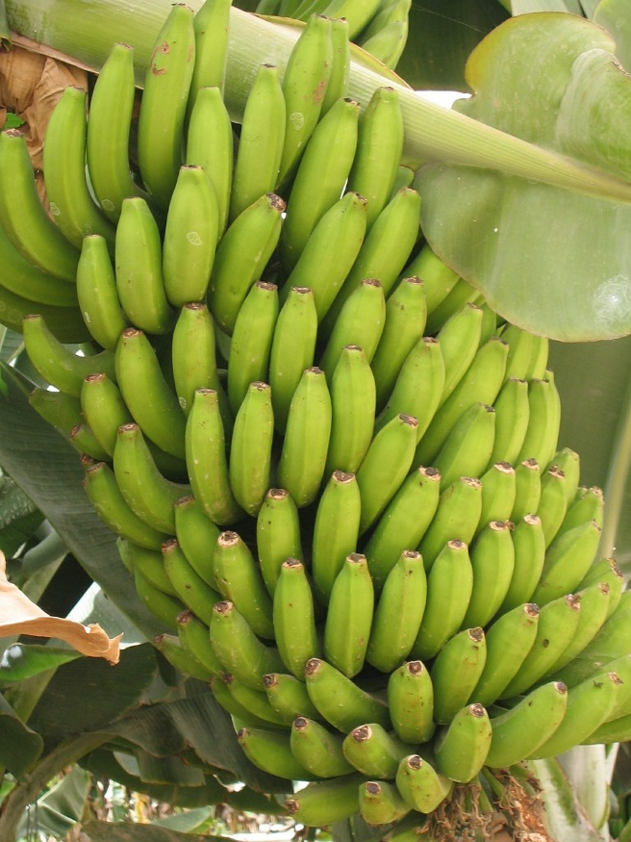
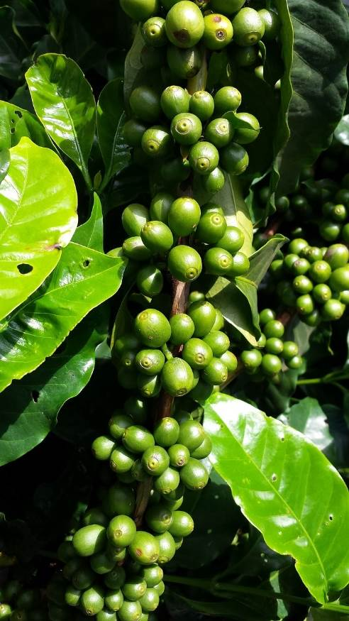
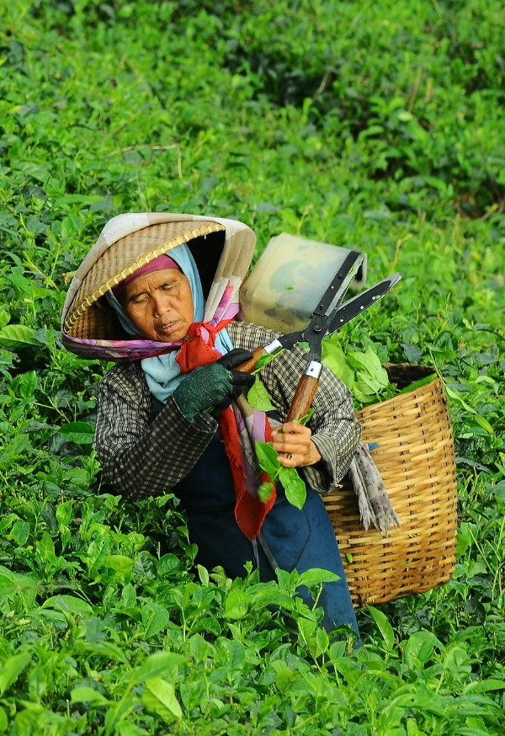
Growing and Making
People all over the world earn their living by growing food or making things to sell.

Slide 5
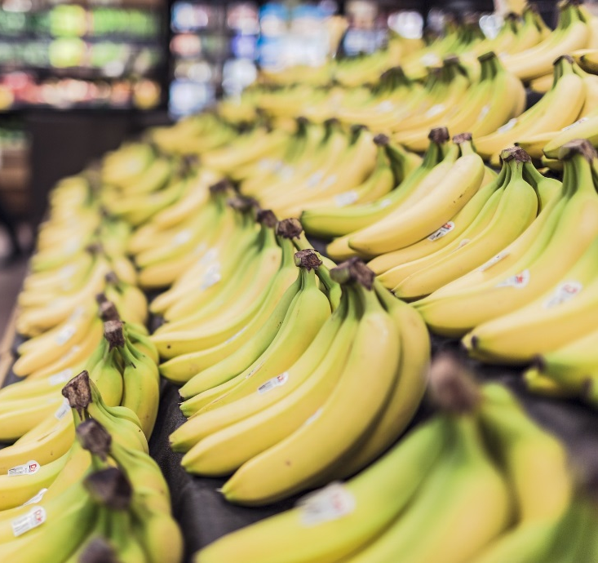

Shipping
Their food and products are shipped to other parts of the world and sold in shops.
Many products in our supermarkets are made from things imported from less developed countries in Africa and Asia for example.

Slide 6
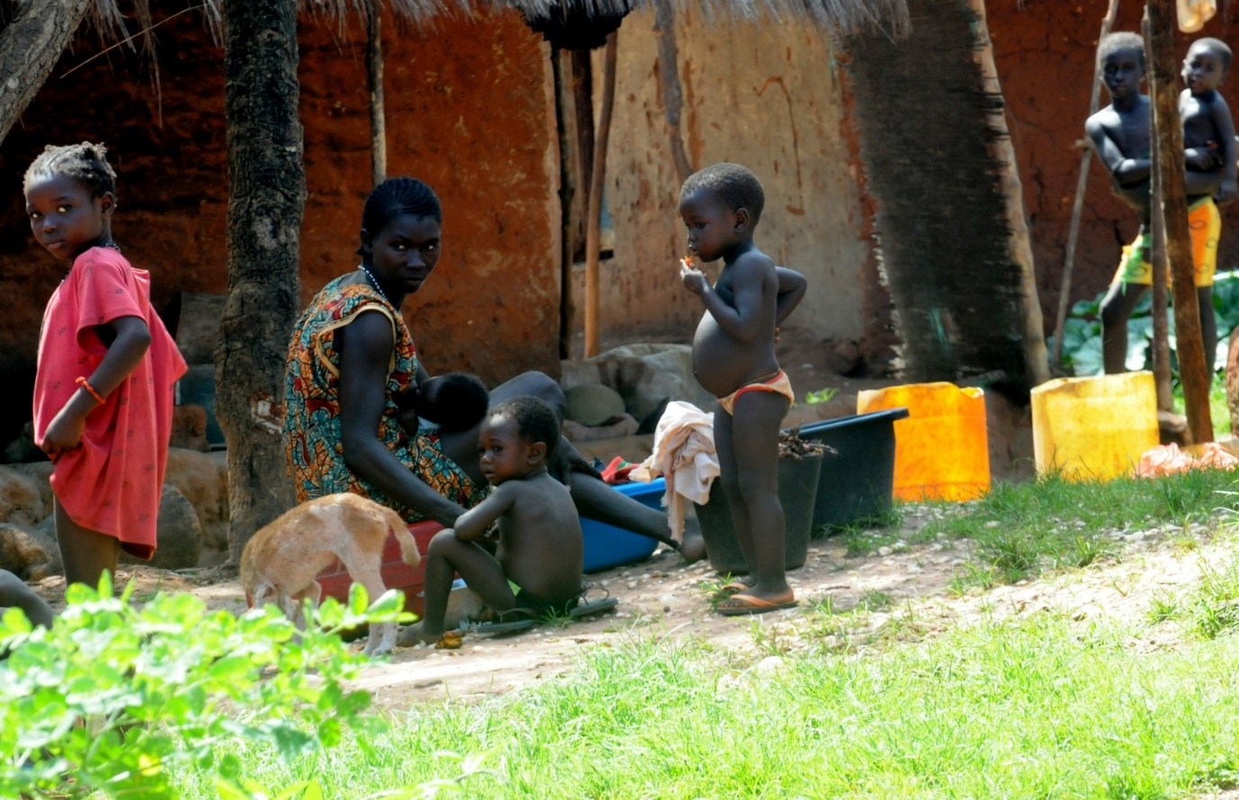
Selling
However, unless they are paid a fair price for what they have produced, they will not have enough money for food, schooling, medicine or clothing.

Slide 7
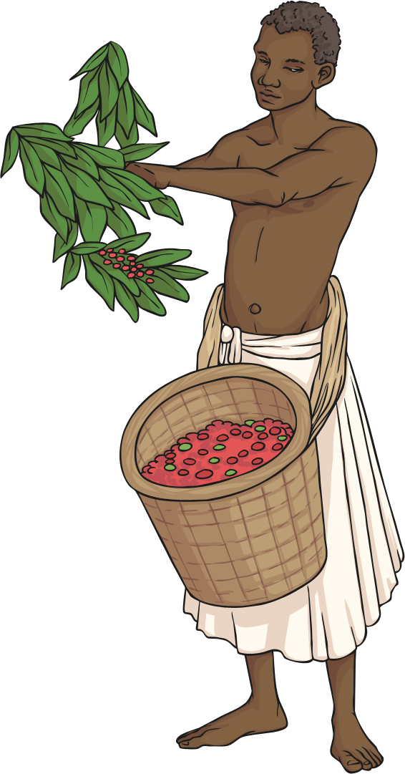
How Can Fair Trade Help?
Fair Trade is about paying a fair price for things that we buy. This helps to improve the lives of families all over the world.
Did you know?
Fair Trade helps over one million farmers and
workers in 74 countries across the world!

Slide 8

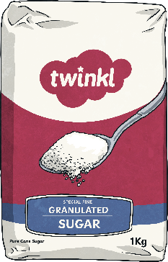


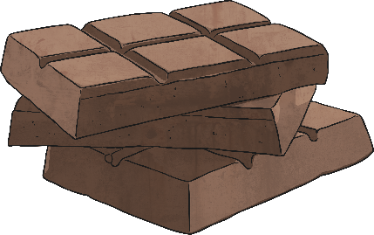

Fairtrade Produce
How do you know if a product is Fairtrade?

Slide 9


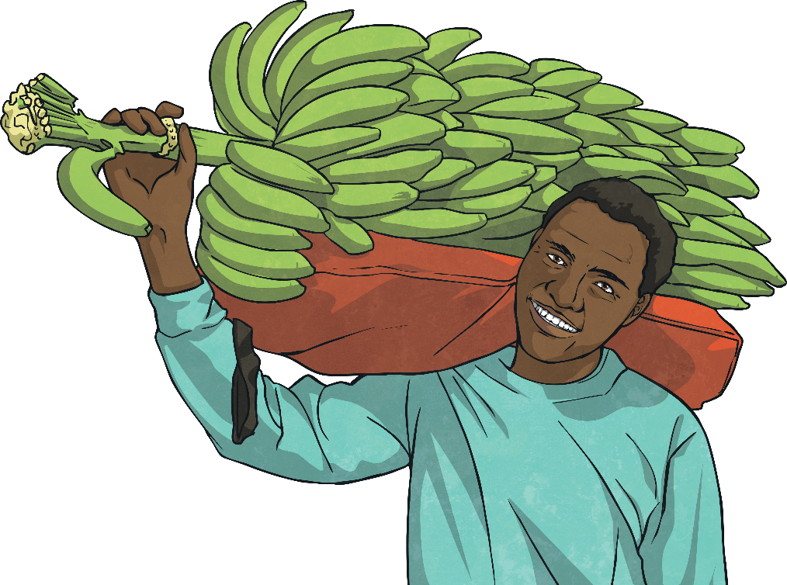
The Fairtrade Logo
Only one in three bananas bought in the United Kingdom are Fairtrade.
If this logo is on a product, it means that it is Fairtrade.

Slide 10

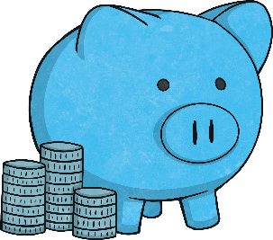
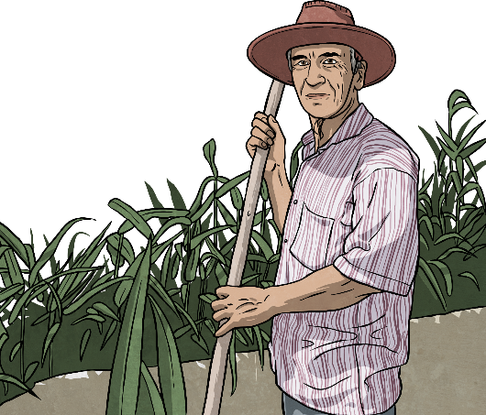
How Does Fair Trade Help?
The great things about choosing to buy Fair Trade items:
Workers receive better prices for crops so people can live better lives.
Extra money goes into projects that help the local community such as bicycles to get to work or wells to provide water.
Workers have better working conditions.

Slide 11
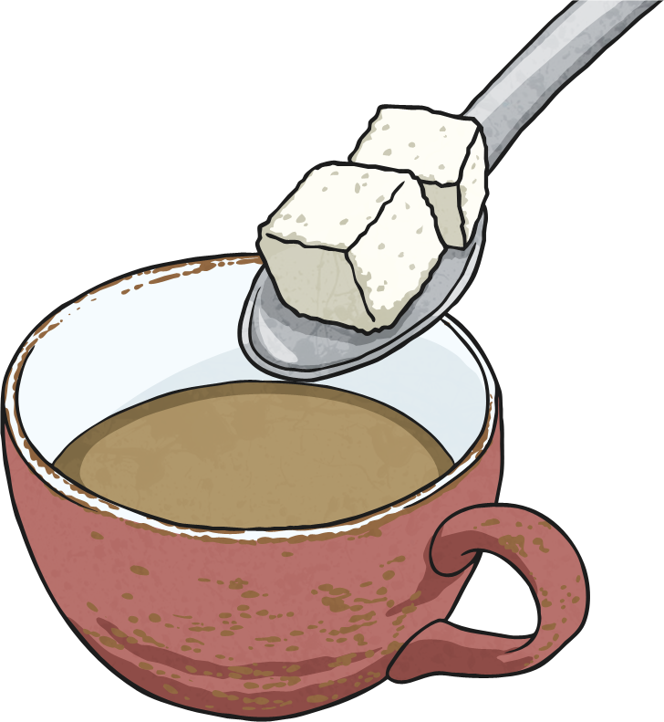
Fair Trade Awareness
Fairtrade Fortnight aims to improve the banana industry to make sure that the people in the supply chain and the millions of struggling banana farmers and workers get a fair deal.
How do people take part?
By buying bananas and other products that have the Fairtrade symbol on them. If you do this, you know that a fair price has been paid to the workers.
World Fair Trade Day is celebrated all over the world every year in May.
How do people take part?
By raising money to help this worthwhile cause.

Slide 12
Time for Reflection
Do all of the workers get a fair price for the produce they grow?
Think about the workers who grow all of the foods we like to eat.
Would buying Fairtrade products help improve the lives of others?

