Slide 2


Who Is the Masked Reader?
Can you work out who the celebrity masked reader is and what book they are reading?
?
Solve three clues to work out who the masked reader is.
?
Solve three more clues to find out what book they’re reading.

Slide 3

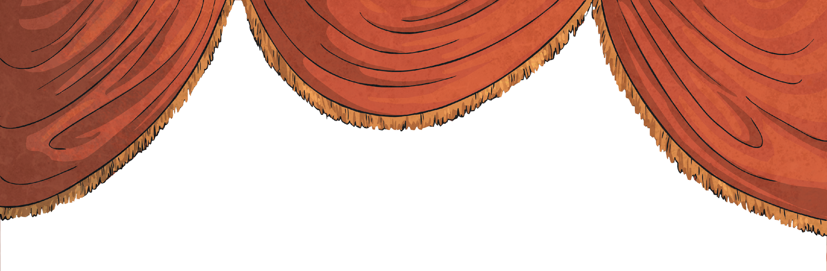



Masked Reader 1
Clue 1: He is a judge on the TV show ‘Britain’s Got Talent’.
Clue 2: He is a children’s book author, a comedy writer and actor.
Clue 3: He swam 140 miles of the River Thames in 2011 for Sport Relief.
?
Click to find out who it is.

Slide 4


It’s David Walliams!

Slide 5
Can you guess what David is reading?
Clue 1: The lead character in the book is a boy.
Clue 2: The boy finds he isn’t good at being good.
Clue 3: One of the characters in the story is called Perfect Peter.
?
Click to find out what the book is.

Slide 6

David is reading ‘Horrid Henry’ by Francesca Simon.

Slide 7
Masked Reader 2
Clue 1: He is a British rapper and makes grime music.
Clue 2: He was the first British rapper to headline at Glastonbury (a famous festival). He was also the first Black
British solo artist to headline there.
Clue 3: He has started publishing books under the label #Merky Books.
?
Click to find out who it is.

Slide 8
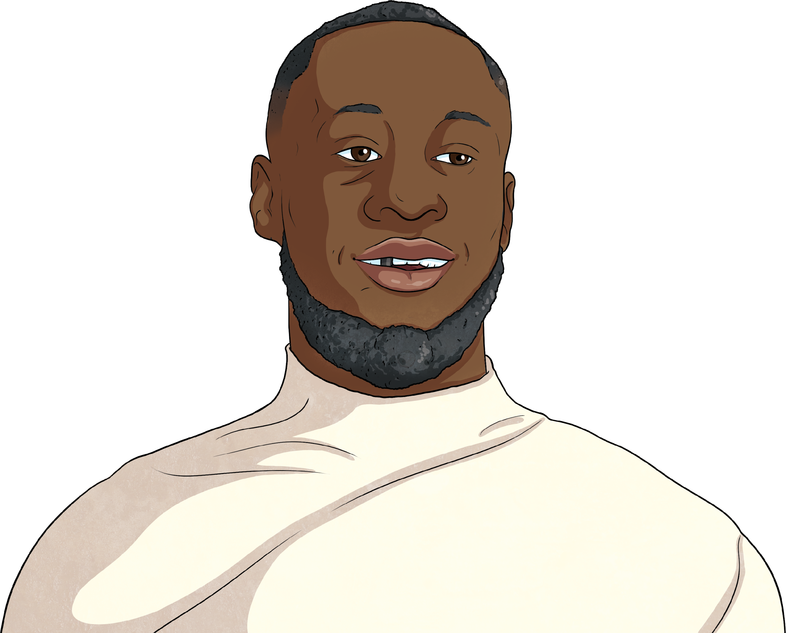
It’s Stormzy!

Slide 9
Can you guess what Stormzy is reading?
Clue 1: The book is written by Stormzy’s favourite author, Malorie Blackman.
Clue 2: The story is about a missing teddy bear.
Clue 3: It has a character called Prince, a detective dog.
?
Click to find out what the book is.

Slide 10

Stormzy is reading ‘Betsey Biggalow the Detective’ by Malorie Blackman.

Slide 11
Masked Reader 3
Clue 1: She is a professional singer and one of her albums is called ‘Our Version of Events’.
Clue 2: She had the honour of performing at the opening and closing ceremonies of the London Olympics in 2012.
Clue 3: She received an MBE for her services to music.
?
Click to find out who it is.

Slide 12

It’s Emeli Sandé!

Slide 13
Can you guess what Emeli is reading?
Clue 1: The book is about siblings, Amanda and Josh, who have just moved to a new house.
Clue 2: The story is set in the town, Dark Falls.
Clue 3: Amanda and Josh have a suspicion that their house is haunted.
?
Click to find out what the book is.

Slide 14
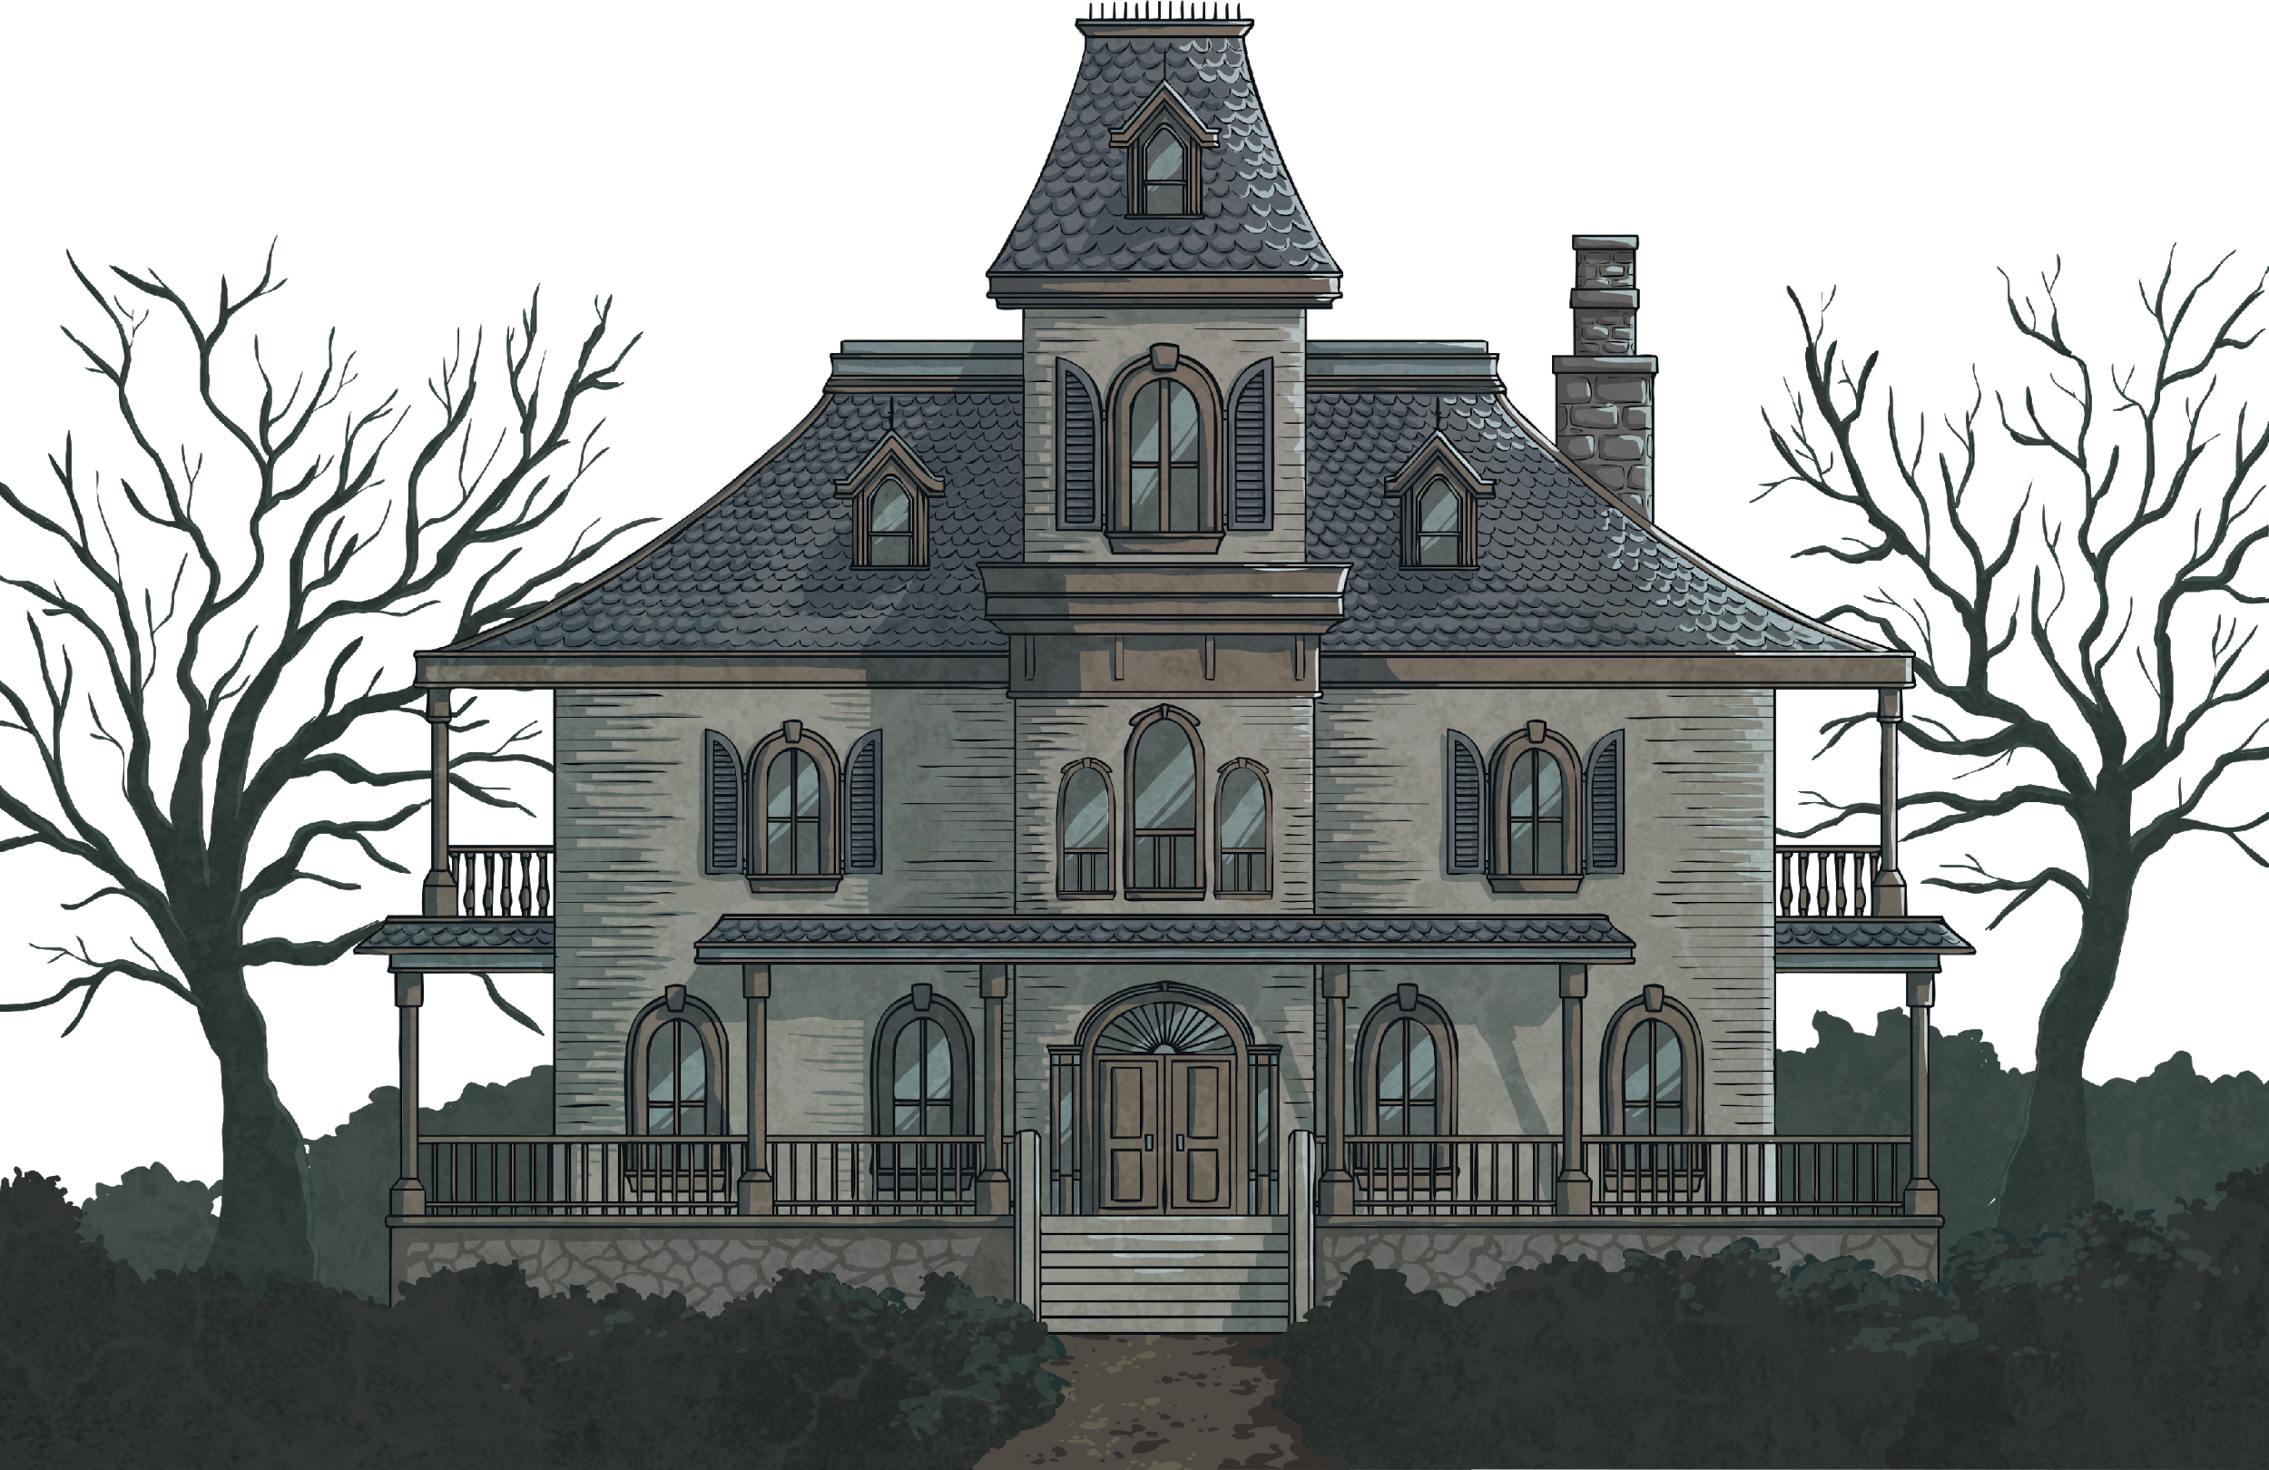
Emeli is reading ‘Welcome to Dead House’ by RL Stine.

Slide 15
Now It’s Your Turn!
Think of your own masked reader (this could be a celebrity, or someone in your school).
Think of the book the masked reader is reading.
Think of three clues about the reader and three about the book.
?
Let your classmates try to guess who your masked reader is and what they are reading.

