Slide 1
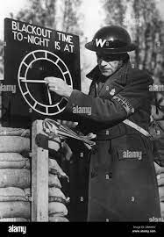
LO: To understand what happened during the Blitz.
Must: I can explain what the ‘Blitz’ meant.
Should: I can explain how people protected themselves.
Could: I can use mapping skills to place defences in England.
Even better if: I can use empathy to understand other’s experiences.

Slide 2
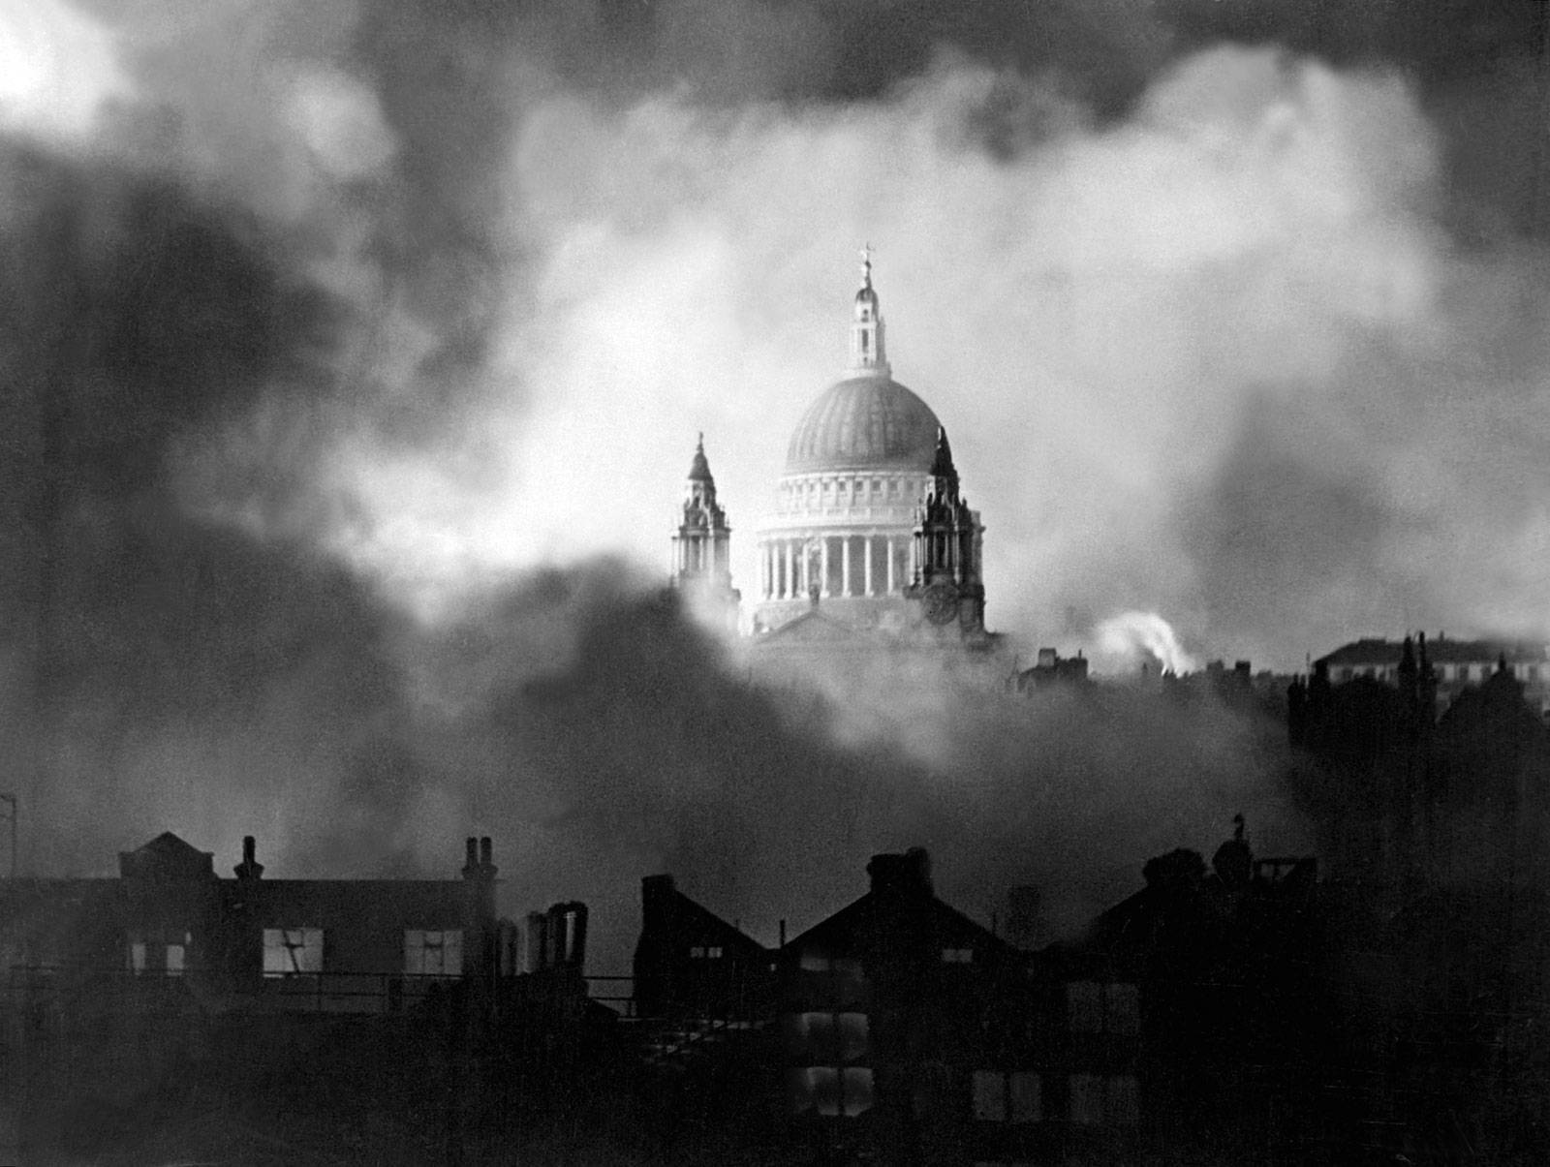
The Blitz.
What Does Blitz Mean?
The word Blitz is short for the German word ‘Blitzkrieg’, which means ‘lightning war’.
From September 1940 until May 1941, Germany began air raids in which they bombed parts of Britain at night-time. They decided to concentrate on bombing London and on 7th September 1940, London’s first night of the Blitz took place, killing over 2000 people.
https://www.bbc.co.uk/teach/class-clips-video/history-ks2-the-blitz/zm22jhv

Slide 3
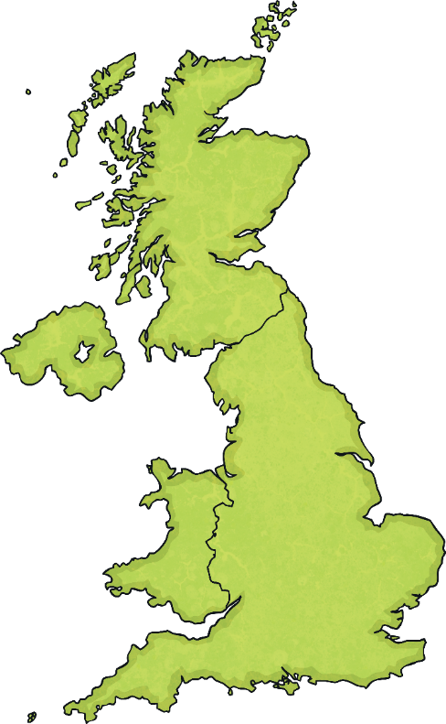
Why Were the Germans Bombing?
The Germans wanted to damage industrial areas, like factories and ports, so that it made it harder for the British to move weapons to fight them.
They didn’t just stop at London. They bombed many other places throughout the country. They also bombed areas where people lived and thousands of people were killed.
Adolf Hitler thought that if the people of Britain saw others being killed and that their country was being destroyed, they would give up and stop fighting them, allowing Germany to take control of their country.

Slide 4
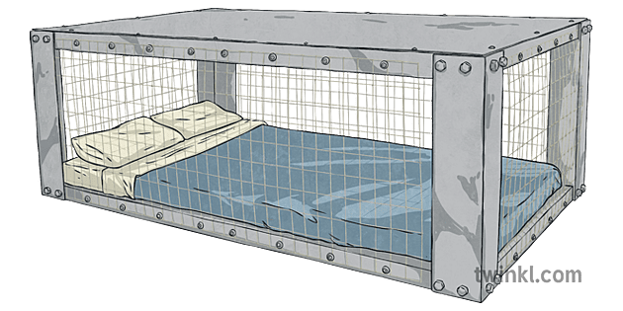
How did people protect themselves?
The RAF flew ‘interception’ missions to attack German bombers before they arrived at the target. Radar allowed the RAF to detect enemy planes in time.
People would shelter in public shelters, or they would construct shelters at home such as Anderson shelters.
The ‘blackout’ came into effect. People would cover lights up so towns would be less visible from the air. Windows, street lights and car headlights would be covered to let out a minimum amount of illumination.

Slide 5
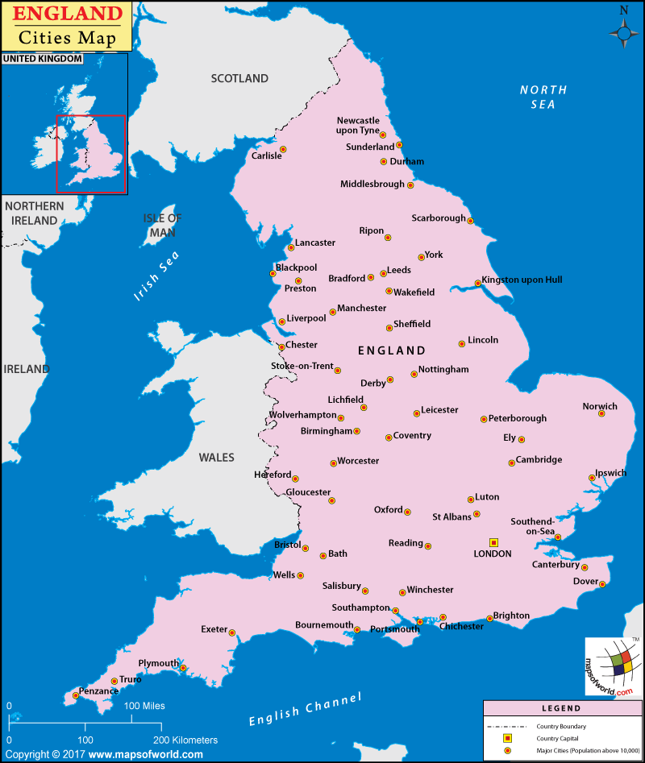
Your task is to plan where to build radar stations and RAF bases.
Your goal is to protect UK cities vital to the war effort, such as London and Coventry.
You have enough resources to build 8 radar stations. Radar stations can detect enemy planes up to 80 miles away. (radius of 80 miles)
You have enough resources for 6 RAF bases. Pilots flying from the bases will generally have enough fuel to fly 100 miles for interceptor missions. (radius of 100 miles).
Choose a symbol for Radar stations and RAF bases and place these on the map- don’t forget to add them to the legend!
Use the scale to judge the radius each one can protect.

Slide 6
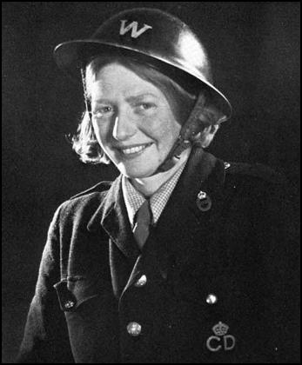
ARP officers were in charge of organising the blackout and making sure the people made it to the shelters. It was a difficult job.
It has started! If they keep this up for another week, the war will be over. The East End won’t be able to stand much more of this sort of thing. What’s more, the Fire Brigade won’t be able to stand much more of it either. This is the first leave I’ve had since Thursday… Down came the bombs. You could hear the HEs going over the top with a low whistling sound. After a moment or two they started in with the incendiaries and dropped a Molotov over the docks. There was fire in every direction. The City was turned into an enormous, loosely stacked furnace, belching black smoke. Air Raid Warden ( London ) , 1941
"When the siren sounded we would hurry to the shelters, ticking off the names of the residents in their areas as they arrived, then back they went to hurry and chivvy the laggards and see that those who chose to stay in their houses were all right... They carried children, old people, bundles of blankets, and the odd personal possessions which some eccentrics insisted on taking with them to the shelters." Francis Faviell—ARP ( London ) 1958
‘’I go into a house, decide who's alive and who's dead, tot up the number of victims and what is necessary in the way of fire services, ambulances, demolition etc... Women warders are better than men in most cases... They can see in a moment who is in the house because they know what to look for. If the kettle is on the stove they know the occupants are probably downstairs and have not gone to bed; if there is a cot they know there is a baby about somewhere." Senior Warden, 1941
Discuss- What skills would a good ARP warden need?
Do you think you have what it takes?

