Slide 1
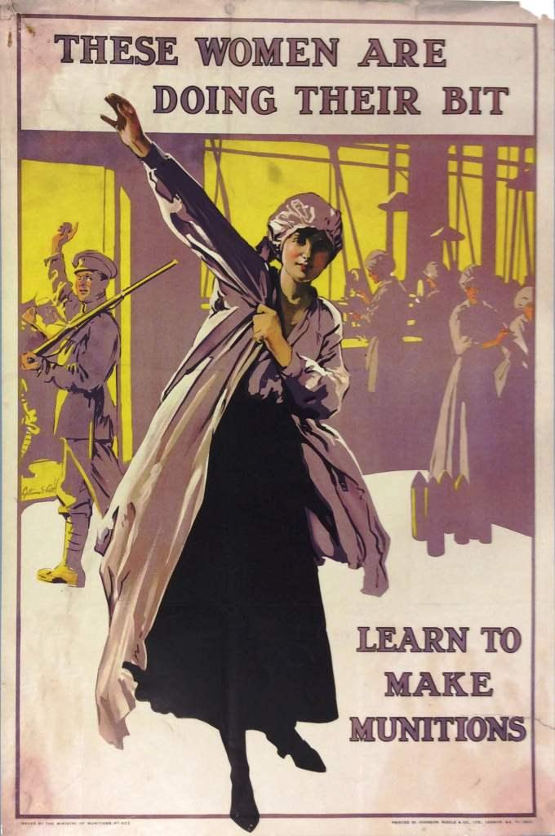
L.O: To learn about WW1 propaganda. 17.01.22
P | Success Criteria | T
 | Must understand the purpose of propaganda in WW1.
 | Should: use empathy to think how the posters make the viewer feel.
 | Could: evaluate how persuasive different posters are.
 | Even better if… I can argue whether using propaganda is ethical.
https://www.bbc.co.uk/teach/class-clips-video/your-country-needs-you/zrhmhbk

Slide 2
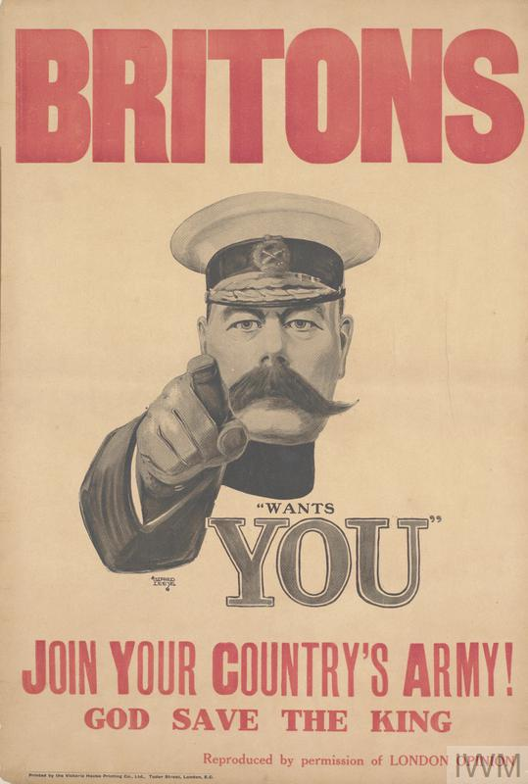
This is a very famous poster you may have seen before. The man in the image is Lord Kitchener, who was the government’s secretary of war.
He knew that the British army needed more men and hoped to inspire 100,000 people to join up. He believed that volunteer soldiers would be more effective than conscripted soldiers.
Lord Kitchener was very popular with the British public. They believed he would ‘win the war by Christmas’.
https://www.historyforkids.net/lord-kitchener.html
What do you think is effective about this poster?
What do you think is not effective?

Slide 3
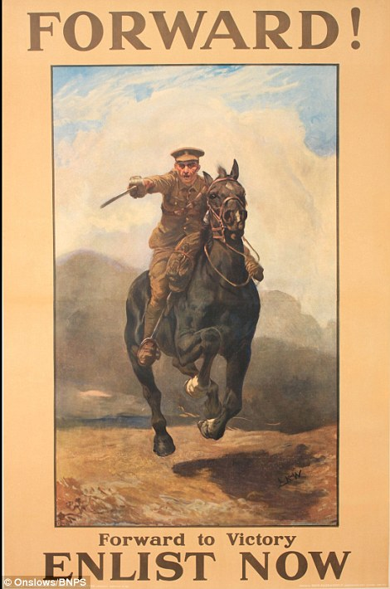
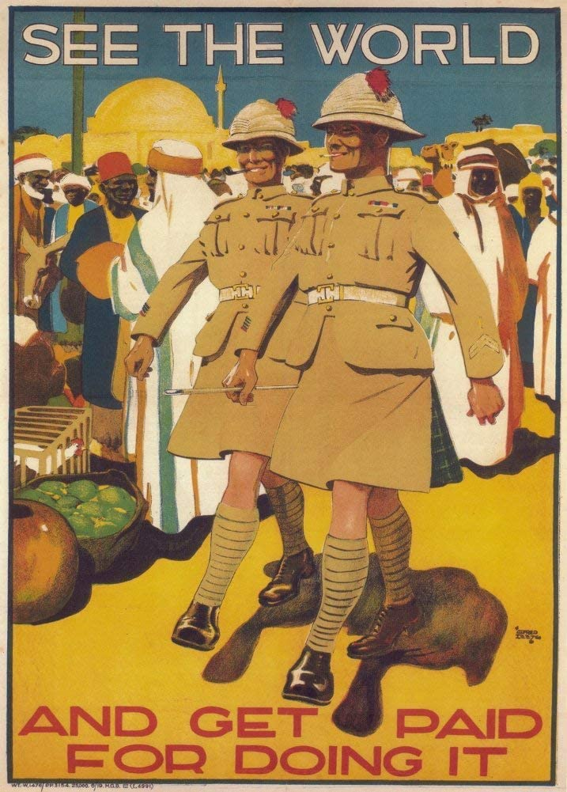
Many young men thought that going to war would be an exciting adventure.
How do these posters make going to war seem attractive?

Slide 4
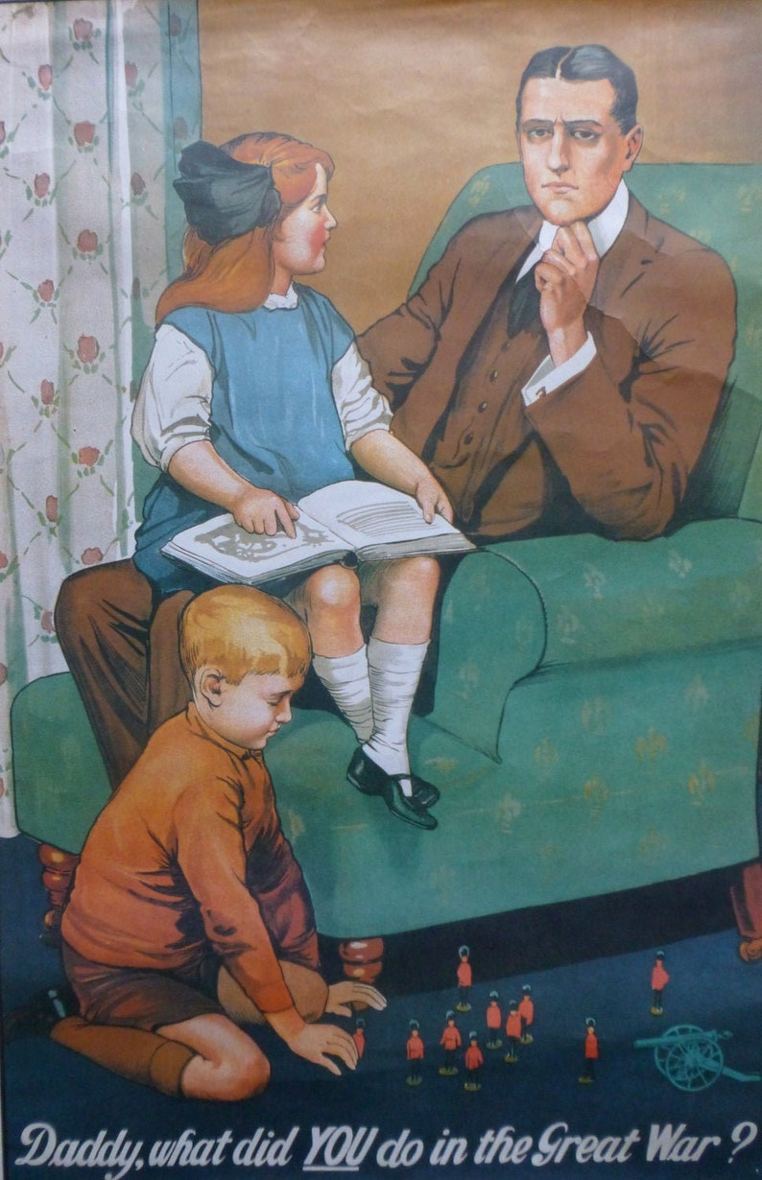
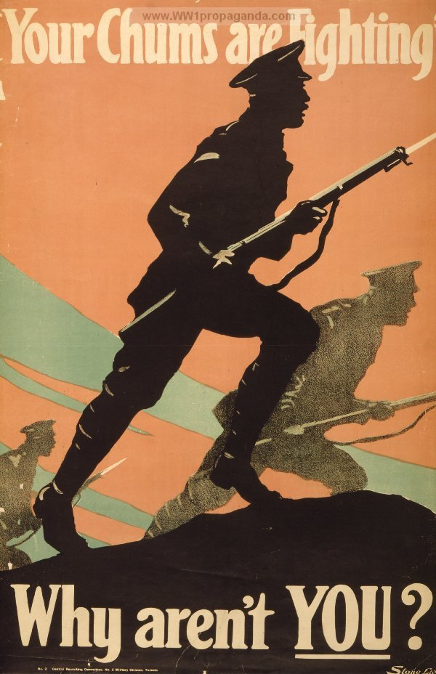
Some took a different approach- what emotion are these posters designed to make the viewer feel?
Do you think they are effective?

Slide 5
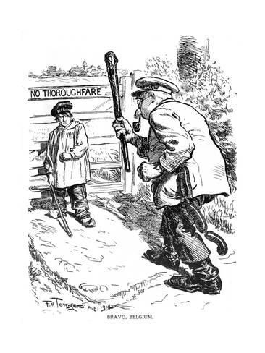

Many people in Britain were very angry that Germany had invaded the small country of Belgium.
They saw the Germans as bullies, trying to push smaller countries around.
What kind of story do you think the cartoon on the left is trying to tell?

Slide 6
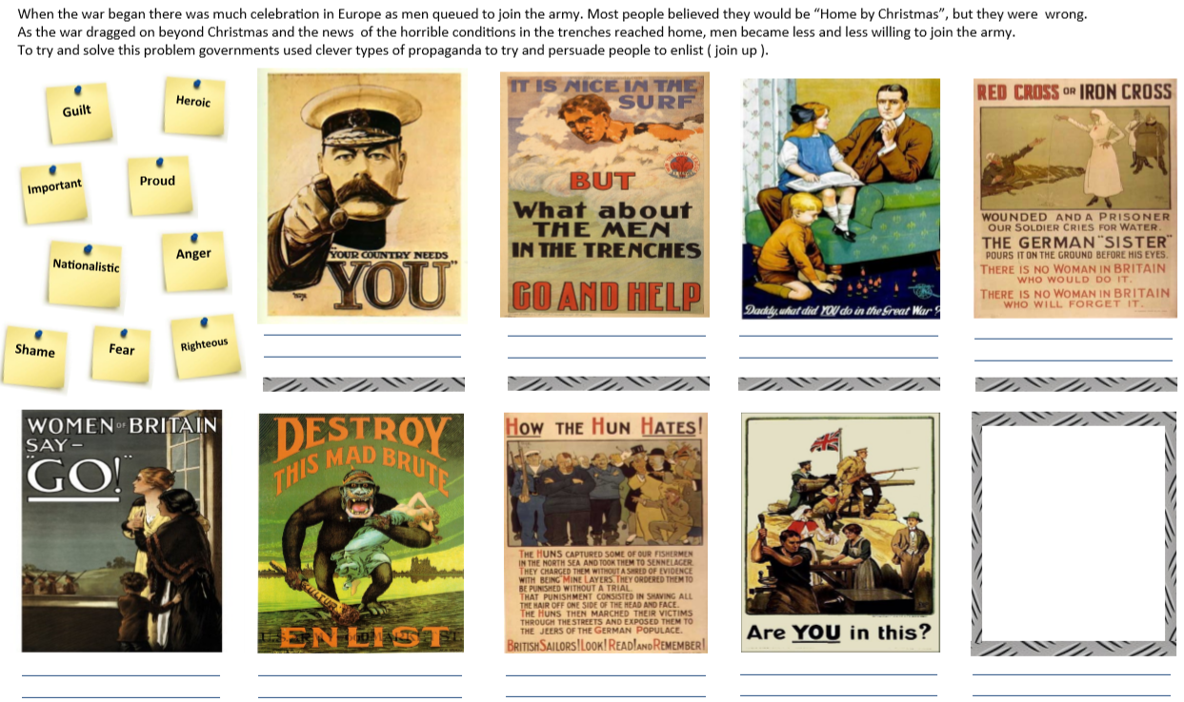
Task- identify the emotion each poster is trying to create. Then order the posters by how effective you think it is!

Slide 7
Plenary- Discuss this question with your partner. Do you agree?
Is it morally right for a government to use propaganda to influence its citizens?

