Slide 2


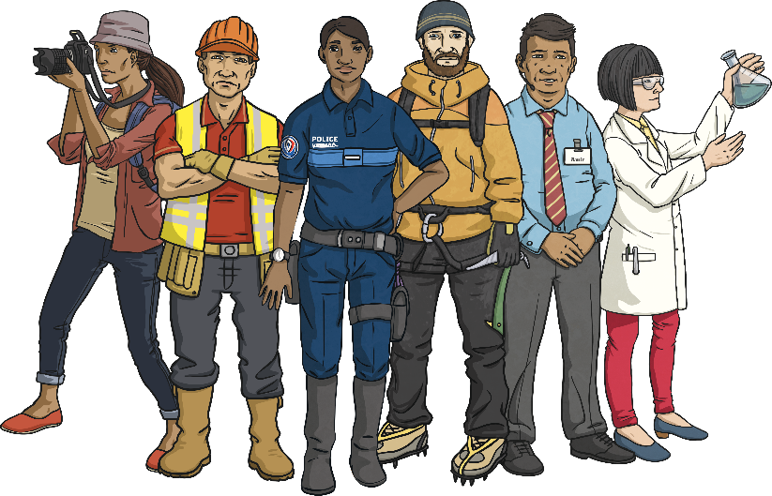
What Is a Career?
A career is a job or area of work that people specialise in for a long period of their lives. There are many different careers that people can choose from (some of which you might not have heard of yet). When choosing a career, it’s good to think about what you’re really interested in and what skills you have or would like to develop.
Here are some careers that you may wish to explore when you’re older.

Slide 3
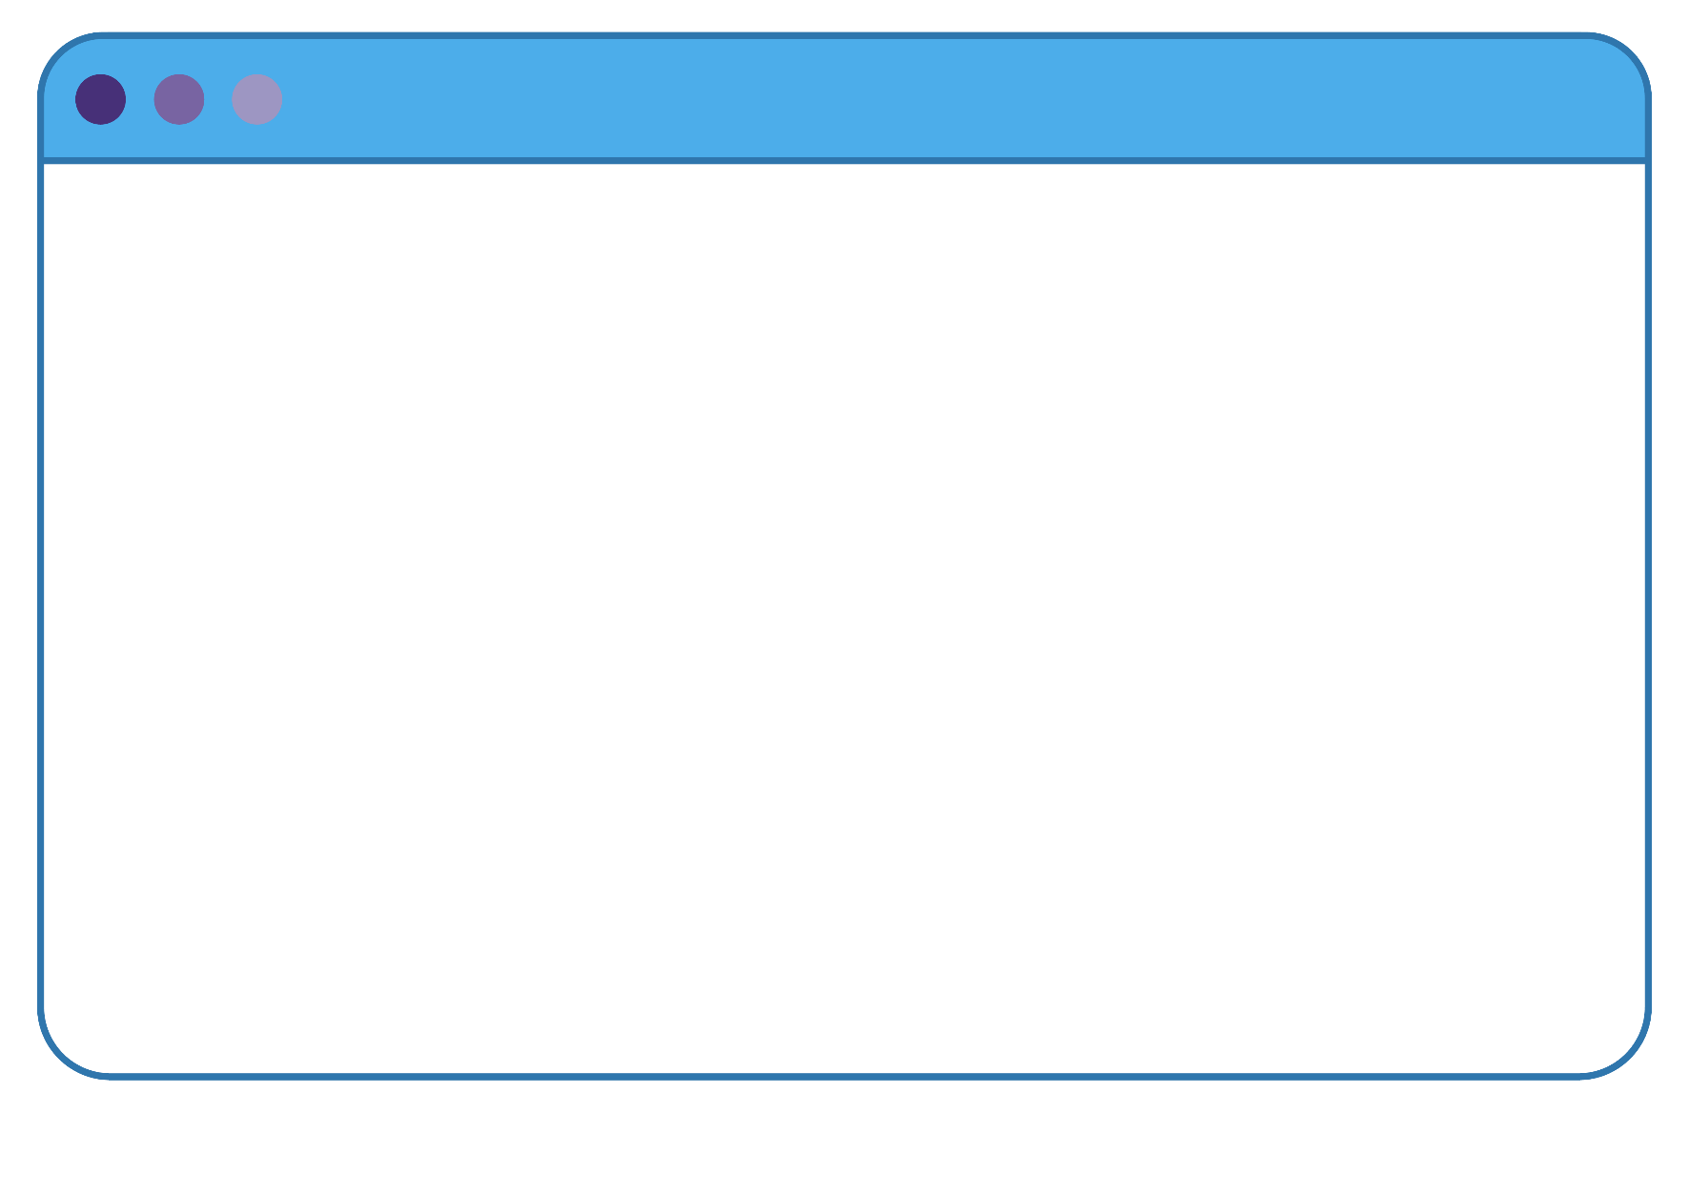
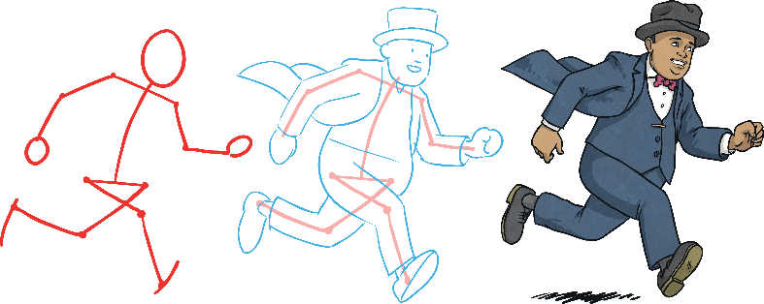
A Is for Animator
An animator is someone who creates moving images using drawings, computer graphics or models. These could be used for many types of content including cartoons, films, online videos and computer games.

Slide 4

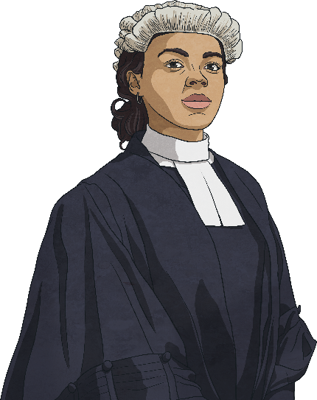
B Is for Barrister
A barrister is a legal professional who offers support to people in court. They fight for the rights of the people they are working for and provide them with advice regarding the law.
Barristers must be very knowledgeable about the area of law they specialise in, have great communication skills and be able to express their arguments clearly.

Slide 5
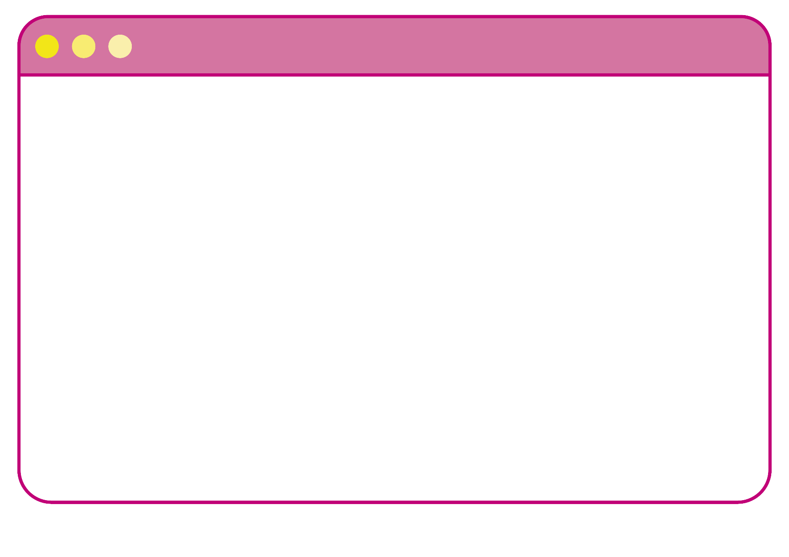
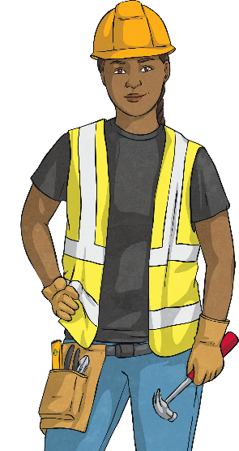
C Is for Civil Engineer
Civil engineers plan, design and manage different construction projects. These could be transportation networks, such as railways, roads and tramways, or buildings, such as hospitals, stadiums and airports.
Civil engineers should be able to analyse data, have good problem-solving skills and work well as part of a team.

Slide 6


D Is for Dietitian
Dietitians are health professionals that offer advice to patients on what foods they should eat to help them improve their health and manage existing health conditions.
They should have a keen interest in food and science, be good at explaining things clearly and enjoy helping other people.

Slide 7
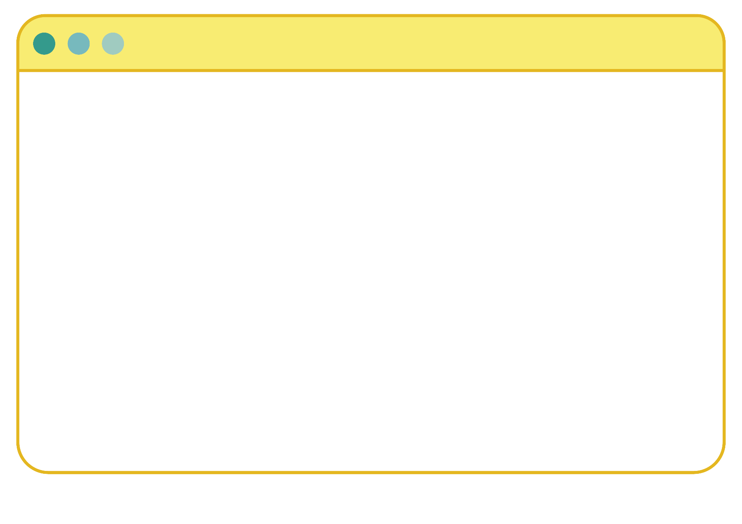

E Is for Events Organiser
An events organiser plans and manages different social events for businesses and for the public. These could be weddings, birthday parties, product launches or even large-scale sports events and festivals.
They are responsible for making sure the events run smoothly are within budget. They should be able to listen well to others, have great organisational skills and be able to keep calm under pressure.

Slide 8


F Is for Front End Developer
Front end developers design and create the user interface for websites and mobile apps. This is the part of the website or app that you see and interact with. They can use different computer programming languages to do this.
Front end developers need to listen well to their clients and use their creativity to bring their ideas to life. They should also have good problem-solving skills.

Slide 9

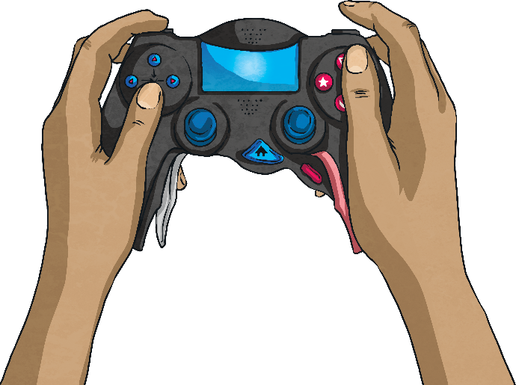
G Is for Games Tester
A games tester’s job is to test computer games at different stages of the development process. They check that the games work well and identify any glitches that need to be fixed.
They should have excellent observational skills and a good understanding of what makes a successful computer game.

Slide 10
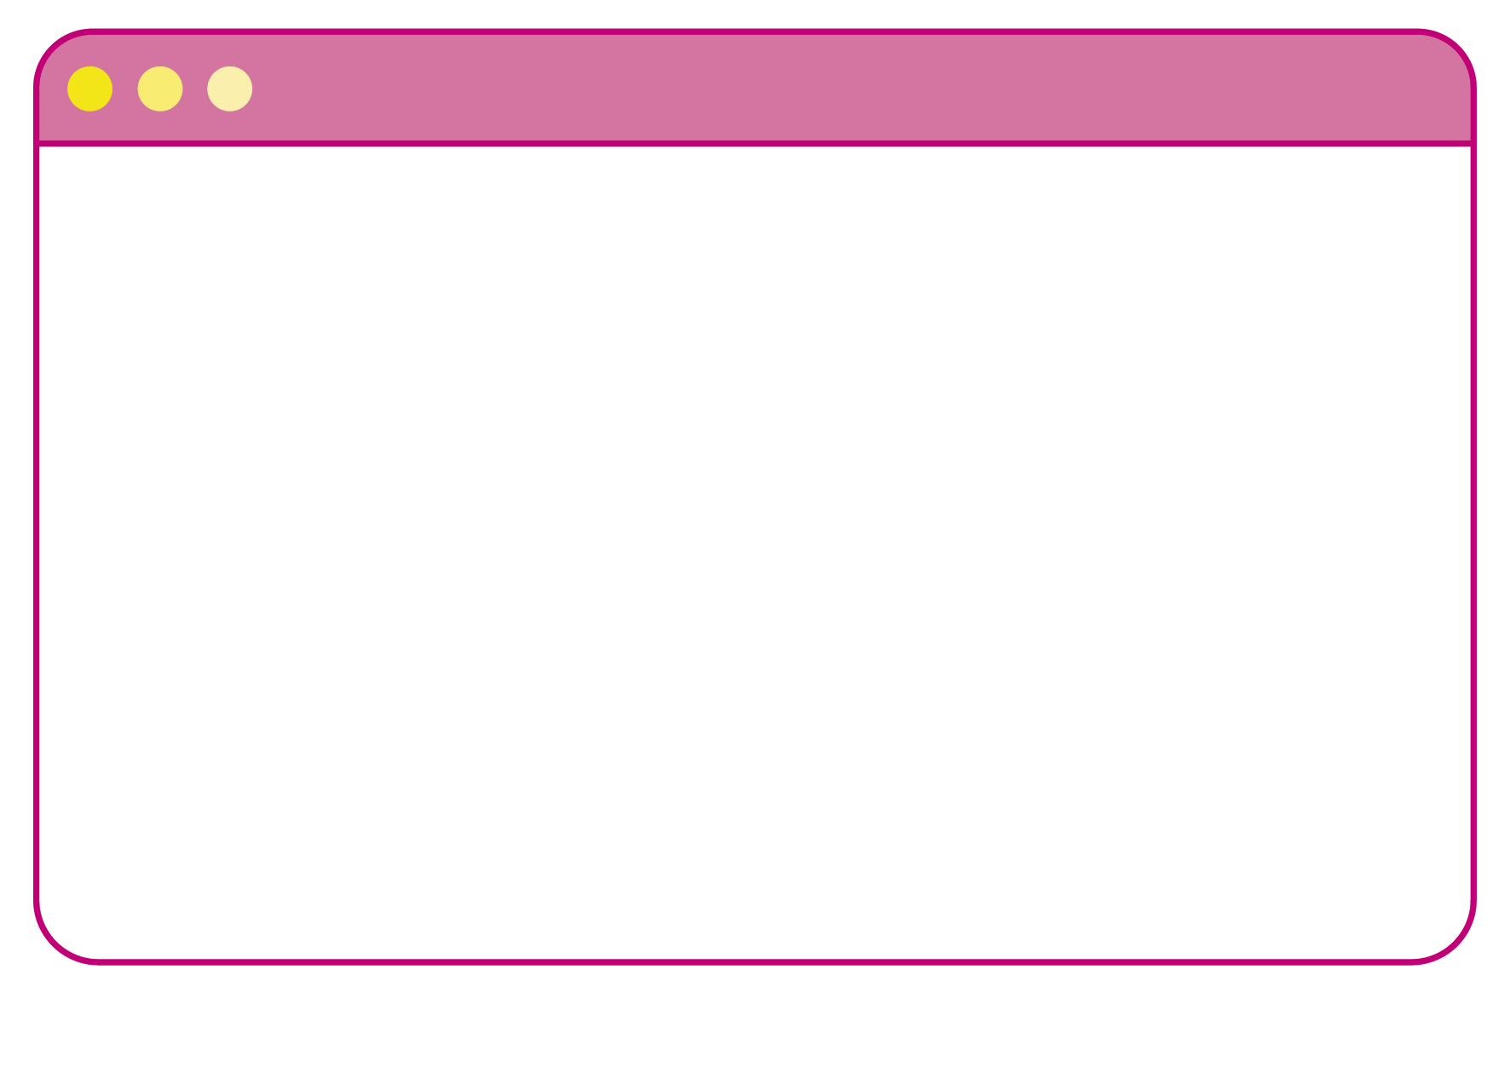
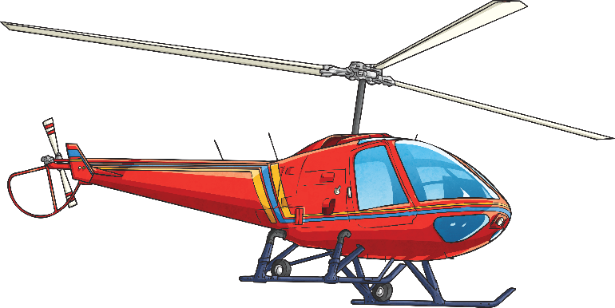
H Is for Helicopter Pilot
Helicopter pilots are in charge of flying helicopters, managing any other staff on board and ensuring the safety of all passengers. They work in many different fields. For example, they may fly air ambulances, transport people to oil rigs or take tourists on sightseeing tours.
Helicopter pilots should have quick reaction skills, good focus and be able to take the lead in high-pressure situations.

Slide 11


I Is for Interior Designer
Interior designers plan the decor and layout of the inside of different buildings. For example, they could be involved in the design of homes, restaurants, hospitals, shops and hotels. Interior designers make sure the spaces look attractive but are also practical.
Important skills for interior designers include being creative, working well as part of a team and being able to make decisions confidently.

Slide 12
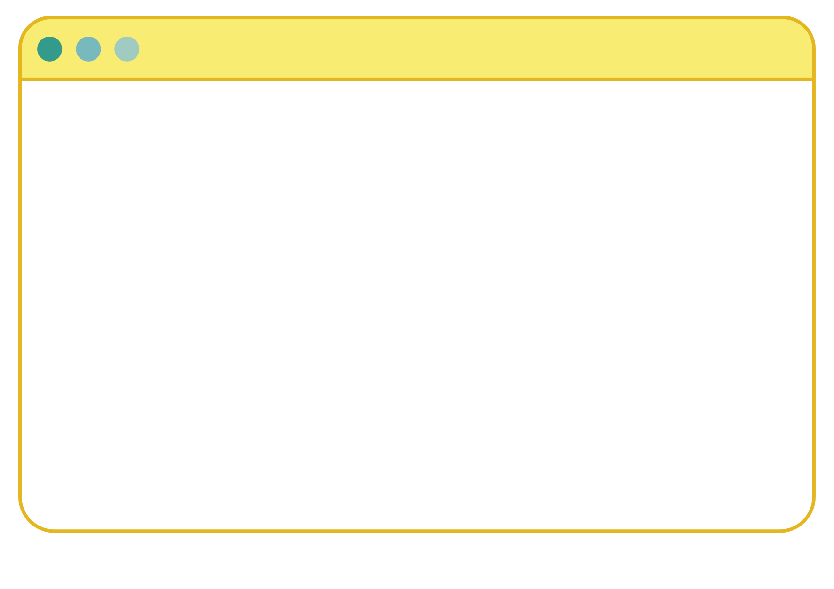
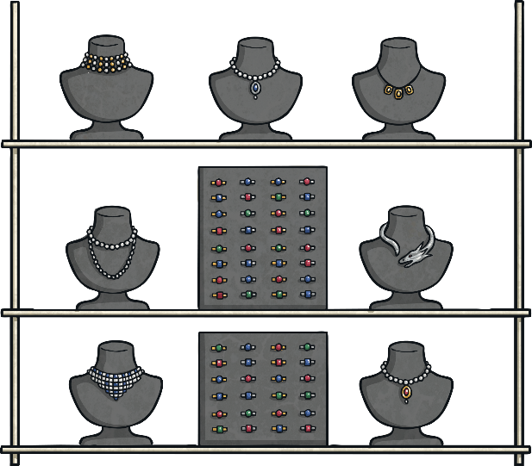
J Is for Jewellery Designer
Jewellery designers design and create different types of jewellery using a range of materials. Some jewellery designers will work for larger businesses where their designs will be made in large quantities; others may run their own small business and create unique designs for customers.
Jewellery designers need to think creatively and enjoy seeing their ideas brought to life. They also need to be good at listening to their customers and have great time management skills.

Slide 13
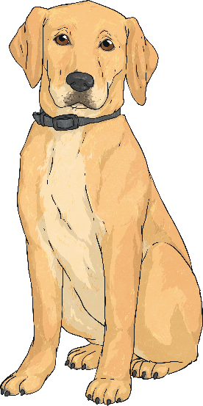
K Is for Kennel Manager
Kennel managers are responsible for making sure all dogs (and sometimes other animals) are well looked-after while in their care. They need to hire and manage other members of staff and organise work schedules. They must also ensure that all animals are regularly cleaned and provided with food, water and exercise.
Kennel managers should have a real love of animals, have great organisational skills and enjoy a physically demanding job.

Slide 14
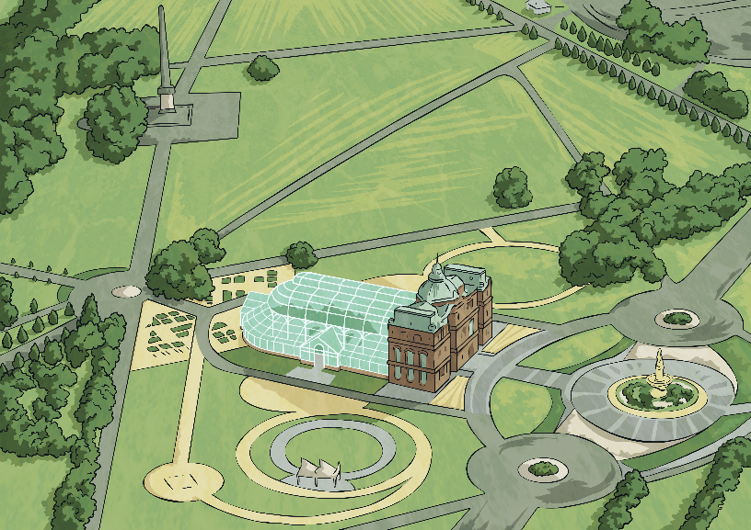
L Is for Landscape Architect
Landscape architects plan, design and manage the creation of green (or open) spaces. These could be private gardens, larger public parks or even green spaces in housing estates and by sporting sites. They ensure that the landscapes are beautiful to look at but also suitable for local wildlife.
Landscape architects must have a good eye for detail, care about the environment and have great communication skills.

Slide 15
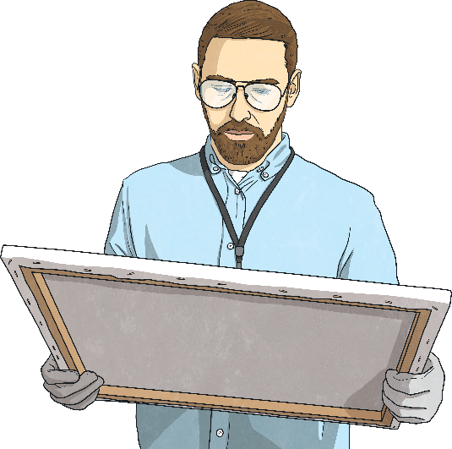
M Is for Museum Curator
Curators are in charge of the collections that are on display in museums and art galleries. These collections can contain a variety of objects, such as historical artefacts, works of art or scientific items. Curators decide what goes on display and make sure the objects are well-cared-for.
Curators need to have a real passion for the subjects they create exhibitions for and should be good team leaders.

Slide 16
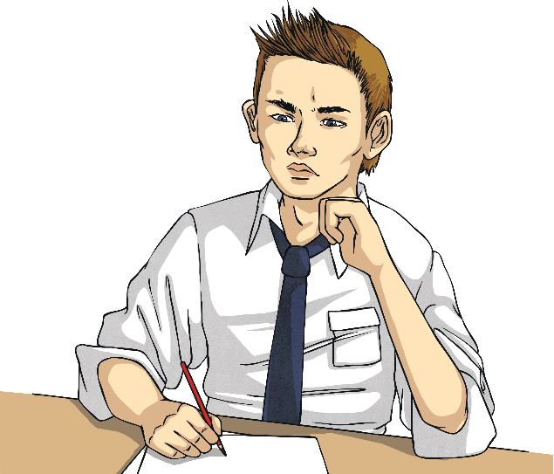
N Is for Newspaper Journalist
This job involves reporting for national, local and online newspapers. Newspaper journalists cover a range of topics, such as news, politics, sports and culture. They carry out research, interview people and write their articles in an engaging and easy to understand way.
Newspaper journalists must be able to work to tight deadlines and be good at communicating with others face to face and through their writing.

Slide 17
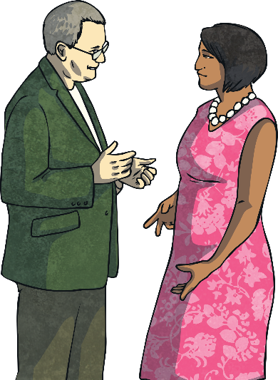
O Is for Occupational Therapist
Occupational therapists help people who have difficulties with everyday tasks due to illness, old age or because they’ve been involved in an accident. They monitor what their patient’s needs are and provide them with equipment and exercises to help them become more independent.
They can work in a range of different settings, such as hospitals, schools, workplaces and care homes.
Occupational therapists should be kind, patient and have excellent problem-solving skills.

Slide 18
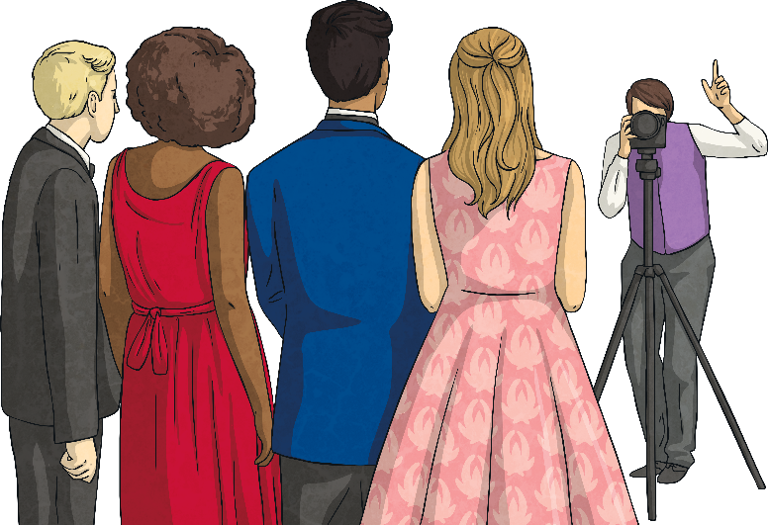
P Is for Photographer
Photographers capture visual images for a range of purposes depending on what area they specialise in and what their client wants.
For example, they may work in advertising, fashion, life events, such as weddings, or for newspapers.
Photographers must be creative, have a keen eye for detail and have great technical skills for working with a variety of equipment and computer software.

Slide 19
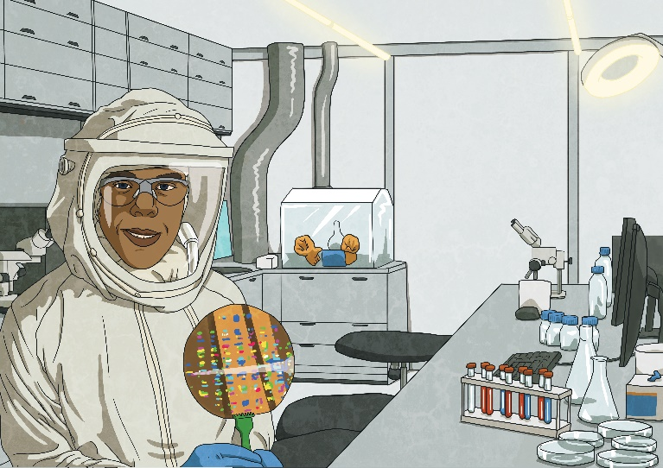
Q Is for Quantum Physicist
Quantum physicists specialise in a type of science called quantum physics. This is the study of the smallest units that make up everything in our universe (atoms and subatomic particles). This job involves looking at how these interact with one another and how this affects everything around us.
Quantum physicists should have a love of maths and science and have excellent reasoning skills.

Slide 20
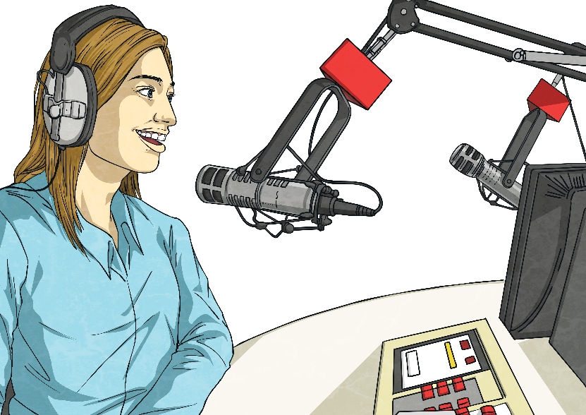
R Is for Radio Producer
Each radio show you listen to will have a producer, who works in the background to make the show as engaging as possible. They come up with radio show ideas and then work with presenters, assistants and technicians to ensure everything runs smoothly.
Radio producers must work very well under pressure, have excellent teamwork skills and enjoy being creative.

Slide 21
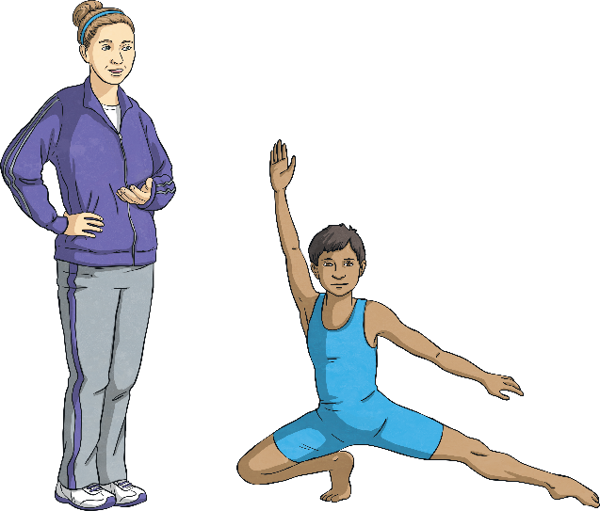
S Is for Sports Coach
Sport coaches support people taking part in sports and help them to improve their performance. They may work with professional athletes, help train sports teams or even teach children in schools. They must work out what their client needs to improve and create plans to help them achieve their full potential.
Sports coaches should have a great love of their sport, be excellent at motivating others and be able to provide people with useful feedback.

Slide 22

T Is for Theatre Stage Manager
Theatre stage managers manage the actors, props and costumes in a theatre performance. They make sure that everything is prepared for the director so that the show can be brought to life. They are involved in all stages of the production from initial rehearsals right through to the performance. Their main role is to solve any problems that may arise.
Theatre stage managers must be able to stay calm under pressure, have passion for live performance and have excellent communication skills.
props – Visual aids used for storytelling.
director – The person who is in charge of the whole show.

Slide 23
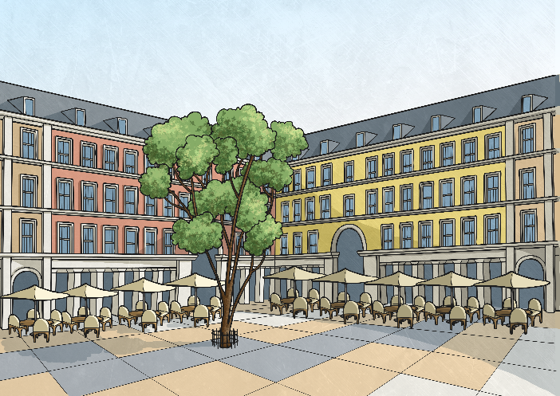
U Is for Urban Designer
Urban designers plan practical and attractive places for people to use, such as buildings, parks and leisure spaces. They work as part of a bigger team to create these areas and make sure they are enjoyable and useful to the people that use them.
Urban designers must be able to come up with imaginative solutions to planning problems, listen well to the needs of others and have good technical and artistic skills.

Slide 24
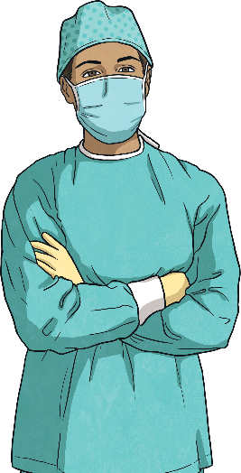
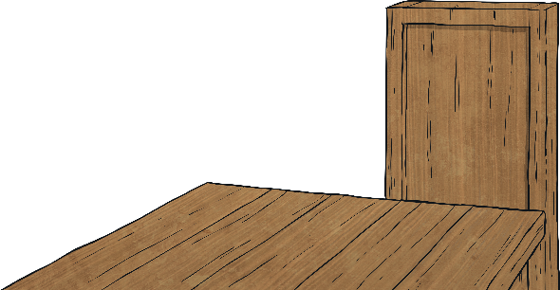
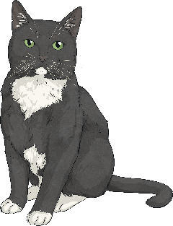
V Is for Veterinary Surgeon
Veterinary surgeons diagnose and treat sick or injured animals including pets, farm animals and zoo animals. They prescribe animals with medicine, perform operations and x-rays and give advice to their owners on how to care for them.
Veterinary surgeons must be confident when handling animals, have excellent problem-solving skills and be great at communicating clearly with others.

Slide 25

W Is for Writer
There are many different ways to be a writer. Writers can choose to write fiction or non-fiction work, such as stories, biographies, poetry, television and film scripts and content for websites. They normally write alone but can sometimes work as part of a writing team.
For a writer to be good at what they do, they must be creative, self-disciplined and have a passion for sharing their ideas with the world.

Slide 26
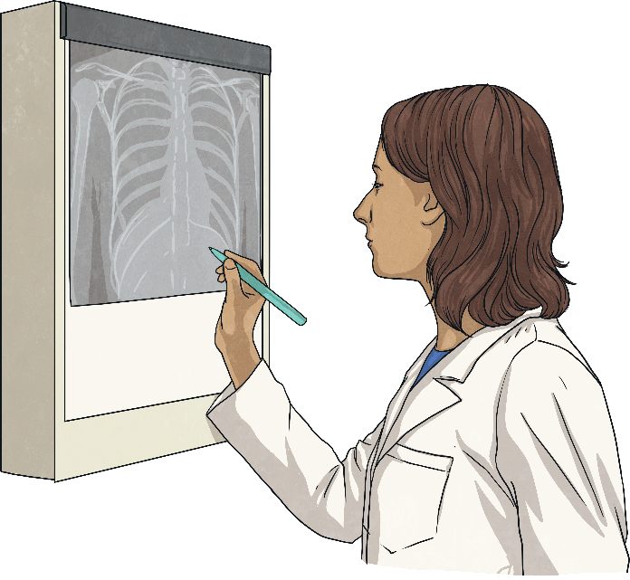
X Is for X-Ray Technologist (Radiographer)
X-ray technologists help to diagnose health conditions and injuries by capturing images of inside the body using X-ray machines. After checking the images carefully, they must then report their findings to other health professionals so the patient can receive the care they need.
X-ray technologists must have excellent observation skills, be confident in using complex technical equipment and be supportive and reassuring to patients.

Slide 27
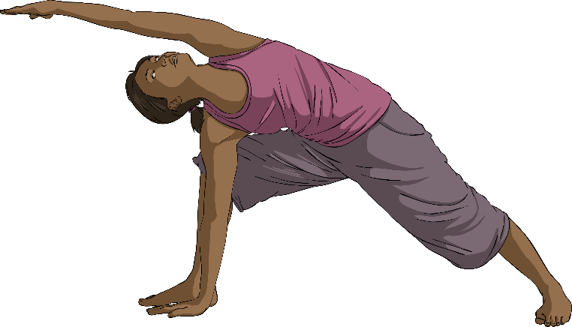
Y Is for Yoga Teacher
Yoga teachers plan and teach lessons for their classes. They help people get into the right positions and poses and support them with their breathing and meditation skills.
Yoga teachers are not only very enthusiastic about their yoga but also enjoy helping others to relax and improve their skills. They must be patient and be able to communicate effectively to an audience.

Slide 28
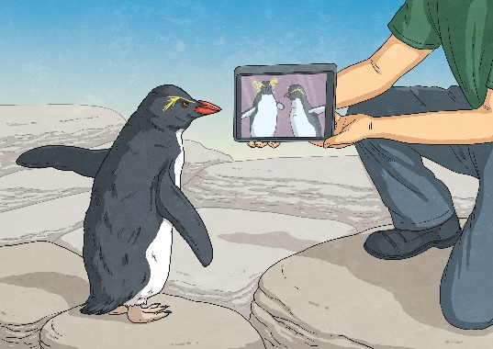
Z Is for Zoologist
Zoologists are scientists who study animals and their behaviour. They often specialise in specific types of animals, such as mammals, reptiles or even fossil remains. They monitor the animals closely, record information and can use this data to write scientific reports or provide recommendations on how to look after them.
Zoologists need to be very observant and interested in the animals they study. They should also be able to clearly present their findings to others and work well as part of a team.

