Slide 2
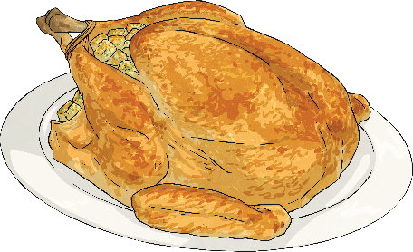
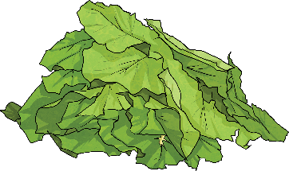
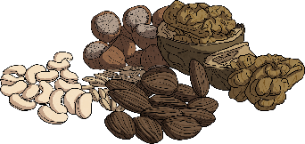
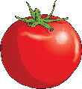
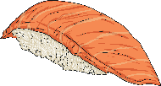
What is Food?
We all need food and water.
Food is any nutritious substance that we eat or drink in order to stay healthy and grow.
There are lots of different types of food. How many different types of food can you name?
The different types of food include:
vegetables;
fruits;
grains, beans and nuts;
meat and poultry;
fish and seafood;
dairy foods.

Slide 3
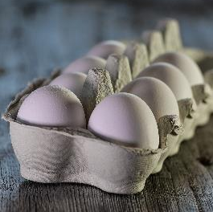
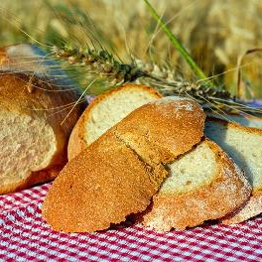
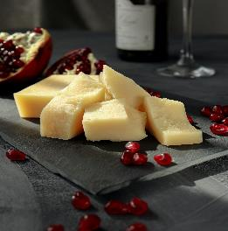
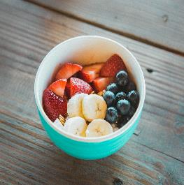
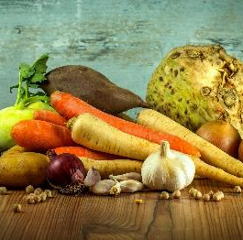
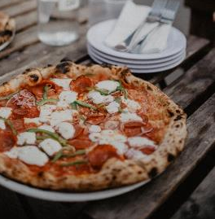
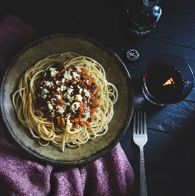
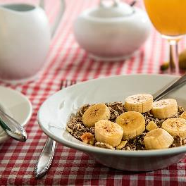
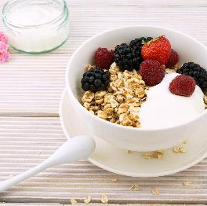
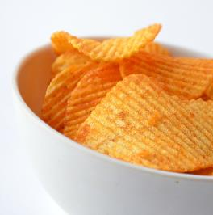
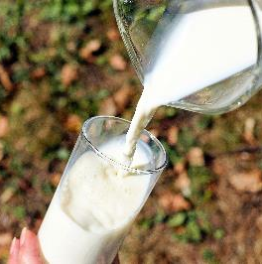
Different Foods

Slide 4
What is World Food Day?
World Food Day is an event organised by the Food and Agriculture Organisation of the United Nations.
It brings together governments, businesses, the media and general public to raise awareness and take action for those who suffer from hunger and for the need to ensure healthy diets for all.
Each year, lots of different events take place around the world to celebrate World Food Day, such as marathons, hunger marches, exhibitions, cultural performances, contests and concerts.
This year, the event is being held on Friday 16th October.

Slide 5
World Food Facts
The number of people who
do not have regular access
to safe, nutritious and
sufficient food.
690 million
The number of people who
are hungry.
3.5 trillion
The amount of money in US dollars malnutrition costs the global economy every year.
2 billion

Slide 6
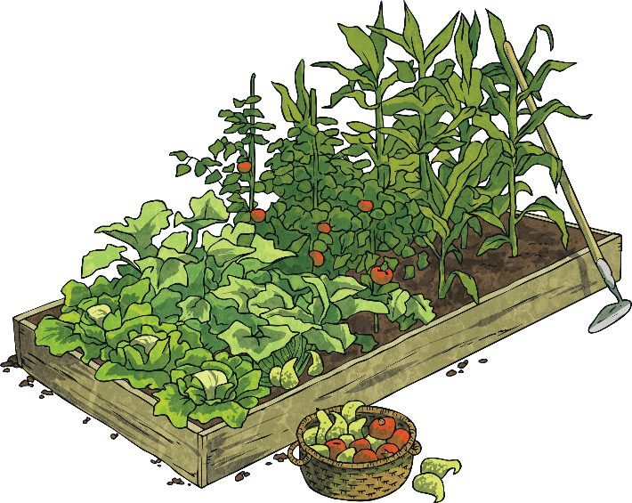
Our Actions Are Our Future
The slogan for World Food Day 2021 is, ‘Our actions are our future’.
What do you think this means?

Slide 7
Our Actions Are Our Future
Climate change is continuing to challenge poorer farmers in rural areas.
The way we produce, use and waste food is taking its toll on our planet’s natural resources, environment and climate.
The COVID-19 global health crisis has been a time to think about all the things we truly cherish, as well as our most basic needs. In doing so, many people have found a renewed appreciation for food; something that many take for granted and, sadly, many must go without.

Slide 8
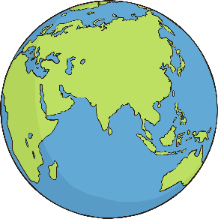
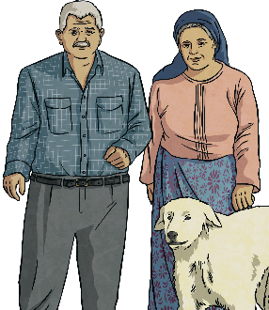


Did You Know…?
More than 3 billion people (almost 40% of the world’s population) cannot afford a healthy diet.
Despite extreme poverty, more than 33% of the world’s food is produced by smallholder farmers.
14% of the world’s food is lost due to harvest, handling, storage and transportation and 17% is wasted by us. This is a total of 31% waste.
Climate change is continuing
to challenge poorer farmers in rural areas. This is affecting major crops that contain proteins and some essential vitamins
and minerals.

Slide 9
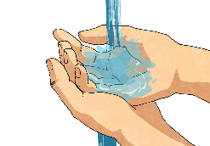
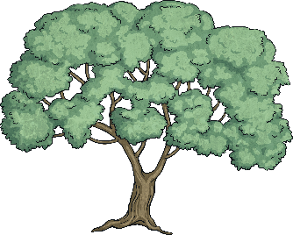
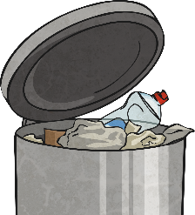
Our Actions Are Our Future
Nature can teach us how to look after our planet.
It provides us with the essentials that we need, such
as water, food, clean air, medicine and materials for shelter.
Trees clean our air but they also provide nutrients for
food. This is part of the agri-food system, similar to
ecosystems in that everything is connected.
It’s important that we stop to appreciate what we have.
We have been producing, consuming and wasting food
for too long and now is the time to take action.

Slide 10
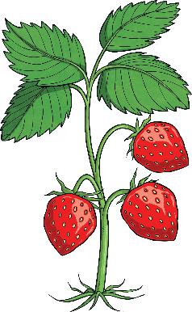
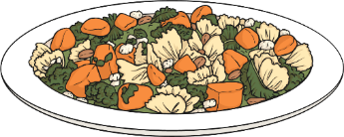
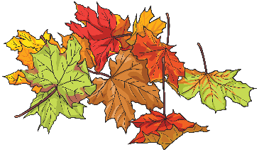
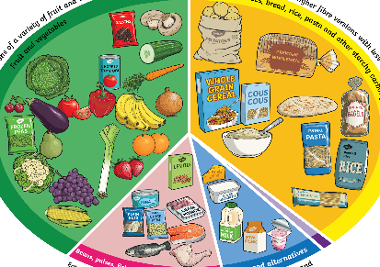
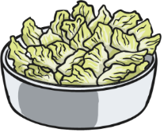
What Can We Do?
Don’t waste food
Choose seasonal
foods
Grow food at home
Choose healthy and diverse foods
Choose local
foods

Slide 11
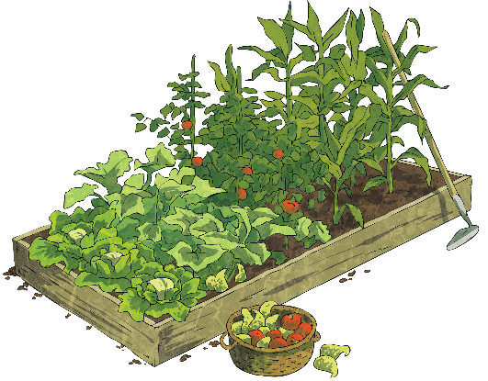
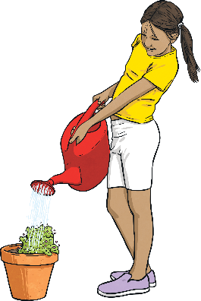
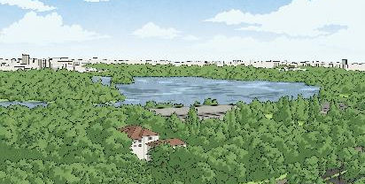
Add Some Green to a Space
Why don’t you create a green space in window boxes on your balcony or in your garden to help cities to breathe.
Did You Know…?
Large green spaces create shade and they also clean the air, cool the city and reduce water pollution.
You could even get involved in a local community garden or allotment project. Growing food at home is a fun way
to learn about plants and value
them, while keeping yourself healthy!

