Slide 1
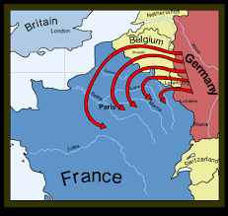
Trench warfare.
L.O: To learn about conditions on the western front. 24.01.22
P | Success Criteria | T
 | Must be able to describe the main features of trench warfare.
 | Should: learn about the conditions solders lived in.
 | Could: research aspects of life in the trenches.
 | Even better if… I can empathise with the soldier’s situation.
In August 1914, Germany was at war with Britain, France and Russia.
The Germans knew they would lose trying to fight on two sides at once.
They had to try to beat France quickly, then focus all their power on Russia.
They decided to attack France by traveling through Belgium.
This was called the Schlieffen Plan.

Slide 2
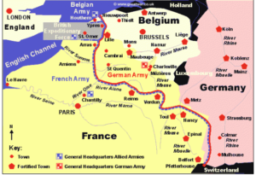
The British and French armies rushed to fight back and stop the Germans taking over Paris.
Both sides were trying to get the advantage by getting behind their opponent- this meant both sides went further and further north. This was known as 'The race to the sea’.
By December 1914, both sides had dug long lines of trenches from the north of Belgium all the way to Switzerland in the south.
This area of fighting became known as ‘The Western Front’.

Slide 3
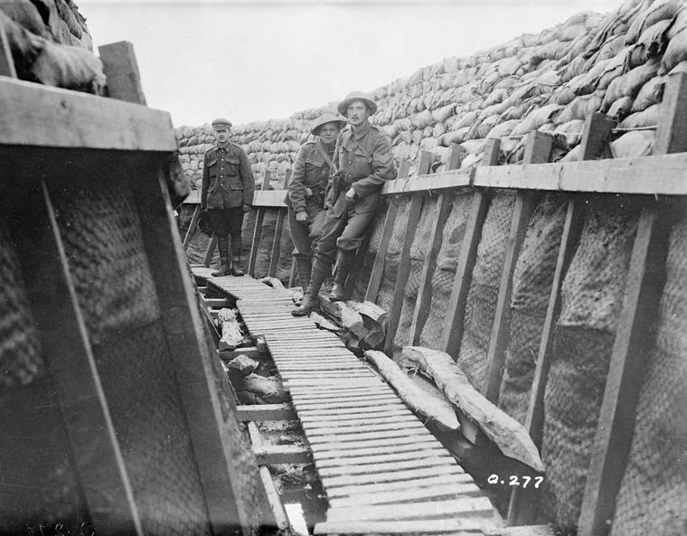
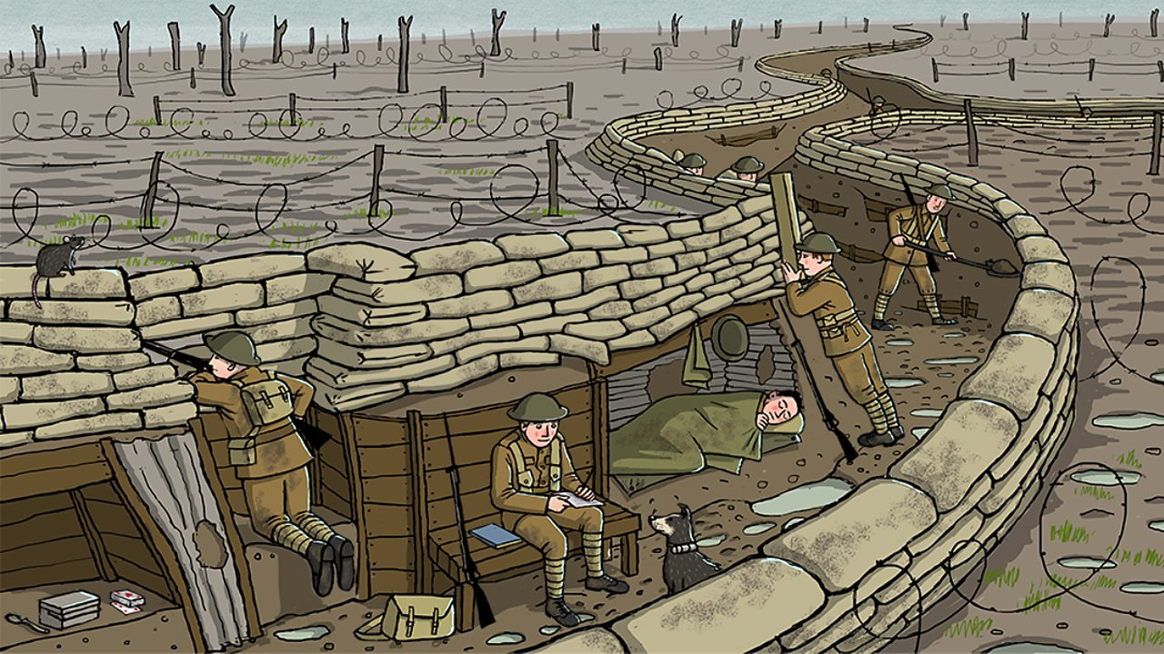
After 1914, these lines didn’t move much until the end of the war.
In between the English and German trenches was an area known and no man’s land.
Both sides would attempt to cross no-man’s land to break through the defences of their enemy.
It was very difficult and dangerous. Millions of soldiers were killed between 1914-1918.
https://www.twinkl.co.uk/go/resource/tg3-e-02-life-in-the-trenches-hotspots

Slide 4
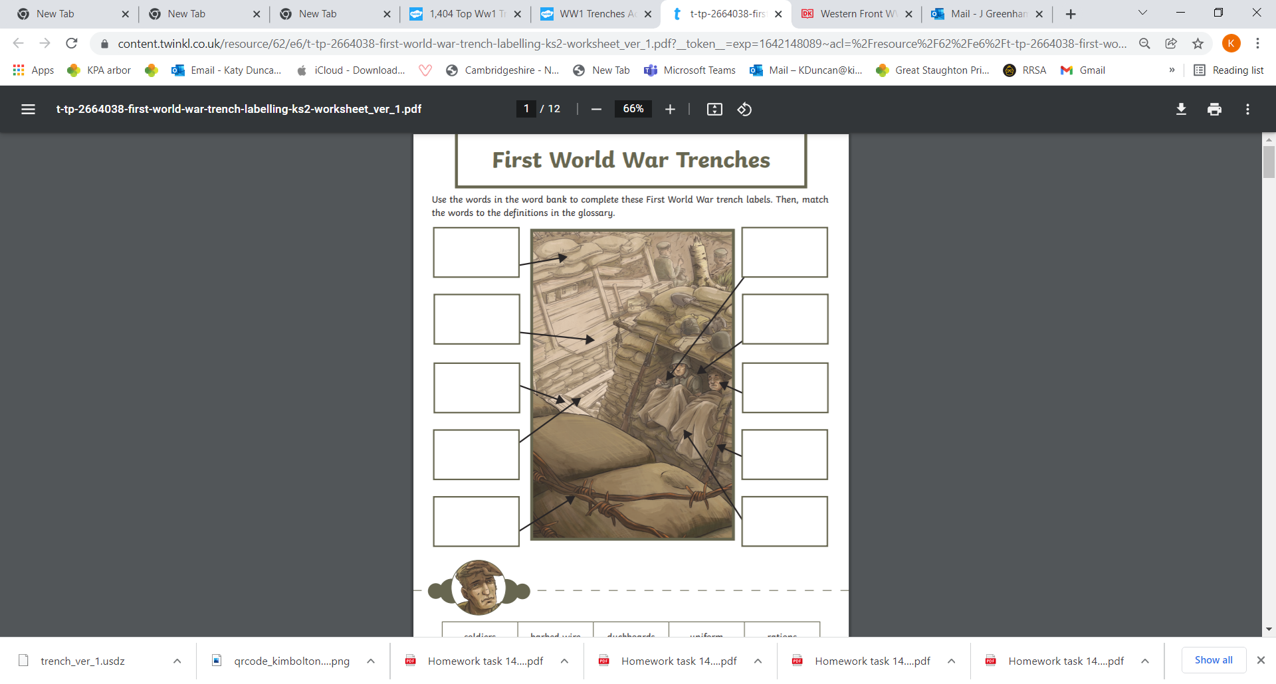
Task 1
Annotate this diagram of the trenches, labelling each part of the trench system. If you don’t know the meaning of any words, use books and internet resources to find out the meaning.
Extension- create a glossary of new vocabulary about trench warfare.

Slide 5
Follow these links for really good information on the western front.
https://www.bbc.co.uk/bitesize/topics/zqhyb9q/articles/z8sssbk
https://www.bbc.co.uk/bitesize/clips/zgs3r82
https://www.dkfindout.com/uk/history/world-war-i/western-front/
https://kids.kiddle.co/Trench_warfare
https://historyforkids.org/wwi-trenches-facts-for-kids/

Slide 6
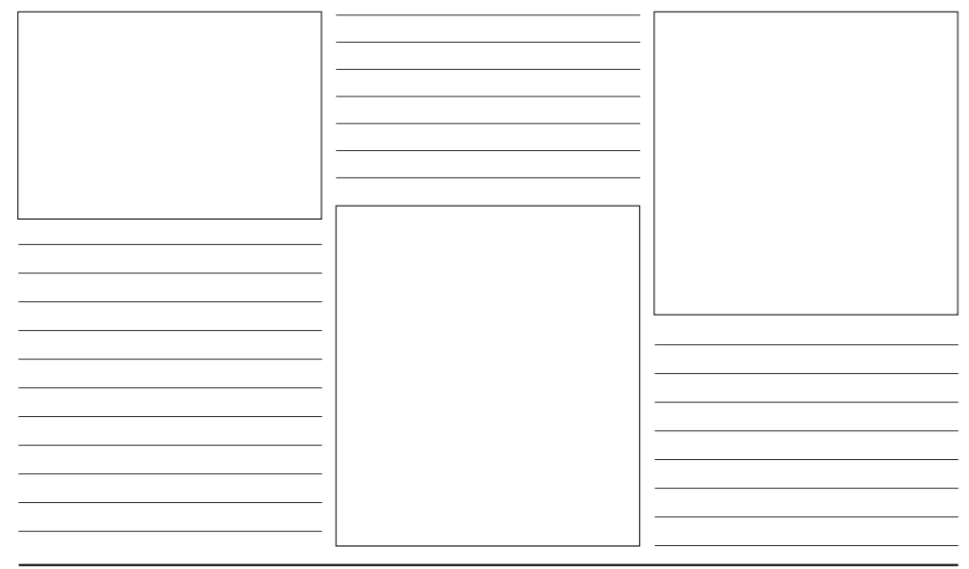
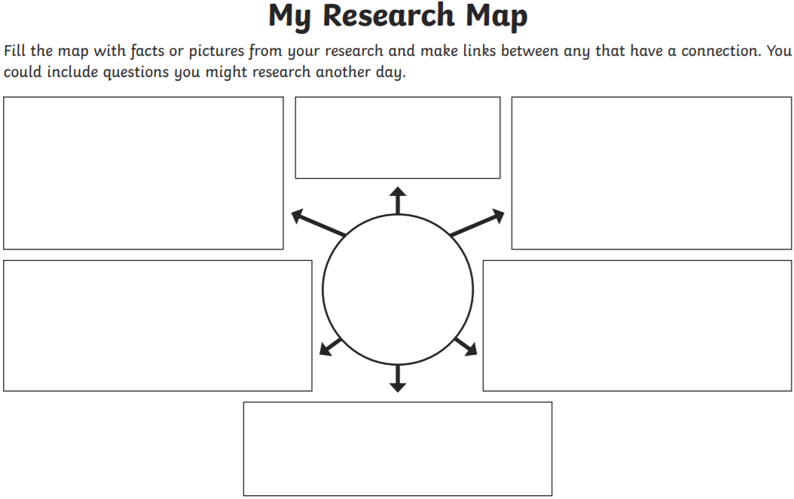
Task 2- Create a fact file about life for soldiers on the Western Front.
Choose 4-5 topics to investigate. These could be combat tactics, soldiers’ everyday life, food, equipment, entertainment, living conditions, or any other aspect of trench warfare you think is interesting.
Choose a writing frame to record your information.

Slide 7
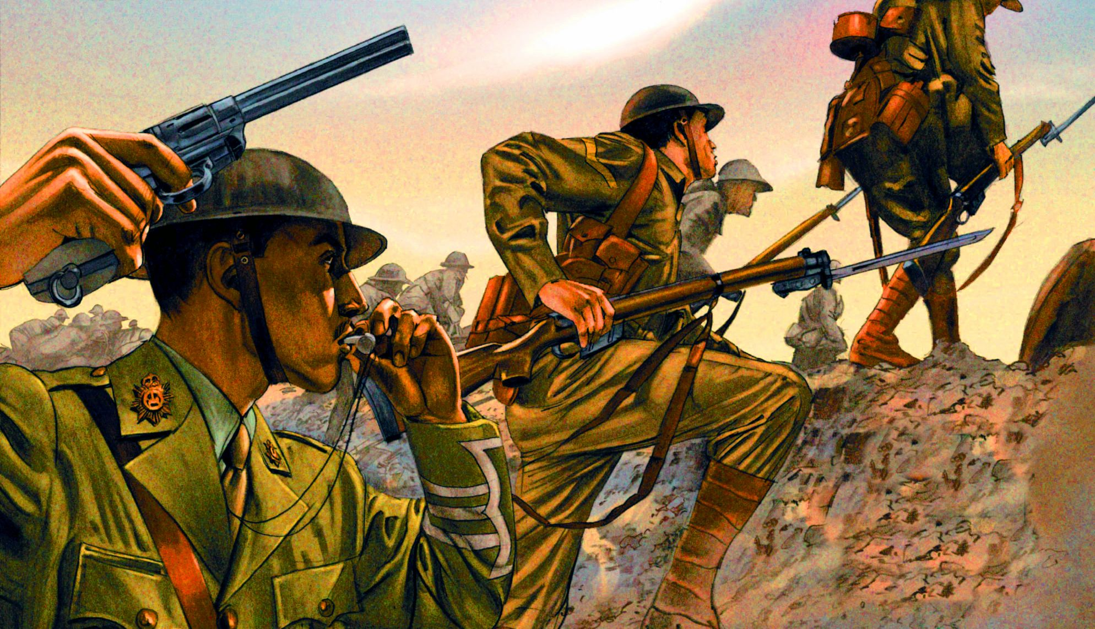
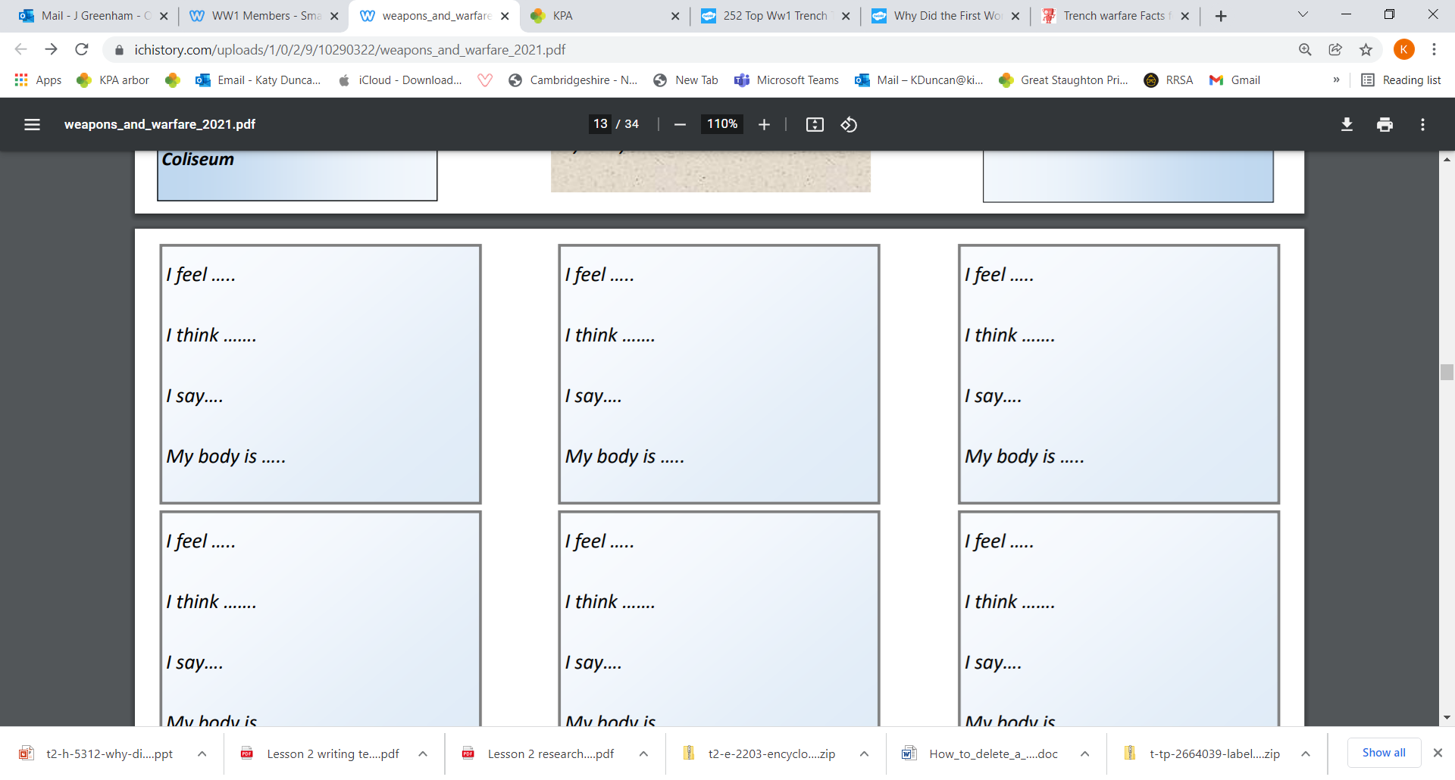
Plenary
Imagine you are one of the soldiers about to go ‘over the top’.
Try to get into the mind-set of how you would be feeling at that time.
Complete the statements to explore what it may have been like to fight on the western front.

