Slide 1
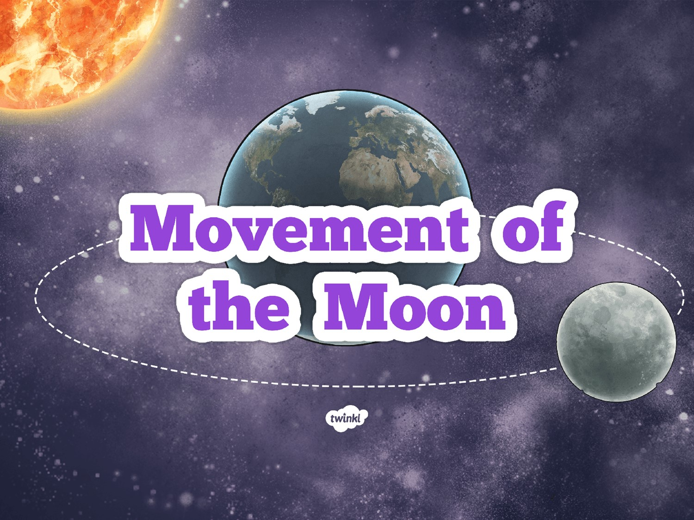

Slide 2
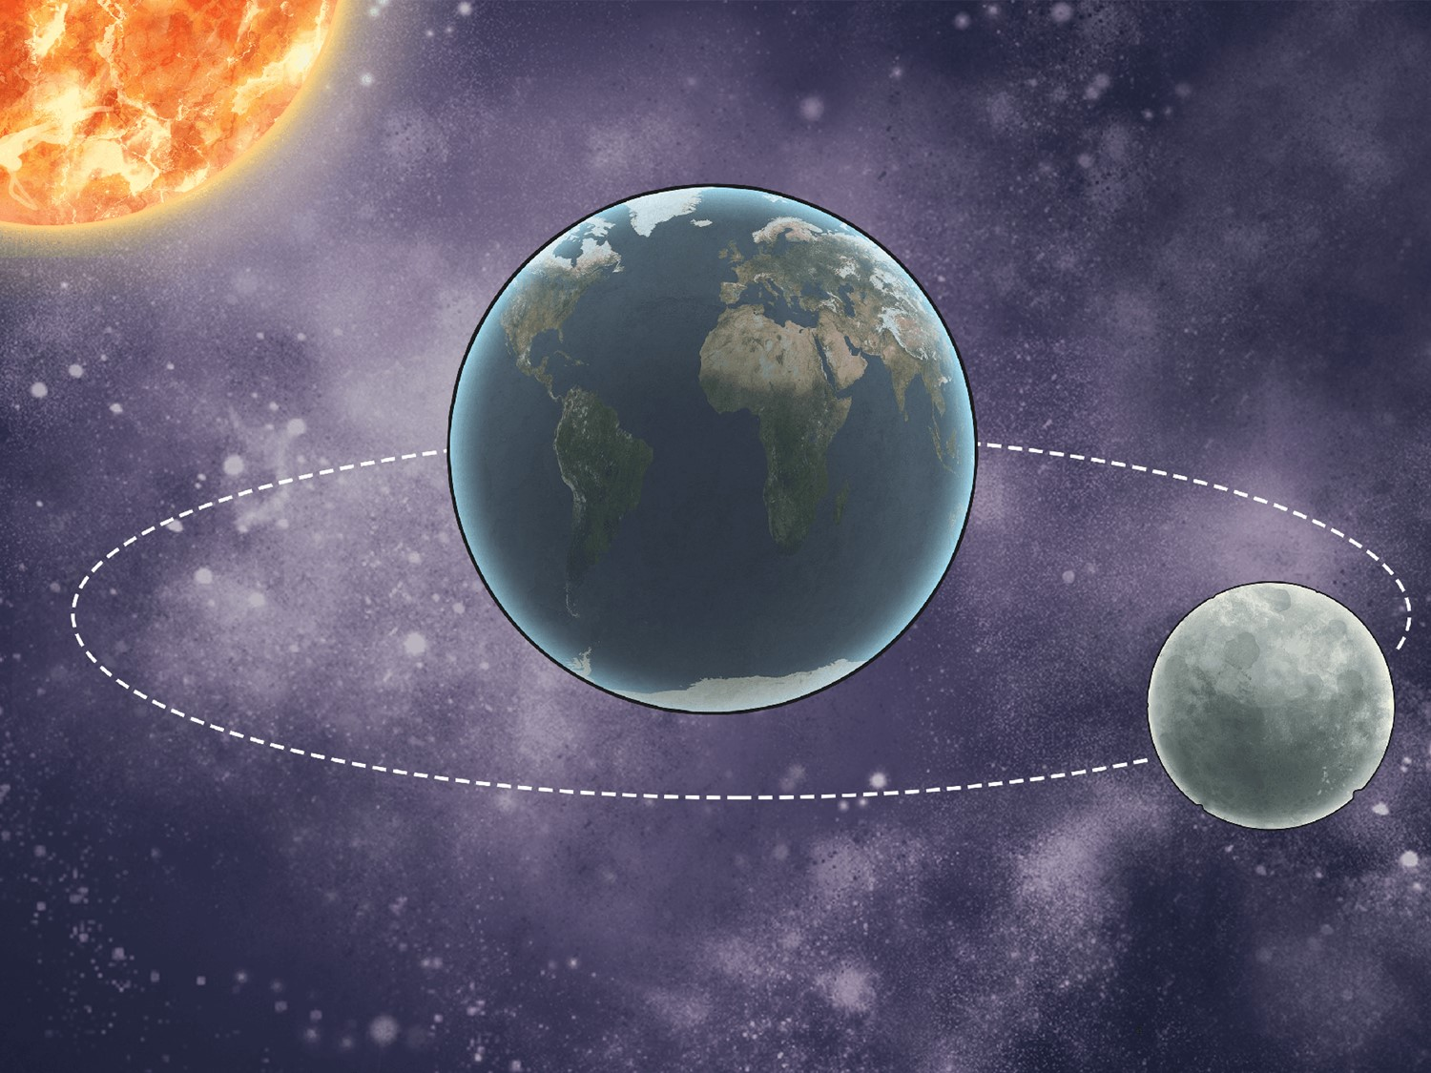
Aim
I can describe the movement of the Moon.
Success Criteria
I can explain that the Moon orbits the Earth not the Sun.
I can explain how the Moon moves relative to the Earth.
I can explain how the Earth and Moon move relative to the Sun.

Slide 3

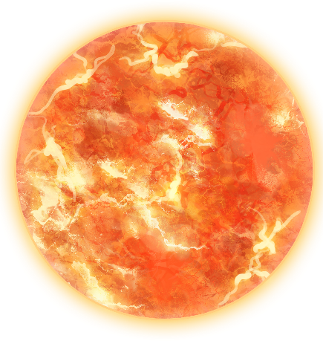

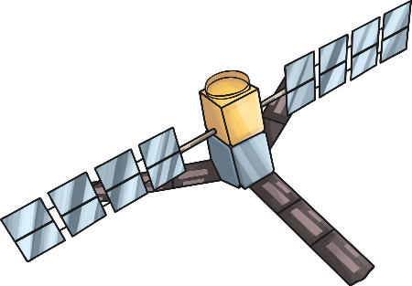
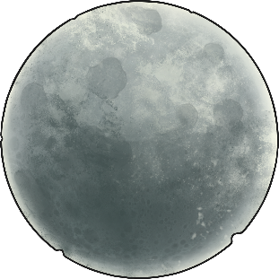
Orbiting Objects
We know the Earth orbits the Sun.
Are there any objects that orbit the Earth?
Does it move in any other type of way?

Slide 4
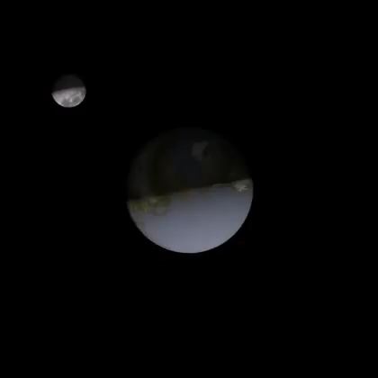
Moon Movement
How does the moon move?
Does it rotate?
Why is the moon only lit from one side?

Slide 5

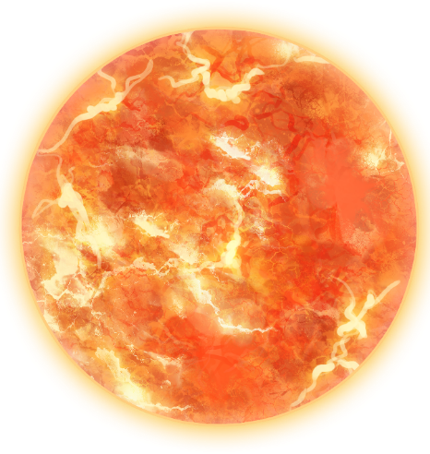




Moon Models
Use two objects to demonstrate how the moon and earth move relative to the sun.
Each pair/group will get a chance to show their model and demonstrate how it works.
Remember:
Let those talking explain first and then ask questions
Listen carefully so that you don’t ask questions about what they have already explained.

Slide 6
Phases of the moon.
What do you notice about the light hitting the moon when:
It is in front of the Earth?
It is behind the Earth?
It is to the side of the Earth?
https://www.bbc.co.uk/bitesize/clips/z3jd7ty

Slide 7
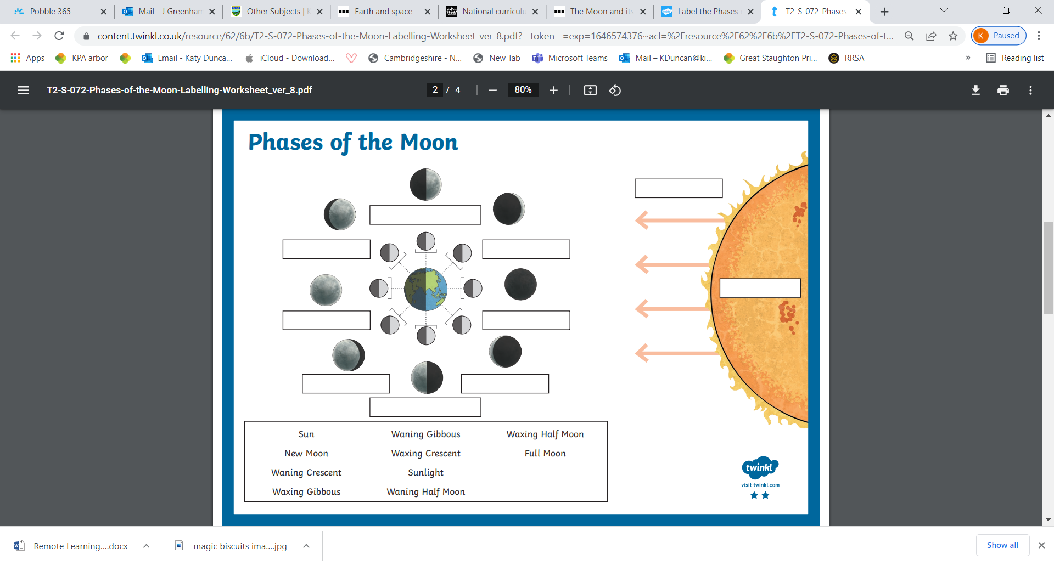
Task: Moon Diagram.
Create an annotated diagram to explain how the moon seems to appear and disappear in the night sky.

Slide 8
Plenary.
Research task:
Find out if any of the other planets have moons, like Earth. What can you discover?
Find out what is meant by the terms Solar eclipse and Lunar eclipse. Write a short explanation for each, including diagrams.

