Slide 1
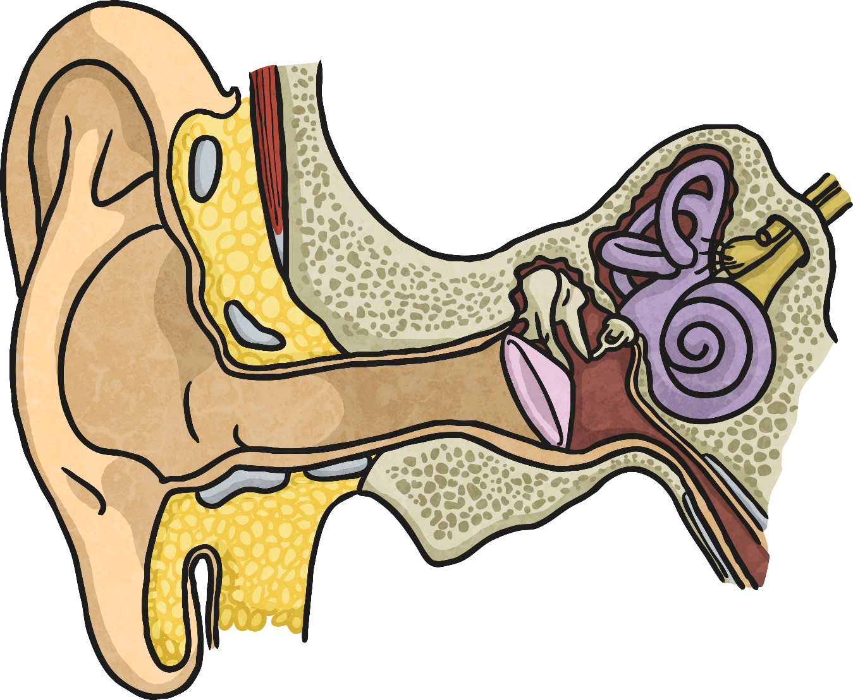

Hearing Sounds

Slide 2
Aim
I can explain how different sounds travel.
Success Criteria
I can describe how vibrations make sounds.
I can explain how vibrations change when a sound gets louder.
I can explain how loud and quiet sounds travel to our ears.

Slide 3

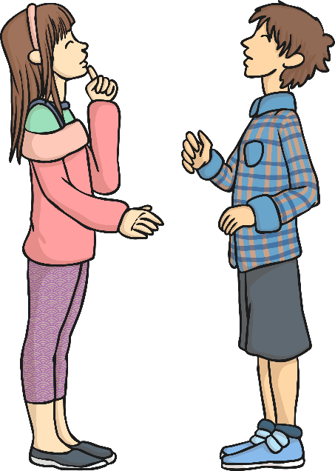

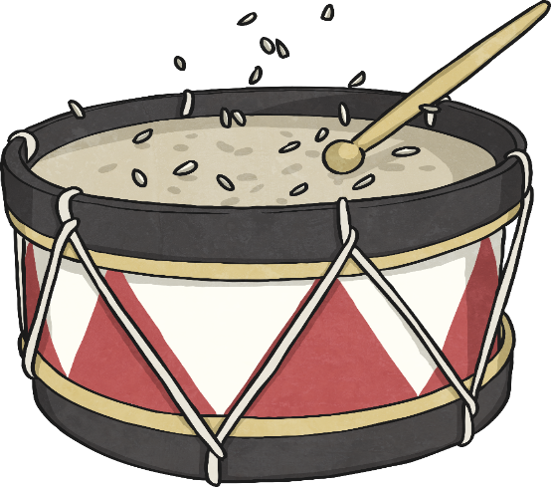





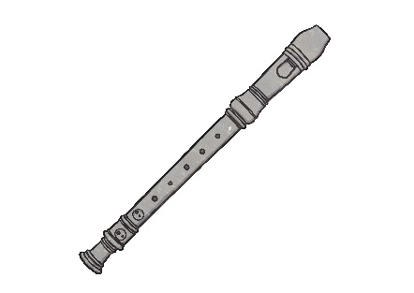
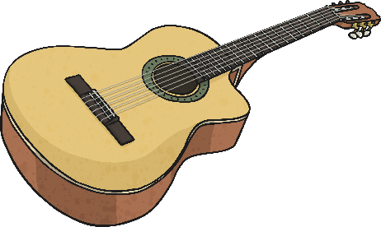

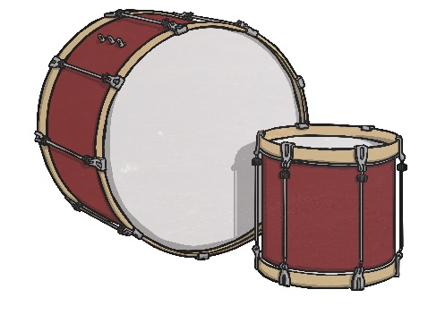




Vibrations
Vibrations
Sounds are made when something vibrates.
Talk to your partner about what is vibrating in each of these pictures to make a sound.
By placing rice on a drum, you can see the vibrations when you hit the drum, as well as hearing the sound.

Slide 4

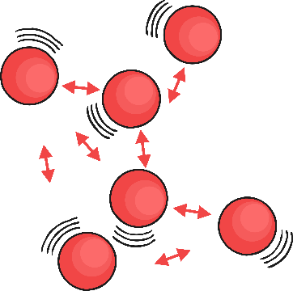
Loud and Quiet
Try this mini investigation to find out if the vibrations change when the loudness of the sound changes.
Place some rice on the skin of a drum.
Bang the drum three times: gentle, medium and hard.
Observe the way the rice vibrates each time.
Is there a link between the loudness of the sound and the size of the vibrations?

Slide 5
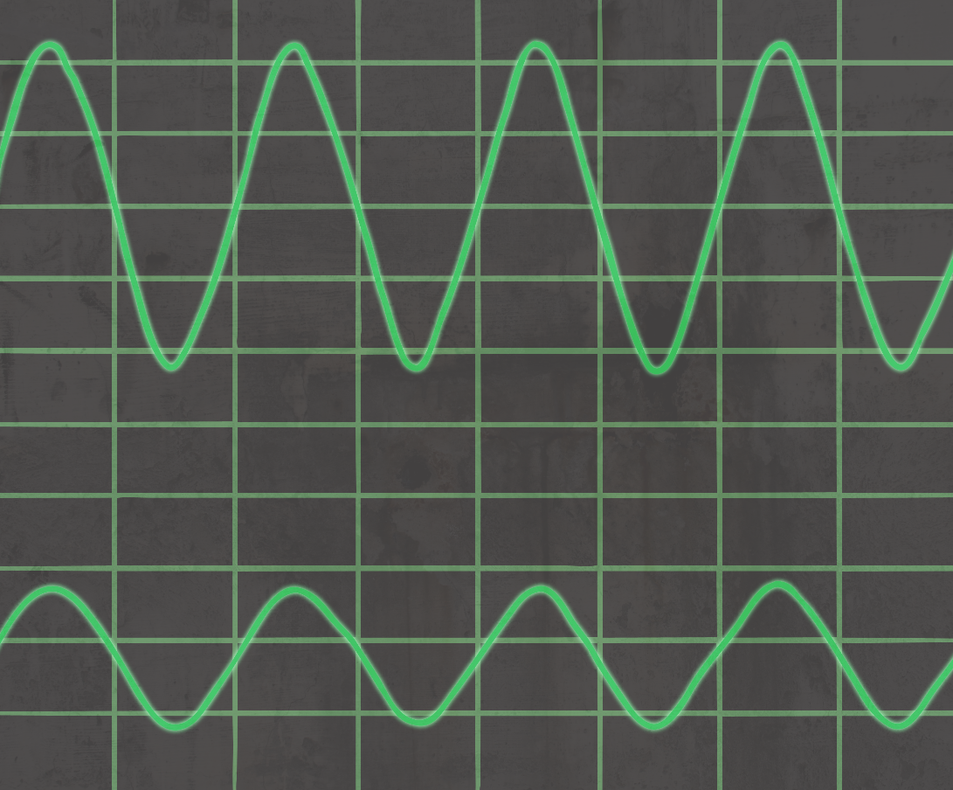
Loud and Quiet
The louder the sound, the bigger the vibration. You should have noticed that the rice grains vibrated more when you hit the drum harder, creating a louder sound.
The size of the vibration is called the amplitude.
Quieter sounds have a smaller amplitude, and louder sounds have a bigger amplitude.

Slide 6

How Does Sound Travel?
So we know that sounds are caused by vibrations, and the louder sounds have bigger vibrations.
But how do these different sounds reach our ears?
These children have been talking about their ideas.
What do you think of their ideas?
Watch this clip to see if you can identify how different sounds travel.
I think sound can travel through the air because the air is lighter and easier to get through than solids or liquids.
Sound moves the air from the source of the vibration into our ears. If we are listening, we will hear the sound.
https://www.bbc.co.uk/bitesize/clips/z9h6n39

Slide 7

How Does Sound Travel?
Sound can travel through solids, liquids and gases.
Sound travels as a wave, vibrating the particles in the medium it is travelling in.
So in our example, when you hit the drum, the drum skin vibrated. This made the air particles closest to the drum start to vibrate as well. The vibrations then passed to the next air particle, then the next, then the next. This carried on until the air particles closest to your ear vibrated, passing the vibrations into your ear.

Slide 8

Hearing Sounds
Once in your ear, the vibrations travel into the ear canal until they reach the eardrum. The eardrum passes the vibrations through the middle ear bones (the hammer, the anvil and the stirrup) into the inner ear. The inner ear is shaped like a snail and is called the cochlea. Inside the cochlea, there are thousands of tiny hair cells. Hair cells change the vibrations into electrical signals that are sent to the brain through the hearing nerve. The brain tells you that you are hearing a sound and what that sound is.

Slide 9

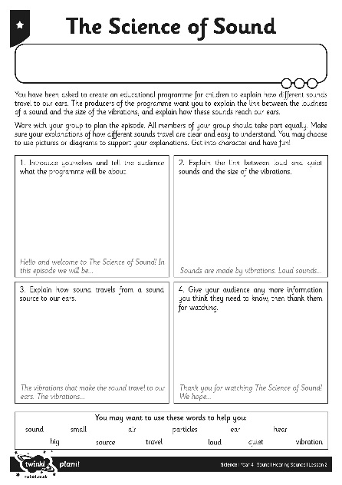
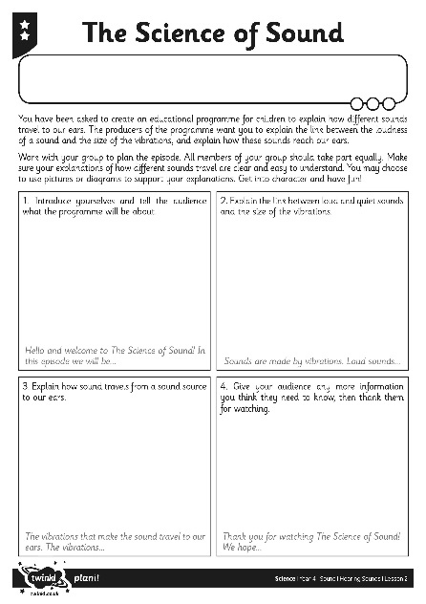
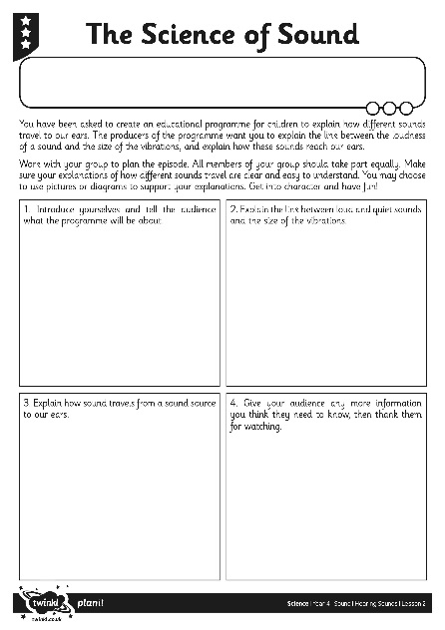
The Science of Sound
Use the ideas you saw in the clip, or you could alter the ideas to come up with your own way of dramatising and explaining how different sounds travel for the programme.
Use The Science of Sound Activity Sheet to plan your ideas and then practise what you will do and say. Make sure your explanations are clear and easy for children to understand. Have fun and get into character!
You may film your programmes, or you may perform them to your class or another audience.

