Slide 1
LO: To choose a research question about food
I can consider what foods humans might eat.
I can think of an enquiry question.
I can create an action plan to answer a question.

Slide 2
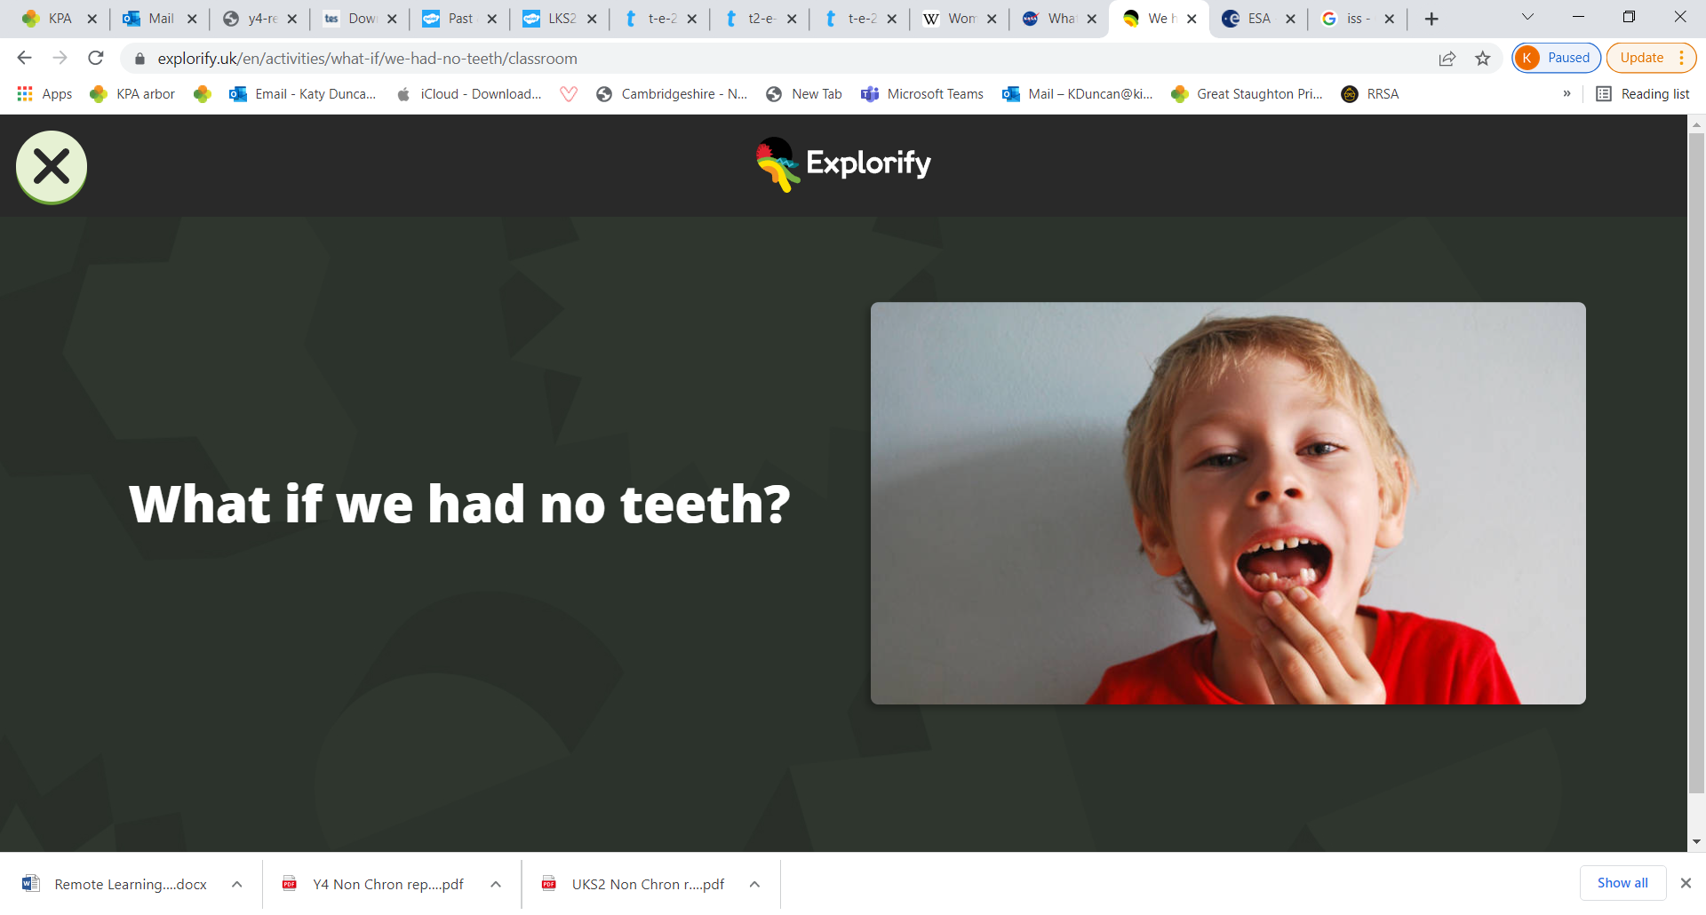
Starter.
Imagine if humans had no teeth. How would that affect our lives?
With your talk partner, discuss what might be a Plus, Minus and Interesting way to think about the question.
If you get stuck, consider:
What kinds of teeth do we have?
Why are our teeth different shapes?
Do all animals have teeth?

Slide 3
In this lesson you will be coming up with a research question related to our work on teeth and digestion.
Think about this- What foods are humans designed to eat? How do you know?
What different kinds of diets might people have? Are all of them healthy for humans?

Slide 4
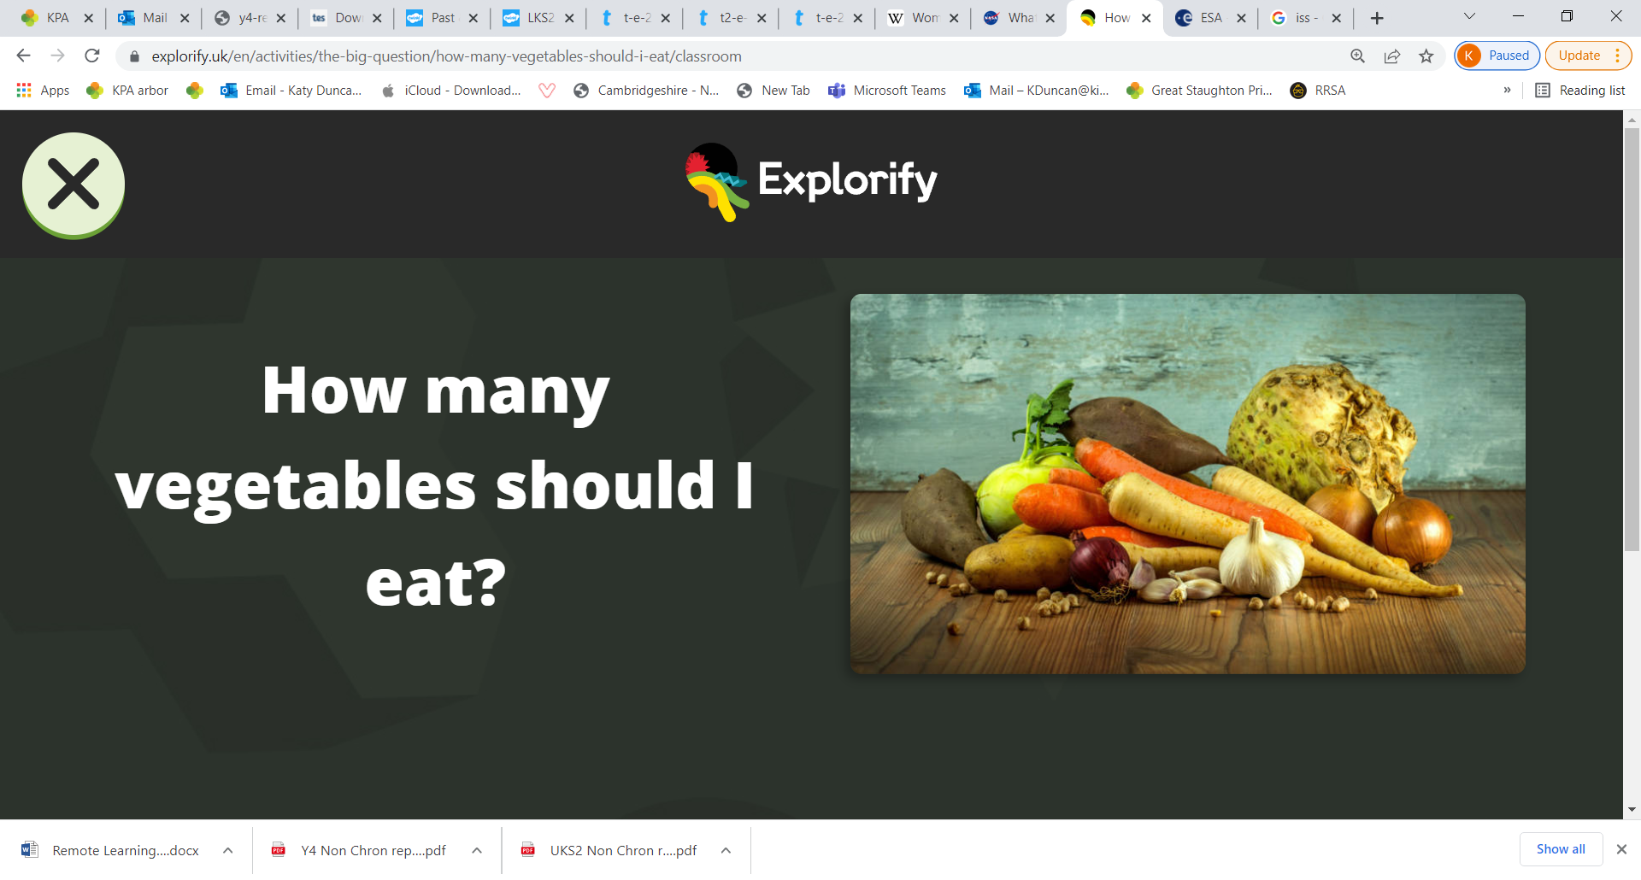
Your task is to work in small groups to come up with a research question that you would like to answer- related to the question above.
Example- Are green vegetables healthier than other coloured vegetables?
You should then work as a team to come up with an enquiry to answer your question.
Consider these ideas as you think.
What types of food do we choose to eat?
What types of food are we designed to eat?
Do all animals eat the same foods?

Slide 5
Choosing a research question.
Try to select a question that might provide a useful benefit for people’s lives.
Try to make sure your research question is specific, not vague. How will you measure your answer?
e.g. How healthy do carrots make you? (Too vague, what do you mean by healthy?)
What effect does eating carrots have every day have on vision in low light? (a question we can measure the answer to).

Slide 6
Thinking of an action plan.
What method of enquiry will you select?
Observation over time
Pattern seeking
Identifying, classifying and grouping
Comparative and fair testing
Research using secondary sources
What equipment will you need?
How will you measure and record results?
What results to you expect to find? Why do you think so?

Slide 7
At the end of the lesson, your group will present their research question in addition to an action plan to answer it.
The audience should listen carefully and decide: will their enquiry find out the information needed to answer the question?

