Slide 1
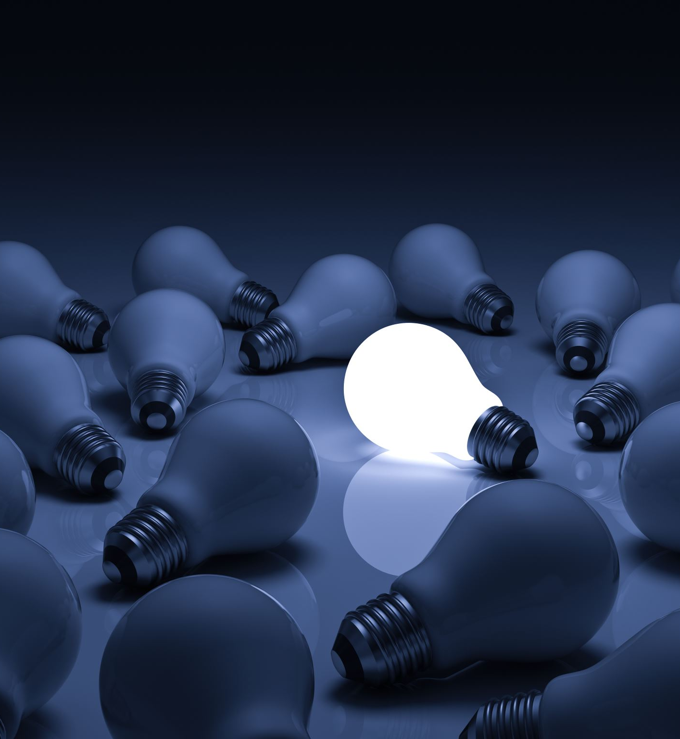
Brain power!
Year 5 Growth Mindset: To explain how the brain works

Slide 2
Watch one, or both, of these video clips:
Our Brain - Human Anatomy Lesson for Kids
Learn about the Brain
You might want to take some notes!

Slide 3
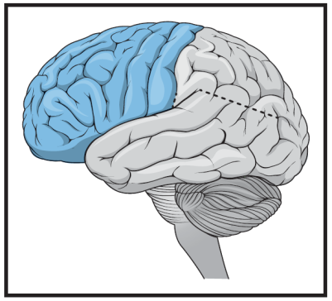
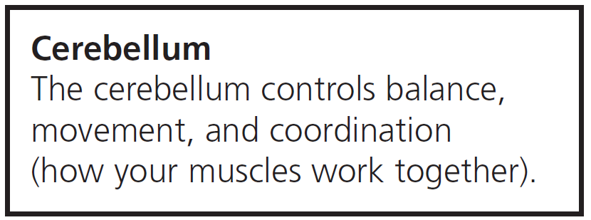
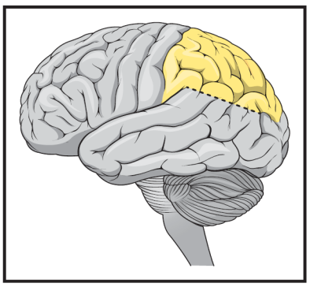
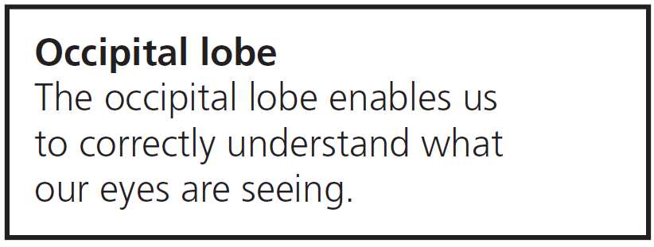
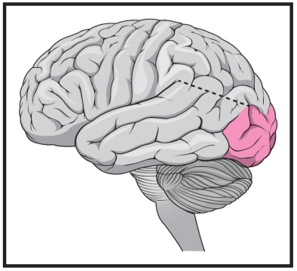
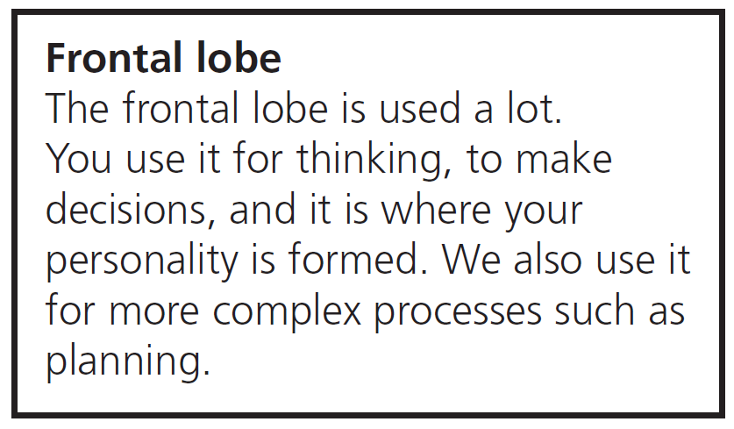
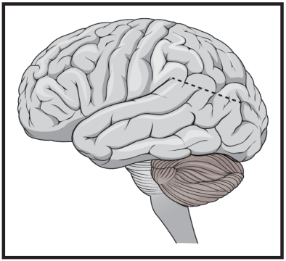
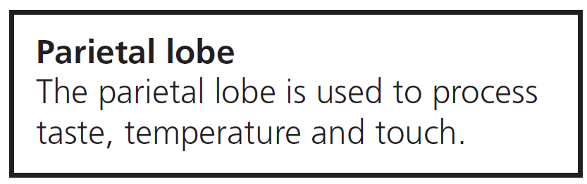

Can you match these?

Slide 4
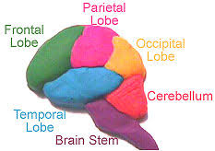
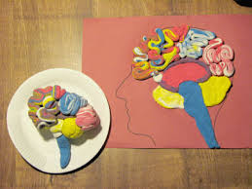
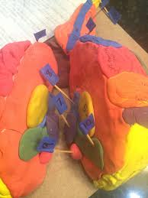
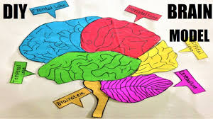
Create a model brain!
You could use modelling clay, wool, cake or any other materials of your choosing (follow the link for a make your own play dough recipe).
Key parts of the brain need to be clear.

Slide 5
Be the teacher…
You now need to use your model to create a short video; you will need to explain about the different parts of the brain and what each part does. This video needs to be suitable for the other children in Saturn class.
We would love to see what you have created so please upload your videos to Tapestry.

