Slide 1
Reception LO: understand recently introduced vocabulary about non-fiction texts. Must: listen attentively. Should: take part in discussions. Could: use some new vocabulary, fiction/ non-fiction. Year 1 LO: to identify the features of a non-fiction text. Must: know the difference between fiction and non-fiction. Should: identify and label the key features of a non-fiction text. Could: define the key features of a non-fiction text.

Slide 2





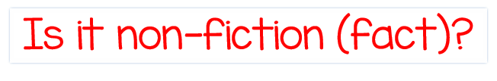

Slide 3

Stories | Information
Not real | Real and true
Characters | Gives us information
Made up | Teaches us new things
Setting | Text features – headings, captions
Beginning | Real pictures
Middle | Contents
End
Illustrations

Slide 4
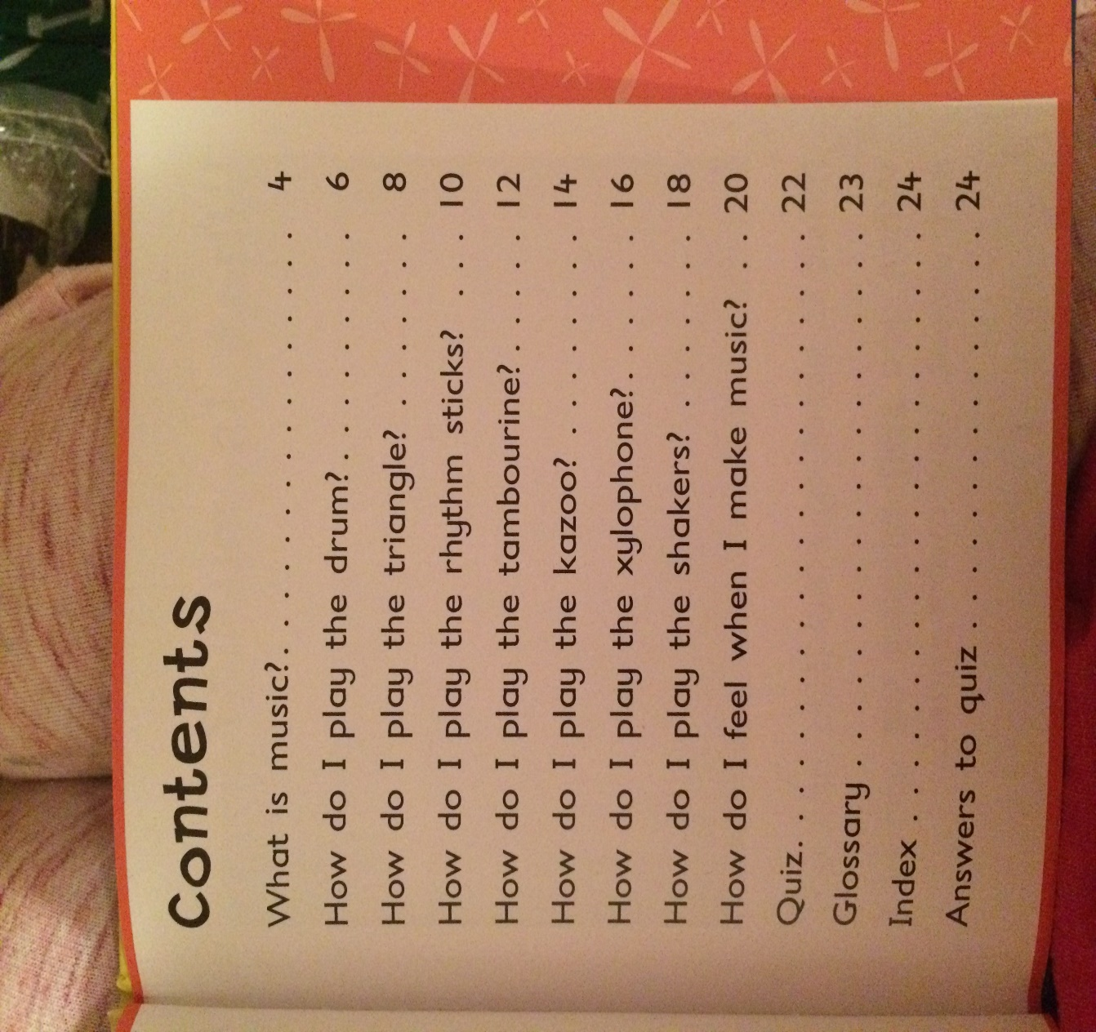
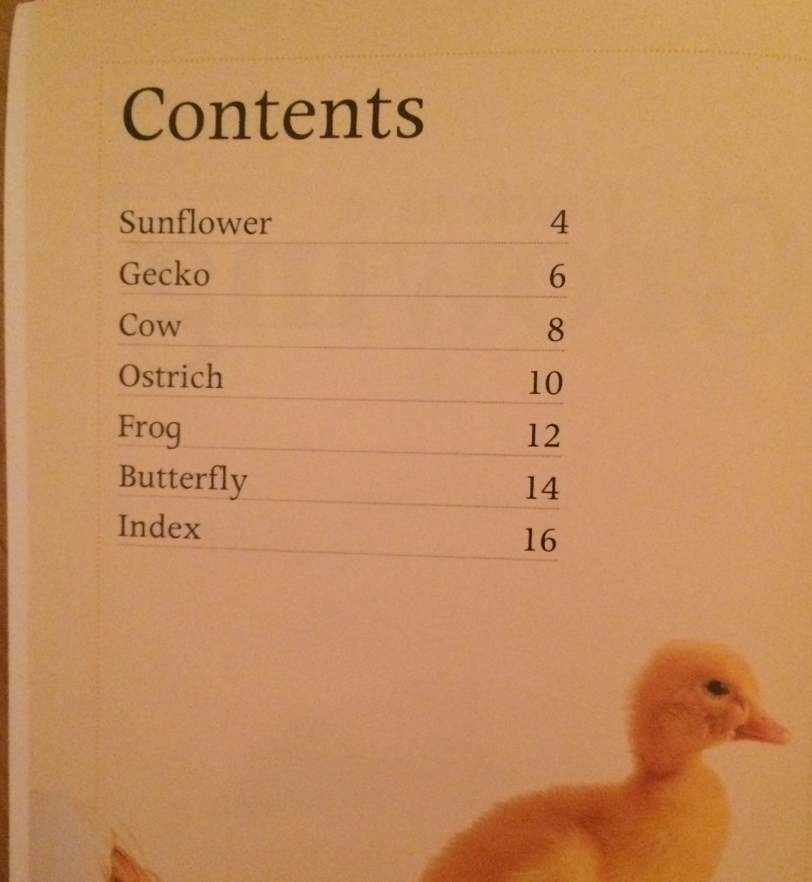
Contents page

Slide 5
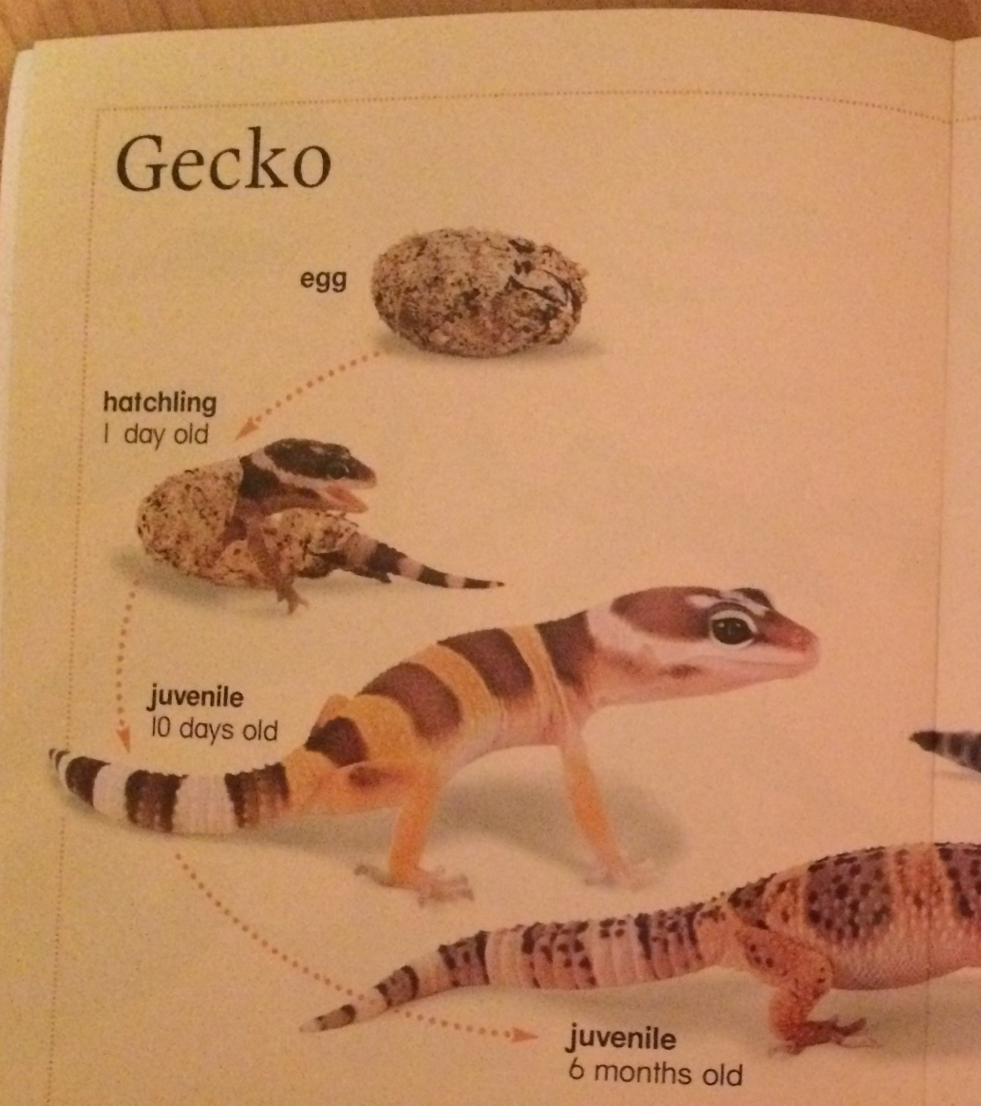
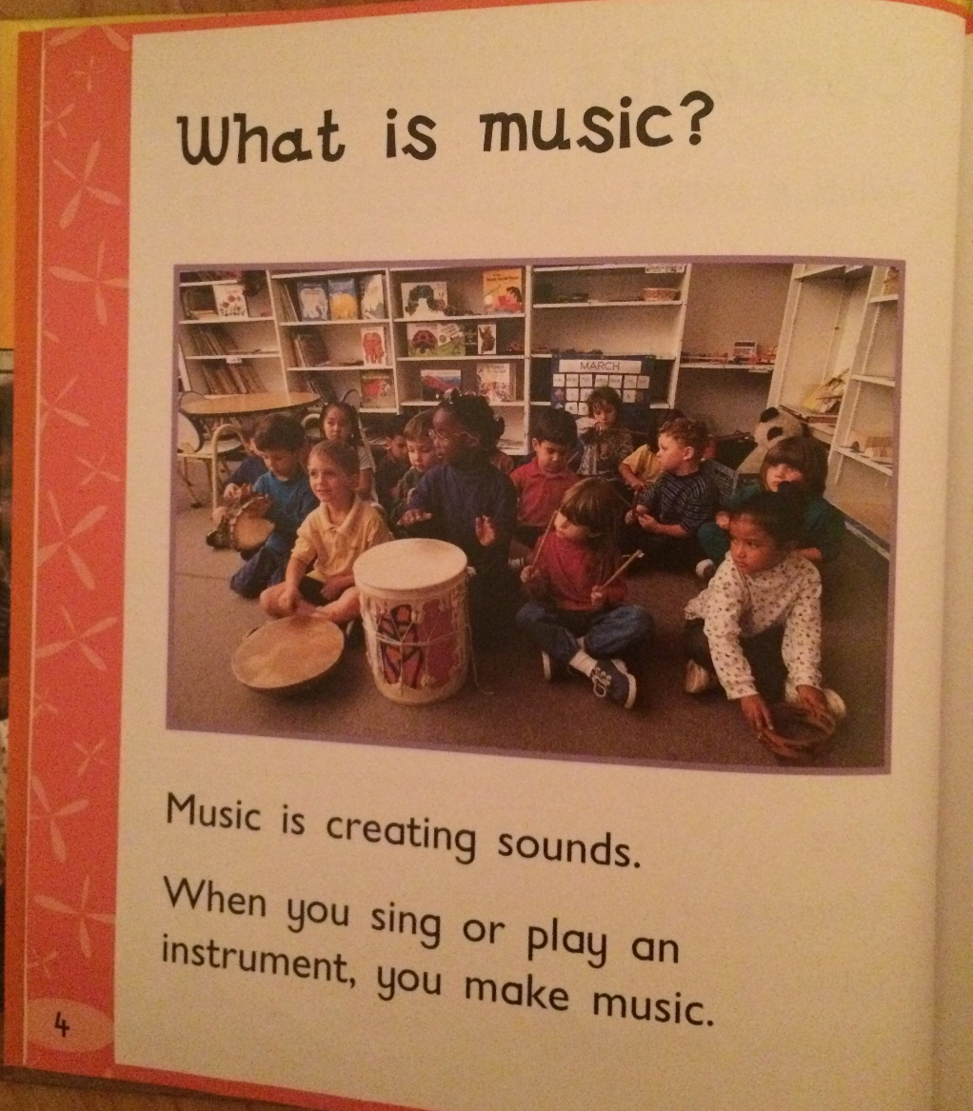
Headings

Slide 6
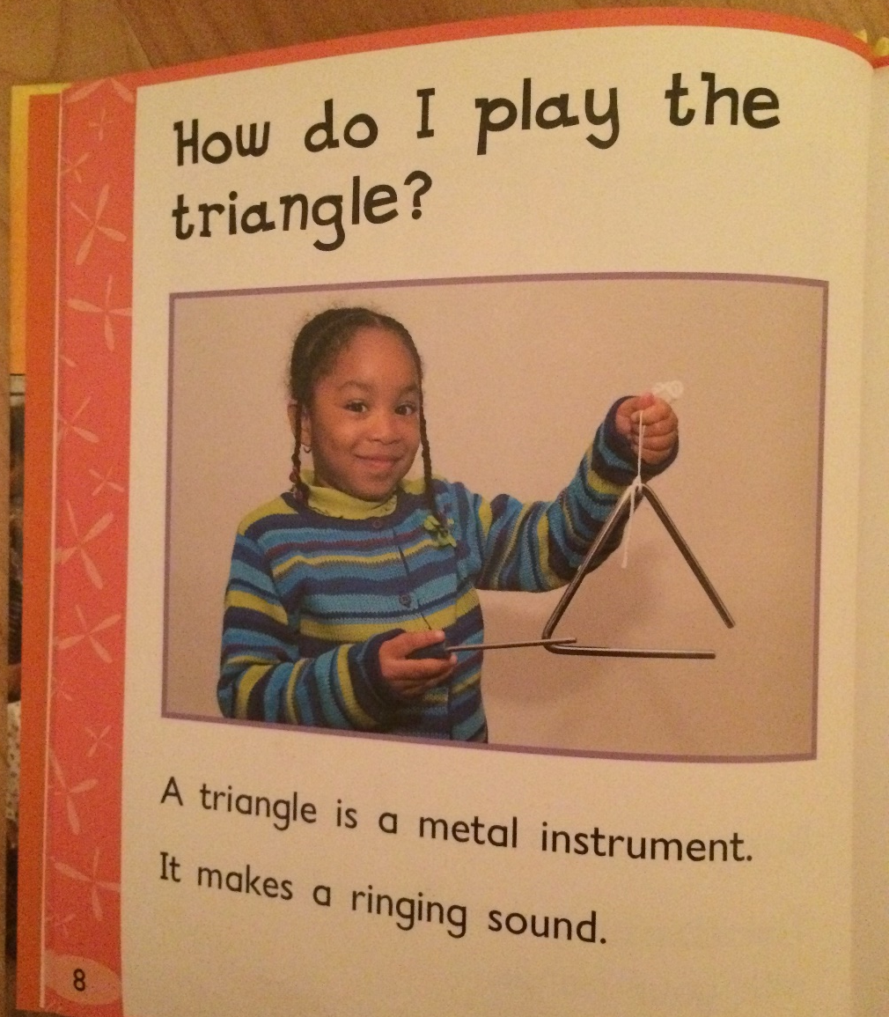
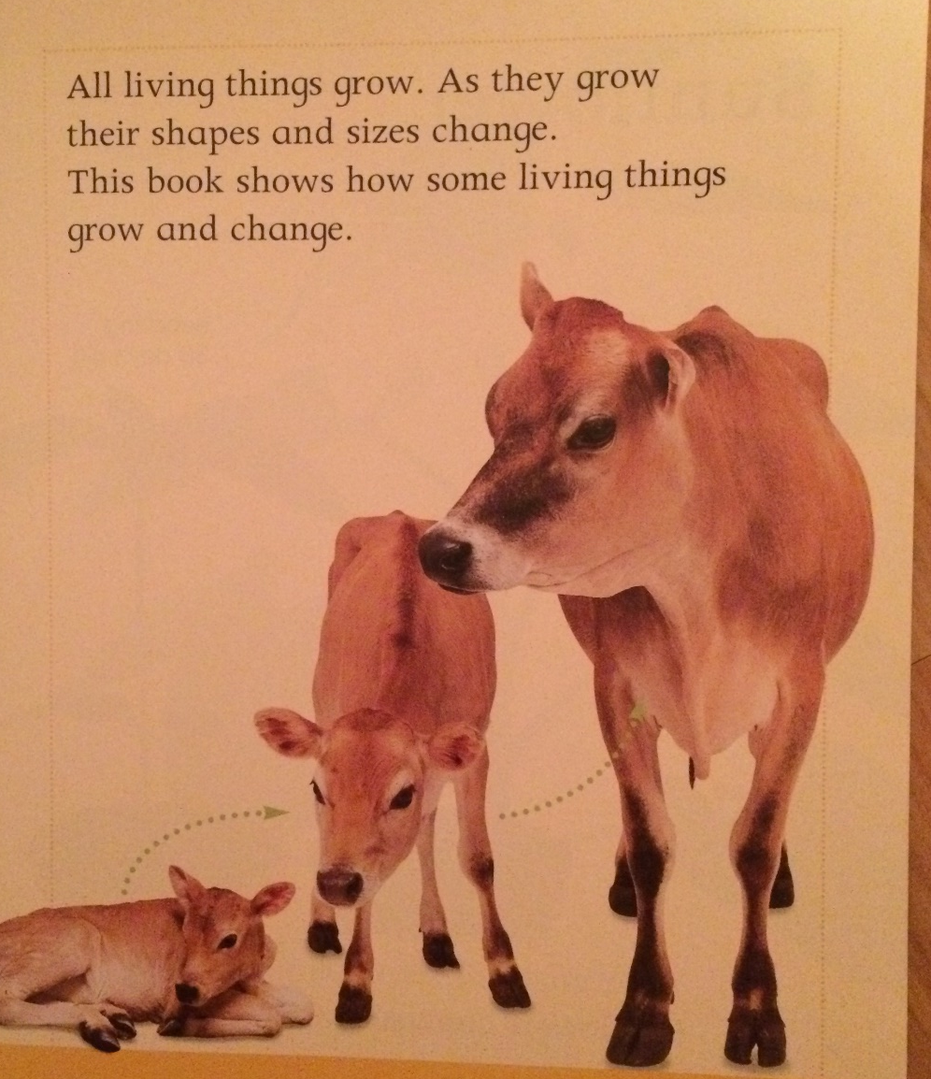
Photographs

Slide 7
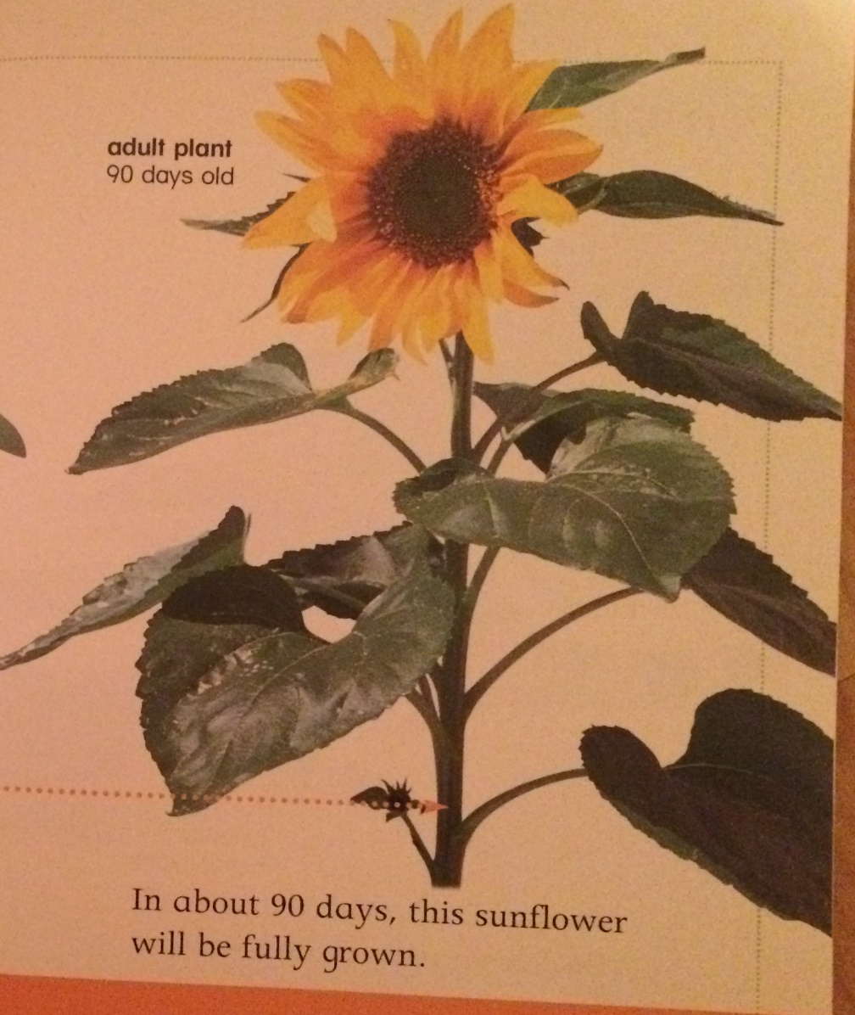
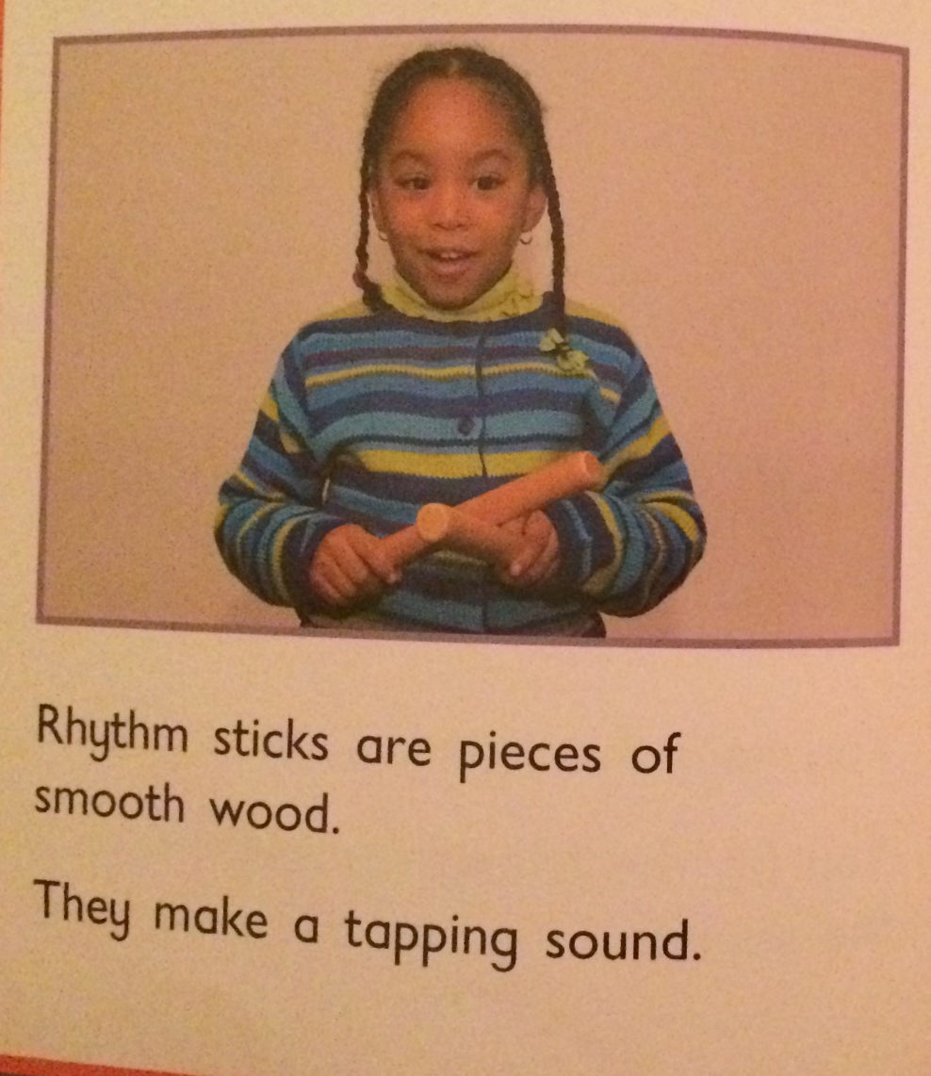
Captions

Slide 8

Diagram

Slide 9

Labels

Slide 10
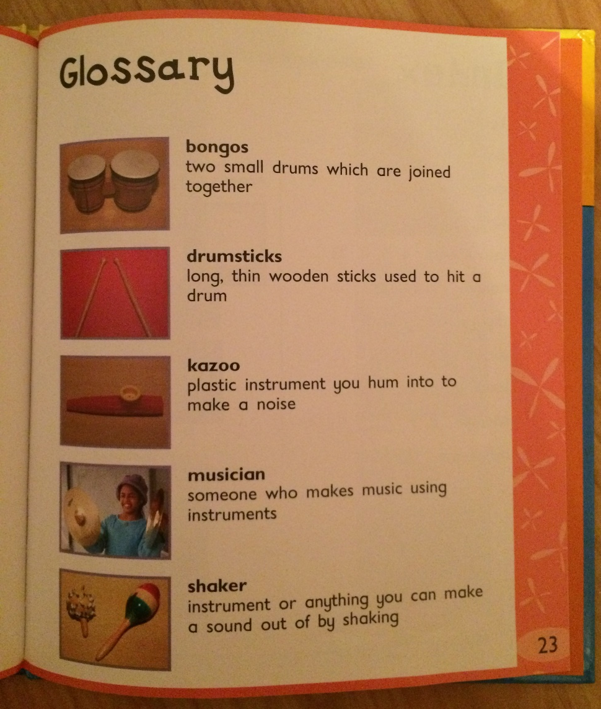
Glossary

Slide 11
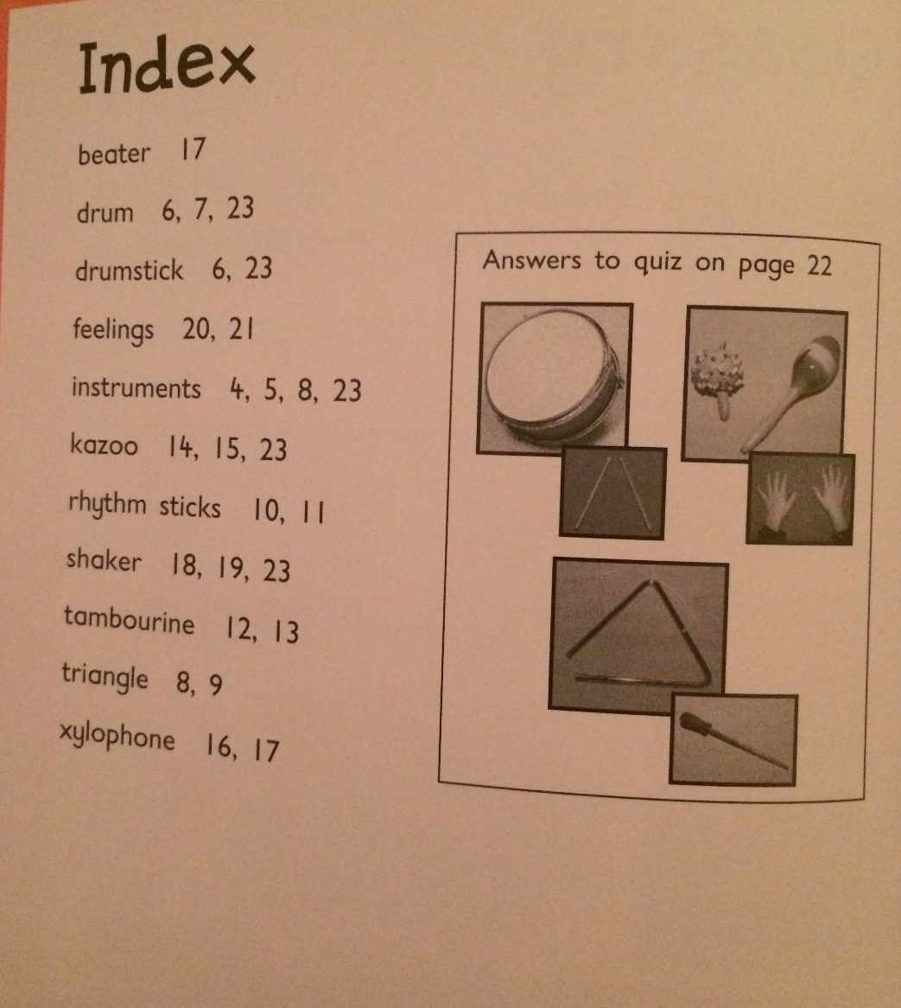
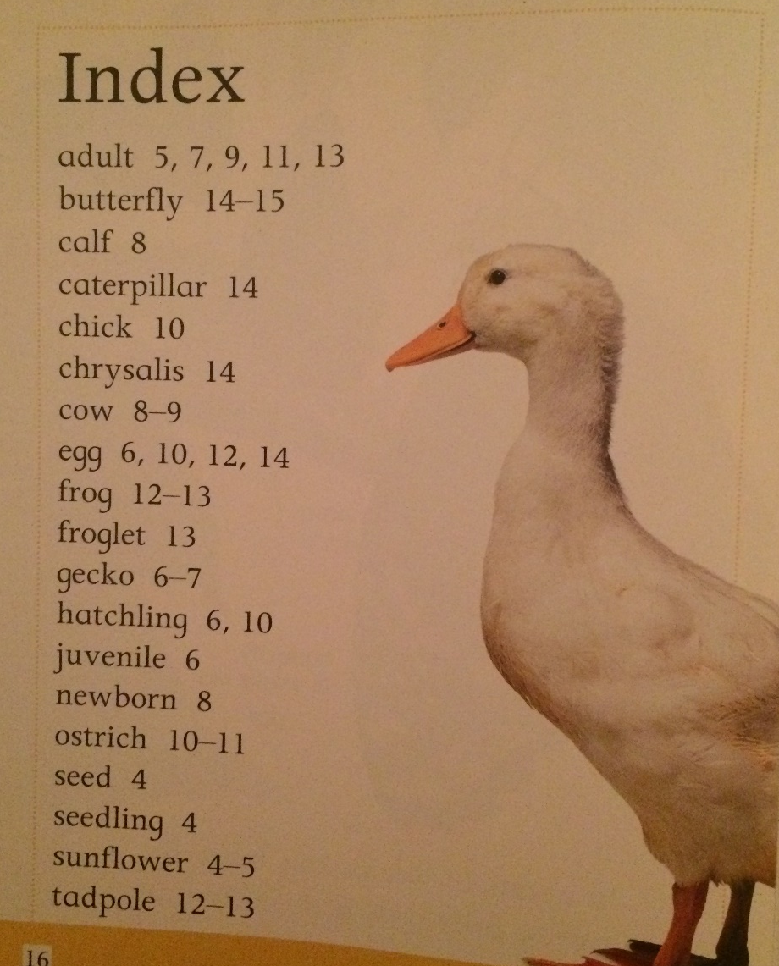
Index

