Slide 1
Reception LO: To match uppercase and lowercase letters.
Must: Understand what is a capital letter.
Should: Can match uppercase and lowercase letters.
Could: Can write a sentence with a capital letter.
Year 1 LO: To use capital letters.
Must: Understand what is a capital letter.
Should: Can use capital letters in a sentence.
Could: Correctly add punctuation to a sentence.

Slide 2
Can you remember the alphabet song from yesterday?

Slide 3
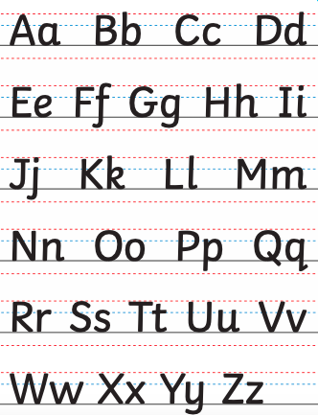
Today we are looking at capital letters and lowercase letters…

Slide 4
With your talking partner...
Where should we use capital letters in our writing?
Be ready to give your ideas!

Slide 5
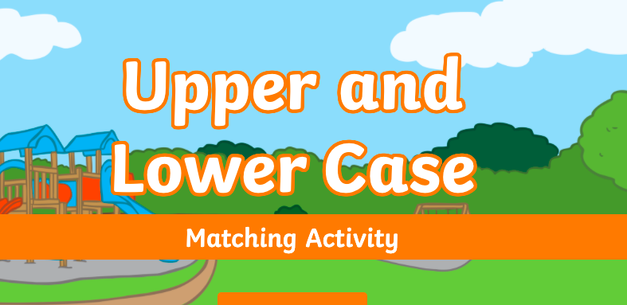
Let’s play a game…grab your whiteboards to write your answer!
https://www.twinkl.co.uk/go/resource/upper-and-lower-case-interactive-matching-activity-tg-448

Slide 6
Reception Task:
Can you go and match the capital letters to the lowercase letter.
Then can you help the easter bunny match the correct letters together?
Challenge: Write a sentence with a capital letter.

Slide 7
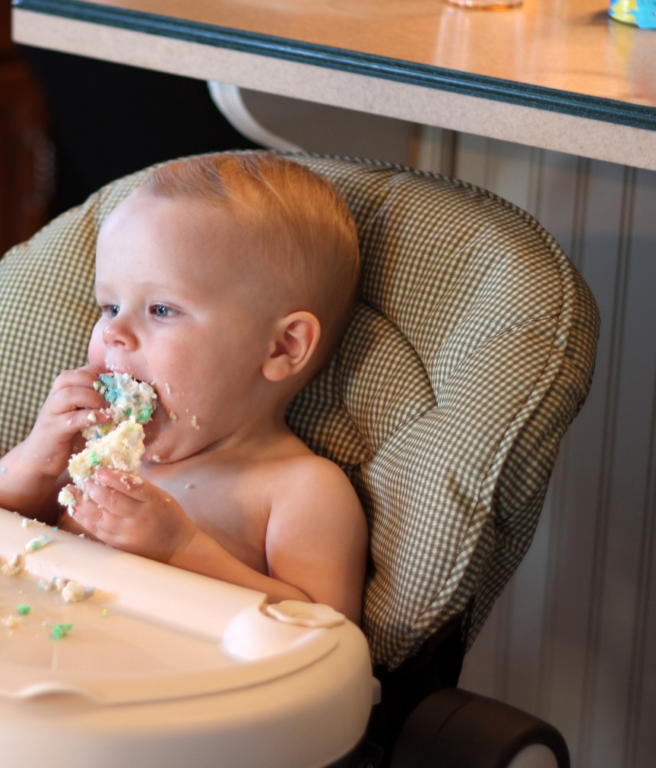
Starting Sentences
Capital letters are always used to start sentences
He loves to eat cake!
Photo courtesy of viviannguyen(@flickr.com) - granted under creative commons licence – attribution

Slide 8
Proper Nouns
Nouns are naming words.
Proper nouns are naming words for individual people, places, days of the week and months of the year.
Proper nouns all need capital letters.
Common Nouns | Proper Nouns
girl | Helen
country | England
city | Sheffield
football team | Nottingham Forest
day/month | Monday/September

Slide 9
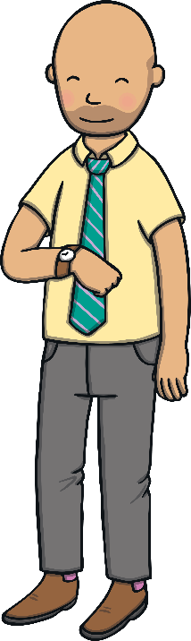
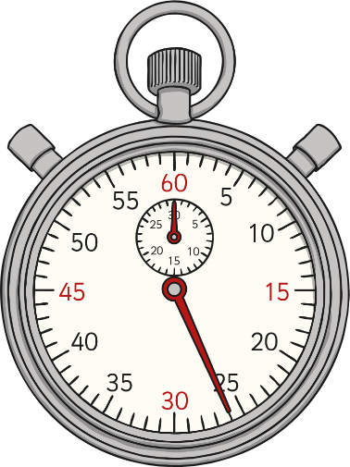
The Personal Pronoun ‘I’
When we are writing about ourselves we use the
personal pronoun ‘I’
I can tell the time.
The personal pronoun ‘I’ always needs a capital letter.

Slide 10
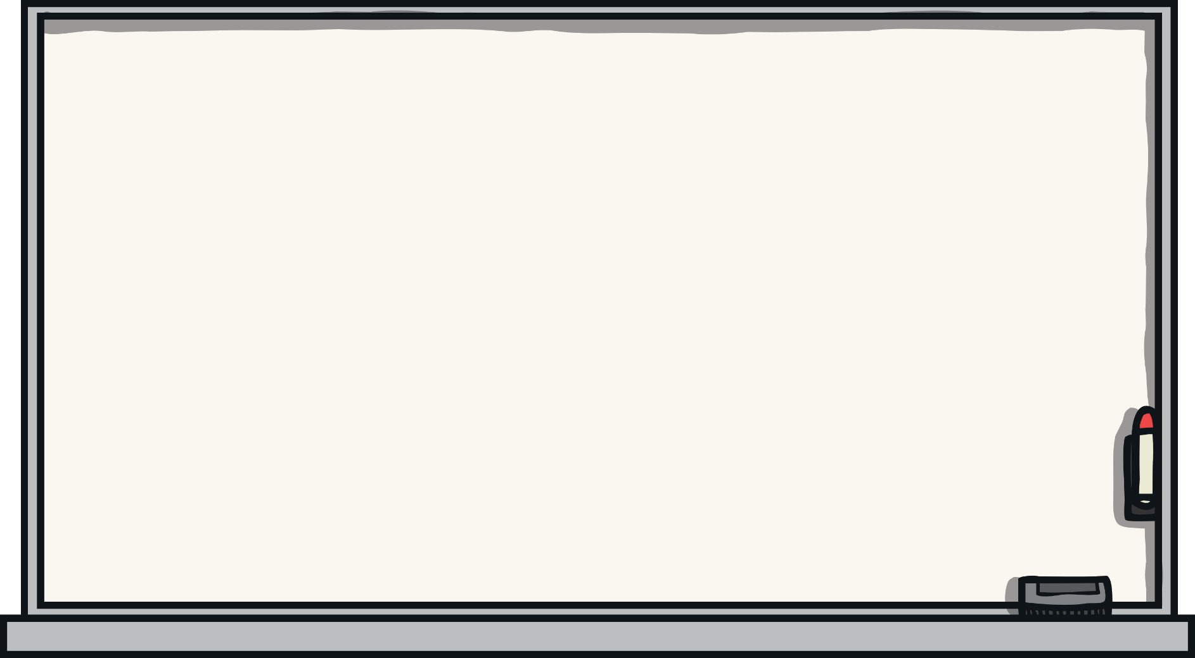
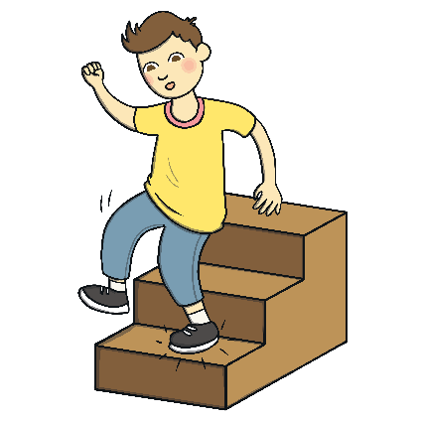
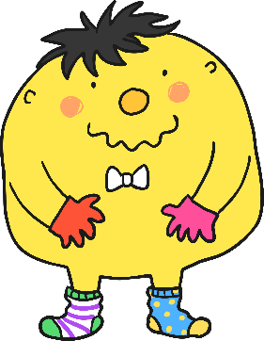
Fix the Sentence
1
the boi runned down the stairs
The boy ran down the stairs.
Next
Answer

Slide 11


Fix the Sentence
2
hannah is played in the peel.
Hannah is playing in the pool.
Next
Answer

Slide 12

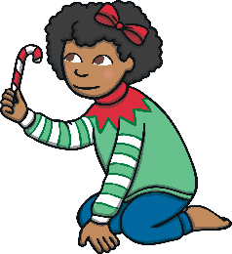
Fix the Sentence
10
whair are yuo gowing this crismas!
Where are you going this Christmas?
Next
Answer

Slide 13
Year 1 Task:
Can you correct the sentences making sure they have a capital letter in the right place!

