Slide 1

LO: to record what we know and what we want to find out about plants. Must: share ideas with a partner. Should: record what I know about plants. Could: record what I would like to find out about plants.
What do you think our science topic is this term?

Slide 2

Warm up:
Plickers Quiz!

Slide 3
Main Teach:
What do you already know about plants? Share your ideas with a partner.

Slide 4
Main Teach:
What do you want to find out about plants? Record some questions.

Slide 5
Main Teach:
How will you find out about plants?
Some ideas:
First hand experiences
Photos
Videos
Books
The internet
Espresso

Slide 6
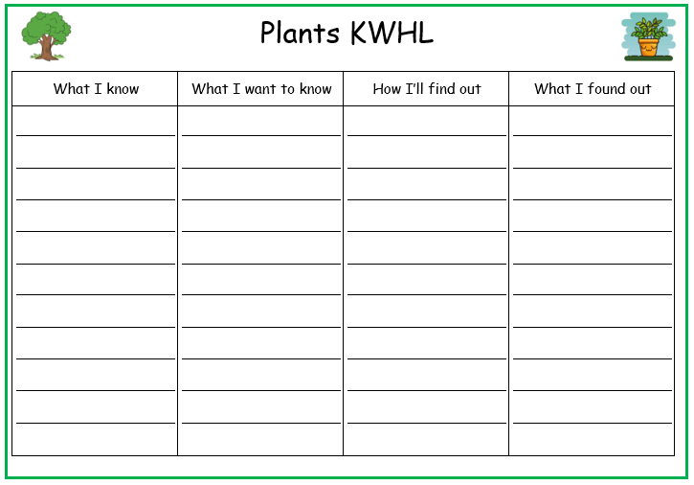
Main Teach:
Use your ideas to fill in the first 3 columns of the KWHL grid.

Slide 7

Plenary:
Share your KWHL grid with others. Share what we want to find out to display on our science learning wall.

