Slide 1

LO: to know what a plant is and name the key parts. Must: know that plants are living things. Should: name some common plants. Could: name the main parts of a plant.

Slide 2
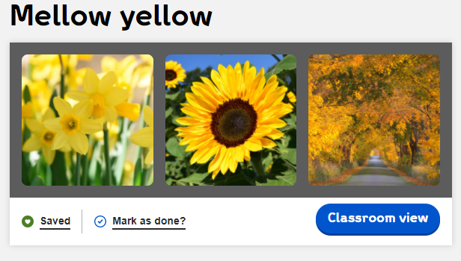
Warm up:
https://explorify.wellcome.ac.uk/en/activities/odd-one-out/mellow-yellow

Slide 3
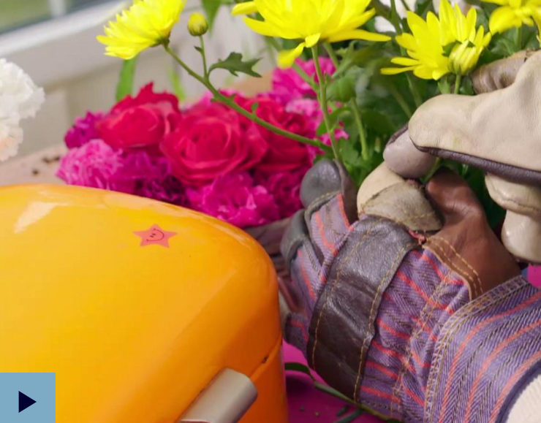
Main Teach:
https://www.bbc.co.uk/teach/class-clips-video/science-ks1-ks2-ivys-plant-workshop-parts-of-a-plant/zvdkpg8
Plants are living things.

Slide 4
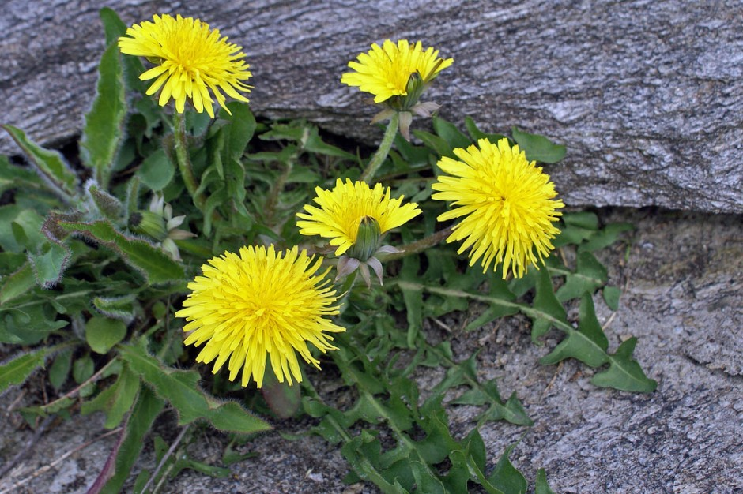
Dandelion

Slide 5
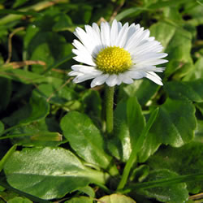
Daisy

Slide 6
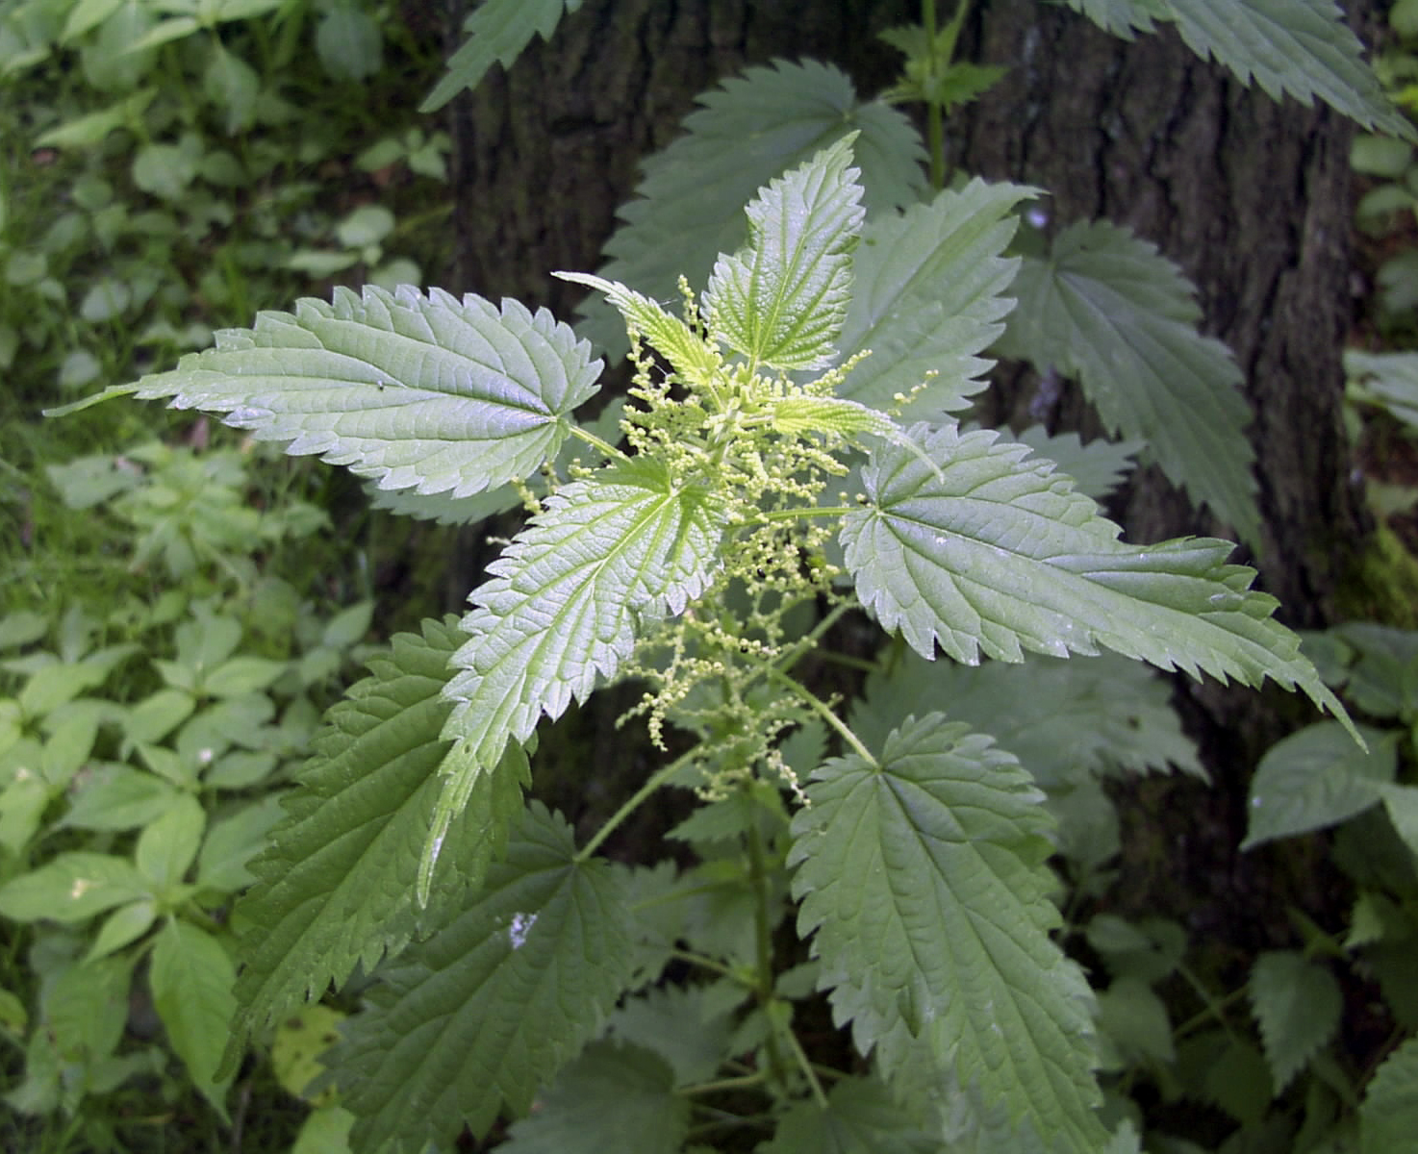
Stinging nettle

Slide 7
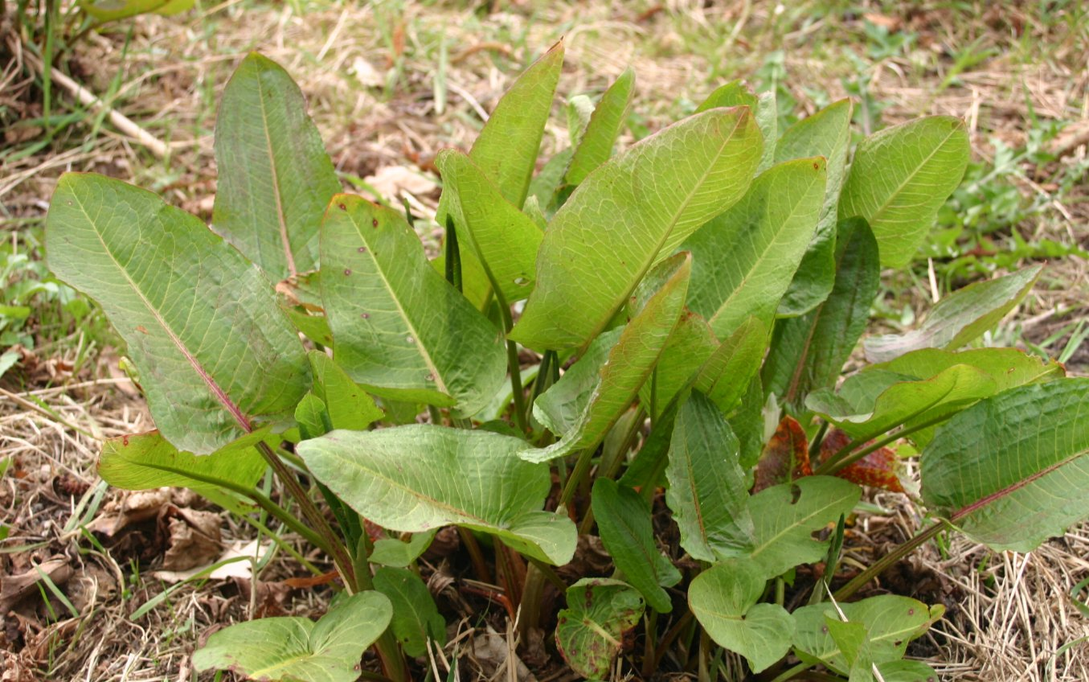
Dock

Slide 8
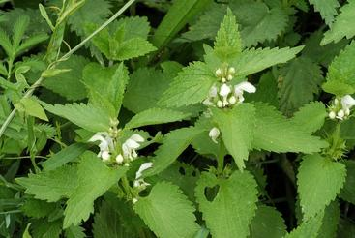
White dead nettle

Slide 9
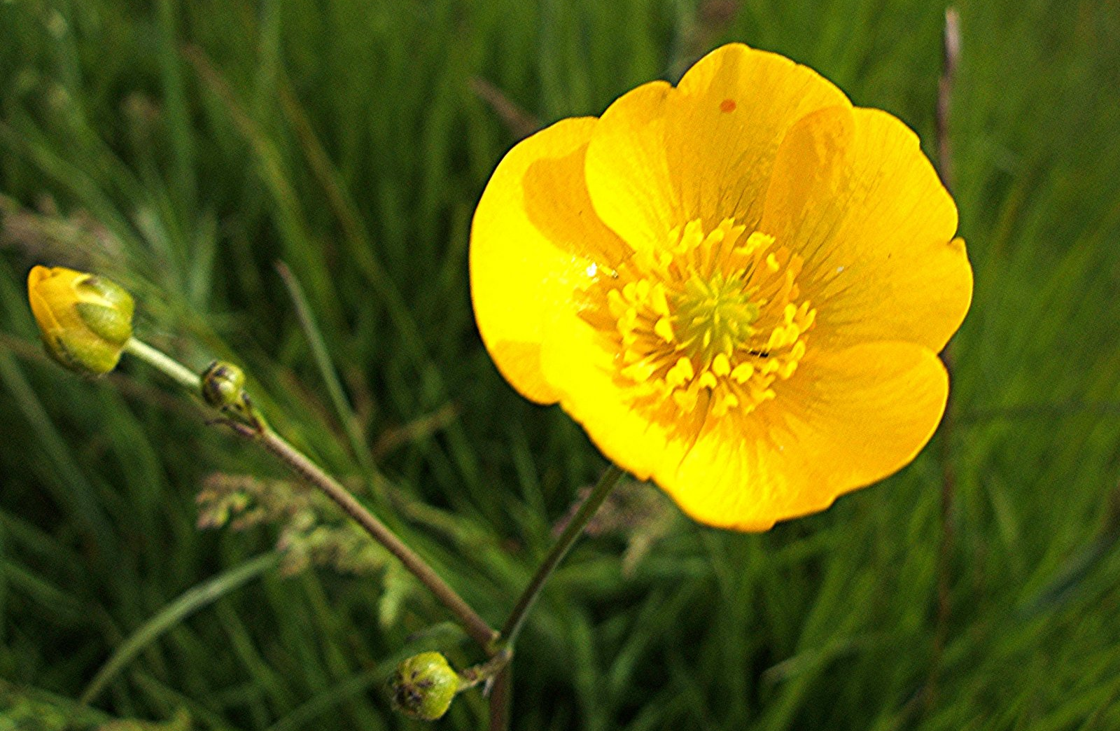
Buttercup

Slide 10
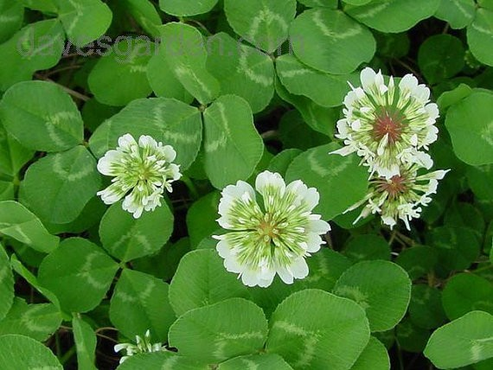
Clover

Slide 11
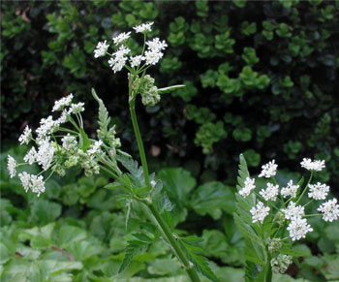
Cow parsley

Slide 12
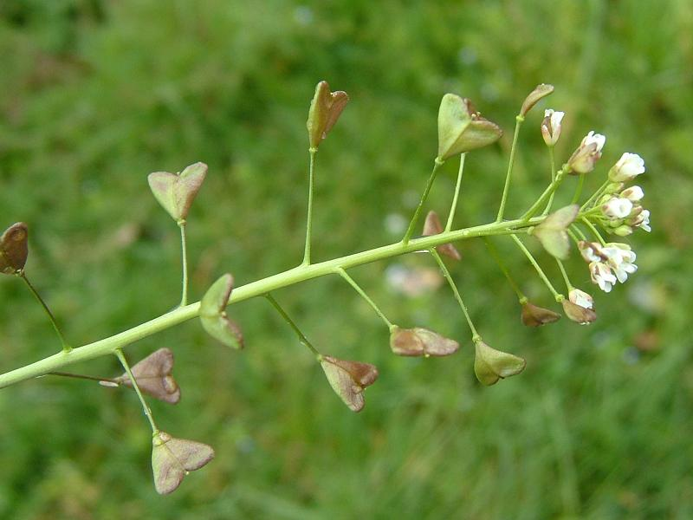
Shepherd’s purse

Slide 13

Rose

Slide 14
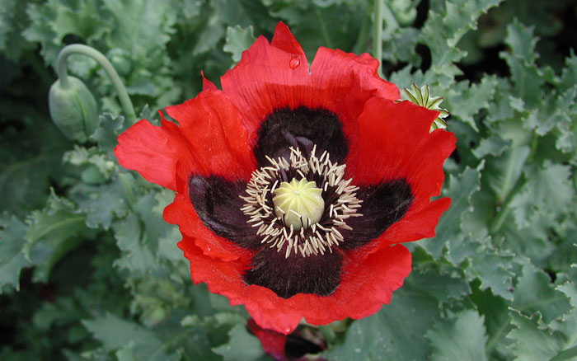
Poppy

Slide 15
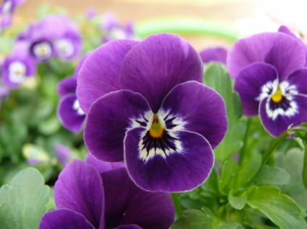
Pansy

Slide 16
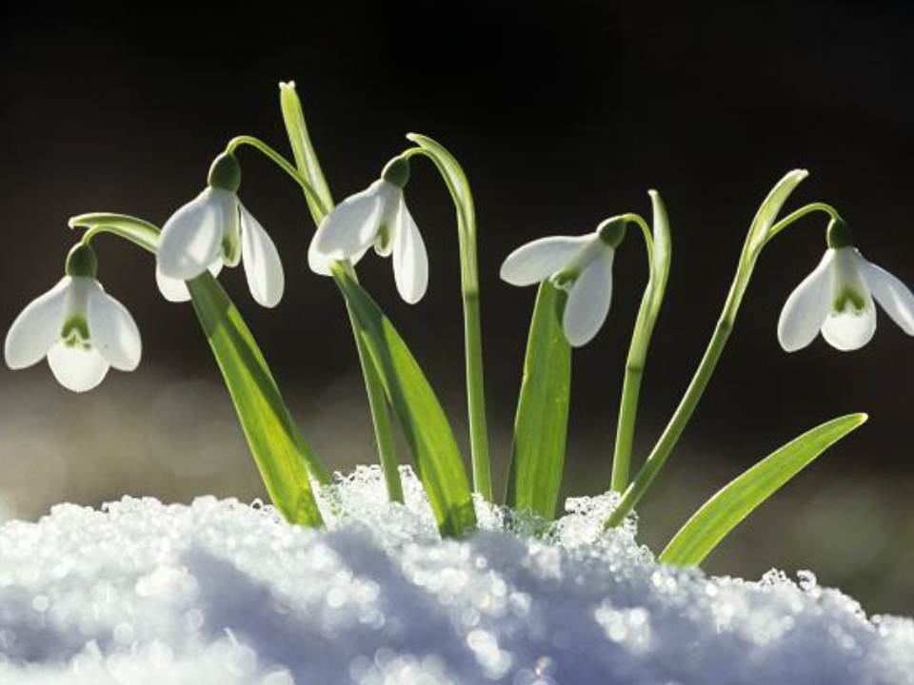
Snowdrop

Slide 17
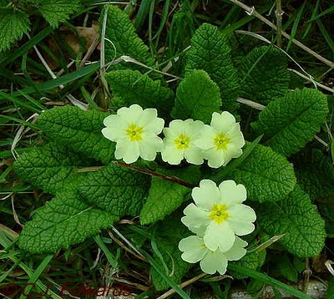
Primrose

Slide 18
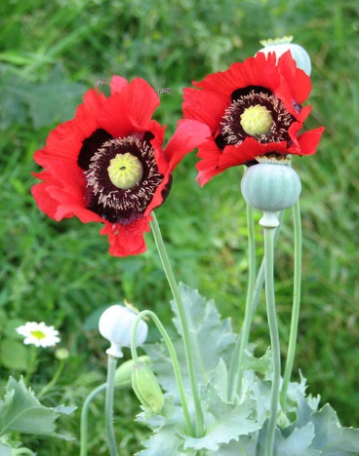
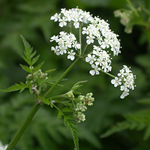
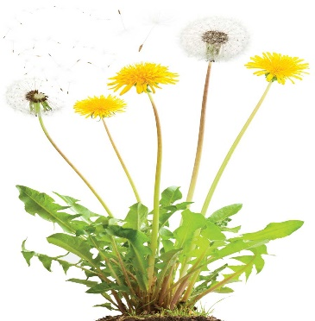


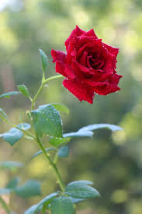
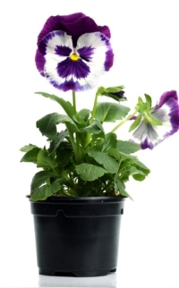
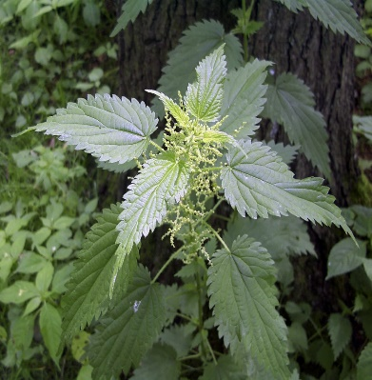
Daisy
Cow Parsley
Poppy
Dandelion
Dock
Buttercup
Rose
Pansy
Stinging Nettle

Slide 19
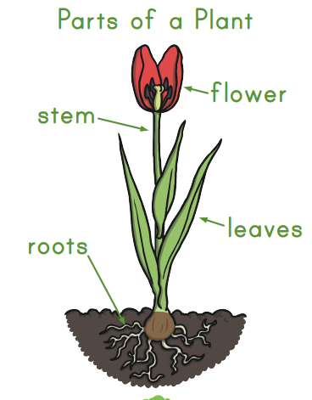
Activity 1:
Can you name the parts of a plant?
What is the function of each part?

Slide 20


Functions:
Flower: attracts bees and insects to pollinate the plant.
Stem: holds the plan upright
Leaves: make food for the plant using the sun.
Roots: takes up water and nutrients from the soil.

Slide 21

Carousel activities:
1) sketch a plant using pencils
2) paint a plant at the painting station.
3) use post-it notes to label a real plant.
Challenge: can you label the functions of each part of the plant?

Slide 22
Plenary:
What do plants need to grow? Discuss together. How can we find out?
Notes:
Plan a simple investigation for next lesson.

