Slide 1

LO: to investigate what plants need to grow.
Must: explain what you want to find out.
Should: set up a simple experiment.
Could: observe and record your findings.

Slide 2
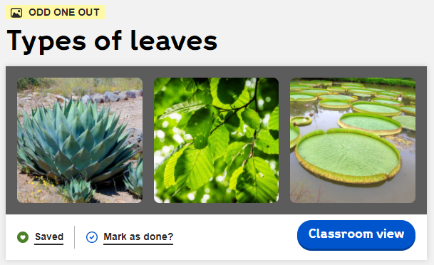
Warm up:
https://explorify.wellcome.ac.uk/en/activities/odd-one-out/types-of-leaves

Slide 3
Our questions:
What do plants need to grow?
What happens if you don’t water a plant?
Will plants grow in the dark?
Do plants need soil?
Notes:
Share ideas about what plants need to grow? How can we find out the answers to our questions?

Slide 4
Our experiment:
Light/ no light
Soil/ no soil
Water/ no water
Light, water and soil.

Slide 5
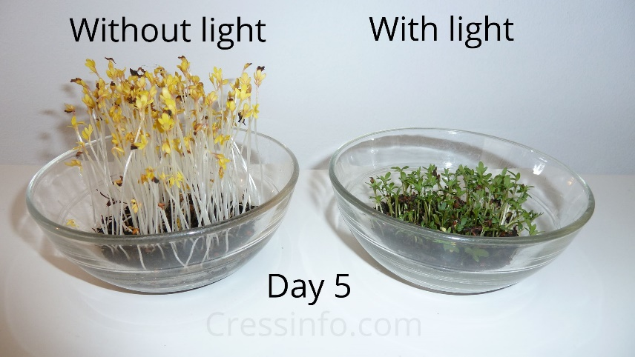
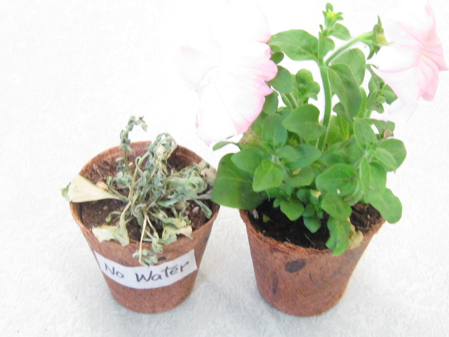
You have the following equipment:
Cress seeds
Water
Paper towels
Soil
Petri dishes
Dark box
Discuss with a partner how you might set up a simple experiment to find out what plants need to survive.

Slide 6
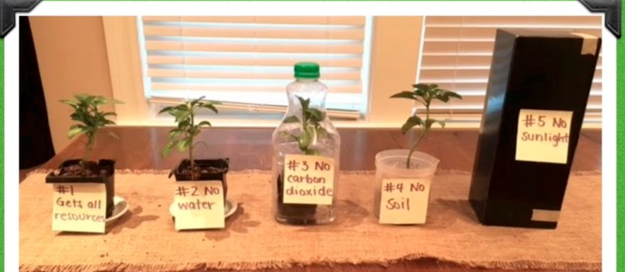
Example:

Slide 7
Task:
Set up your experiment with a partner.
light/ no light
Water/ no water
Soil/ no soil
Has all resources
How will you record your results? Hint: table? photos? Written record?

Slide 8
Plenary:
What do you think will happen to the seeds? Which seed do you think will grow? Why?
Notes:
Plan a simple investigation for next lesson.

