Slide 2
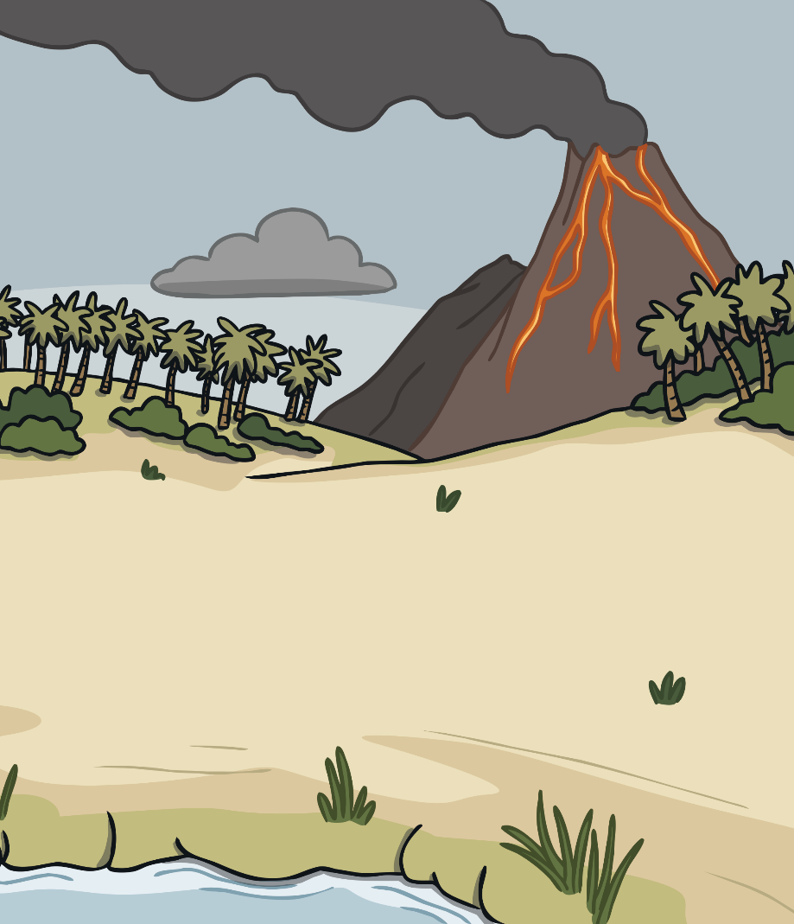
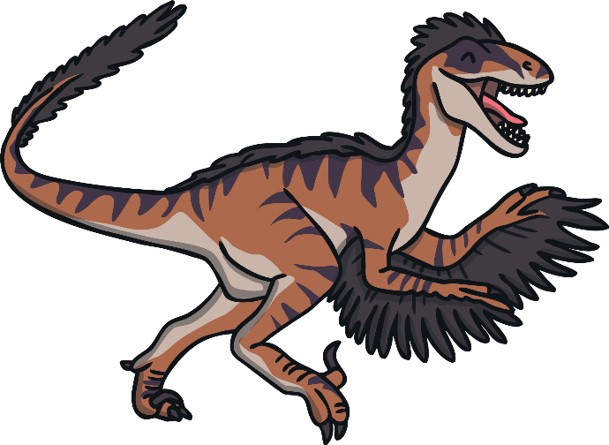
What Does Extinct Mean?
The word extinct is used to describe a living thing that doesn’t exist anymore. It might be a plant or an animal.
Something that is extinct has died out and there is no way another one can be born as a baby, grown from a seed or hatched from an egg.
Why do some living things
become extinct?
Others become extinct because the food they eat has run out.
Some become extinct because they have been hunted and killed.
Some become extinct because the places where they live or grow have been destroyed to make room for buildings and factories.

Slide 3
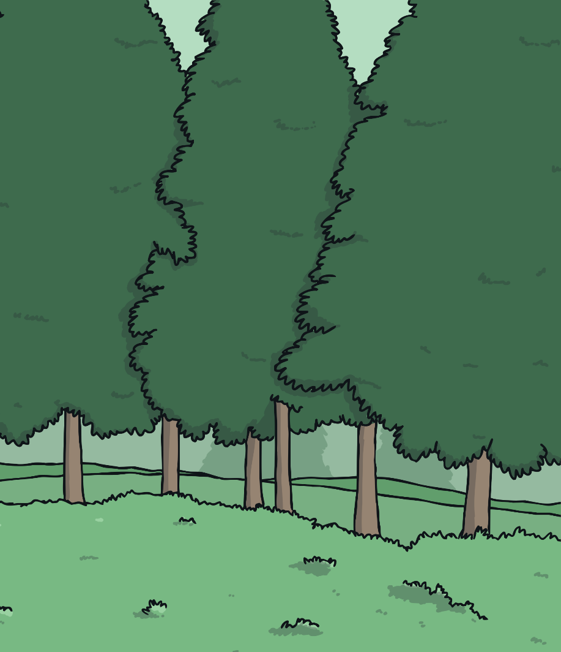
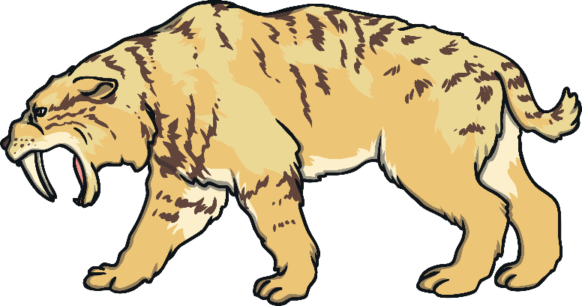
Sabre-Toothed Cat
Their habitat (where they lived) was in grasslands and pine forests where they could drink from lakes and rivers.
These cats were excellent hunters and they had
very long canine teeth.
The sabre-toothed cat became extinct around 10 000 years ago. They had big strong teeth to catch their food. They ate mammoths and mastadons. The sabre-toothed cat died out when mastadons became extinct.
They had a body
a bit like a bear.

Slide 4
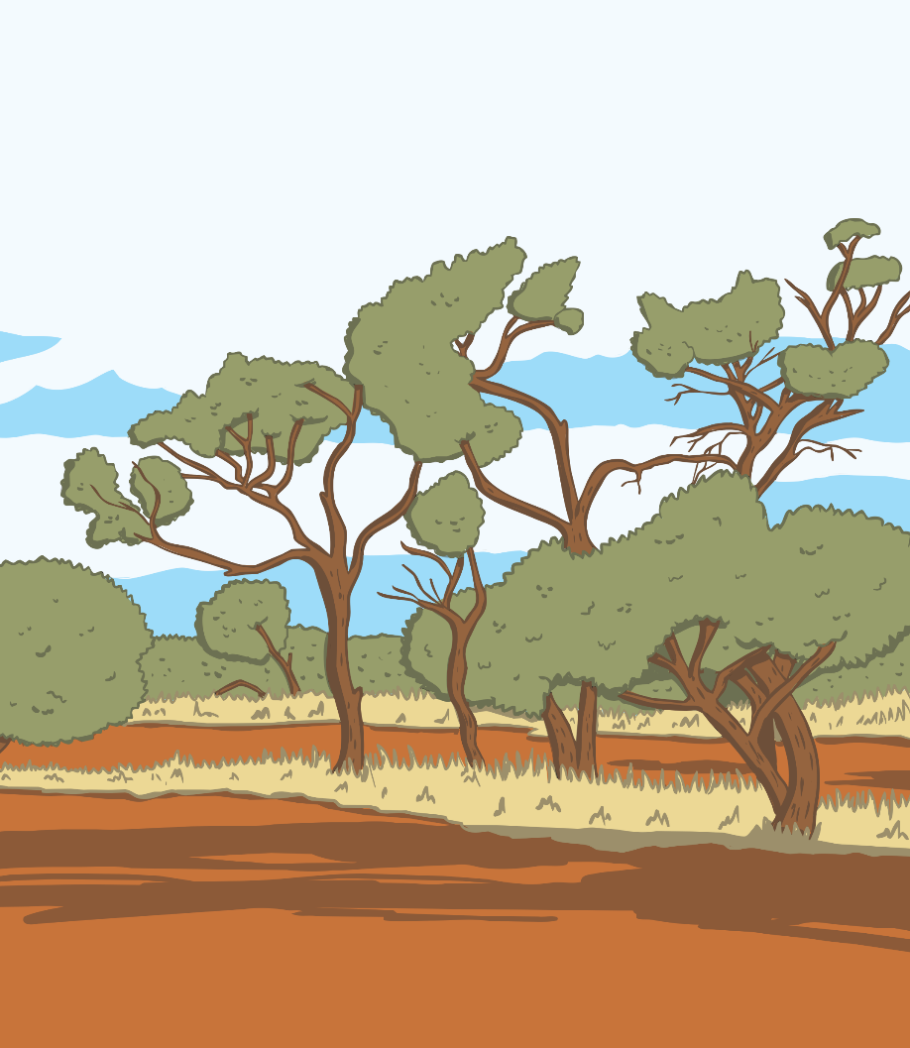
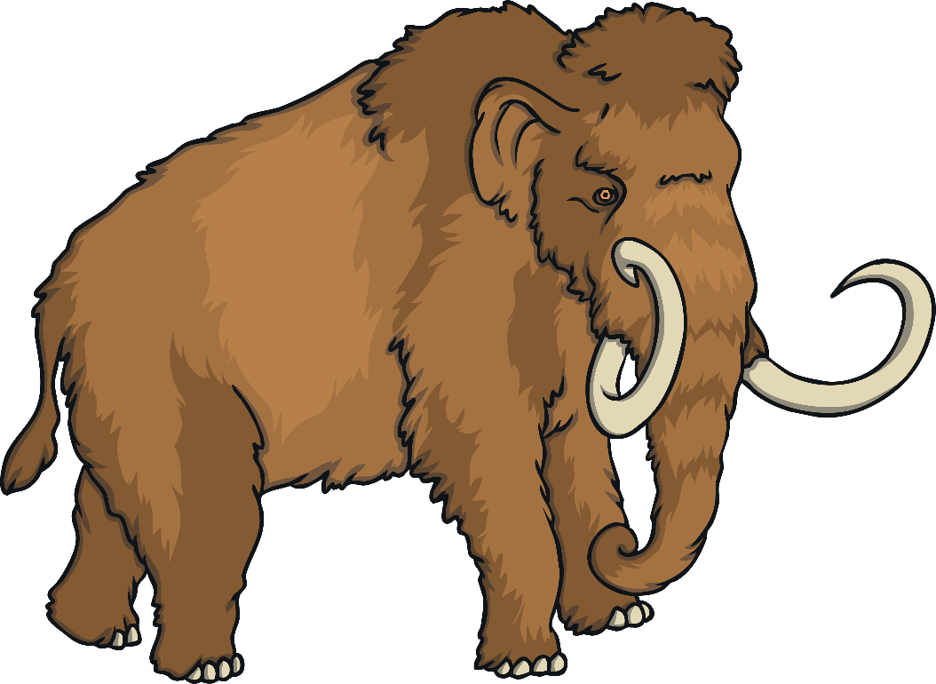
Woolly Mammoth
Mammoths became extinct 4000 years ago. They were hunted by people for their meat and fur. The woolly mammoth ate leaves and plants. They died out when their habitat disappeared because of climate change.
They had long tusks.
Their bodies were covered in long hair to keep them warm.

Slide 5
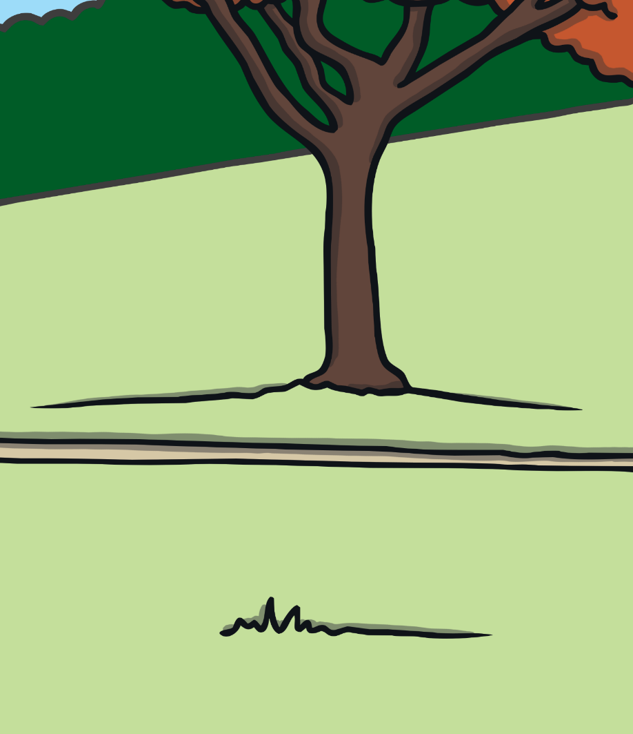
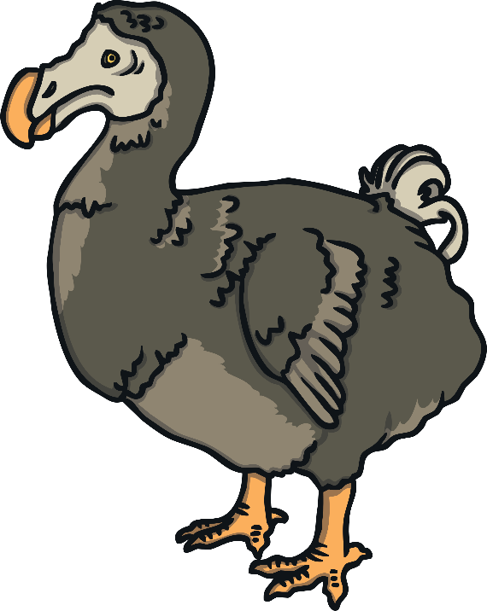
Dodo
The dodo could grow up to 1 metre tall. It lived in Mauritius and was hunted for its meat by sailors. The last dodo was seen nearly 400 years ago. It is thought to have lived in woods and ate seeds, roots and fruits.
They had a strong, green beak.
The dodo was a bird with short wings. It couldn’t fly.

Slide 6
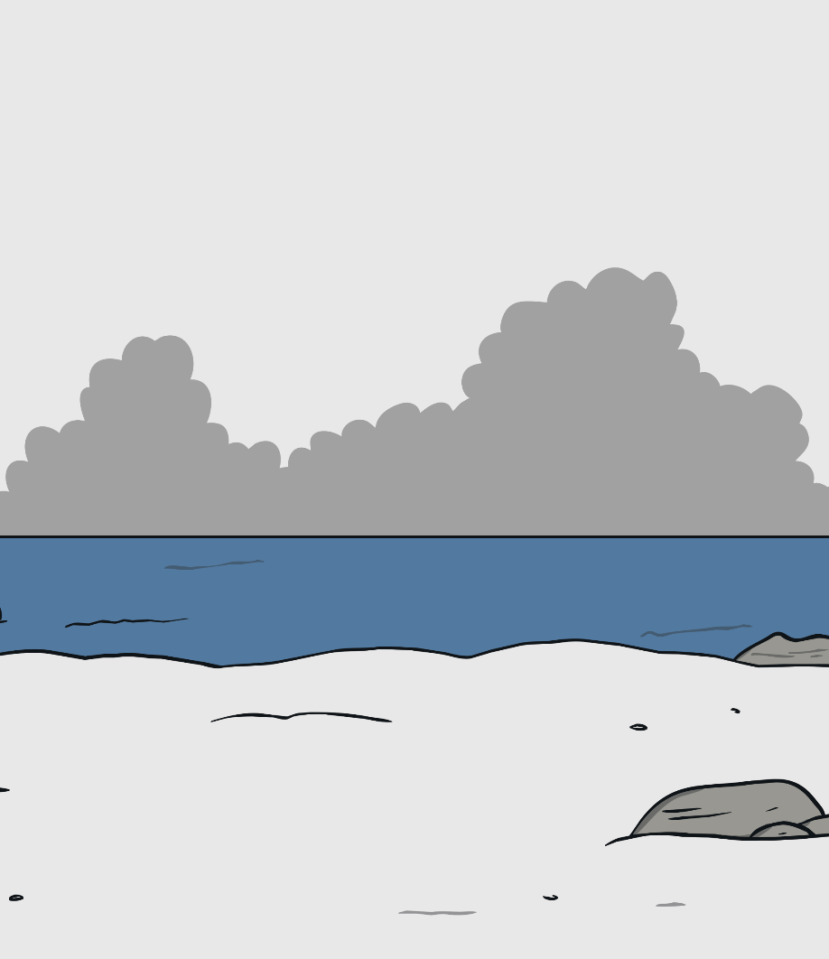
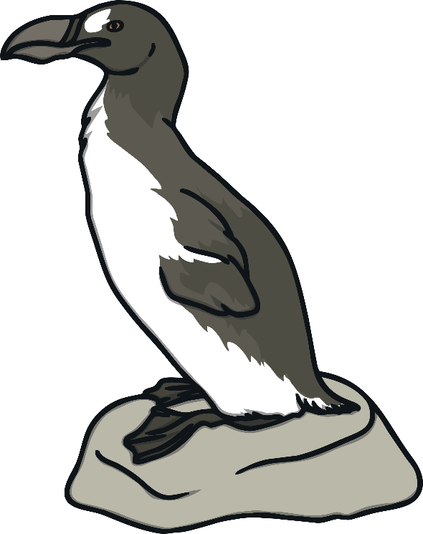
Great Auk
The Great Auk looked a bit like a penguin.
They had a long, hooked,
black beak.
They used their strong wings for swimming but they couldn’t fly.
The great auk lived in cold, rocky coasts and ate fish. It was hunted for its meat. The last one was hunted in Iceland 175 years ago, in 1844. Many of their eggs are on display in museums.

Slide 7
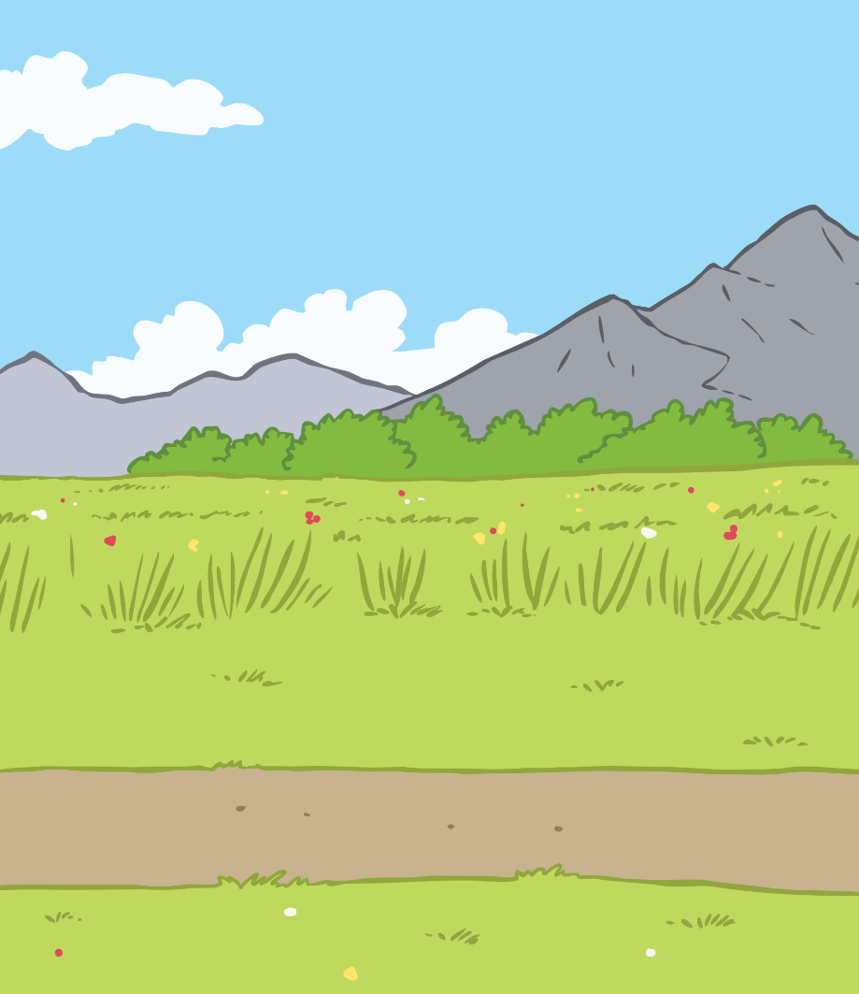
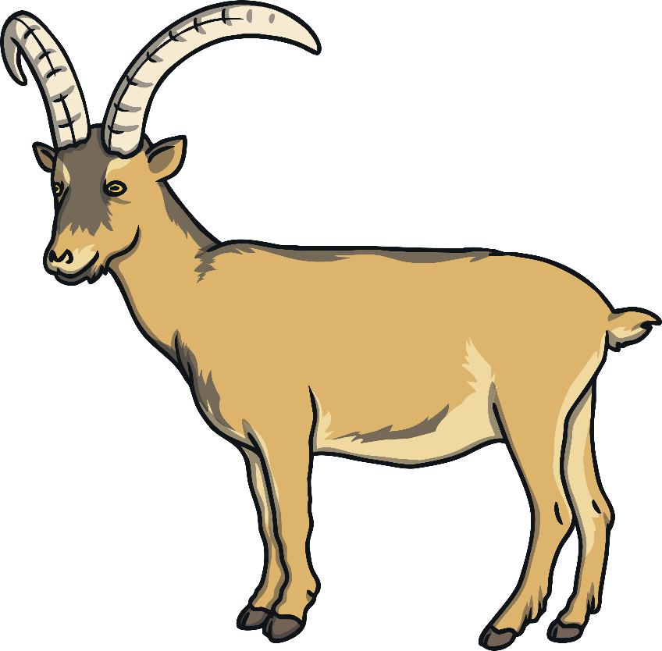
Pyrenean Ibex
The Pyrenean ibex looked a bit like a mix between a goat and a deer.
The male Pyrenean ibex had long, curved horns.
The Pyrenean ibex lived in the mountains of France and Spain.
It ate bushes and grass. It is thought it became extinct because it was hunted and because it was in competition for food with other animals. It has been extinct since 2000.

Slide 8
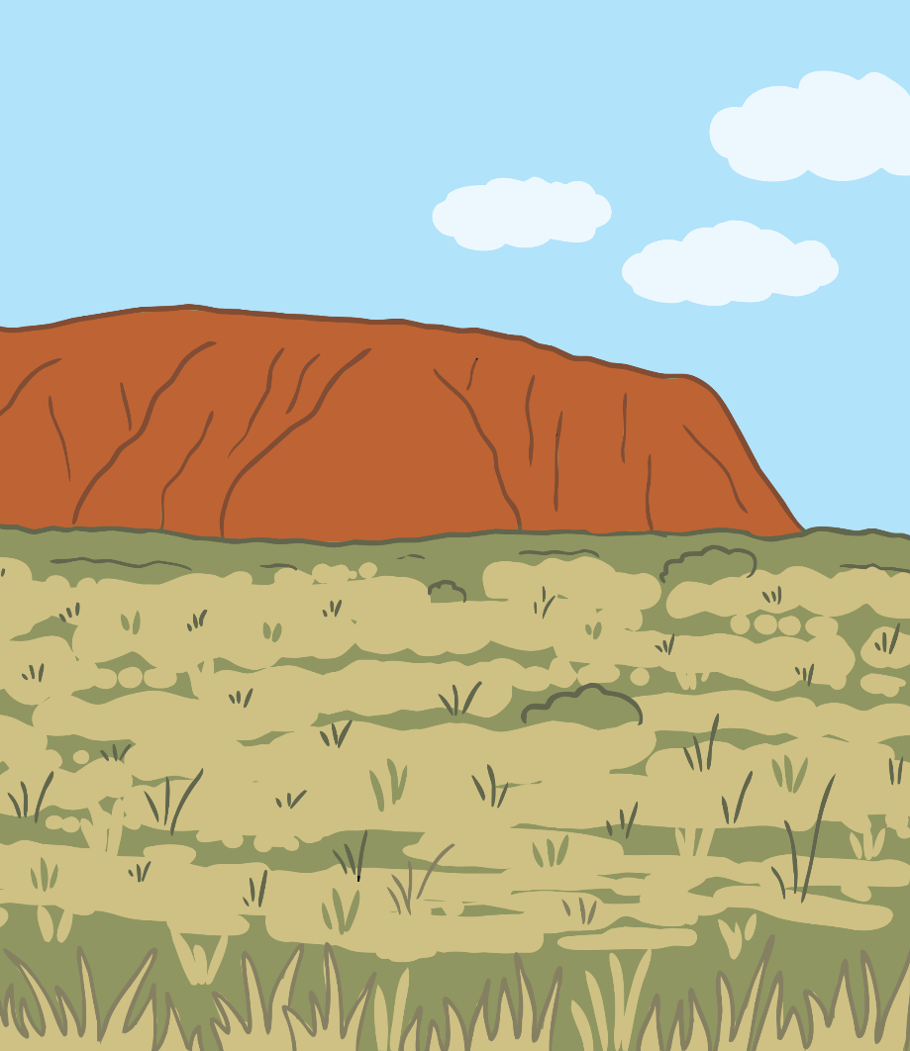
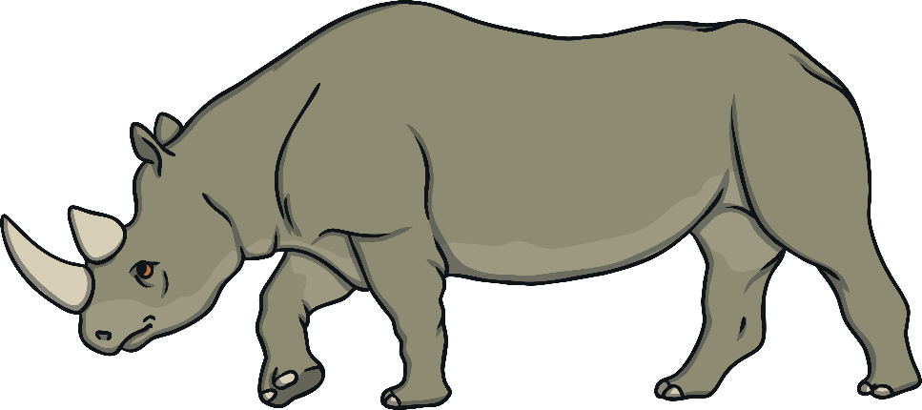
West African Black Rhino
The West African black rhino couldn’t see very well. It knew there was danger if the birds nearby flew away.
The West African black rhino
had two horns on its head.
The West African black rhino ate leafy plants and was hunted for its horns. Some people thought it would make people better if the horn was made into powder and put in medicines. It has been extinct since 2011.

Slide 9
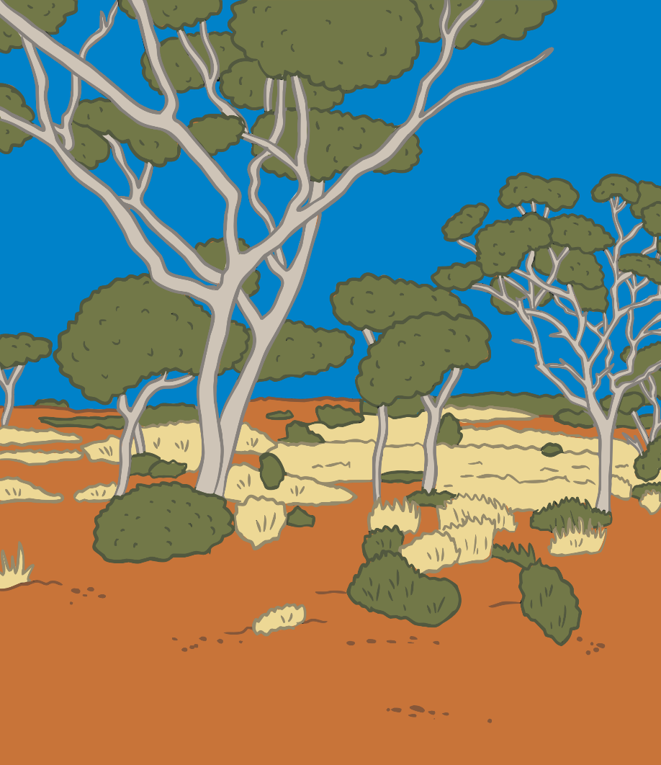
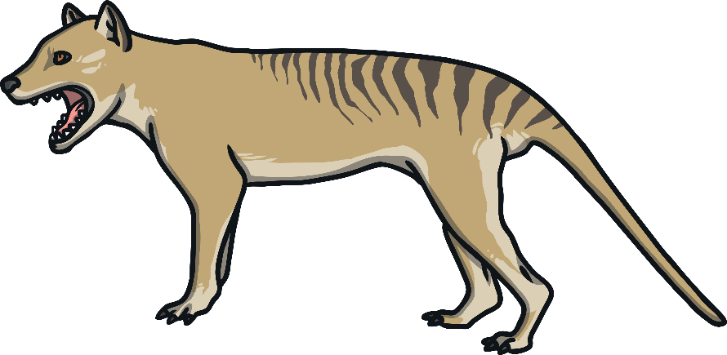
Tasmanian Tiger
The Tasmanian tiger had a pouch
to carry its babies, a bit like a kangaroo.
It had black stripes
across it’s back.
The Tasmanian tiger had a face
a bit like a fox.
The Tasmanian tiger lived in Australia and ate wallabies and birds. It hunted at night. People thought it might attack sheep so it was hunted until it was extinct. One hasn’t been seen since 1936.

Slide 10
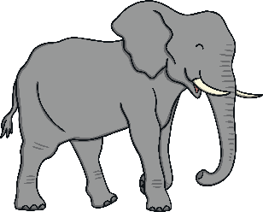
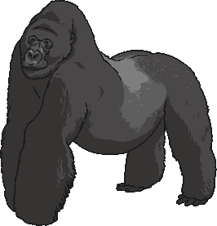
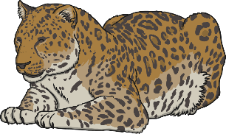
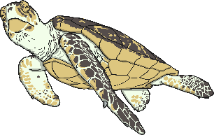
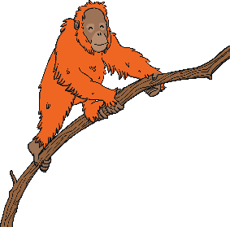
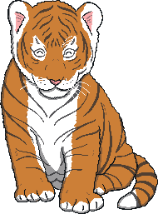
Animals in Danger of Extinction
There are many animals in our world
which are at risk of becoming extinct.
elephant
Amur leopard
sea turtle
gorilla
What facts can you
find out about
these animals?
orangutan
tiger

