Slide 1
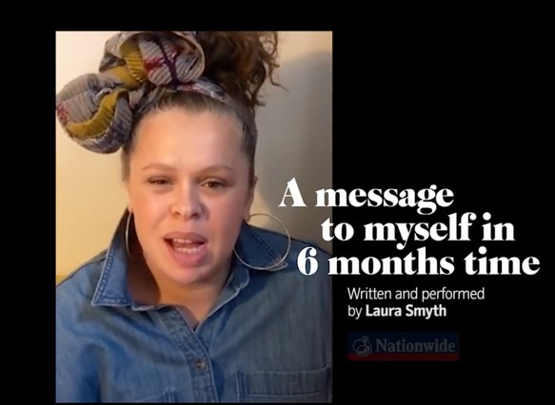

Formal and Informal Language
What is formal and informal register and when do we use it?
How do contractions and question tags affect the register of our language?

Slide 2
Register
Register is created by the way that language and grammar are used.
I just wish he’d lay off me.
I wish he would not disturb me.
Please refrain from conversing with me.
Will you shut up!
Register can be formal or informal.

Slide 3
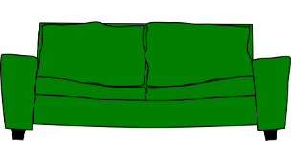
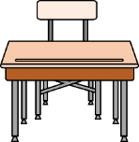


Audience and Context
The register depends on situation and audience.
The same person will use different registers in different contexts.
At home with family
In school with the headteacher
In official writing
You’re going to wear that, are you?
When will we be going on the museum trip?
I wish to register my interest…
Informal
More Formal
Very Formal

Slide 4
Formal language is often used for:
Situation | Audience
Official or formal situations | People you don’t know
Generalised or impersonal writing | People in official/important roles
Written communication more than spoken | People as a group
We would like to request your presence at the dinner to mark the start of the school year.
We regret to inform you that your attendance at the school will be terminated at the end of term.
The Ancient Greeks worshipped many gods and goddesses.
Please remain in cabins after dark.

Slide 5
Informal language is often used for:
Situation | Audience
Everyday conversation | Family, friends and people you know well
Social media and texts | People similar to you
Most spoken communication | People you meet in day-to-day life
It’s okay, man. Thanks for trying.
Eeew! That’s disgusting - that is.
We’re having lunch. Coming?

Slide 6
Formal and Informal Vocabulary
Formal and informal registers tend to use different vocabulary.
Could you assist me?
Give me a hand?
Who is the champion?
Who’s the champ?
He was excluded from school.
He was kicked out of school.
Informal
Formal
With formal vocabulary, words are often longer.

Slide 7
I’d
what’s
we’re
you’re
Contractions
Contractions appear in informal language.
mustn't
haven’t
Spoken language often contains contractions…
but written formal language uses the longer versions of the word/s.
We might write:
Do not say that I did not warn you.
but we are more likely to say:
Don’t say I didn’t warn you.
What are the formal versions of the contractions above?

Slide 8
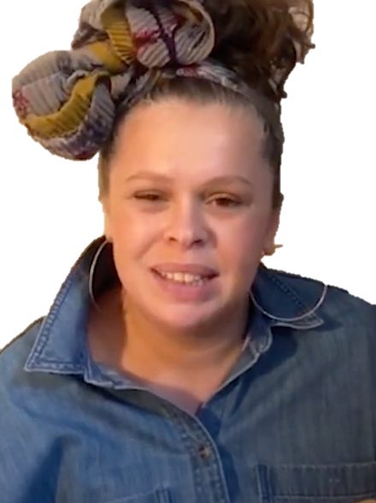
Question Tags can be used in informal language.
Tags are questions added to a clause to encourage a listener to respond.
Tags can be used to soften a command.
main clause
Tag
main clause
Tag
The tag changes a statement into a question.
Pass me a pen
, will you?
You’re joking
, aren’t you?
In very informal speech right and yeah can be used as tags.
main clause
Tag
main clause
Tag
He is from London
, isn’t he?
You’re ready
, yeah?

Slide 9

Breaking Grammar Rules!
Informal language sometimes breaks grammar rules.
This is effective when used sparingly for writing realistic dialogue...
(or in text messages and on social media).
Can’t keep going – too tired.
Unfortunately I cannot keep going as I find myself too tired to continue.
Look mate - I was worried, see? I mean: weight-gain! Hope you’re on top of that!
Focus on my words. I was experiencing concern for your welfare. In particular, the additional weight you have gained during lockdown. Have you a strategy to manage that now?
Ellipsis (omitting words) has not changed the meaning but the grammar is now incorrect. This is common in informal spoken language.
Slang can be used to write realistic dialogue.
In historical stories, old-fashioned slang can help to make the speech sound authentic.

Slide 10
IDEAS
Formal and Informal Vocabulary
Can you try rewriting these examples in more formal language?
That’s cool.
I’m sure it’ll be okay.
That is acceptable.
I am sure it will be okay.
Weird, huh?
Hey, you going to be ready for the test?
Is it strange?
Listen to my question. Are you going to be ready for the test?

Slide 11

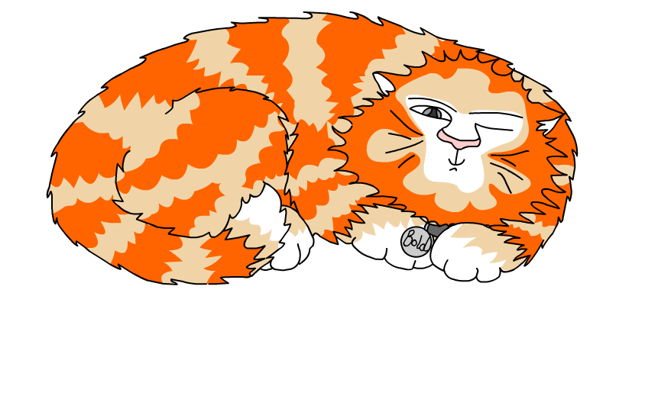
Explore more Hamilton Trust Learning Materials at https://wrht.org.uk/hamilton/ .

