Slide 1

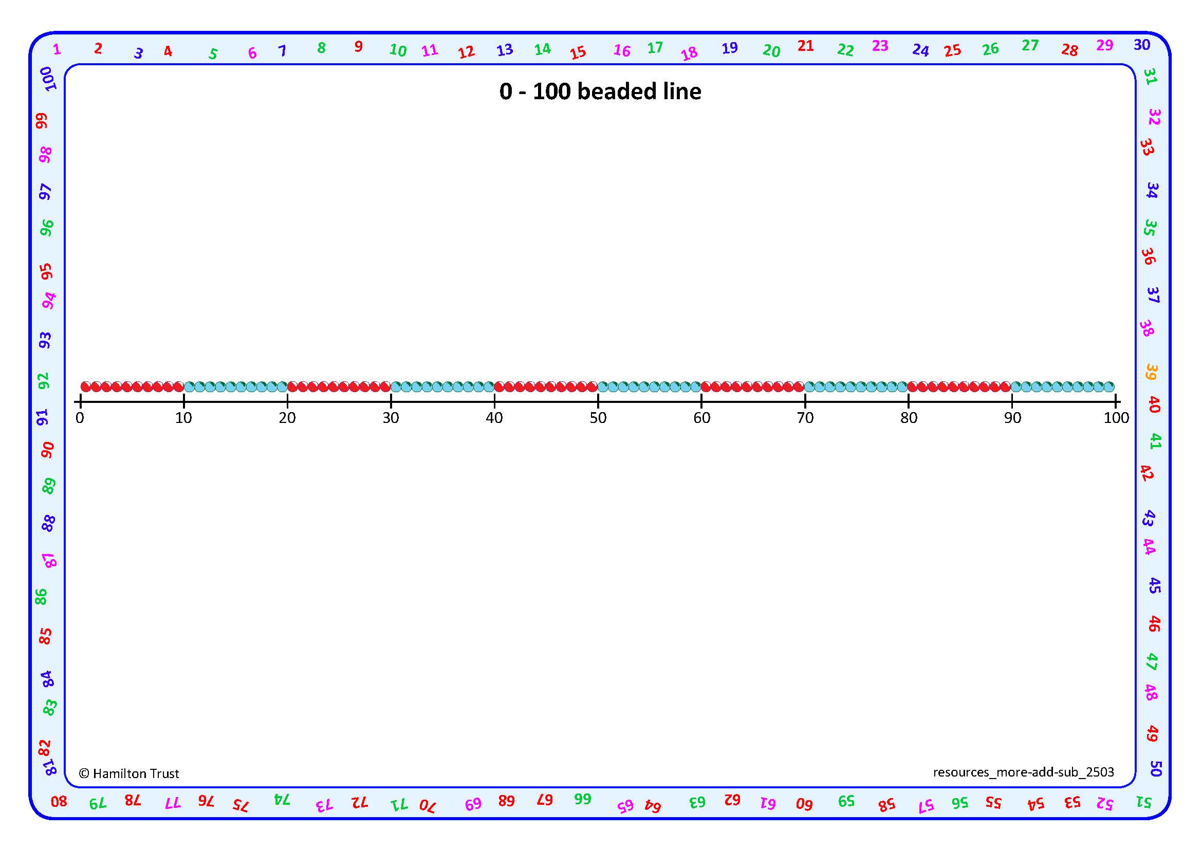


Use Frog on a beaded line to subtract (by counting up).
3
5
37
45
Maths Frog is going to help us subtract numbers which are close together on the beaded line.
Let’s try 45 - 37.
How far has he hopped altogether? What subtraction number sentence can we write?
Mark 37 and 45 on
the line.
Frog starts at 37.
He hops up to the next 10. How far has he hopped?
45 - 37 = 8
45 subtract 37 is 8.
Then Frog hops up to 45. How far has he hopped this time?

Slide 2
Use Frog on a beaded line to subtract (counting up).
2
3
18
23
Frog starts at 18, he always starts on the smaller number.
Mark 18 and 23 on
the line.
Now let’s try 23 - 18.
How far has he hopped altogether? What subtraction number sentence can we write?
He hops up to the next 10. How far has he hopped?
23 - 18 = 5
23 subtract 18 is 5.
Then Frog hops up to 23. How far has he hopped this time?

Slide 3

Use Frog on a beaded line to subtract (counting up).
5
3
65
73
Frog starts at 65, he always starts at the smaller number.
Let’s mark 73 and 65 on
the line. What do you think Frog will do to find the answer?
Now let’s try 73 - 65.
How far has he hopped altogether? What subtraction number sentence can we write?
First he hops up to the next 10. How far has he hopped?
73 - 65 = 8
Then Frog hops up to 73. How far has he hopped this time?
73 subtract 65 is 8.

Slide 4
Use Frog on a beaded line to subtract (counting up).
3
2
57
62
Frog starts at 57, he always starts at the smaller number.
Let’s mark 62 and 57 on
the line. What do you think Frog will do to find the answer?
Now let’s try 62 - 57.
How far has he hopped altogether? What subtraction number sentence can we write?
First he hops up to the next 10. How far has he hopped?
62 - 57 = 5
Then Frog hops up to 62. How far has he hopped this time?
62 subtract 57 is 5.

