Slide 1

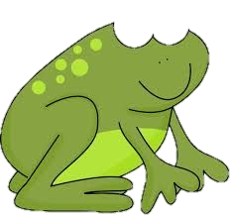
Use Frog on a landmarked line to subtract (counting up).
We want to find 53 - 47.
We could count back 4 tens then another 7 ones, but that would take a long time.
Is there a more efficient way when the numbers are close together?
We can count up using Frog jumps!

Slide 2
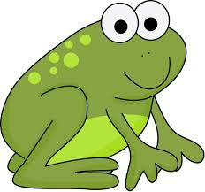

Use Frog on a landmarked line to subtract (counting up).
3
3
47
53
Frog starts at 47.
He always starts at the smaller number.
How far has he hopped altogether? What subtraction number sentence can we write?
Let’s try 53 - 47 on a landmarked line.
Mark 47 and 53 on
the line.
He hops up to the next 10. How far has he hopped?
53 - 47 = 6
53 subtract 47 is 6.
Then Frog hops to 53.
How far has he hopped this time?

Slide 3

Use Frog on a landmarked line to subtract (counting up).
2
4
48
54
Frog starts at 48.
He always starts at the smaller number.
How far has he hopped altogether? What subtraction number sentence can we write?
Let’s try 54 - 48.
Mark 48 and 54 on
the line. What will Frog do next?
He hops to the next 10.
How far has he hopped?
54 - 48 = 6
54 subtract 48 is 6.
Then Frog hops to 54.
How far has he hopped this time?

Slide 4
Use Frog on a landmarked line to subtract (counting up).
6
5
54
65
Frog starts at 54.
He always starts at the smaller number.
Lastly, let’s try 65 - 54.
Mark 54 and 65 on
the line. What will Frog do next?
How far has he hopped altogether? What subtraction number sentence can we write?
He hops to the next 10.
How far has he hopped?
65 - 54 = 11
65 subtract 54 is 11.
Then Frog hops to 65.
How far has he hopped this time?

