Slide 1

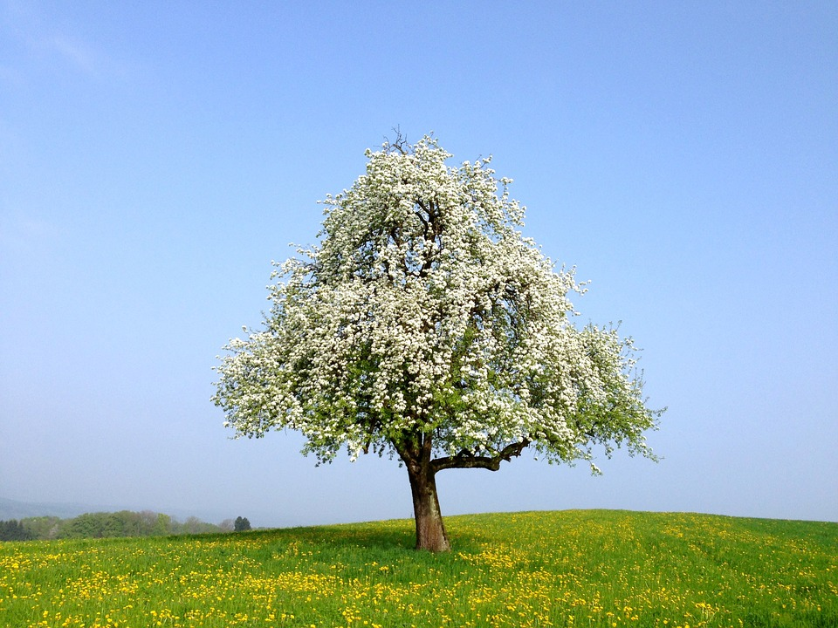
Recognise that two right angles make a half-turn, three make three quarters of a turn and four a complete turn.
What has happened to the picture?
How far has it turned?
The tree has turned through a right angle… a quarter of a full turn.
Notes:
Show children the picture and tell them to close their eyes. Click so that the tree turns clockwise 90° then tell children to open their eyes.

Slide 2
Recognise that two right angles make a half-turn, three make three quarters of a turn and four a complete turn.
Watch as it turns…
Count the right angle turns…
2 right angles is half a complete turn.
4 right angle turns make a complete turn.

Slide 3
Recognise that two right angles make a half-turn, three make three quarters of a turn and four a complete turn.
Which direction did the tree move?
Clockwise!
Let’s move it
anticlockwise...

Slide 4
Recognise that two right angles make a half-turn, three make three quarters of a turn and four a complete turn.
What have I done to this pattern?
And now?
Quarter turn
Half turn

