Slide 1
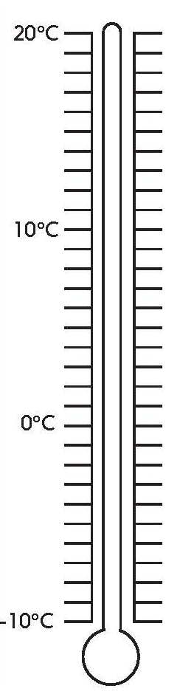

Use negative numbers in context of temperature.
The thermometer is showing the temperature when water freezes.
That’s when we get frost and ice outside in the winter....
On a cold night, the temperature might fall 1 degree below 0 degrees Celsius. How do we write this?
What if it was even colder? Where is minus 5 on this scale?
Numbers more than 0 are called positive numbers.
-1°C
(minus 1 degree Celsius)
-1°C
-5°C
(minus 5 degrees Celsius)
Numbers less than 0 are called negative numbers.
-5°C

Slide 2
Use negative numbers in context of temperature.
What is the difference in temperature?
One day last Spring, the temperature was 10°C.
The difference between 10 and 0 is 10; then between 0 and -2 another 2.
10°C
The difference is 12, with a change of -12.
Overnight, it fell to minus 2°C.
-2°C
The difference between two temperatures will always be a positive number. A change will be given as a negative number if the temperature falls, or as a positive number if it rises.

Slide 3
Use negative numbers in context of temperature.
The next day, the temperature rose from -2 °C to 5°C.
What is the difference and the change from the overnight temperature?
5°C
The difference between -2 and 0 is 2; then between 0 and 5 another 5.
-2°C
The difference is 7, with a change of 7.

