Slide 1



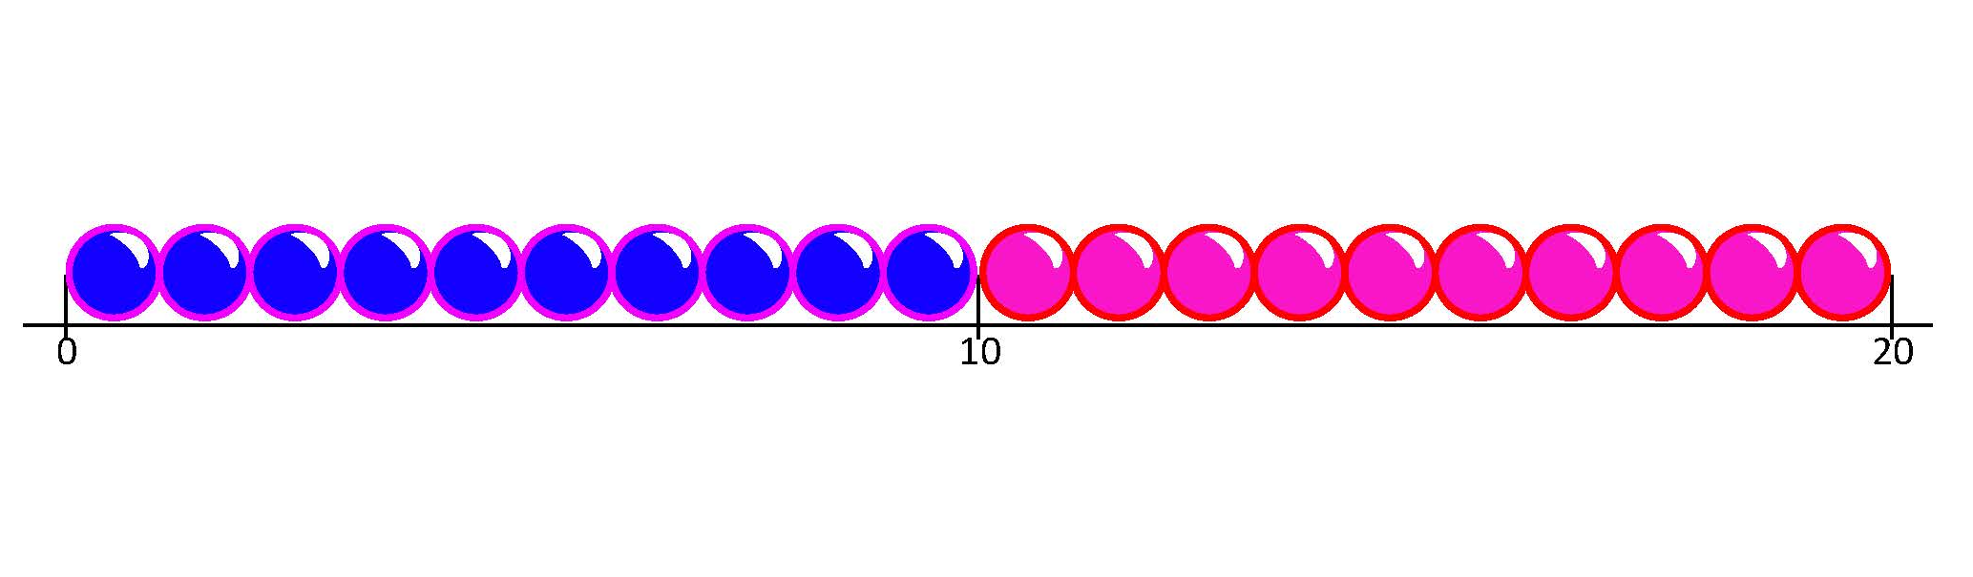
Know that multiplication can be done in any order.
What you can see?
How many rows?
How many in each row?
How many altogether?
What number sentence could we write to describe this array?
What can you see now?
How many rows?
How many in each row?
What number sentence can we write?
What can you say about
4 × 3 and 3 × 4 ?
4 × 3 = 12
We can read this as:
4 lots of 3, or 4 times 3.
3 × 4 = 12
We can read this as:
3 lots of 4, or 3 times 4.
Let’s count in 4s on a bead string…
Let’s count in 3s on a bead string…
+3
+3
+3
+3
3
6
9
12
4
8
12
+4
+4
+4

Slide 2

Know that multiplication can be done in any order.
What can you see?
How many rows?
How many in each row?
How many altogether?
What number sentence could we write to describe this array?
What can you see now? How many rows?
How many in each row? What number sentence can we write?
2 × 7 = 14
7 × 2 and 2 × 7 have the same answer!
Multiplication can be done in any order.
7 × 2 = 14

